Slide 1
Cloud Security
AWS as an example

Slide 2
Cloud Security
Security of the Cloud
  Implemented by the cloud service provider. (i.e. Them: AWS, IBM, Microsoft, etc.)
Security in the Cloud
  Implemented and operated by the customer (i.e. You).
  Related to security of customer content.
  Applications that make of use of the cloud providers services.

Slide 3
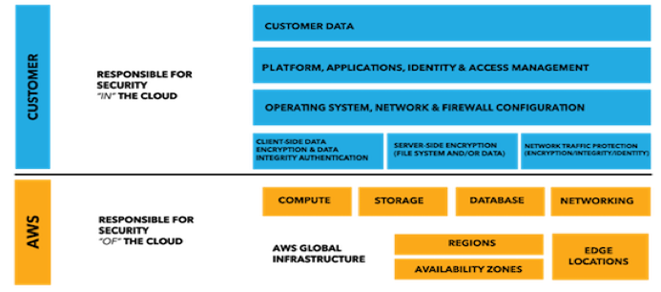
Cloud Security – AWS vs. You
Of the Cloud vs. In the Cloud

Slide 4
You Decide…
Which ports are open (Firewall)
Which IP address may access your resources
What patches are applied to the Operating System
Do you have encryption enabled
Account access
User Access lists

Slide 5
They Decide…
Global Security of the Cloud
  Hardware
  Data centers
  Networks
  Anti virus software

Slide 6
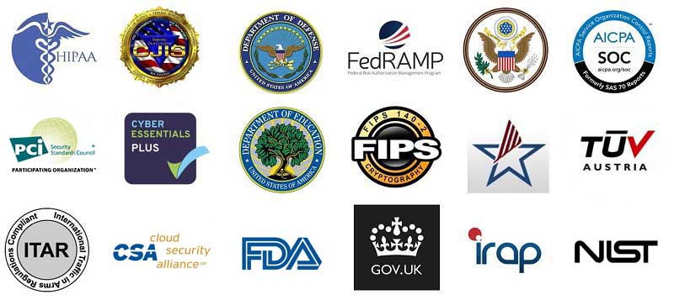
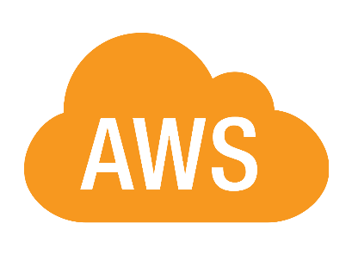
AWS Compliance

Slide 7
IaaS Infrastructure as a Service
EC2, VPC, S3 security are all controlled by you.
Elastic Compute Cloud (EC2)
  Servers (small and big based on need)
Simple Storage Service (S3)
  Upload and share files.
Virtual Private Cloud (VPC)
  Amazon’s private cloud runs services networked.

Slide 8
Storage Decommission
Blocks unauthorized users from seeing customer data.
When storage is taken back from a customer, it must go though the data scrubber called the HyperVisor before is can be used by another customer.

Slide 9
On the Network
AWS protects against
  Denial of service
    Security groups, access control lists
  Man in the middle
  IP spoofing
    Host based firewall infrastructure. Will not accepts if IP address is not it’s own
  Port scanning
  Packet sniffing

Slide 10
Security
ELB (Elastic Load Balancing)
Security groups with inbound and outbound security restrictions.
EC2 (Elastic Compute Cloud)
Firewall is configures by default in a Deny All but… mode
You can used https encryption and encrypted tunnel access around VPN’s

Slide 11
Databases and non-Internet facing
You can use subnets to place databases and non-internet facing subnets to avoid direct internet access to servers.

Slide 12
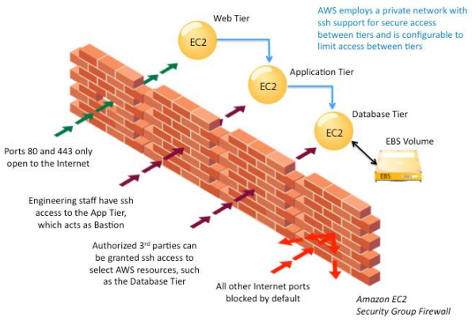
AWS firewall

Slide 13
Amazon CloudWatch
You can used CloudWatch to track logs and metrics that alert you via email and text messages
Basic monitoring (free)
  Polls every 5 minutes
  5GB for ingestion
  5GB storage
Detailed monitoring
  Polls every minute
  Cost more money

Slide 14
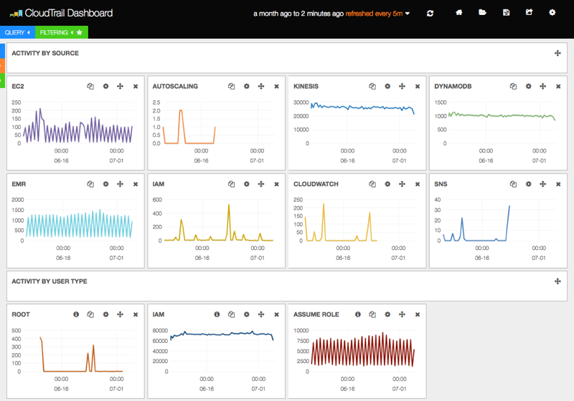
AWS CloudWatch dashboard

Slide 15
UEBA-User & Entity Behavior Analytics
Examples)
A user is doing an unusual amount of salesforce downloads
A userid logging in from different places in the world at the same time.
A customer making purchases outside the normal profile.

