Slide 1
Data Science/Analytics

Slide 2
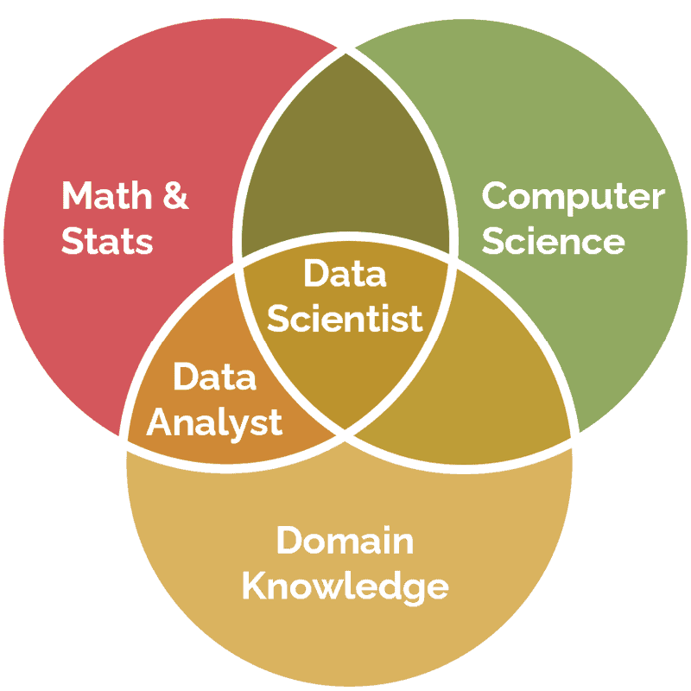
Data Venn Diagram
Data Analytics – Domain Knowledge and Mathematics
Data Science – Domain Knowledge, Mathematics, Computer Science
Data Science = Data Analytics + Domain Knowledge

Slide 3
Goal Driven Data Science
Goal-driven data science focuses on using data analysis and insights to achieve specific, pre-defined objectives, rather than just exploring data for general knowledge.
Pose the question
Search existing (generate new) data for the answer
Example) How many points is the home field advantage for an American Football team?

Slide 4
Asking the wrong question
You want to research if “marriage” is getting better over the last 10 years?
What do you search for:
  Percent of people who got divorces over 10 years?
  Number of people who got divorced over 10 years?
  Number of people who got married and didn’t get divorced
  Percent of people who got married and didn’t get divorced

Slide 5
Rule Based Systems
Rule-based systems, also known as rule-based expert systems or production systems, are AI systems that use predefined rules, often in the form of "if-then" statements, to make decisions or solve problems
Medical diagnosis: "If the patient has a fever and cough, then consider the possibility of an infection".
Fraud detection: "If a transaction exceeds a certain amount and is made from an unusual location, then flag as potentially fraudulent".
Customer service chatbots: "If the user asks about shipping, then provide information about shipping options".

Slide 6
Generating new Facts
Transitive property of inequalities) If X<Y and Y<Z ➔ X<Z
Fact 1) A < B
Fact 2) B < C
We generate a new fact
Fact 3) A < C

Slide 7
Getting your facts straight
Transitive property of inequalities) If X<Y and Y<Z ➔ X<Z
Fact 1) 5 < 6 true
Fact 2) 6 < 8 true
Generated Fact 1) 5 < 8 true
Fact 3) 8 < 2 nonsense
Generated Fact 2) 5 < 2 more nonsense

Slide 8
Proving 2=1
Start with an assumption: Let's assume that a = b.
Multiply both sides by a: a * a = a * b (or a² = ab).
Subtract b² from both sides: a² - b² = ab - b².
Factor both sides: (a + b) (a - b) = b (a - b).
Divide both sides by (a - b): (a + b) = b.
Substitute a = b: b + b = b.
Simplify: 2b = b.
Divide both sides by b: 2=1

