Slide 1
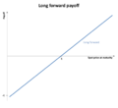
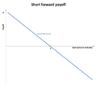
Forwards and Futures

Slide 2
Forward contract
In finance, a forward contract or simply a forward is a non-standardized contract between two parties to buy or sell an asset at a specified future time at a price agreed today.

Slide 3
Forward Attributes/Payoffs
One party A agrees at time 0 (now) to purchase from another party B, an amount of a commodity/Asset at price K at some time in the future.
Party A is said to be “Long” and Party B is “Short”.
K – is the deliver price or (forward price)
T – Deliver Time
Si : spot price – price at present time for any time i
Payoff to A) St() - K
Payoff to B) K - ST()

Slide 4
Example of a Forward
IBM is currently selling for $100 (spot price) and party A agrees to purchase 1 share of IBM from party B, 1 year from now for K = $120. They have made (signed) a forward contract.
If 1 year from now, let’s say the price of IBM is $150, Party A exercises the forward contract and buys the stock from party B for $120 and immediately sells it for $150 making a profit of $150 - $120 = $30.
Party B has to go out to the market and buy a share for $150 and sell it to party A for $120 and loses $30.
Winnings always equal losings in forwards contracts.

Slide 5
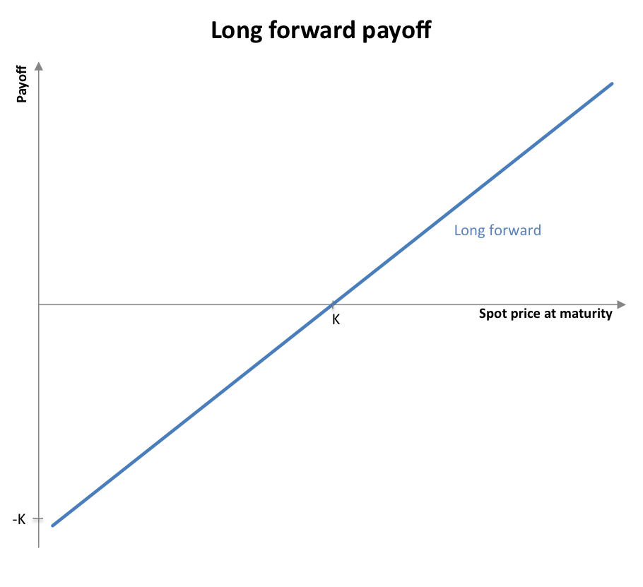
Long Payoff graph

Slide 6
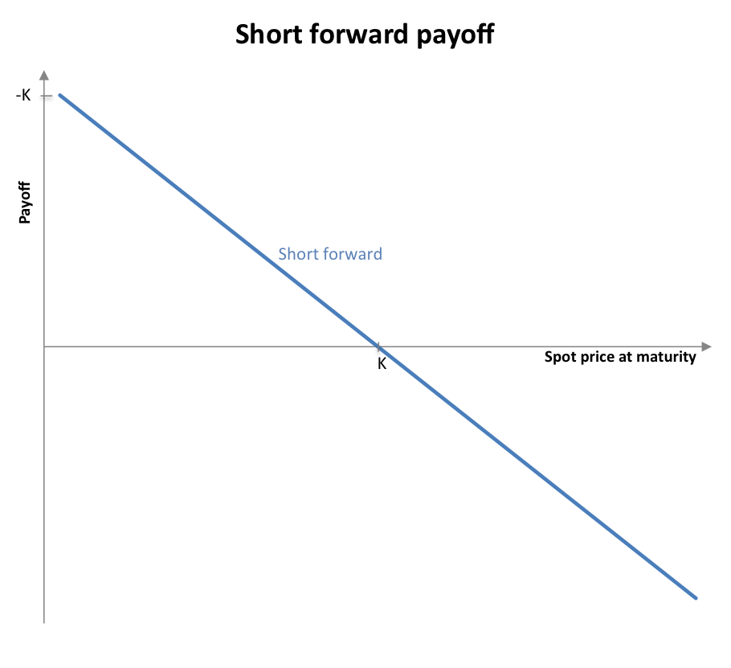
Short Payoff Graph

Slide 7
No Arbitrage
Spot price = $100, K = $126, T = 1 Year, r = 5%... and there are people in the market biding to go long and short on this forward contract.
Is this even possible? …if so consider doing this:
Right now,
  Borrow $100 at 5%,
  Buy a share of stock at $100 and hold on to it
  Sign on the short side of the contract
Wait 1 year
  Sell the stock for $126 as agreed to a year before regardless of the current price.
  Pay back the bank the $105 it now owes
  Profit $21 guaranteed.

Slide 8
Retail Value of a Forward
Using the previous example, the party A is expected to make $21 a year from today.
That is equal to $21/(1.05) = $20 today
The risk-neutral price for this forward would be $20 today. And would trade in the forwards Over the counter (OTC) markets at that price.

Slide 9
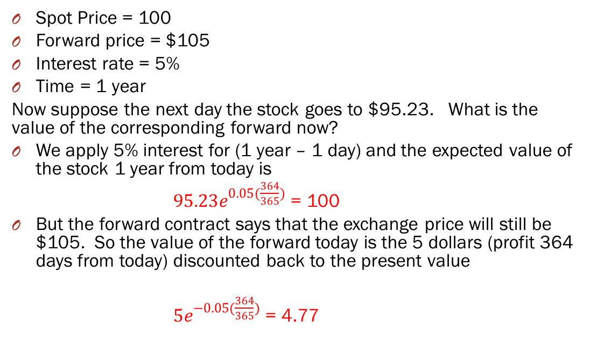
Ex) Change in value of Forward
Spot Price = 100
Forward price = $105
Interest rate = 5%
Time = 1 year
Now suppose the next day the stock goes to $95.23. What is the value of the corresponding forward now?
We apply 5% interest for (1 year – 1 day) and the expected value of the stock 1 year from today is
$95.23e^{0.05(\frac{364}{365})}$ = 100
But the forward contract says that the exchange price will still be $105. So the value of the forward today is the 5 dollars (profit 364 days from today) discounted back to the present value
$5e^{−0.05(\frac{364}{365})}$ = 4.77

Slide 10
Mark-to-Market
After 1 day, Party B gained $4.77. Now consider adding a rule added to the forward contract that says that “each day, the value of the forward contract will be calculated based on the market price of the underlying commodity (referred to a Mark-to-Market), and the losing side for that day will pay the winning side the exact amount of the change in the forward contract.
Note: this would make it less likely that if the losing side build up a massive loss, might default on the contract.

Slide 11
Futures
A Futures contract is like a Forward contract, except:
The NPV (net present value calculated via mark-to-market) is exchanged between both parties on a daily basis.
Daily payment are calculated and enforced by a brokerage between both parties.
Bought and sold on an exchange

