Slide 1
Linear Regression
For Big Data sets and Data Science Applications

Slide 2

Average(Mean) and Median
Suppose we have 3 numbers and wanted to know the mean and median?
3, 2, 10
Mean: add them up and divide by n $\frac{\sum{3+2+10}}{3}$ = 5
Median: sort the numbers to get (2,3,10) and pick the middle number to get 3

Slide 3
Finding the mean (sum distances = 0)
Given the numbers (3,2,10) Guess at the mean: 3 (maybe the median is the mean)
Sum the difference from all values to the guessed value:
(3-3) + (2-3) + (10-3) = 0 -1 +7 = +6
- Guess again: 4 and sum (3-4) + (2-4) + (10-4) = -1 -2 +6 = +3
- Guess again: 5 and sum (3-5) + (2-5) + (10-5) = -2 -3 +5 = 0 ← minimal difference = mean
- Guess again: 6 and sum (3-6) + (2-6) + (10-6) = -3 -4 +4 = -3
- Guess again: 7 and sum (3-7) + (2-7) + (10-7) = -4 -5 +3 = -6
We started with a guess of 3, then made progress guessing toward 5, then after 5 our guess regressed away from the minimal value
We are assuming integer values only.

Slide 4
Finding the median (sum |distances|)
Given the numbers (3,2,10) Guess at the mean: 3 (maybe the median is the mean)
Sum the difference from all values to the guessed value:
|(3-3)| + |(2-3)| + |(10-3)| = |0| +|-1| +|+7| = 8
- Guess again: 4 and sum |(3-4)| + |(2-4)| + |(10-4)| = |-1| +|-2| +|+6| = 9
- Guess again: 5 and sum |(3-5)| + |(2-5)| + |(10-5)| = |-2| +|-3| +|+5| = 10
- Guess again: 2 and sum |(3-2)| + |(2-2)| + |(10-2)| = |-1| +|0| +|+9| = 9 ← regressing
We are assuming integer values only.

Slide 5
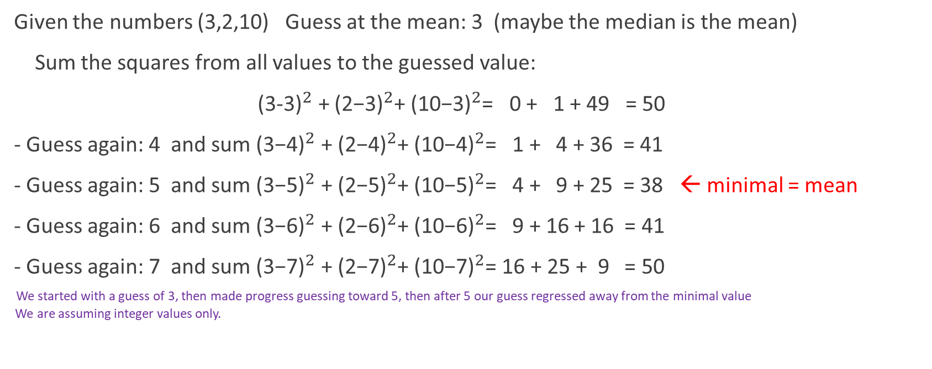
Finding the mean (least sum of squares)
Given the numbers (3,2,10) Guess at the mean: 3 (maybe the median is the mean)
Sum the squares from all values to the guessed value:
${\text{(3−3)}}^{2}$ + ${\text{(}\text{2}\text{−3)}}^{2}$+ ${\text{(}\text{10}\text{−3)}}^{2}$= 0 + 1 + 49 = 50
- Guess again: 4 and sum ${\text{(3−}\text{4}\text{)}}^{2}$ + ${\text{(2−}\text{4}\text{)}}^{2}$+ ${\text{(10−}\text{4}\text{)}}^{2}$= 1 + 4 + 36 = 41
- Guess again: 5 and sum ${\text{(3−}\text{5}\text{)}}^{2}$ + ${\text{(2−}\text{5}\text{)}}^{2}$+ ${\text{(10−}\text{5}\text{)}}^{2}$= 4 + 9 + 25 = 38 ← minimal = mean
- Guess again: 6 and sum ${\text{(3−}\text{6}\text{)}}^{2}$ + ${\text{(2−}\text{6}\text{)}}^{2}$+ ${\text{(10−}\text{6}\text{)}}^{2}$= 9 + 16 + 16 = 41
- Guess again: 7 and sum ${\text{(3−}\text{7}\text{)}}^{2}$ + ${\text{(2−}\text{7}\text{)}}^{2}$+ ${\text{(10−}\text{7}\text{)}}^{2}$= 16 + 25 + 9 = 50
We started with a guess of 3, then made progress guessing toward 5, then after 5 our guess regressed away from the minimal value
We are assuming integer values only.

Slide 6
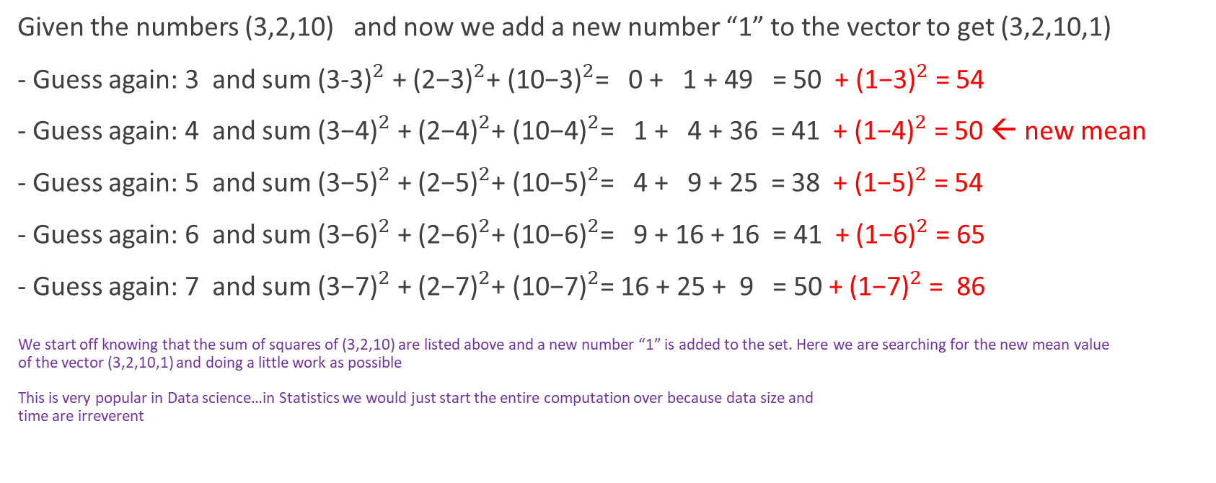
Finding new mean (least sum of squares)
Given the numbers (3,2,10) and now we add a new number “1” to the vector to get (3,2,10,1)
- Guess again: 3 and sum ${\text{(3−3)}}^{2}$ + ${\text{(}\text{2}\text{−3)}}^{2}$+ ${\text{(}\text{10}\text{−3)}}^{2}$= 0 + 1 + 49 = 50 + ${\text{(}\text{1}\text{−3)}}^{2}$ = 54
- Guess again: 4 and sum ${\text{(3−}\text{4}\text{)}}^{2}$ + ${\text{(2−}\text{4}\text{)}}^{2}$+ ${\text{(10−}\text{4}\text{)}}^{2}$= 1 + 4 + 36 = 41 + ${\text{(1−}\text{4}\text{)}}^{2}$ = 50 ← new mean
- Guess again: 5 and sum ${\text{(3−}\text{5}\text{)}}^{2}$ + ${\text{(2−}\text{5}\text{)}}^{2}$+ ${\text{(10−}\text{5}\text{)}}^{2}$= 4 + 9 + 25 = 38 + ${\text{(1−}\text{5}\text{)}}^{2}$ = 54
- Guess again: 6 and sum ${\text{(3−}\text{6}\text{)}}^{2}$ + ${\text{(2−}\text{6}\text{)}}^{2}$+ ${\text{(10−}\text{6}\text{)}}^{2}$= 9 + 16 + 16 = 41 + ${\text{(1−}\text{6}\text{)}}^{2}$ = 65
- Guess again: 7 and sum ${\text{(3−}\text{7}\text{)}}^{2}$ + ${\text{(2−}\text{7}\text{)}}^{2}$+ ${\text{(10−}\text{7}\text{)}}^{2}$= 16 + 25 + 9 = 50 + ${\text{(1−}\text{7}\text{)}}^{2}$ = 86
We start off knowing that the sum of squares of (3,2,10) are listed above and a new number “1” is added to the set. Here we are searching for the new mean value
of the vector (3,2,10,1) and doing a little work as possible
This is very popular in Data science…in Statistics we would just start the entire computation over because data size and
time are irreverent

Slide 7
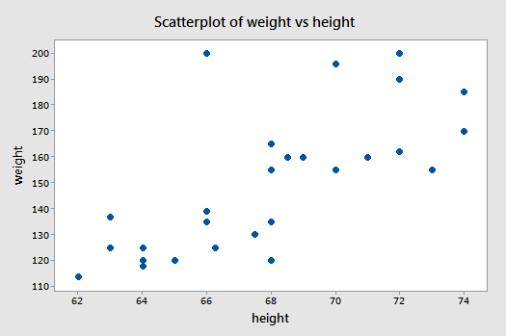
Linear Regression

Slide 8
Investment Portfolio
You have an investment portfolio like your 401K account. Your account is invested in some mix of stocks and bonds.
The funds do not disclose which stocks they are invested in but you notice that when the DJIA goes up, you balance goes up and when the DJIA goes down, you balance goes down.
Because the fund manager may make changes to the funds portfolio, your account balance will not directly map to the DJIA but will loosely map to it.
You want to find a percentage. If the DJIA goes up X percent then you account will go up Y percent. If X and Y can be found, then your account will go up Y/X whenever the DJIA goes up X percent. For example, if the DJIA goes up 3% and during that time your account went up 2%, then we conclude that for every 1% increase in the DJIA will cause your account will go up 2/3 = 0.6667.

Slide 9
Ex) Tracking your 401K for 5 months

Slide 10
Possible

