Slide 1
Markets – (Stock Market)

Slide 2
Example: Jack’s Ribs place
Restaurant near the university
Worth $1M
10 owners each owning 1/10 of the business
  10 shares each worth $1M/10 = $100,000
Questions:
  What if someone wants to buy/sell a share?
  Why is the restaurant worth $1M?
  Could the restaurant’s value ($1M) change?

Slide 3
Publicly Traded Companies
A company that has permission to offer its registered securities (stock, bonds, etc.) for sale to the general public, typically through a stock exchange,
Occasionally a company whose stock is traded over the counter (OTC) via market makers who use non-exchange quotation services.

Slide 4
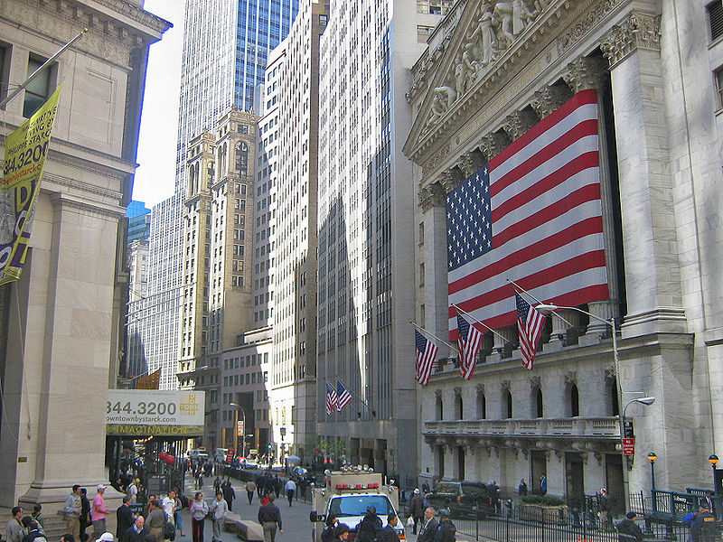
New York Stock Exchange

Slide 5
IBM LU
100.00 2.75
IBM LU
99.75 3.00
Seller 3
400 sh IBM @ $100.25
Seller 5
800 sh IBM @ $100.75
Seller 2
200 sh IBM @ MKT
Seller 4
100 sh IBM @ $100.50
Seller 1
200 sh IBM @ MKT
Seller 3
400 sh IBM @ $100.25
MARKET
MARKET
Buyer 1
100 sh IBM @ MKT
Buyer 5
100 sh IBM @ $99.75
Buyer 2
200 sh IBM @ MKT
Buyer 6
200 sh IBM @ $99.50
Buyer 3
100 sh IBM @ $99.75
Buyer 7
100 sh IBM @ $99.25

Slide 6
Features of a market
BBBO (Best Bid Best Offer)
Auction
Market orders
Limits orders
Constantly changing prices

