Slide 1
Matlab - Introduction
Hello worLd,
variables,
arrays,
plots,
for loops,
Simulation

Slide 2
Hello World
% anything after the percent sign is a comment and therefore does not do anything
disp('Hello World'); % displays Hello World

Slide 3
Displaying the answer
X=5 % will set X=5 and since x is the last element referenced, X will be displayed
X=55;y=66 % will set X=55 and X=66 and display both
X % will display what x is currently set to

Slide 4
2D arrays
x = 0:10 % x is integers the matrix [0 1 2…10]
x=0:0.5:10 % x is reals from 0 to 10 by halfs [0.0, 0.5.1.0,1.5,2.0, … 9.5,10.0]
x = -pi:pi % x starts at -3.14 and increments by 1 as long as the values are less than +3.14

Slide 5
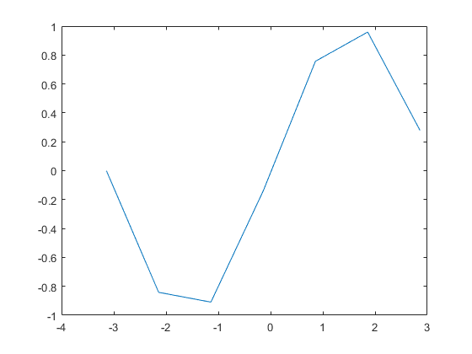
Plotting a graph – sin of x from –pi to pi
x=-pi:pi; % from negative pi to positive pi
y=sin(x); % y is a matrix with values of sin of all the x values
plot(x,y); % plots x and y…notice the graph looks goofy because of the odd values of x

Slide 6
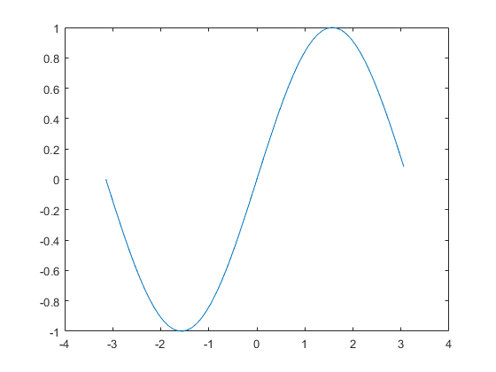
Much nicer with 0.1 intervals
x = -pi:0.1:pi; % x is all value between –pi and pi on 0.1 intervals…old y doesn’t line up with x
y = sin(x); % reset y for the new x
plot(x,y) % much nicer graph

Slide 7
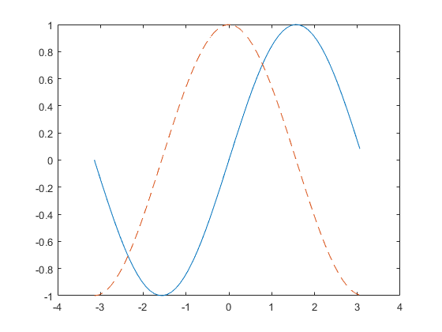
Setting the increment size
x = -pi:0.1:pi; % x is all value between –pi and pi on 0.1 intervals…old y doesn’t line up with x
y1 = sin(x); % sets y1 vector
y2 = cos(x); % sets y2 vector
plot(x,y1,x,y2,'--') % plot Y1 against x using a line and Y2 against x using a dotted line

Slide 8
Matlab has Pre-defined functions - pi
pi= 400; % changes the pre-defined value of pi – you shouldn’t do this
2*pi % will produce 800
Clear pi % sets pi back to what it was when Matlab starts up which is 3.1416
Clear x % sets x back to what is was when Matlab starts up which is undefined.
Clear all % resets all variables back to what they were when Matlab starts up

Slide 9
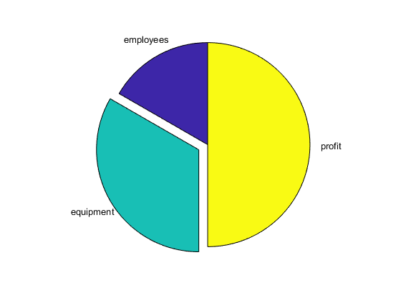

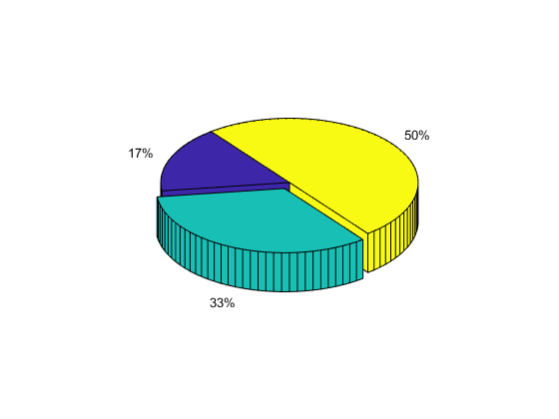
Creating a Pie chart
x = [1,2,3];
explode = [0,1,0];
pie(x,explode)
pie3(x,explode)
pie(x,explode,{'employees','equipment','profit'})

Slide 10
Functions
function result = factorial (m)
if (m == 1)
result = m;
else
result = m .* factorial(m.-1);
end
end
factorial(5);

Slide 11
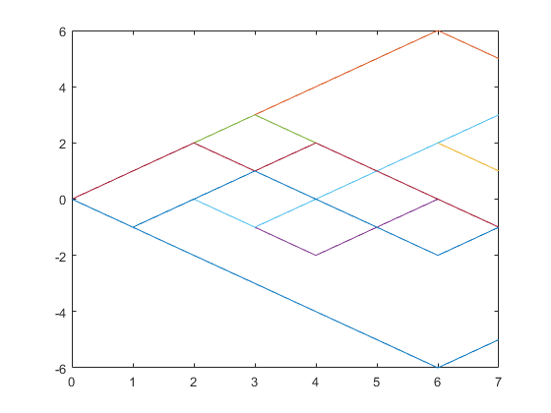
EX) Random Walk (Simulation)
% plotting several sample paths of random walks
p=0.5; % simulate a coin toss head = 50 percent chance
n=8; % number of coin flops
for i=1:n % simulate flip the coin 50 times
y=[0 cumsum(2.*(rand(1,n-1)<=p)-1)]; % n steps
plot([0:n-1],y); % plot the random walk
hold on % print new plot on the current graph
end

