Slide 1
Stock Options
Calls and Puts
European, American and Asian Options
Put-Call Parity

Slide 2
Options
In 1973, Options came to the forefront as a trading vehicle when the Chicago Board of Options (CBOE) offered listed option trading to the public for the first time.
An “Option” is a contract is a contract that entitles its owner to
buy or sell a security (called the underlying security)
at a certain price (the strike price)
on/before a certain date (the expiration date)

Slide 3
Example of an Option
IBM stock is currently selling for $81.50 per share
Steve and Mary agree to the following:
Mary is required to sell 100 shares of IBM to Steve for $85 per share any time that Steve wants in the next 3 months.
Steve will pay Mary $2 per share- up front, non-refundable for this option. $2*100 = $200.

Slide 4
Why do Options Buyers exist?
Why would Steve do this?
He is hoping that IBM, at some point in the next 3 months, will sell for much more than $85. Let’s say IBM goes up to $100/sh in 2 months later, the following could happen:
Steve calls Mary and say, “guess what? I want to exercise my option and buy 100 shares of IBM from you for $85 each.
Mary gives Steve 100 shares of IBM
Steve gives Mary for $85 * 100 = $8,500
Steve sells the 100 Shares to the open market for $100 each giving him 100 * $100 = $10,000.
Steve’s total profit is:
$10,000 - $200 - $8,500 = $1,300. Not bad for 2 months of work? Right? Actually what work did he do?

Slide 5
Why do Options sellers Exist?
Since Steve will not call Mary as long as IBM is under $85, she is hoping that IBM doesn’t go over $85 within the next 3 months. If IBM never goes over, $85 in the 3 months of the Options Contract, Steve will never Call Mary and Mary will make a profit of $200 for doing nothing.

Slide 6
Types of options
Call Options - The buyer/owner/holder of the option contract has the right to buy the underlying stock.
Put Options - The buyer/owner/holder of the option contract has the right to sell the underlying stock.

Slide 7
Styles of Options
European – the option can only be invoked on the expiration day
American – the option can be invoked any time from now until the expiration date at the owners request.
Asian - the payoff is determined by the average underlying price over some pre-set period of time

Slide 8
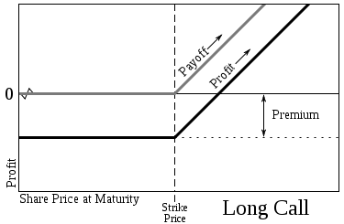
Payoffs: Long Call

Slide 9
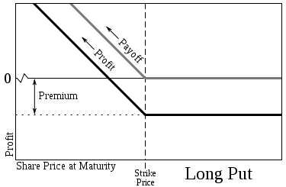
Payoffs: Long Put

Slide 10
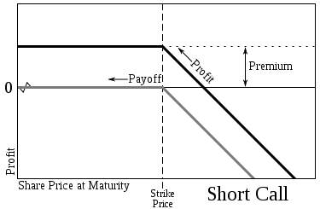
Payoffs: Short Call

Slide 11
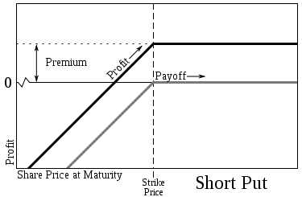
Payoffs: Short Put

Slide 12
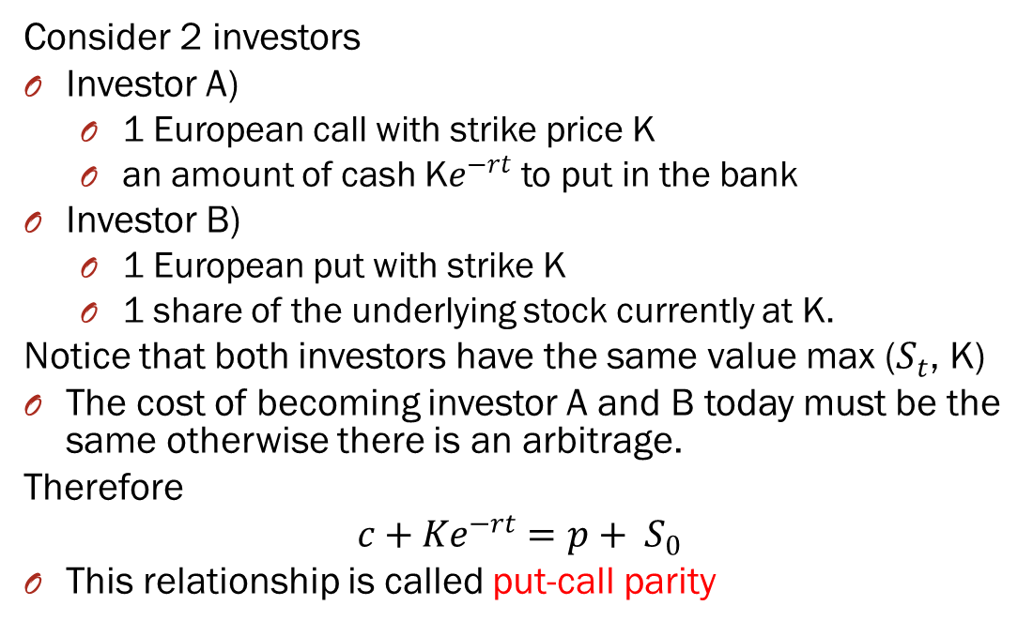
Put-Call Parity
Consider 2 investors
Investor A)
1 European call with strike price K
an amount of cash K$e^{−rt}$ to put in the bank
Investor B)
1 European put with strike K
1 share of the underlying stock currently at K.
Notice that both investors have the same value max ($S_{t}$, K)
The cost of becoming investor A and B today must be the same otherwise there is an arbitrage.
Therefore
$$c+Ke^{−rt}=p+ S_{0}$$
This relationship is called put-call parity

Slide 13
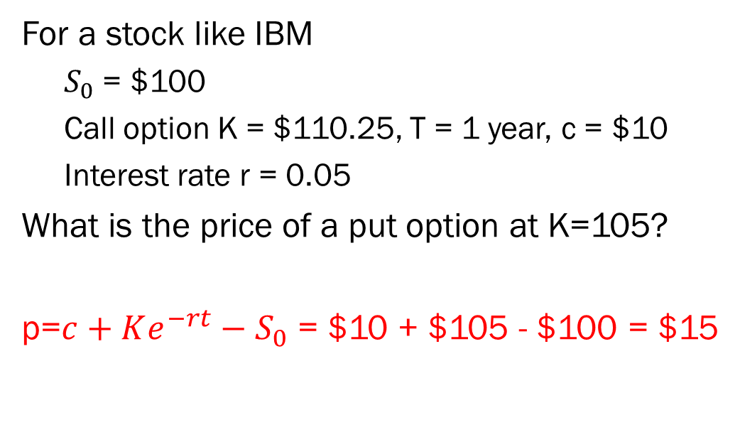
Example) Put-Call Parity
For a stock like IBM
$S_{0}$ = $100
Call option K = $110.25, T = 1 year, c = $10
Interest rate r = 0.05
What is the price of a put option at K=105?
p=$c+Ke^{−rt}−S_{0}$ = $10 + $105 - $100 = $15

