Slide 1
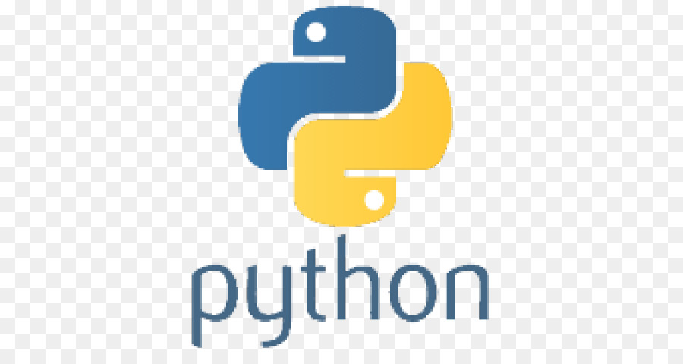
Functions
Parameters, return values, pass

Slide 2
Python Functions
In Python a function is defined using the def keyword: (short for define)
def helloWorldFunction(): print(“Hello World from a function")
Notice that this function performs a task (saying Hello World…) but it does not return a result.
Note: functions are standalone tasks. When a ‘function’ is in a class, it is referred to as a method.

Slide 3
Function that returns a value
def area(R): Pi = 3.14
A = pi * R * R
return A
Notice that this function returns a result. You call the function and you supply the radius (input parameter) and the function calculates and returns the Area by a return value A.
Area5 = area(5); # will cause the variable Area5 to be equal to 3.14 * 5 * 5 = 78.5
Note: ‘5’ is the argument and R is the function parameter

Slide 4
Parameters passed by reference
def swap(left,right):
temp = left
left = right
right = temp
first = 6
last = 3
swap(first, last)
print(‘first = ‘ + first + ‘ and last = ‘ last’)
Output
first = 6 and last = 3

Slide 5
Parameters passed by reference
def swap(left,right):
first = right
last = left
first = 6
last = 3
swap(first, last)
print(‘first = ‘ + first + ‘ and last = ‘ last’)
Output
first = 6 and last = 3

Slide 6
Functions can format output
def printNameNicely(first, last):
print(first + “ “ + last)
Can be used to print out many people’s names with a nice space between first and last names.
As you can imagine Python provides common print formatting functions so you don’t have to write them yourself.

Slide 7
Number of Parameters must match
def printNameNicely(first, last):
print(first + “ “ + last)
printNameNicely(‘Cher’) # error function required 2 parameters, only 1 supplied
printNameNicely(‘Elton’,’John’) # works fine
printNameNicely(‘Sarah’,’Jessica’,’Parker’) # error too many parameters 3 vs. 2

Slide 8
Function callers have varying parameters
Suppose a function accepts the users children's names and different users have a different number of children.
Use a variable size array for the parameters. * followed by the array name.
def countChildren(*kids):
numberOfKids = len(kids)
print(‘You have ‘ + numberOfKids + ‘ Children’)
countChildren(‘Greg’,’Peter’,’Bobby’,’Marcia’,’Jan’,’Cindy’)
The countChildren function will print “You have 6 Children”

Slide 9
Specify parameter by name (not order)
def printNameNicely(first, last):
print(first + “ “ + last)
printNameNicely(last=‘DiMaggio’,first=‘Joe’)
This is good if you know the names of the parameters but don’t remember the order
Again all parameters are required.

Slide 10
Function that do/return nothing
def DoNothing():
pass
To create a function that doesn’t do anything leaving it blank like in C/Java will cause confusion because the body of the function must be indented. So we indent and type the python keyword ‘pass’
C++ equivalent function that does nothing and returns nothing
void DoNothing() { }

Slide 11
Functions that return none
def helloWorldFunction(): print(“Hello World from a function")
this function prints a sentence but returns nothing. You can return the ‘none’ object if you like
def helloWorldFunction(): print(“Hello World from a function")
return

Slide 12
Default Arguments (recap)
def percent(num, dem = 100):
return a/b
f = percent(1,2) # f will be set to 1/2 which is 0.5
f = percent(30) # f will be set to 30/100, second parameter defaults to 100

Slide 13
Required Arguments (recap)
def percent(num, dem = 100):
return a/b
f = percent() # error because num is a required argument (no default provided)
f = percent(dem = 200) # error again again is required

Slide 14
Keyword Arguments (recap)
def percent(num, dem = 100):
return a/b
f = percent(dem = 200, num = 100)

Slide 15
Keyword Arguments (recap)
def sum(*numbers):
return sum(numbers)
f = sum(1,3,5) # f will be 8
f = sum(1,3,5,7) # f will be 15

Slide 16
Lambda functions
def multiplyBy(n): return lambda a : a * n doubleMe = multiplyBy(2) x = doubleMe(3) # will set x to 6
A lambda function is a template to generate other functions.
Effectually the above code generate the function
def doubleMe(a)
return a * 2

Slide 17
Lambda functions
def multiplyBy(n): return lambda a : a * n # define a template to generate functions doubleMe = multiplyBy(2) # generates a function that doubles its input parameter tripleMe = multiplyBy(3) # generates a function that triples its input parameter
quadrupleMe = multiplyBy(4) # generates a function that quatruples its input parameter
x = doubleMe(100) # sets x to 200 which is double the input parameter
y = tripleMe(100) # sets y to 300 which is triple the input parameter

