Slide 1
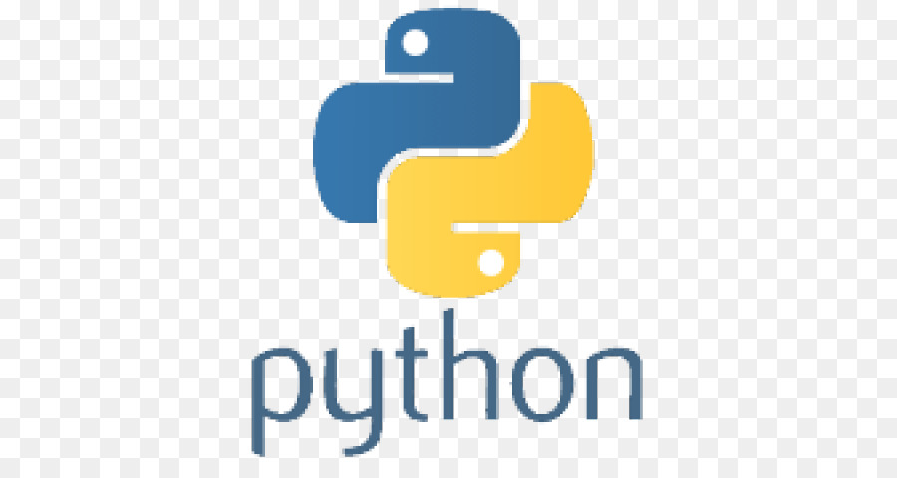
Python – Introduction
Hello World, Primitive types, If-Then-Else, Arrays, For loops, While loops

Slide 2
Hello World
// Hello World in Java
class HelloWorld
{
public static void main(String args[])
{
System.out.println(“Hello World”)
}
}
# Hello World in Python
print(“Hello World”)

Slide 3
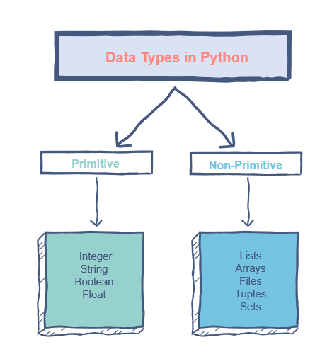
Primitive (and non-Primitive) Types
Types do not need to be declared first
radius = 5 # creates an integer
pi = 3.14 # creates a float
msg = “ the area is: “ # creates a string
itIsRaining = true # creates a boolean

Slide 4
It is Python used for
web development (server-side),
software development,
mathematics,
system scripting.

Slide 5
What can Python do?
Python can be used on a server to create web applications.
Python can be used alongside software to create workflows.
Python can connect to database systems. It can also read and modify files.
Python can be used to handle big data and perform complex mathematics.
Python can be used for rapid prototyping, or for production-ready software development.

Slide 6
Why Python?
Python works on different platforms (Windows, Mac, Linux, Raspberry Pi, etc).
Python has a simple syntax similar to the English language.
Python has syntax that allows developers to write programs with fewer lines than some other programming languages.
Python runs on an interpreter system, meaning that code can be executed as soon as it is written. This means that prototyping can be very quick.
Python can be treated in a procedural way, an object-orientated way or a functional way.

Slide 7
Python vs. Other Languages
Python was designed for readability, and has some similarities to the English language with influence from mathematics.
Python uses new lines to complete a command, as opposed to other programming languages which often use semicolons or parentheses.
Python relies on indentation, using whitespace, to define scope; such as the scope of loops, functions and classes. Other programming languages often use curly-brackets for this purpose.

Slide 8
If-Then Statement - then code indented
if mets > phillies:
print(“Mets are winning”) # indent is required for if statement
if mets > phillies:
print(“Mets are winning”) # will cause an error…no indenting on an IF statement

Slide 9
If-Else Statement (aka If-Then-Else)
if mets > phillies:
print(“Mets are winning”)
else:
print(“Phillies are winning”)

Slide 10
Python doesn’t have a switch
Switch statements (or Case statements) are often used by programming languages when the is a large amount of cases and a long series of If-Then statements would be written.
Python believes the simple syntax allows you to just write out the list of if-then

Slide 11
Python Arrays
Arrays are used to store multiple values in one single variable:
teams = [“Mets", “Yankees", “Phillies"] # local teams
n = len(teams) # sets n to the length of the array which is 3
# index starts at 0 and goes to n-1 so teams[0] is “Mets” and teams[1] is “Yankees”
teams.remove(“Yankees“); # remove the teams[1] element
teams.append(“Oriles“); # add a new team to the end of the array

Slide 12
Array functions
append() | Adds an element at the end of the list
clear() | Removes all the elements from the list
copy() | Returns a copy of the list
count() | Returns the number of elements with the specified value
extend() | Add the elements of a list (or any iterable), to the end of the current list
index() | Returns the index of the first element with the specified value
insert() | Adds an element at the specified position
pop() | Removes the element at the specified position
remove() | Removes the first item with the specified value
reverse() | Reverses the order of the list
sort() | Sorts the list

Slide 13
For Loops
# python
for x in teams:
print(x)
// java
int n = length(teams);
for (int i=0; i=< n-1; i++)
{
print(teams[i];)
}

Slide 14
For loop in a string
for c in “Yankees”:
print(c)
# will print Yankees
for c in “Yankees”:
if c==‘e’:
break
print(c)
# will print Yank
for c in “Yankees”:
if c==‘e’:
continue
print(c)
# will print Yanks

Slide 15
For loops with ranges
# python
for x in range(2,6)
print(x)
# will print 2 3 4 5
// Java
for(int x=2; x < 6; x++)
{
print(x);
}
// will print 2 3 4 5

Slide 16
For loops with ranges
# python
for x in range(2,6,2)
print(x)
# will print 2 4
// Java
for(int x=2; x < 6; x=x+2)
{
print(x);
}
// will print 2 4

Slide 17
Random subset For loop
for m in [1,3,5,7,8,10,12]
print “Month “ + m + “ has 31 days”;

Slide 18
While Loop
i = 1 while i < 6: print(i) i += 1
i = 1 while i < 6: print(i) i += 1
if i == 3
break
i = 1 while i < 6: print(i) i += 1
if i == 3
continue

