Slide 1

Python – Object References
Pre-req:
Primitive Types: Integers, Floats, Booleans and strings
Data Structures: basics Data structures like lists, TUPLES

Slide 2
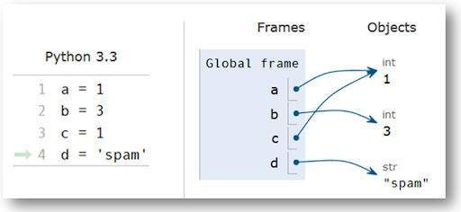
Python Objects and their references
In C (and C++) a declaration like
int a=1; // creates storage, assigns the
// name ‘a’ to that storage,
// assign the storage to value 1
int b=a; // separate storage also value 1
In Python a declaration like
a=1 # creates an object, initialized to 1,
# then creates a reference ‘a’ for it
b=a # create reference ‘b’ to same object
What should happen if reference ‘a’ is assigned to 4 “a = 4” ?
What should happen if reference ‘b’ is assigned to reference ‘a’ b=a ?

Slide 3
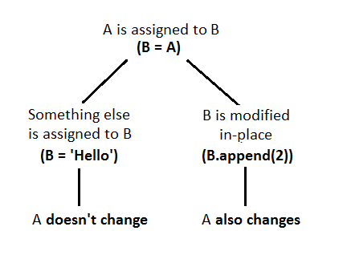
B = A, then B is changed
A = ‘Goodbye’
B = A
B = ‘Hello’
print(‘You say ‘ + A)
print(‘and I say ‘ + B)
You say Goodbye
And I say Hello
A = (0,1)
B = A
B = B.append(2)
print(A)
print(B)
( 0, 1, 2)
( 0, 1, 2)

Slide 4
References to variables(aka objects)
A1 = “April 1” # creates an object with ‘set to April 1’, then create object reference A1
A2 = “April 2”
A3 = “April 3”
Today = A1 # creates an object reference Today and refers to the same object A1 refers to
Tomorrow = A2
A1 = “April Fools” # create a brand new object ‘April Fools’ and now A1 refers to that object
Print(‘Today is: ‘ + Today) # will output Today is: April 1
Print(‘A1 is: ‘ + A1) # will output A1 is: April Fools

Slide 5
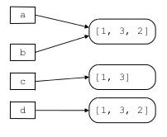
Object References on Array operations
A = [1,3,2]
B = A
C = A[0:2]
D = A[:]
What happens to A if the sort function is run on B B.sort()?
Answer: A gets sorted as well because the python sort function sorts ‘in place’.

Slide 6
Alias to objects
A1 = (“April 1” , “Mostly Sunny”)
A2 = (“April 2” , “Cloudy”)
Today = A1 # Today is an alias for A1…at least for now
Tomorrow = A2 # Tomorrow is an alias A2…at least for now
A1 = (“April 1” , “Mostly Sunny” , ” Chance of Rain”) # Today WILL NOT have a chance of rain
A2.append(“ Chance of Rain”) # Tomorrow WILL have a chance of rain

Slide 7
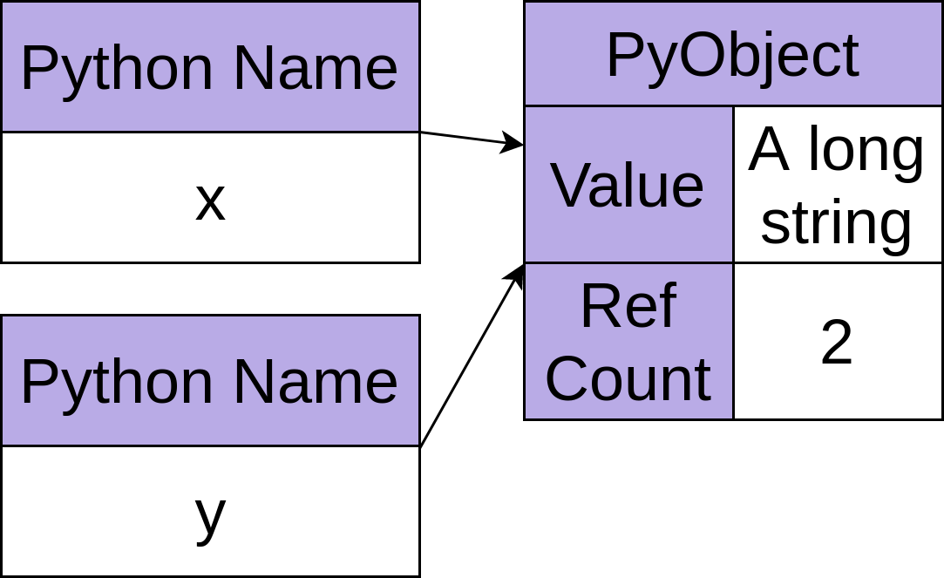
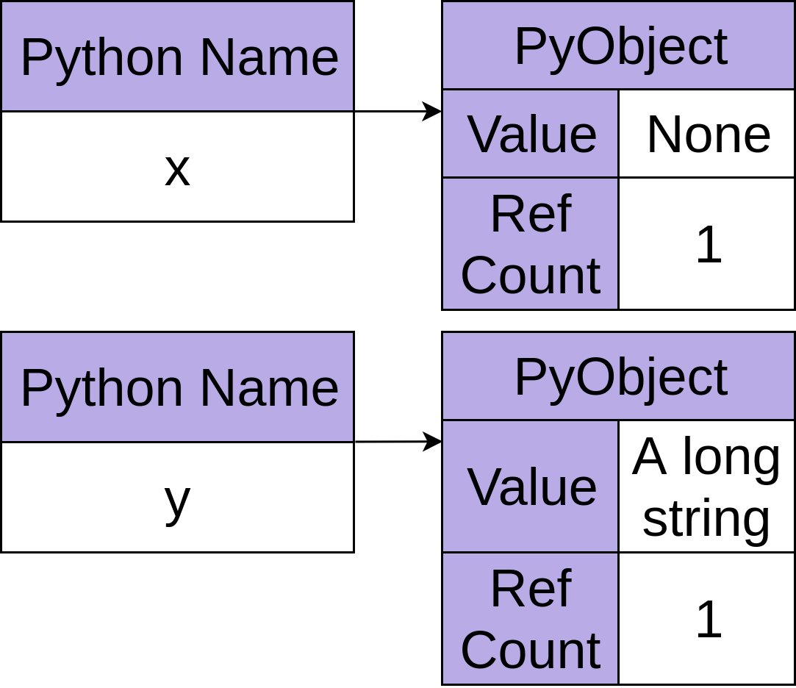
Reference counts
x = ‘A long string’
y = x
x = ‘None’

Slide 8
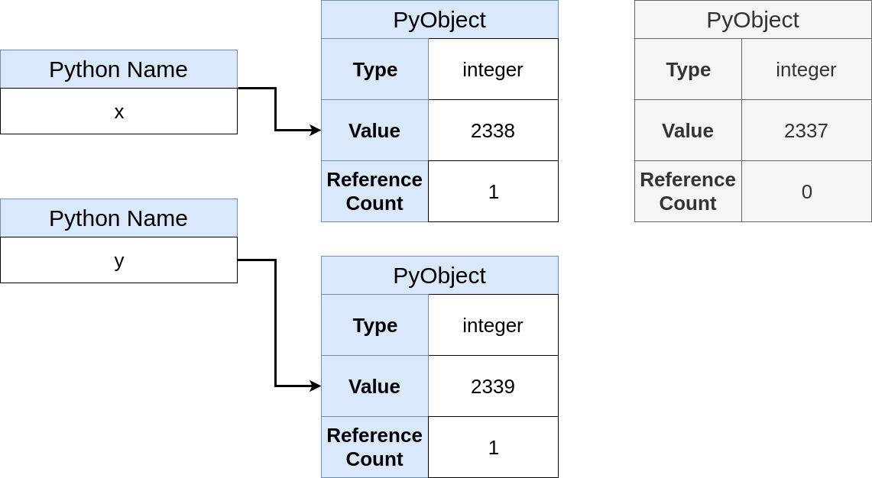
Reference Counts/Garbage Collections
x = 2337
y = x
x = 2338
y = 2339
# do we still need 2337 around?

Slide 9
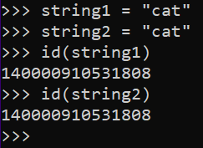
What is this pointing stuff?
The arrows on the previous slides are simply the machine address of where the object is located in memory at the present moment.
The id function can be used to print out the machine address (aka the arrow) of an object.
Since string1 and string2 are both equal to the same string, python only needs 1 string for both references.

Slide 10
History – In C and C++ Aliasing
String A1 = ‘April 1’;
String A2 = ‘April 2’;
String myBirthday = A1; // myBirthday is new storage set to ‘April 1’ that is not A1
String *Today; // Today is a pointer to a string (ie can hold the address of a String)
Today = &A1; // Today is set to the address of the storage for A1
*Today = ‘April Fools’ // the storage that Today points at, is set to ‘April Fools’
// now A1 is set to ‘April Fools’. Since Today points at A1, *Today is set to ‘April Fools’.
// myBirthday is set to ‘April 1’ because is was created as separate storage from A1

Slide 11
History – In C and C++ Null Pointer
int *p1 = malloc(sizeof(int)); // allocates memory for 1 integer and have p1 point to it
*p1 = 5; // the storage p1 points to is set to 5
int *p2; // p2 is a pointer to an integer with no initial value yet
p2 = p1; // pointer p2 points to the same integer p1 points to
free(p1); // frees the storage that p1 points to (therefore the storage p2 points to also)
cout << “P2 points to “ << *p2 // prints the integer that p2 points to only it doesn’t exist
How can we fix this issue?

Slide 12
History – In C and C++ Memory Leak
boolean alwaysTrue = true;
Int *p1; // p1 is a pointer to an integer
while(alwaysTrue) // infinite loop
{
*p1 = malloc(sizeof(int)); // allocate storage and have p1 point to it
}
This infinite loop will keep allocating memory, setting p1 to it and do this over and over until the computer crashes do to being out of memory.

