Slide 1
B+ Trees
Storage Access
Paging
Buffer Replacement
Page Replacement

Slide 2
Storage Access
A database can be mapped into a number of different files, which are maintained by the underlying Operating System. These files reside permanently on disk, with backups on tape.
A major goal of the database system is to minimize the number of block transfers between the disk and memory.

Slide 3
Paging
Programs in a database system make requests (calls) on the buffer manager when they need a block from disk. If the block is already in the buffer, the manager passed the address of the block in main memory to the requester.
If the block is not in the buffer, the buffer manager must first make space for the new block which could involve selecting a block to remove.

Slide 4
Buffer replacement strategies
When the buffer manager needs to select a block to remove, a block in memory must be selected from all of the blocks that are currently in memory. It would be optimal if it were known when the next reference to each page currently in memory was going to happen in the future. Then the buffer manager would select the page that will be referenced furthest into the future. If there were a way to predict this, it would be know as the Optimal Page Replacement strategy. There are a few page replacement strategies that do their best to emulate the optimal way.

Slide 5
Page replacement algorithms
Least Recently used
Each page will be time stamped when it is referenced. When a page needs to be selected for removal, the page with the oldest timestamp is selected.
This method is time consuming. First, every page reference (read or write) now requires the operating system to update the timestamp for that page. Secondly, when it comes time to select the page for removal, all time stamps must be compared.
First in first out
This method chooses the page that entered the system first out of all the pages currently in memory. It can be implemented using a linked list.
First in last out
This method chooses the page that entered the system most recently out of all the pages currently in memory. It can be implemented using a stack.

Slide 6
B and B+ Trees
A B-tree is a balanced tree that has a root node, intermediate nodes and leaf nodes. The nodes have V values and P pointers. P = V + 1. The size of a node is therefore: P(size of a pointer) + V(size of a value). The node is arranged as [pointer, value, pointer…value, pointer]. The values are in sorted order.
When a node is visited, a linear search of the values is conducted through the value fields, and the pointer that is between the values that are less then and greater than the number being searched for is used to point to the next child node in the search.
In order to keep the tree balanced, we need to set a minimum number of children nodes on each node. Otherwise, some branches could be longer than others. It is very popular to set the minimum to ½ V.

Slide 7
Notation
The notation for the structure is: “X-Y B-tree” where X is the minimum number of children a node can have and Y is the maximum. The B stands for “Balanced” and tree means that it is a tree structure (no cycles).

Slide 8
Analysis
In the “algorithms analysis”, world there are many arguments as to what the best number of values and pointers each node should have. The more children, the wider and therefore less hops to take to reach the bottom, however the bigger each node is, the more time spent at each node and also the more work is needed when updating the tree structure.
In the “database” world, the focus is on reducing the number of disk I/O’s. Therefore the size of the node should be set to the size of a page for the hardware that the database is operating on.

Slide 9
B to B+ tree
On the intimidate nodes, there are values that are used to navigate through the tree. In a B-Tree the values in the tree may appear on intermediate nodes and may appear on leaf nodes. In the database world, our goal is not to find is a value is in the tree, it is to find the pointer to the record that contains the value we are searching for. Therefore we must make a change to the B-Tree usage. First we must realize that when we get to the bottom of the tree the leaf node will have pointers to the tuples that the was found in the search. Therefore every value in the structure must appear on a leaf node in addition to being on intermediate nodes that are used to navigate to the bottom of the Tree. Also, it is often useful if the leaves of the tree form a linked list since in many database applications that search for a value, often want a list of records starting with that record and going somewhat further in that list. For example, All accounts with balances between $1000 and $2000. We would want do quickly find the first balance of $1000 or more and then walk through a linked list to the next. And not have to find the next.
A B-tree that contains all values on leaf nodes and links all nodes together is called a B+-tree.

Slide 10
Example
Example)
Block size is 4 kilobytes ( 4 * 1024 = 4096 bytes)
Key field being searched is 32 bytes
Disk addresses are 8 bytes
Number of tuples in the database 1,000,000
How many key values and Pointers can we squeeze into a 4K block?

Slide 11
More on the Example
Typically, a B+ tree node is made to be the same size as a disk block, lets say 4 kilobytes. Which a search-key size of say, 32 bytes, and a disk-pointer size of 8 bytes, we could store
((4 kilobytes – 8) / (8 + 32)) we could fit 102 search values and therefore 103 children in each node.
If the B+-tree has a maximum of 103 children per node and a minimum of 103/2 = 52 children per node, then if we assume the worst case (each node has 52 children) then the could need $\log_{52}$(1,000,000) = 4 nodes need to be accessed.
Therefore 4 disk I/O would be needed to find the address of the tuple being searched on disk. When you consider that the root nodes of popular B+-tree structures are typically kept in main memory, there would only be 3 I/O accesses.

Slide 12
Inserting into a B+ tree

Slide 13
Inserting into a B+ tree

Slide 14
Inserting into a B+ tree

Slide 15
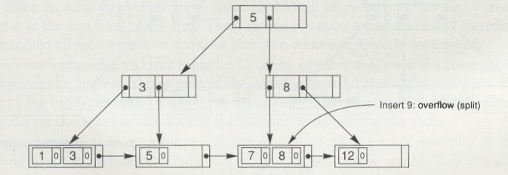
Inserting into a B+ tree

Slide 16
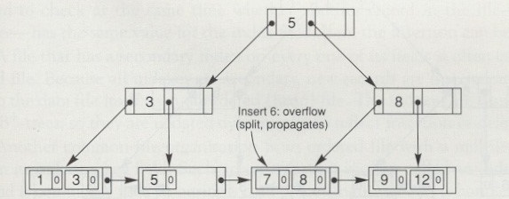
Inserting into a B+ tree

Slide 17
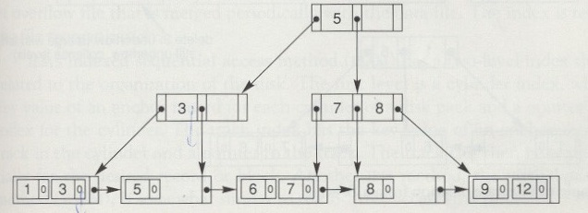
Inserting into a B+ tree

Slide 18
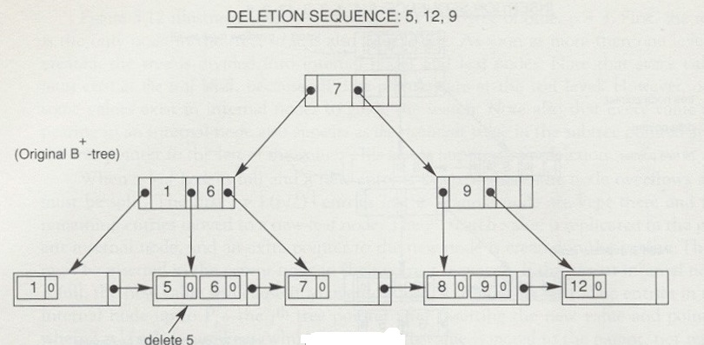
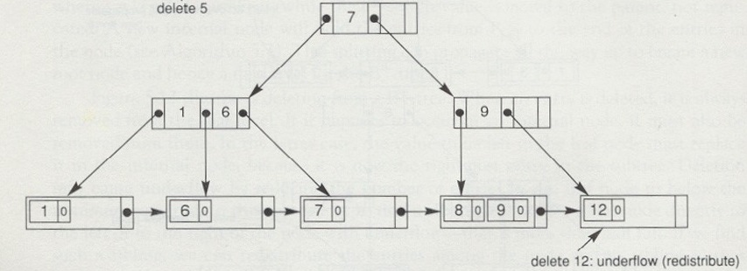
Deleting from a B+ Tree

Slide 19
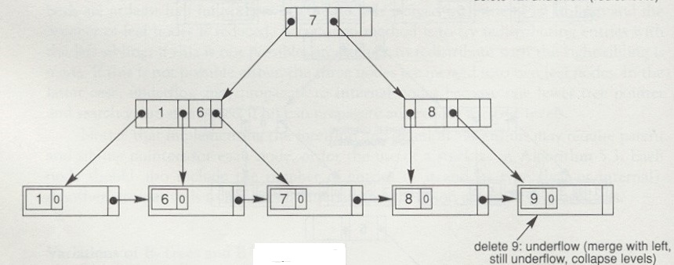
Deleting from a B+ Tree

Slide 20
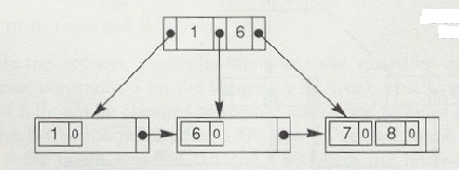
Deleting from a B+ Tree

Slide 21
DDL for indexes
create index <index-name> on <relation-name> (<attribute-list>)
create, index and on are key words in DDL
attribute-list – is the list of attributes of the relations that form the search key for the index.
The type of the index used here is the default for the database system. Ex) B+ tree
Many database systems also provide a way to specify the type of index to be used (such as B+-tree or hash table)

Slide 22
Algorithm for nested loop joins
SELECT *
FROM R,S
WHERE R.a = S.b
The algorithm for performing the join is:
for each tuple Tr in R
for each tuple Ts in S
if (R.a = S.b)
add Tr • Ts to the result

Slide 23
Number of I/O’s for a nested loop query
SELECT *
FROM R,S
WHERE R.a = S.b
For example let,
Nr = 100 // R has 100 tuples
Ns = 1000 // S has 1000 tuples
Fr = 6 // 6 tuples of r can fit into 1 I/O buffer
Fs = 10 // 10 tuples of r can fit into 1 I/O buffer

Slide 24
Number of I/O’s for a nested loop query
Suppose there are n=11 page frames to load data into main memory from disk
Let consider giving n-1 frames to one table and 1 frame to the other
How main I/Os would we need to do to preform this query
$$\left\lceil \frac{N_{r}}{F_{r}}\right\rceil +\left\lceil \frac{N_{s}}{F_{s}}\right\rceil ∗\left\lceil \frac{\left\lceil \frac{N_{r}}{F_{r}}\right\rceil }{B_{r}}\right\rceil$$
$N_{r}$ = Number of records in R, $F_{r}$ number of R records per frame, $B_{r}$ number of buffers for R
$\left\lceil \frac{100}{6}\right\rceil +\left\lceil \frac{1000}{10}\right\rceil ∗\left\lceil \frac{\left\lceil \frac{100}{6}\right\rceil }{10}\right\rceil$= 17 + (100*2) = 217 ←every case

Slide 25
Number of I/O’s for a nested loop query
Suppose table S has a 2 level index on column b (3 I/Os to get to the bottom of the B+ tree plus 1 I/O to get the data (in the best case) and each I/O block can 100 key values (therefore a maximum of 101 children each)
If we stick with giving 10 buffers to R and 1 buffer to S and we use the index on field b
$\left\lceil \frac{N_{r}}{F_{r}}\right\rceil + N_{r}$ * 3 = $\left\lceil \frac{100}{6}\right\rceil +100$ * 3 = 17 + 300 = 317 ←best case
Note: This would no be a good use of the buffers and a misuse of the index

Slide 26
Number of I/O’s for a nested loop query
Suppose table S has a 2 level index on column b (3 I/Os to get to the bottom of the B+ tree plus 1 I/O to get the data (in the best case) and each I/O block can 100 key values (therefore a maximum of 101 children each)
If we go with giving 9 buffers to R and 2 buffers to S and we use the index on field b
$\left\lceil \frac{N_{r}}{F_{r}}\right\rceil +1+ N_{r}$ * 2 = $\left\lceil \frac{100}{6}\right\rceil +1+100$ * 2 = 17 + 1+ 200 = 218 ←best case
Note: This would be a better use of the buffers and a good use of the index
A rule of thumb, is give the indexed table enough buffers to efficiently use the index and the remainder of the buffers to the other table.

