Slide 1
Data Structures for Databases
Graphs (representing in computer memory)
Linked lists, Trees, Search Trees
Indexes of Linked Lists

Slide 2
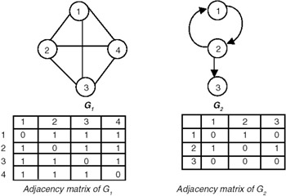
Representing Graphs in Memory
Adjacency matrix

Slide 3
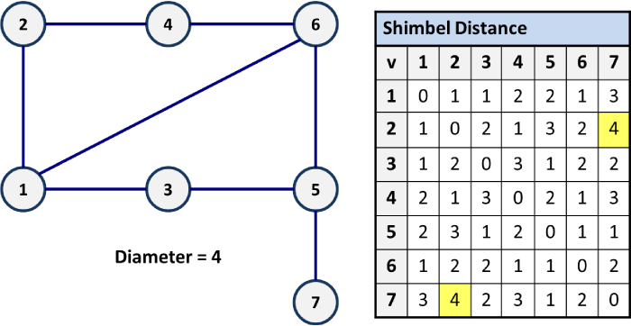
Distance/diameter in connected Graphs
Distance between vertices u and v of a connected graph G, written d(u,v) is the length of the shortest path from u to v.
The diameter of a connected component is the maximum distance between any two of its vertices

Slide 4
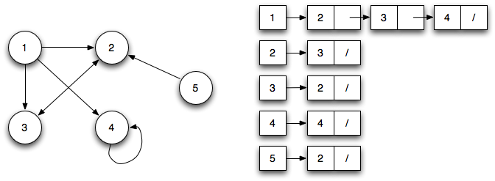
Representing Graphs in Memory
Adjacency lists

Slide 5
Linked List node (Java)
public class Listnode
{
private Object data;
private Listnode next;
public Listnode(Object d) { this(d, null); }
public Listnode(Object d, Listnode n)
{ data = d; next = n; }
public Object getData() { return data; }
public Listnode getNext() { return next; }
public void setData(Object ob) { data = ob; }
public void setNext(Listnode n) { next = n; }
}

Slide 6
Creating an empty Linked List (Java)
public class LinkedList
{
Node head;
public LinkedList(int value) { head = new Node(value); }
public int get(int value) { … }
public void insert(int value) { … }
public void delete(int valie) { … }
}

Slide 7
Sorted Linked Lists vs. Arrays
Linked Lists are easy to insert, delete elements
Arrays are easy to search (binary)
Both are Data Structure that maintain order of elements.

Slide 8
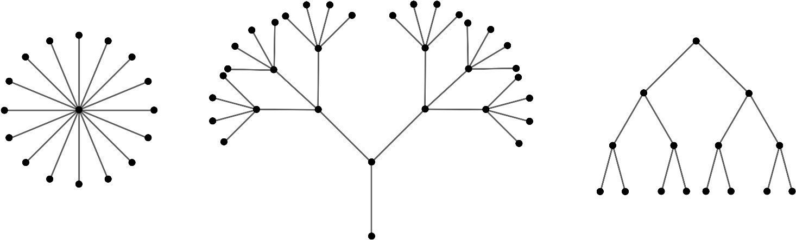
Special Graphs - Trees
A cycle is a closed walk over a subset of vertices where no edge is traversed more than once.
A graph is said to be cycle-free or acyclic if it has no cycles.
A connected graph with no cycles is said to be a tree

Slide 9
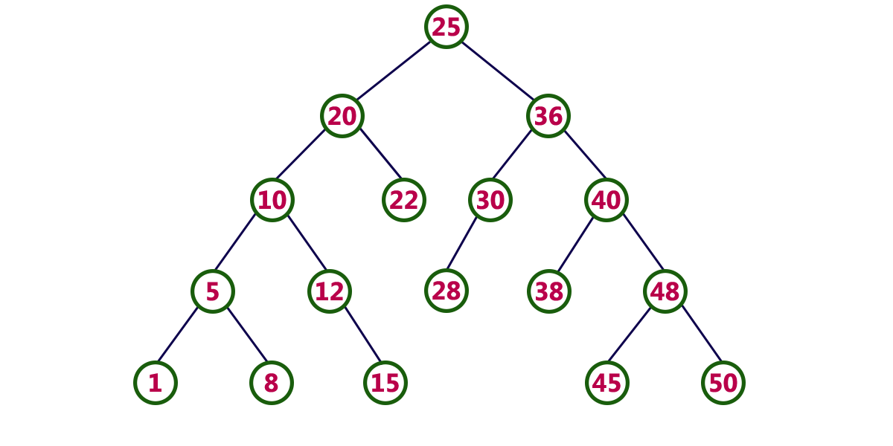
Un-balanced Binary Search Tree

Slide 10
Binary Search Tree (Java Code)
class binarySearchTree
{
class Node
{
int data;
Node left, right;
public Node(int value)
{
data = value;
left = right = null;
}
}
Node root;
binarySearchTree() { root = null; }
}
binarySearchTree BST = new binarySearchTree();

Slide 11
Binary Search Tree (Java Code)
public Node search (Node root, int searchValue)
{
// Base Cases: root is null, return null meaning the search is over
if (root==null) return root;
// if the value is found, return the node and the search is over
if (root.data==searchValue) return root;
// searchValue is less than the root's data, search left child
if (root.data > searchValue) return search(root.left, searchValue);
// searchValue must be greater than root's data, search right
return search(root.right, searchValue);
}

Slide 12
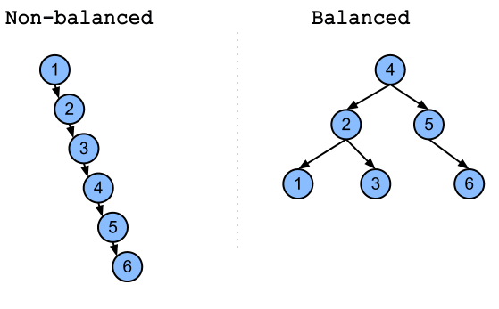
Unbalanced vs. Balanced Trees
Unbalanced – less time to alter, more time to search
Balanced – more time to alter, less time to search

Slide 13
Time to search a linear array
Example: facebook has a table (an array of all of it’s users - over 1 Billion of them).
You login with your <email,password>
Facebook must search for you email in their database to retrieve your password to validate your login.
A linear search of every member would take too long.

Slide 14
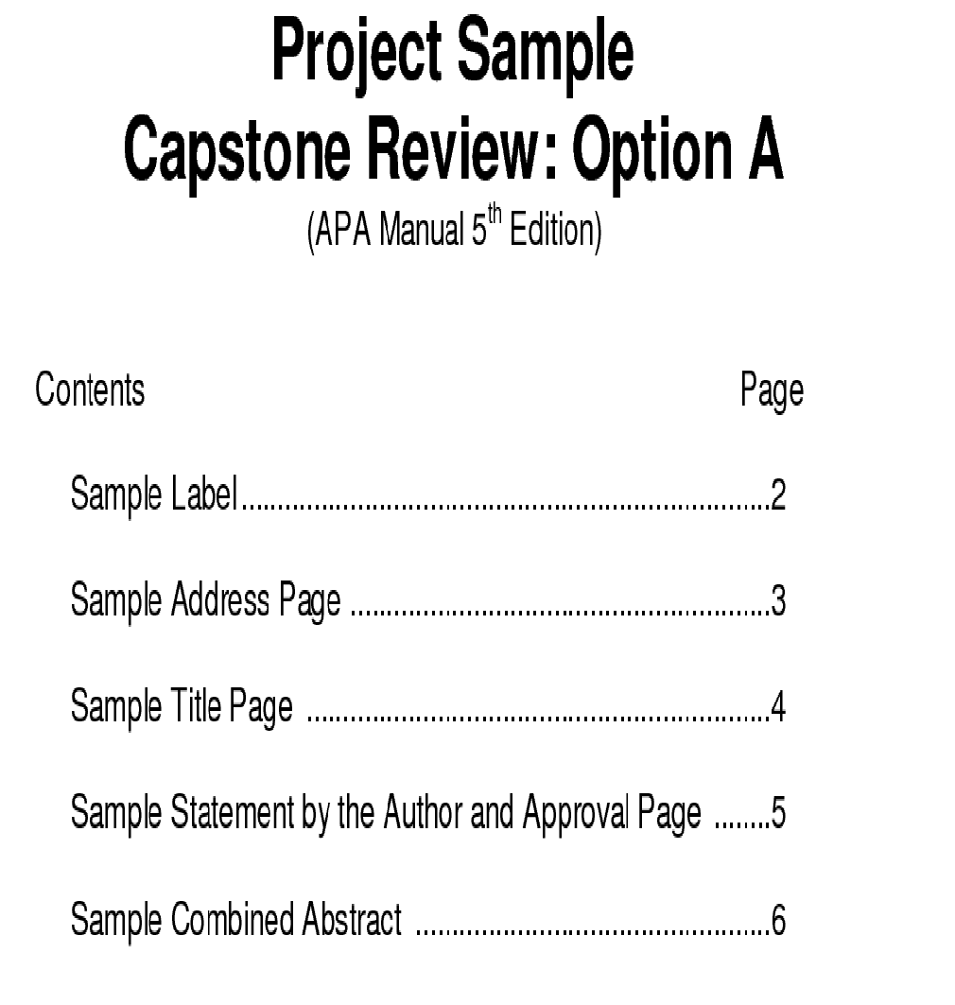
Table Of Contents

Slide 15
Index (Data Structure)
A Data Structure used for find data (unstructured or structures Datasets.)
Example)
A table of contents in a paperback book, is an index to a linked list of DataSets. If you want to read chapter 4, you look in the ToC for the page number of chapter 4, go to that page, then sequential read all pages until the end of chapter 4.

Slide 16
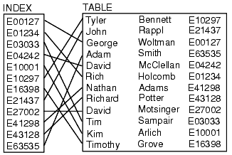
Index on Employee Number

Slide 17
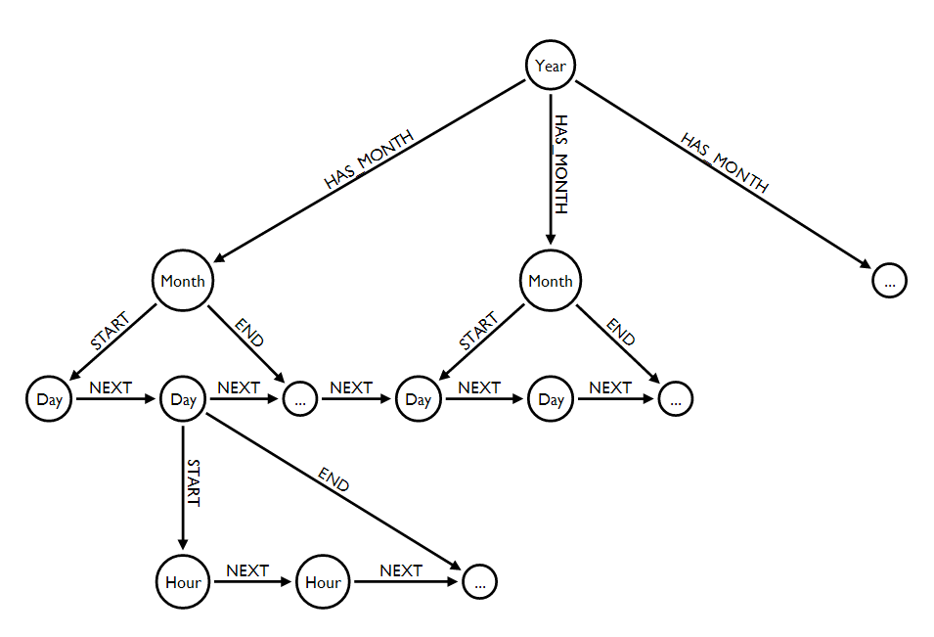
Index to linked lists of Indexes

