Slide 1
Introduction
What is a Database?

Slide 2
Cell phone: Storing your contacts info

Slide 3
Contacts improvement (version 1)?

Slide 4
Contacts improvement (version 2)?

Slide 5
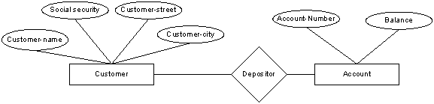
Entity-Relationship model
The E-R data model is based on a perception of a real worked that consists of a collection of basic objects, called entities and of relationships among these objects

Slide 6
Database Languages
DDL (Data-Definitions Language)
One to specify the database schema
One to express the database queries
DDL (Data-Definitions Language)
The database schema is specified by a set of definitions expressed by a special language called the DDL. The result of compilation of DDL statements is a set of tables that are stored in a special file called the data dictionary.
DML(Data Manipulation Language)
Retrieval of information stored in the database
The insertion of new information into the database
The deletion of information from the database
The modification of information stored in the database

Slide 7
DBA (DataBase Administrator)
Schema definition
Storage structure and access-method definition
Schema and physical-organization modification
Granting of authorization for data access
Integrity-constraint specification.

Slide 8
Database Users
Application Programmers – Professionals who interact with the system through DML calls, which are embedded in a program written in a host language like Cobol, C, C++, Java, C#, php,)
Sophisticated Users – form their requests in a database query language. Each query is submitted to a query processor whose function is to break down DML statements into instructions that the storage manager understands.

Slide 9
Query Processor Components
DML Compiler – translates DML statements of a query language into low-level instructions that the query evaluation engine understands.
Embedded DML precompiler – converts DML statements embedded in an application program to normal procedure calls in the host language.
DDL Interpreter – interprets DDL statements and records them in the set of tables containing metadata.
Query Evaluation Engine – executes low-level instructions generated by the DML compiler.

Slide 10
Storage Manager
Authorization and Integrity Manager – tests for the satisfaction of integrity constraints and checks the authority of users to access data.
Transaction Manager – ensures that the database remains in a consistent state despite system failures
File Manager – manages the allocation of space on disk storage and the data structures used to represent information stored on disk.
Buffer Manager – responsible for fetching data from disk storage into main memory, cache memory.

Slide 11
Physical System
Data Files – stores the database itself.
Data Dictionary – stores metadata about the structure of the database.
Indices – provide fast access to data items that hold particular values.
Statistical data – store statistical information about the data in the database. Use for efficient executions.

Slide 12
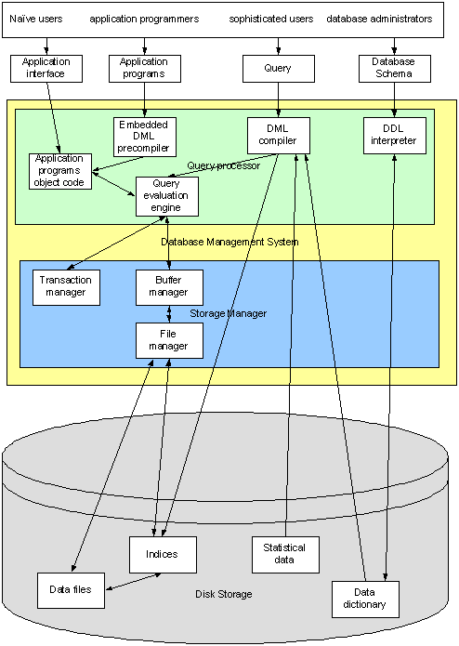
Users
Applications
DBMS
Disk Storage

