Slide 1
Set theory
Definitions
Venn Diagrams
Proof by Induction

Slide 2
Definitions
The concept of a set appears in all branches of mathematics and computer science.
Set - any well defined list of objects, and will be denoted by capital letters like A, B, X and Y
Set Elements (aka Members) - the objects comprising the set. Denoted by small letters like x, y

Slide 3
Set equivalence and difference
Two sets are equivalent if the have the same members
If set A and set B are equivalent then we say $A=B$
If set A and set B are not equivalent then we say $A≠B$

Slide 4
2 way of expressing a set
1) List all elements
A = {a,e,i,o,u} // a finite set
B = {1,3,5,… } // an infinite set
2) Describe the prosperities characterizing the members.
C = { x : x is a letter in the alphabet, x is a vowel}
D = { x : x is an integer, X > 0, x is odd }
Notice:
A = C and B = D

Slide 5
Subsets - $⊂$, $⊃$, contains, contained by
A = {1,3,5}
B = {1,2,3}
C = {1,3}
Is A a subset of B $A⊂B$? No, A has 5 and B does not
Is C a subset of B B$⊃C$? Yes, 1 and 3 are both in B
Is C contained by A? Yes, 1 and 3 are in set A
Does A contain B? No, B has 2 and a does not

Slide 6
Standard sets and common notation
N = the set of positive integers 1.2.3 …
Z = the set of integers …,-2,-1,0,1,2,…
Q = the set of all rational numbers
R = the set of all real numbers
C = the set of all complex numbers

Slide 7
U and $∅$ - Universal and Empty sets
U - the members of all sets under investigation.
$∅$ - the set with no elements
Examples:
R is the universal set of all real numbers
All facebook members is the universal set of
Facebook Members.

Slide 8
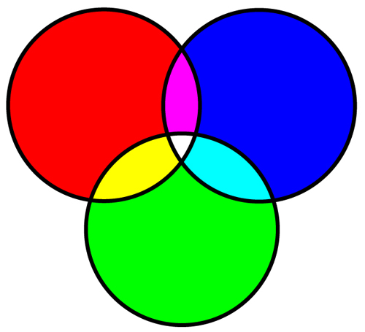
Venn diagrams
R = Red, pink,yellow, white
B = Blue, Lt. Blue, pink, white
G = Green, Yellow, Lt, Blue, White
$R∩G$= Yellow and white
$R∩B∩G$= White
$R∪B∪G$= All colors
R – B = Red and Yellow

Slide 9
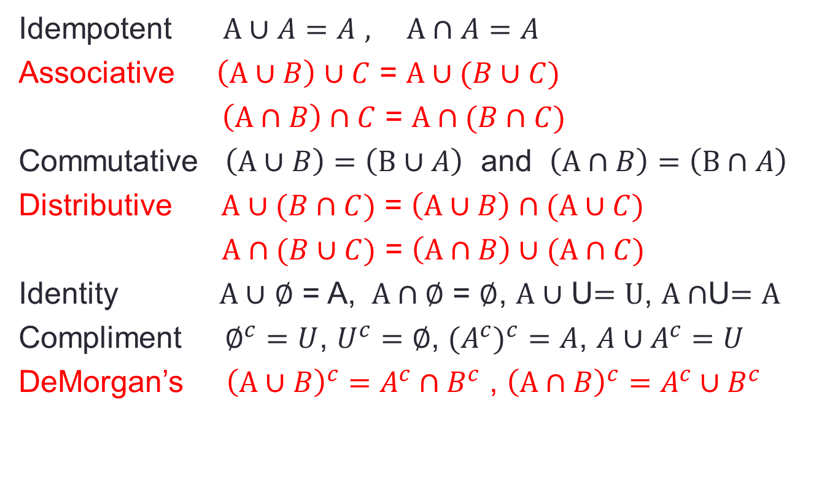
Laws of Algebra of Sets
Idempotent $A∪A=A$ $, A∩A=A$
Associative $\left(A∪B\right)∪C$ = $A∪(B∪C)$
$\left(A∩B\right)∩C$ = $A∩(B∩C)$
Commutative $\left(A∪B\right)=\left(B∪A\right)$ and $\left(A∩B\right)=\left(B∩A\right)$
Distributive $A∪(B∩C)$ = $\left(A∪B\right)∩(A∪C)$
$A∩(B∪C)$ = $\left(A∩B\right)∪(A∩C)$
Identity $A∪$ $∅$ = A, $A∩∅$ = $∅$, $A∪$ U$=U$, $A∩$U$=A$
Compliment $∅^{c}=U$, $U^{c}=∅$, ${{(A}^{c})}^{c}=A$, ${A∪A}^{c}=U$
DeMorgan’s ${\left(A∪B\right)}^{c}=A^{c}∩B^{c}$ , ${\left(A∩B\right)}^{c}=A^{c}∪B^{c}$

Slide 10
Finite Sets
A set is finite if it contains exactly m elements where m is a non-negative integer.
$∅$ - is a finite set
{all letters in the alphabet} is a finite set
{ 2,4,6,…} is infinite
{ all facebook users} is a finite universal set

Slide 11
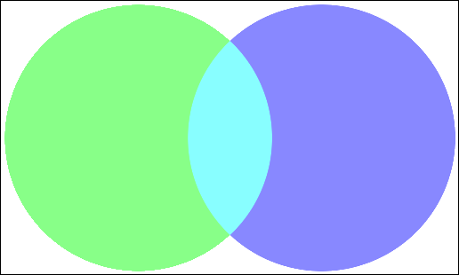
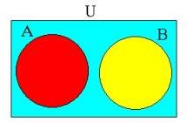
Counting Principle of Finite Sets
n(A) or #(A) is the number of elements in set A
$n\left(A∪B\right)$=n(A) + n(B) – $n\left(A∩B\right)$
$n\left(R∪B∪G\right)$= n(R) + n(B) + n(G)
- $n\left(R∩B\right)$- $n\left(R∩G\right)$- $n\left(B∩G\right)$
$\text{+} n\left(R∩B∩G\right)$
If A and B are disjoint then
$n\left(A∪B\right)$=n(A) + n(B)

Slide 12
Classes of Sets (Sets of a Subsets)
Let S = {1,2,3,4}
Let A be the class of subsets of S containing exactly 3 elements of S
A = { {1,2,3} , {1,2,4}, {1,3,4}, {2,3,4} }
Let B be the class of subsets of S containing a 2 and two other elements of S
B = { {1,2,3} , {1,2,4}, {2,3,4} }

Slide 13
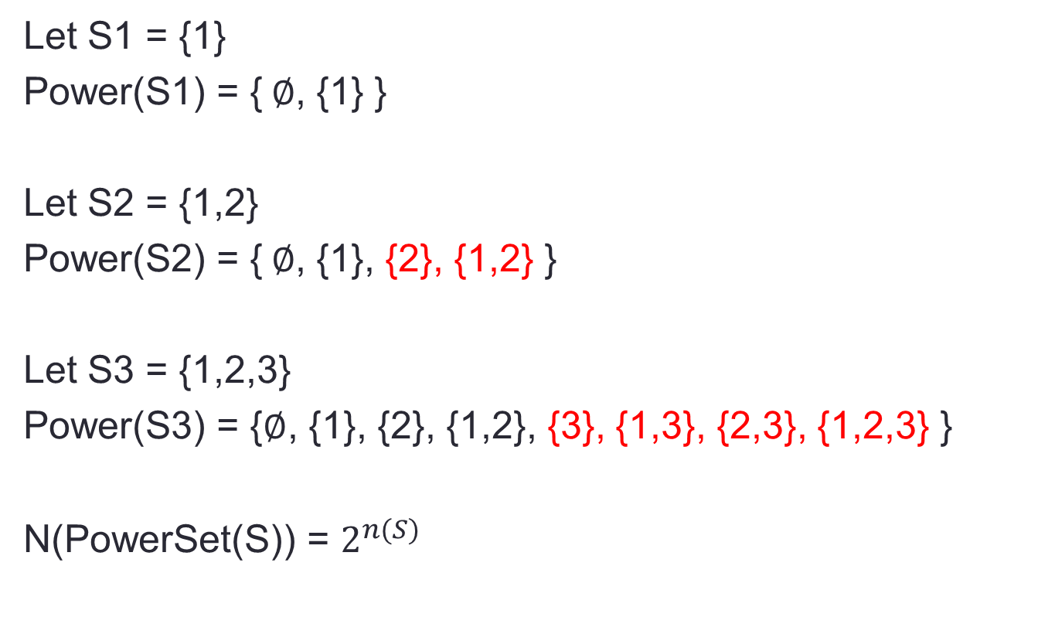
Power Set of a Set
Let S1 = {1}
Power(S1) = {$∅$, {1} }
Let S2 = {1,2}
Power(S2) = {$∅$, {1}, {2}, {1,2} }
Let S3 = {1,2,3}
Power(S3) = {$∅$, {1}, {2}, {1,2}, {3}, {1,3}, {2,3}, {1,2,3} }
N(PowerSet(S)) = $2^{n(S)}$

Slide 14
Example (Artificial Intelligence)
Facts
1) Everything in the garage is useful
2) Fishing poles without hooks are useless
Is the following Conclusion acceptable
Everything in the garage has hooks

Slide 15
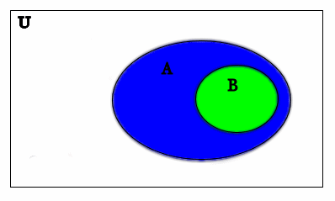
Example (Artificial Intelligence)
Facts
1) Everything in the garage is useful
2) Fishing poles without hooks are useless
Conclusion
Everything in the garage has hooks FALSE
B = everything in the garage
A = everything that is useful
B $⊂$ A
(U – A) = ${\text{(}\text{A}\text{)}}^{c}$ = useless things
POLESNOHOOKS $⊂{\text{(}\text{A}\text{)}}^{c}$ which is disjoint from B

Slide 16
Example (Artificial Intelligence)
Facts
1) Every poet is happy
2) Every programmer is wealthy
3) No one is happy and wealthy
Conclusions
1) No poet is wealthy
2) All Programmers are not happy

Slide 17
Example (Artificial Intelligence)
Facts
1) Every poet is happy
2) Every programmer is wealthy
3) No one is happy and is wealthy
Conclusions
1) No poet is wealthy TRUE
2) All Programmers are not happy TRUE
POETS $⊂$ HAPPY
PROGRAMMERS $⊂$ WEALTHY
HAPPY and WEALTHY are disjoint

Slide 18
Example (Artificial Intelligence)
Facts
1) Every poet is happy
2) Some programmers are wealthy
3) No one is happy and wealthy
Conclusions
1) A person can be a poet and a programmer

Slide 19
Example (Artificial Intelligence)
Facts
1) Every poet is happy
2) Some programmers are wealthy
3) No one who is happy and wealthy
Conclusions
1) A person can be a poet and a programmer TRUE
and such a programmer must be NOT wealthy
POETS $⊂$ HAPPY
HAPPY and WEALTHY are disjoint

Slide 20
Conclusion from a pattern
S = { x : such that x is the sum of consecutive odd integers
starting with 1 }
You notice that
1 = 1
1 + 3 = 4
1 + 3 + 5 = 9
Conclusion
The first n odd numbers sum to $n^{2}$

Slide 21
Proof by observation
You notice that
1 = 1
1 + 3 = 4
1 + 3 + 5 = 9
Conclusion
The first n odd numbers sum to $n^{2}$
The number of number will always be n and the average of the numbers will always be n so the sum will always be
N * (average of numbers) = $n^{2}$

Slide 22
Proof by Induction
Show both
P(1) is true
If P(n) then P(n+1) for all n > 1
1 + 3 +…+ (2n-1) = $n^{2}$
1) 1 = $1^{2}$
2) 1 + 3 +…+ (2n-1) + (2n+1) = $n^{2}$ + 2n+1 = ${(n+1)}^{2}$

