Slide 1
Big Data
RAID
Clusters
Hadoop/Hive

Slide 2

A lot of data these days

Slide 3
Big Data
There is no formal definition of Big Data
Velocity – data coming in at a high speed
Ex: ezpass (cars going 50mph)
Volume – there is a lot of data to look at quickly
Ex: facebook - over 1 Billion users to check per login
Ex: twitter - 400M tweets/day
Varity – data has many types (text, picture, movies, etc.)
Ex: facebook again

Slide 4
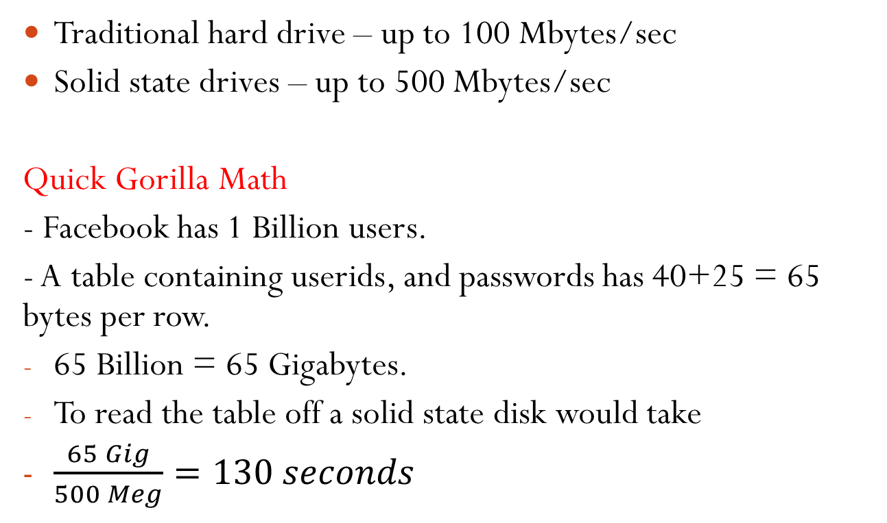
Disk drive reading speeds
Traditional hard drive – up to 100 Mbytes/sec
Solid state drives – up to 500 Mbytes/sec
Quick Gorilla Math
- Facebook has 1 Billion users.
- A table containing userids, and passwords has 40+25 = 65 bytes per row.
65 Billion = 65 Gigabytes.
To read the table off a solid state disk would take
$\frac{65 Gig}{500 Meg}=130 seconds$

Slide 5
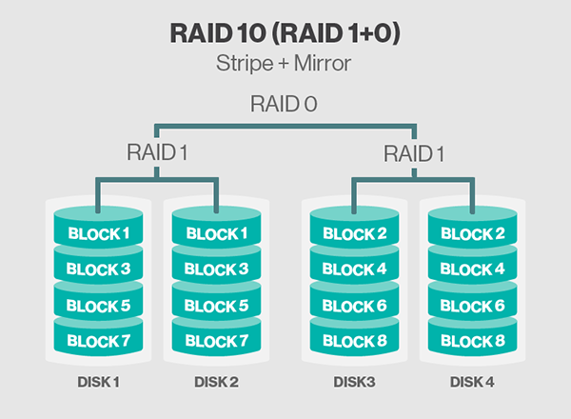
RAID (Redundant Array Independent Disks)

Slide 6
Nodes, Racks and Clusters
Node (a computer CPU/local disk drive(s))
Rack – collection of Nodes connected with very high bandwidth interconnections
Cluster – collection of racks (of nodes)

Slide 7
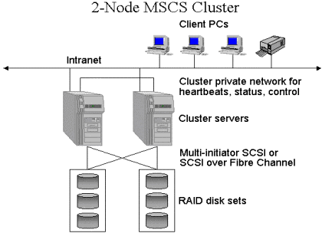
Microsoft Cluster Server

Slide 8

Apache Hadoop is an open-source software framework used for distributed storage and processing of big data sets using the MapReduce programming model.
Framework of Tools.
It consists of computer clusters built from commodity hardware.
Named after a yellow stuffed elephant.

Slide 9
HDFS (HaDoop File System)
HDFS runs on top of all file systems on the cluster.
Designed for streaming data (HaDoop prefers Sequential access over Random Access (aka Indexed files).
Uses Blocks to store files (or parts of files)
Hadoop block are 128M

Slide 10
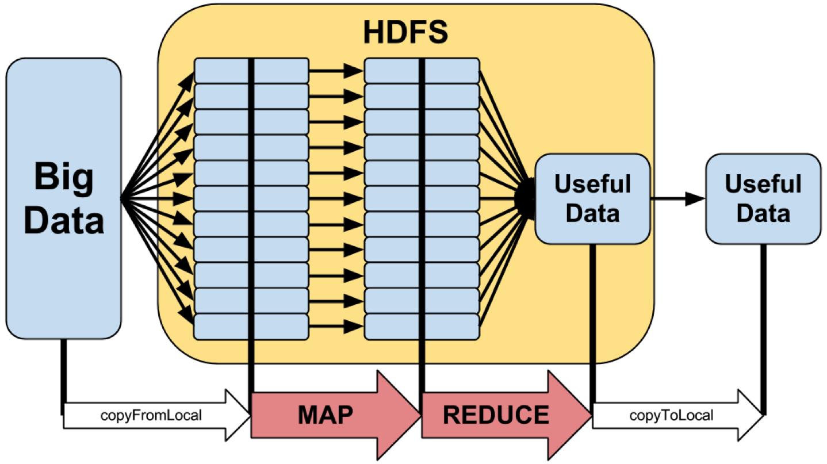
Map Reduce Process

Slide 11
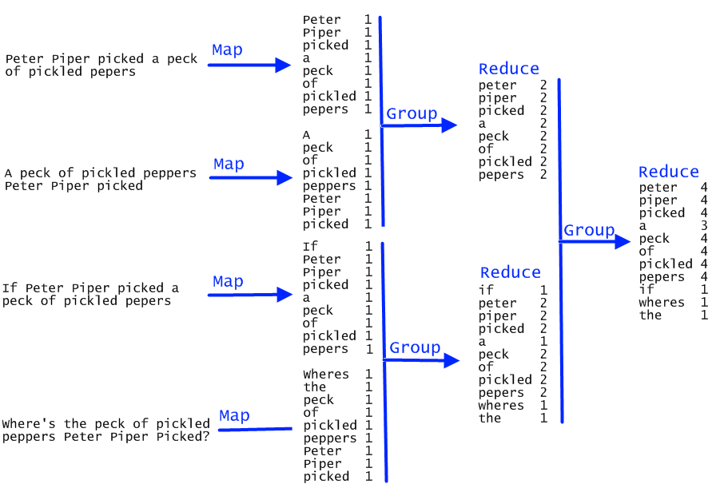
Example of Map-Reduce

Slide 12

Hive
Apache Hive is a data warehouse software project built on top of Apache Hadoop for providing data summarization, query, and analysis.
Hive gives an SQL-like interface to query data stored in various databases and file systems that integrate with Hadoop
Data Warehouse - a large store of data accumulated from a wide range of sources within a company and used to guide management decisions

Slide 13
Features Of Hive
It stores schema in a database and processed data into HDFS.
It is designed for OLAP.
It provides SQL type language for querying called HiveQL or HQL.
It is familiar, fast, scalable, and extensible.
Note: initially developed by facebook then taken over by Apache

Slide 14
Appendix
Apache –
Cluster –
Framework –
Google File System –
MapReduce –
Open Source –

