Slide 1
Black Scholes PDE
Black Scholes
Greeks

Slide 2
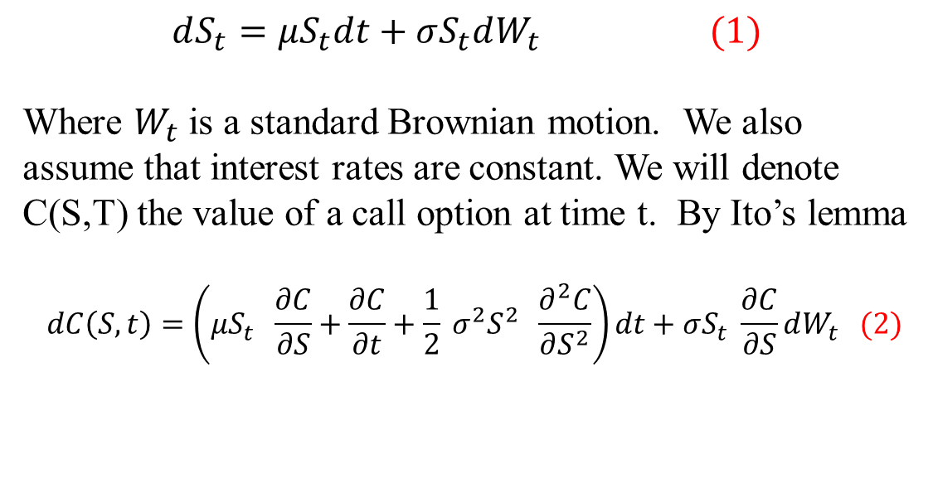
Stock Equation

Slide 3
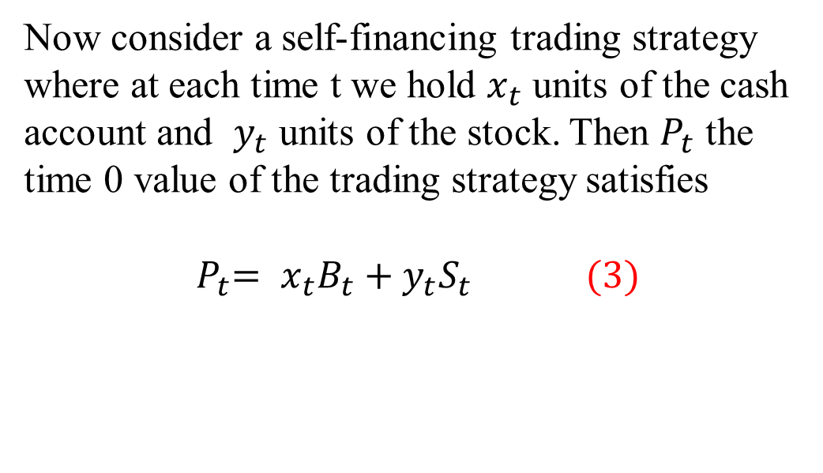
Self Financing

Slide 4
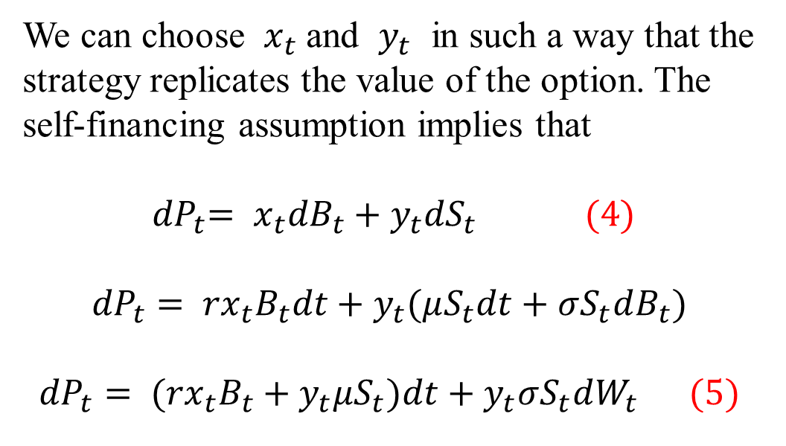
Replicate an Option

Slide 5
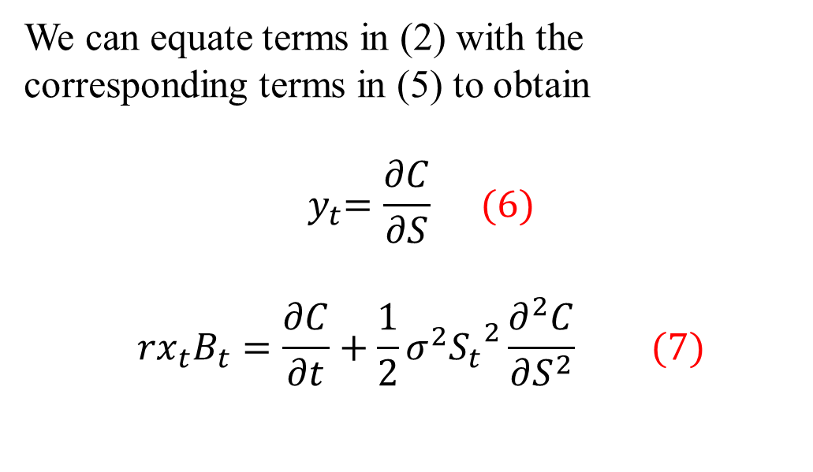
Rewriting terms

Slide 6
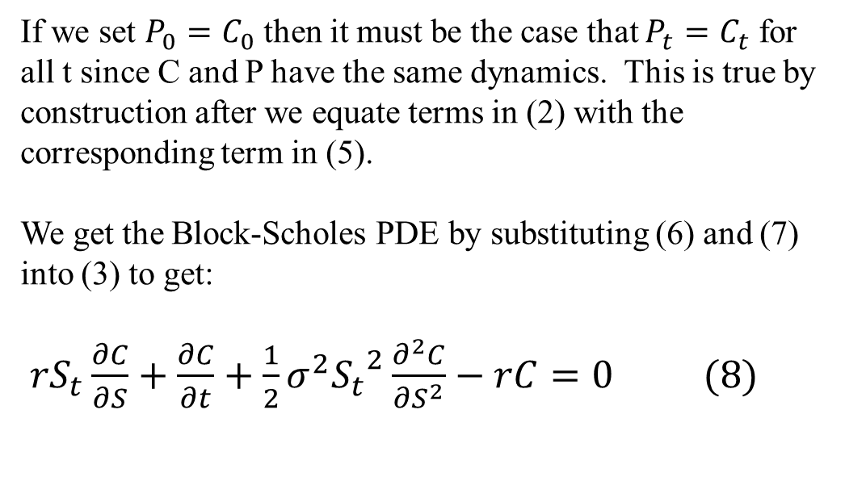
Black-Scholes PDE

Slide 7
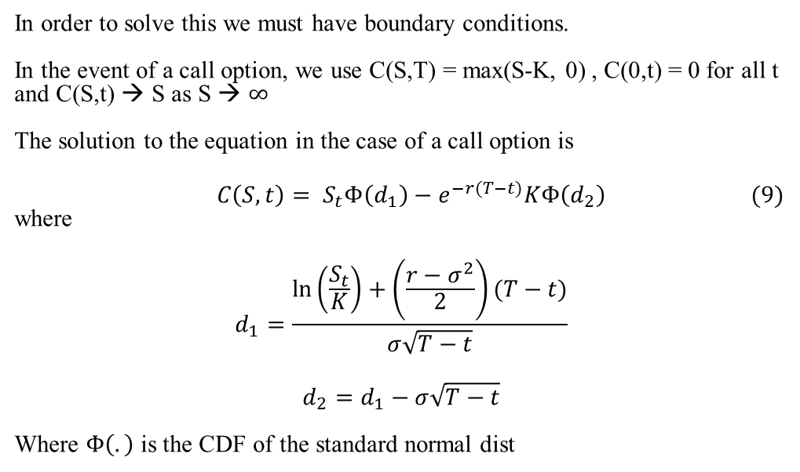
Call Options

Slide 8
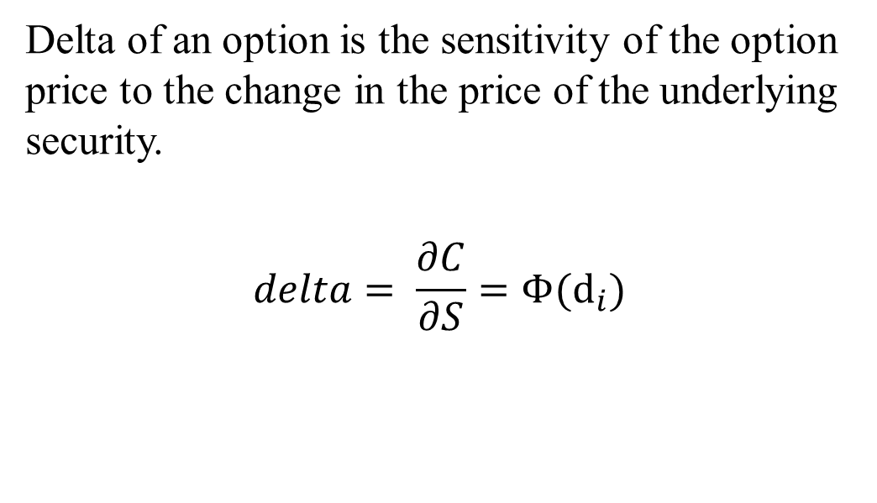
The Greeks (Delta)

Slide 9
Delta Hedging
Delta Hedging is to re-balance the portfolio of the option and stock continuously so that you always have a new delta of zero. Of course this is not practical to hedge continuously and so instead we hedge periodically.
Example) suppose S = $100, C=$10 and Delta = 0.6 and
you sold Call options on 2000 shares.
You can hedge your position by buying 0.6 * 2,000 = 1200 shares. The gains (losses) on the call options would offset the gains (losses) of the stock.

Slide 10
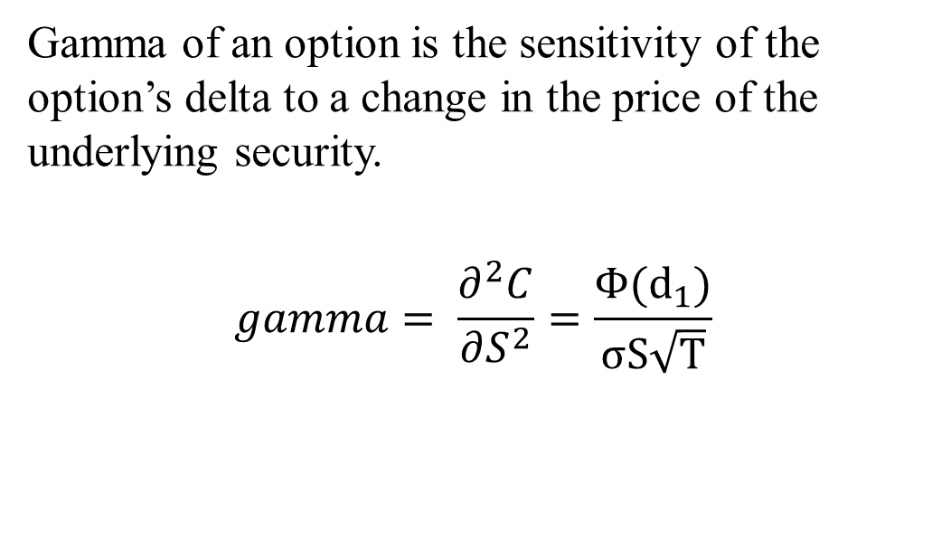
The Greeks (Gamma)

Slide 11
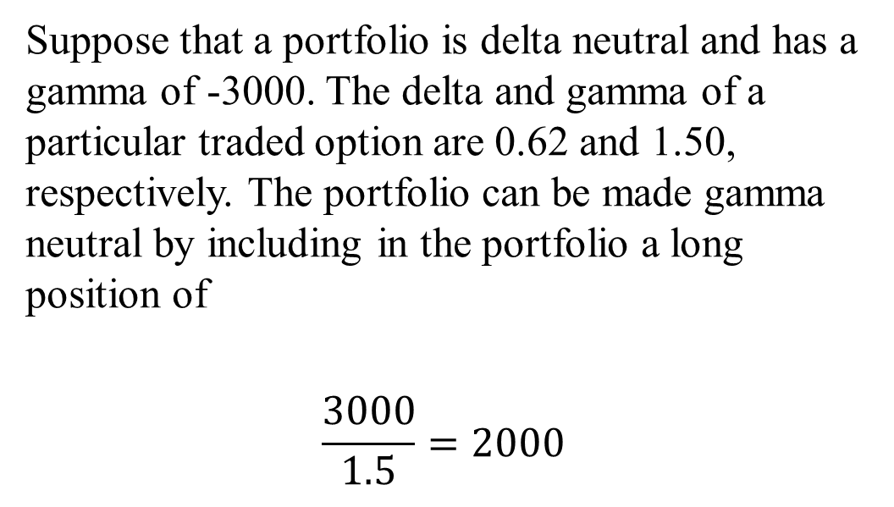
Gamma Neutral portfolio

Slide 12
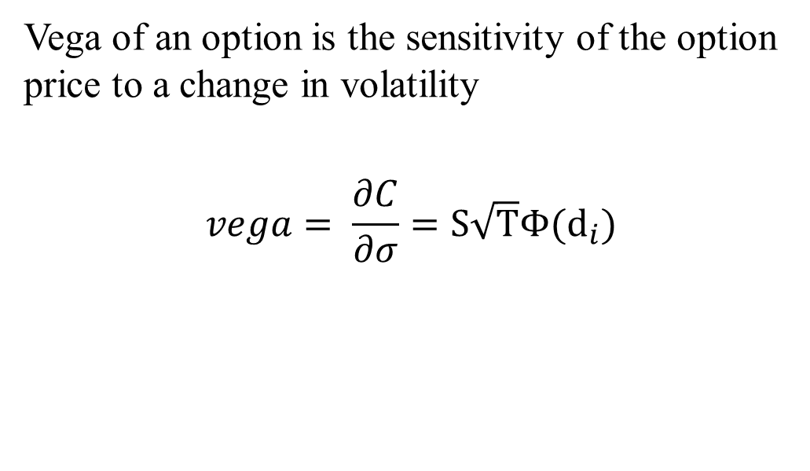
Greeks (Vega)

Slide 13
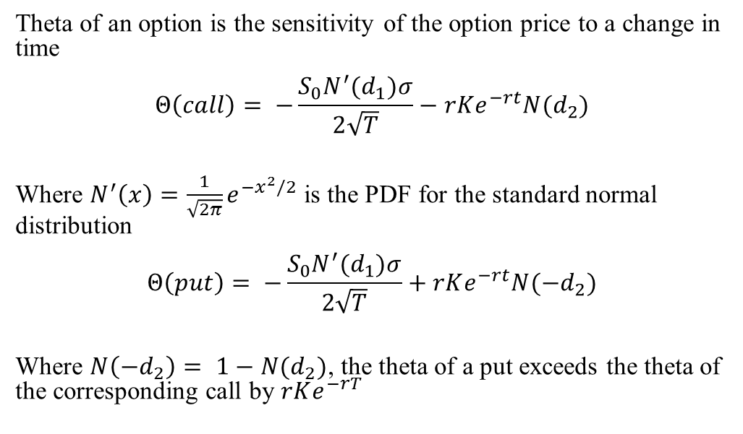
Greeks (Theta)

Slide 14
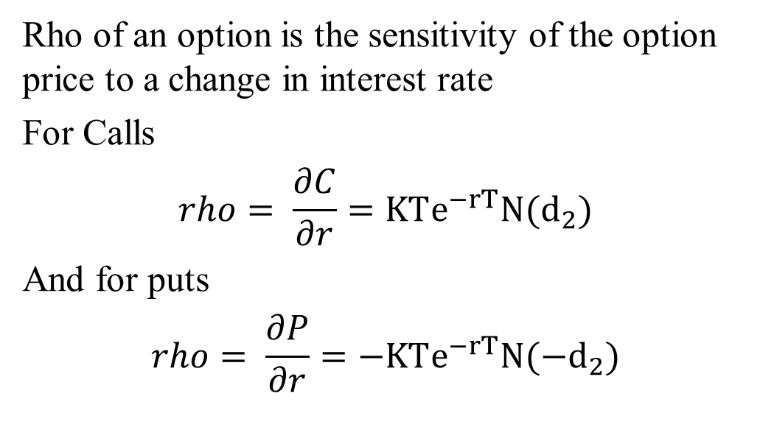
Greeks (Rho)

Slide 15
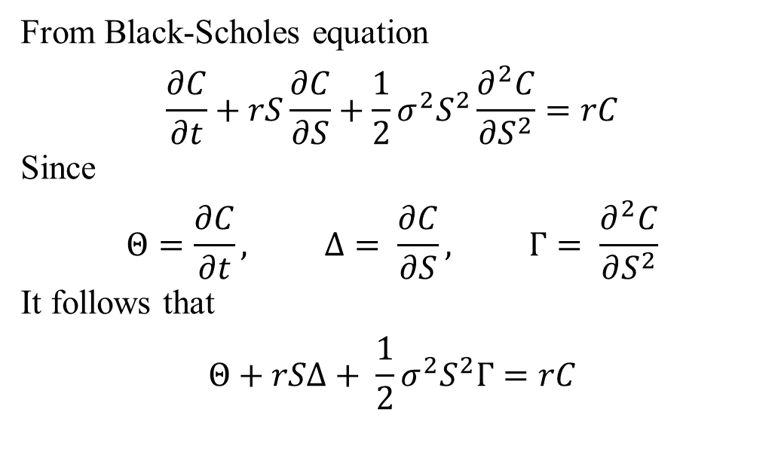
Relationship between Greeks

Slide 16
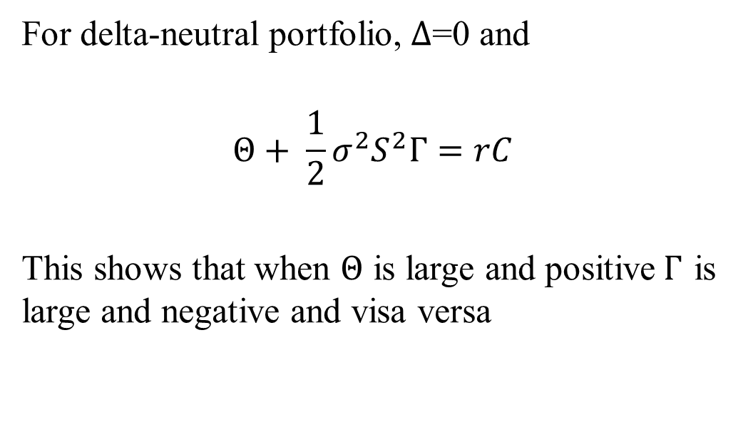

Relationship between $Θ$and $Γ$

