Slide 1
Black-Scholes Applications
Black Scholes
Greeks

Slide 2
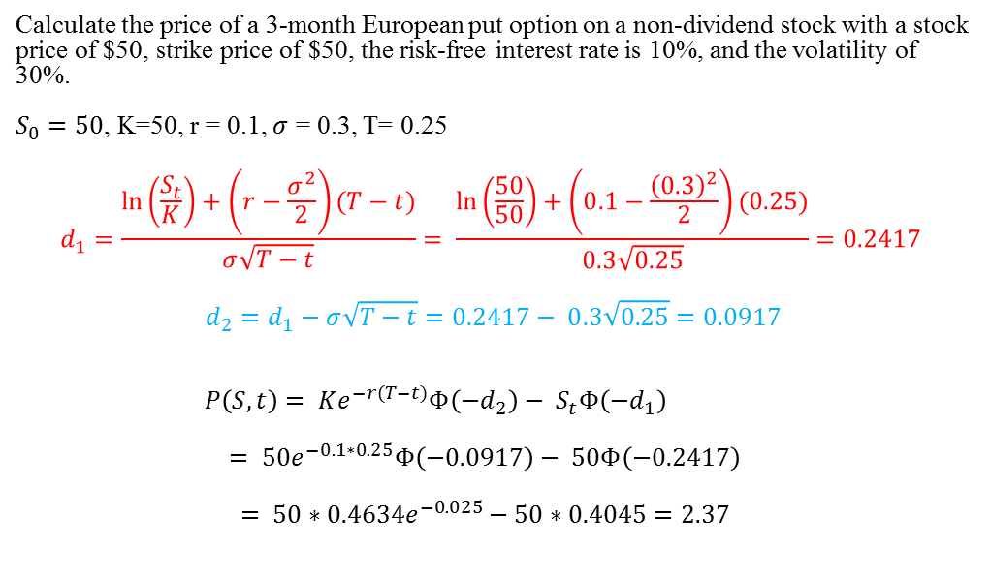
Ex) Put Option Price
Calculate the price of a 3-month European put option on a non-dividend stock with a stock price of $50, strike price of $50, the risk-free interest rate is 10%, and the volatility of 30%.
$S_{0}=50$, K=50, r = 0.1, $σ$ = 0.3, T= 0.25
$$d_{1}=\frac{\ln\left(\frac{S_{t}}{K}\right)+\left(r−\frac{σ^{2}}{2}\right)(T−t)}{σ\sqrt{T−t}}= \frac{\ln\left(\frac{50}{50}\right)+\left(0.1−\frac{{\left(0.3\right)}^{2}}{2}\right)(0.25)}{0.3\sqrt{0.25}}=0.2417$$
$$d_{2}=d_{1}−σ\sqrt{T−t}=0.2417− 0.3\sqrt{0.25}=0.0917$$
$$P\left(S,t\right)= K{e^{−r(T−t)}Φ\left(−d_{2}\right)− S}_{t}Φ\left({−d}_{1}\right)$$
$$= 50e^{−0.1∗0.25}Φ\left(−0.0917\right)− 50Φ\left(−0.2417\right)$$
$$= 50{∗0.4634e}^{−0.025}− 50∗0.4045=2.37$$

Slide 3
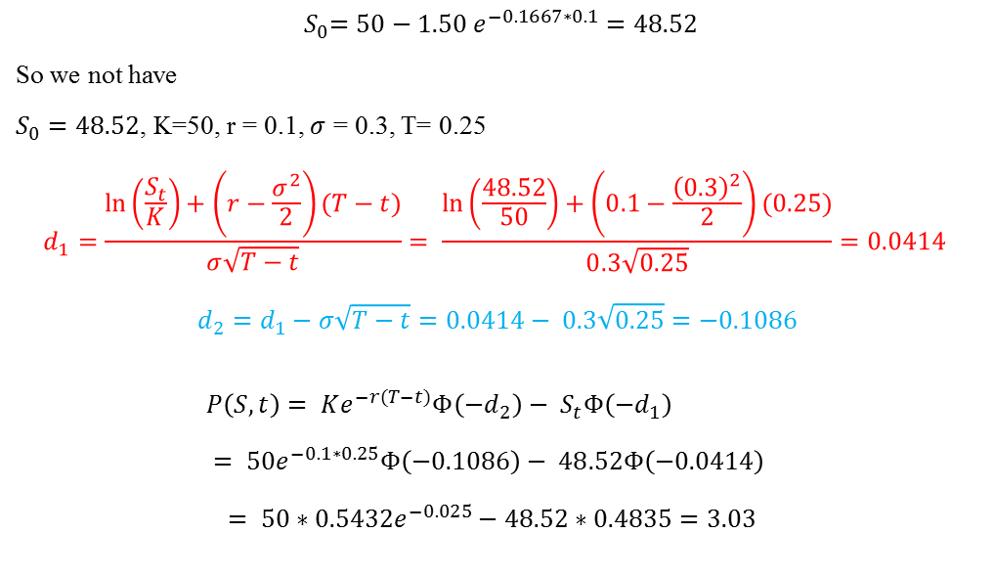
Ex) add a dividend
$${ S}_{0}=50−1.50 e^{−0.1667∗0.1}=48.52$$
So we not have
$S_{0}=48.52$, K=50, r = 0.1, $σ$ = 0.3, T= 0.25
$$d_{1}=\frac{\ln\left(\frac{S_{t}}{K}\right)+\left(r−\frac{σ^{2}}{2}\right)(T−t)}{σ\sqrt{T−t}}= \frac{\ln\left(\frac{48.52}{50}\right)+\left(0.1−\frac{{\left(0.3\right)}^{2}}{2}\right)(0.25)}{0.3\sqrt{0.25}}=0.0414$$
$$d_{2}=d_{1}−σ\sqrt{T−t}=0.0414− 0.3\sqrt{0.25}=−0.1086$$
$$P\left(S,t\right)= K{e^{−r(T−t)}Φ\left(−d_{2}\right)− S}_{t}Φ\left({−d}_{1}\right)$$
$$= 50e^{−0.1∗0.25}Φ\left(−0.1086\right)− 48.52Φ\left(−0.0414\right)$$
$$= 50{∗0.5432e}^{−0.025}− 48.52∗0.4835=3.03$$

Slide 4
Implied volatility
The implied volatility if the volatility that makes the Black-Scholes price of an option equal to its market price.
The market price will drive the “Black-Scholes” implied volatility.

Slide 5
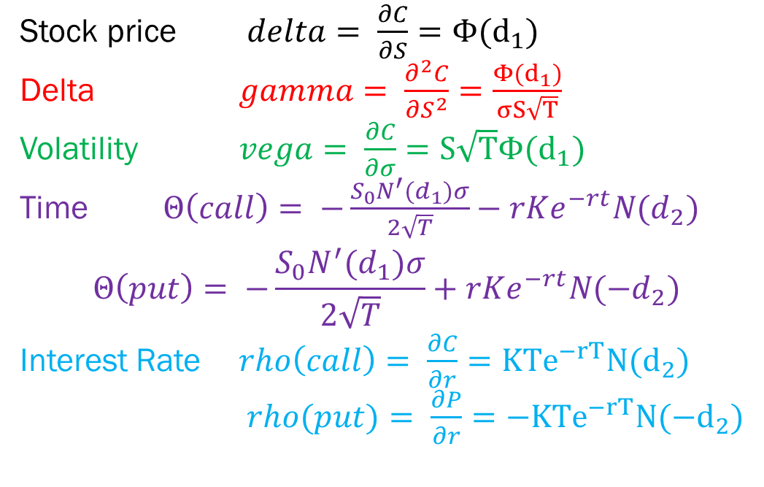
Recall the Greeks
Stock price $delta= \frac{∂C}{∂S}=Φ(d_{1})$
Delta $gamma= \frac{∂^{2}C}{∂S^{2}}=\frac{Φ(d_{1})}{σS\sqrt{T}}$
Volatility $vega= \frac{∂C}{∂σ}=S\sqrt{T}Φ(d_{1})$
Time $Θ\left(call\right)= −\frac{S_{0}N^{′}(d_{1})σ}{2\sqrt{T}}−rKe^{−rt}N(d_{2})$
$$Θ\left(put\right)= −\frac{S_{0}N^{′}(d_{1})σ}{2\sqrt{T}}+rKe^{−rt}N({−d}_{2})$$
Interest Rate $rho\left(call\right)= \frac{∂C}{∂r}=KTe^{−rT}N(d_{2})$
$rho(put)= \frac{∂P}{∂r}=−KTe^{−rT}N({−d}_{2})$

Slide 6
Delta Hedging
A delta of 0.7 means that, when the price of the stock increases(decreases) by a small amount, the price of the option increases(decreases) by 70% of the small amount.
A short position in 1000 options has a delta of -700 and can be made delta neutral with the purchase of 700 shares.

Slide 7
Real example misusing delta
The following data was real at the close on Wednesday December 15, 2010 for Citibank stock
Stock Price = $4.59 Delta = 0.05 Gamma = 0.466 Theta = -.00017
A Call Option that is expiring on Friday December 17, 2010 (2 days later) with a strike price of K=$5.00 was selling for 1 cent.
Suppose someone said to you: “Since Delta is 0.05, if the stock price went up $1 (from $4.59 to $5.59) then the Call Option price would go up 5 cents (from 1 cent to 6 cents)”

Slide 8
Gamma(delta of delta)
The gamma of an option position is the rate of change of the delta of the position with respect to the asset price.
For example, if the gamma is 0.1 would indicate that when the asset price increases by a certain small amount, delta increases by 0.1 of that small amount.

