Slide 1
Brownian Motion for Financial Engineers
Brownian motion
Wiener processes

Slide 2
A process
A process is an event that evolved over time intending to achieve a goal.
Generally the time period is from 0 to T.
During this time, events may be happening at various points along the way that may have an effect on the eventual value of the process.
Example) A Baseball game

Slide 3
Stochastic Process
Formally, a process that can be described by the change of some random variable over time, which may be either discrete or continuous.

Slide 4
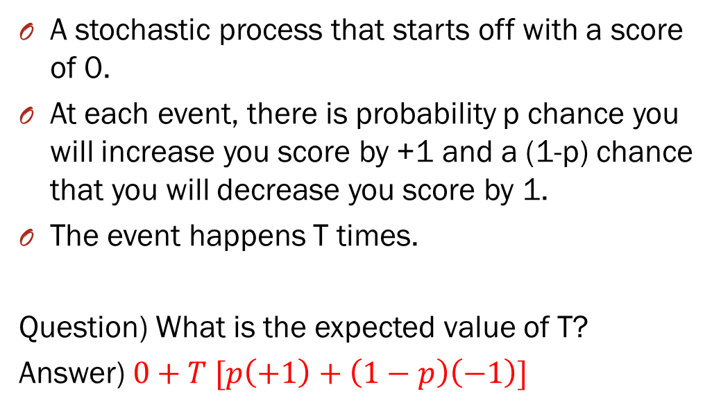
Random Walk
A stochastic process that starts off with a score of 0.
At each event, there is probability p chance you will increase you score by +1 and a (1-p) chance that you will decrease you score by 1.
The event happens T times.
Question) What is the expected value of T?
Answer) $0+T [p\left(+1\right)+\left(1−p\right)\left(−1\right)]$

Slide 5
Markov Process
A Markov process is a particular type of stochastic process where only the present value of a variable is relevant for predicting the future.
The history of the variable and the way that the present has emerged from the past are irrelevant.

Slide 6
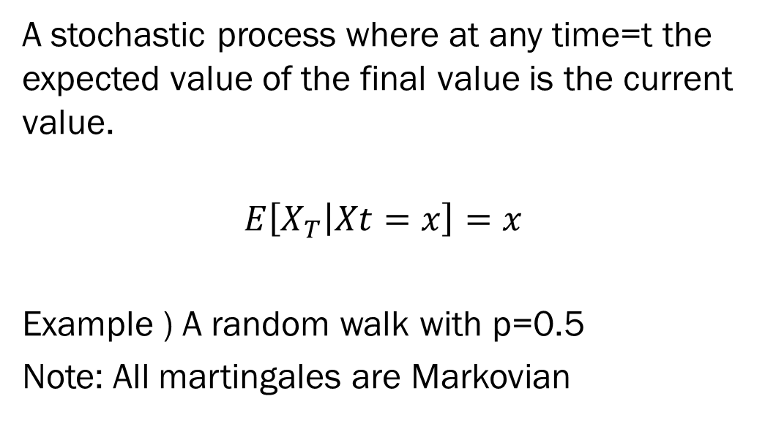
Martingale Process
A stochastic process where at any time=t the expected value of the final value is the current value.
$$E\left[X_{T} | Xt=x\right]=x$$
Example ) A random walk with p=0.5
Note: All martingales are Markovian

Slide 7
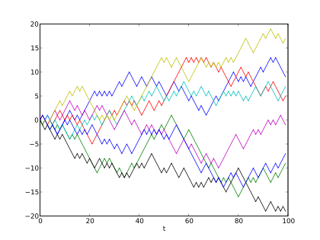
Ex) Random walks which are Markovian Martingales

Slide 8
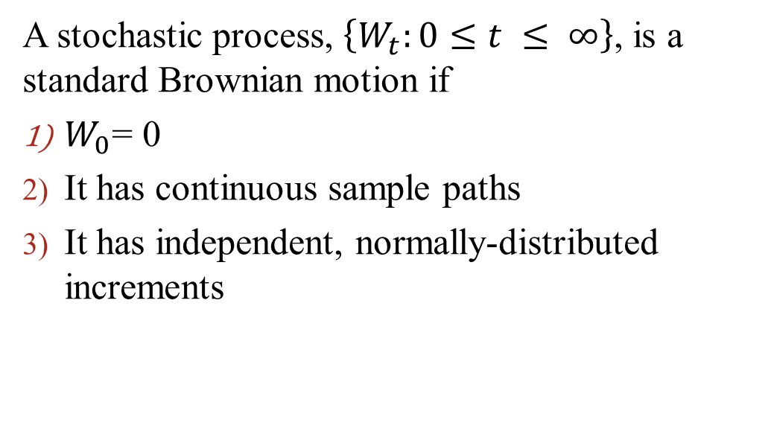
Brownian Motion
A stochastic process, $\left\{W_{t}:0≤t ≤ ∞\right\}$, is a standard Brownian motion if
$W_{0}$= 0
It has continuous sample paths
It has independent, normally-distributed increments

Slide 9
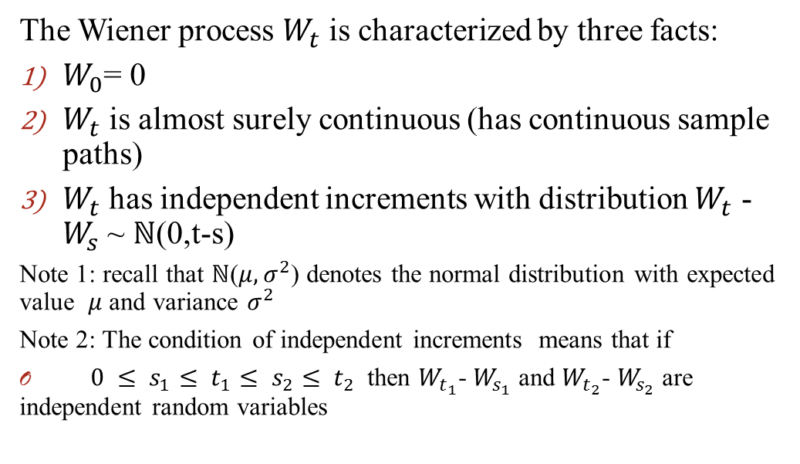
Wiener Process
The Wiener process $W_{t}$ is characterized by three facts:
$W_{0}$= 0
$W_{t}$ is almost surely continuous (has continuous sample paths)
$W_{t}$ has independent increments with distribution $W_{t}$ - $W_{s}$ ~ $ℕ$(0,t-s)
Note 1: recall that $ℕ$($μ,σ^{2}$) denotes the normal distribution with expected value $μ$ and variance $σ^{2}$
Note 2: The condition of independent increments means that if
$0 ≤ s_{1}≤ t_{1}≤ s_{2}≤ t_{2}$ then $W_{t_{1}}$- $W_{s_{1}}$ and $W_{t_{2}}$- $W_{s_{2}}$ are independent random variables

Slide 10
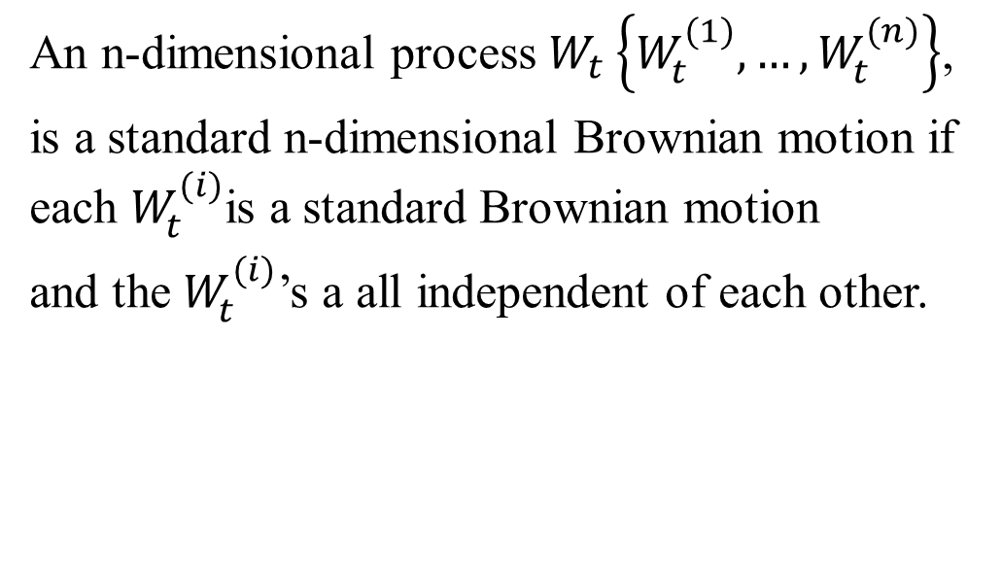
N-dimensional Brownian Motion
An n-dimensional process $W_{t}\left\{W_{t}^{(1)}, …, W_{t}^{(n)}\right\}$,
is a standard n-dimensional Brownian motion if each $W_{t}^{(i)}$is a standard Brownian motion
and the $W_{t}^{(i)}$’s a all independent of each other.

Slide 11
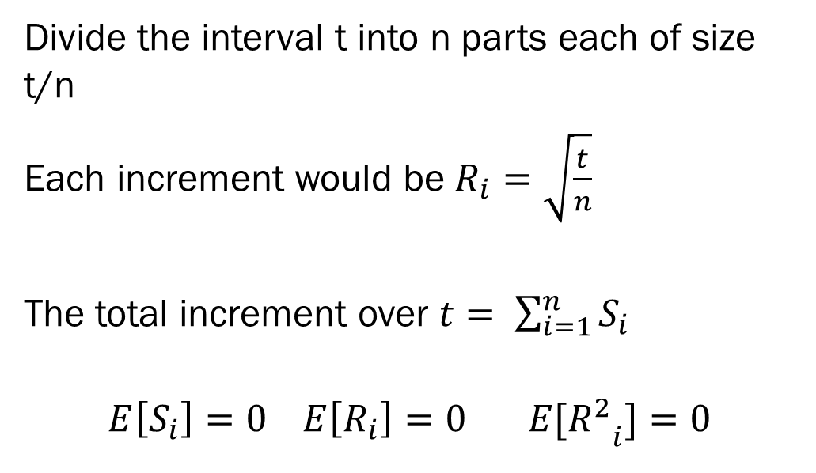
Random Walk with normal increments and n time per t
Divide the interval t into n parts each of size t/n
Each increment would be $R_{i}=\sqrt{\frac{t}{n}}$
The total increment over $t= \sum_{i=1}^{n}{S_{i}}$
$$E\left[S_{i}\right]=0 E\left[R_{i}\right]=0 E[{R_{}^{2}}_{i}]=0$$

Slide 12
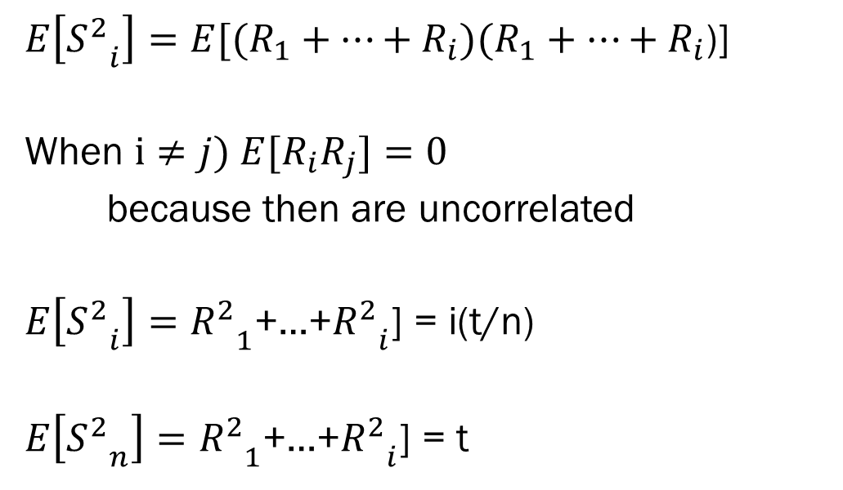
Continuing
$E\left[{S_{}^{2}}_{i}\right]=E[(R_{1}+…+R_{i})(R_{1}+…+R_{i}$)]
When $i≠j) E[R_{i}R_{j}]=0$
because then are uncorrelated
$E\left[{S_{}^{2}}_{i}\right]={R_{}^{2}}_{1}$+…+${R_{}^{2}}_{i}$] = i(t/n)
$E\left[{S_{}^{2}}_{n}\right]={R_{}^{2}}_{1}$+…+${R_{}^{2}}_{i}$] = t

Slide 13
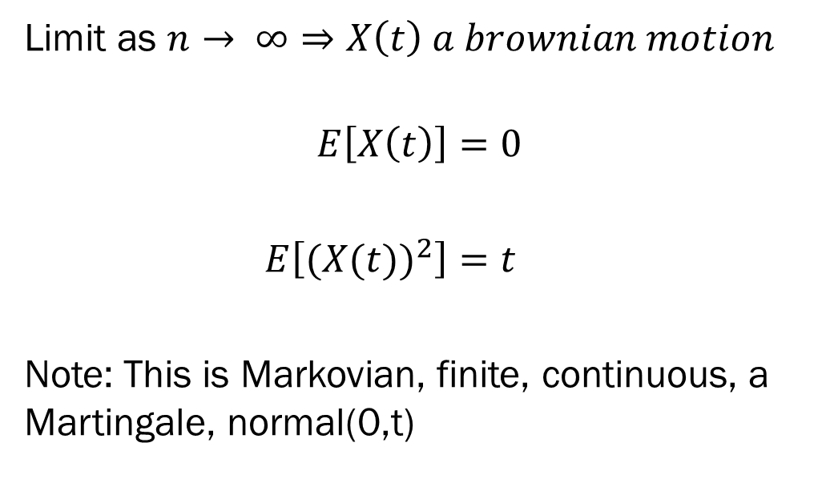
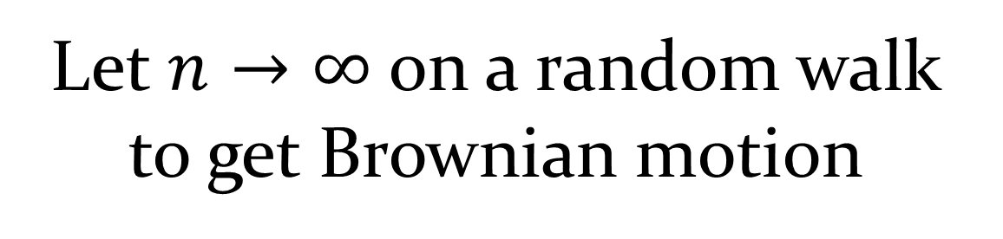
Let $n→∞$ on a random walk to get Brownian motion
Limit as $n→ ∞⇒X\left(t\right) a brownian motion$
$$E\left[X\left(t\right)\right]=0$$
$E\left[{(X(t))}^{2}\right]=t$
Note: This is Markovian, finite, continuous, a Martingale, normal(0,t)

Slide 14
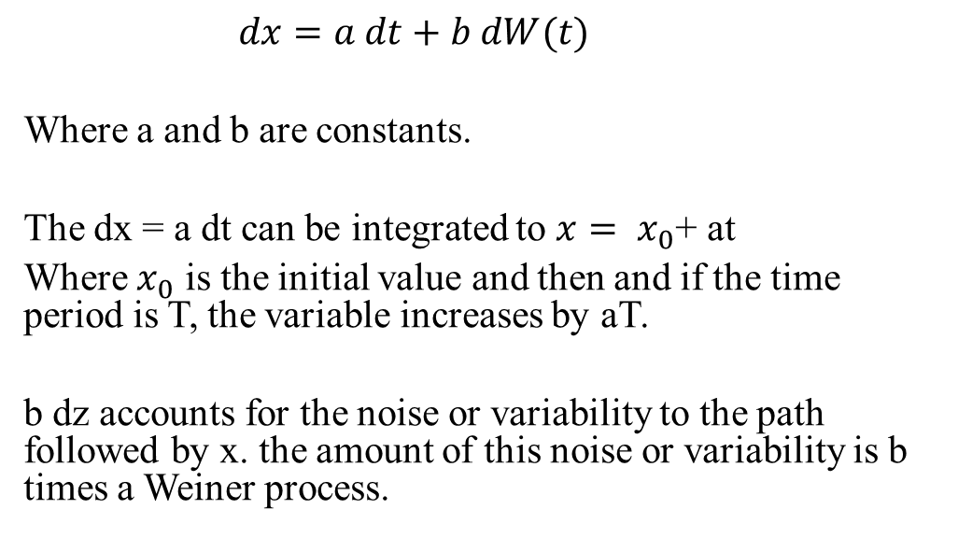
Wiener process with Drift
$$dx=a dt+b dW(t)$$
Where a and b are constants.
The dx = a dt can be integrated to $x= x_{0}$+ at
Where $x_{0}$ is the initial value and then and if the time period is T, the variable increases by aT.
b dz accounts for the noise or variability to the path followed by x. the amount of this noise or variability is b times a Weiner process.

