Slide 1
Data Science
introduction

Slide 2
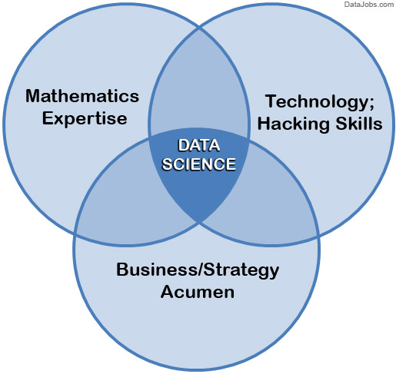
What is Data Science?
Data science is a "concept to unify statistics, data analysis and their related methods" in order to "understand and analyze actual phenomena" with data.^{[3]} It employs techniques and theories drawn from many fields within the broad areas of mathematics, statistics, information science, and computer science, in particular from the subdomains of:
- machine learning (computers learn without being explicitly programmed)
- classification (identifying sets and categories)
- cluster analysis (grouping sets of objects into clusters that have similar properties)
- data mining (discovering patterns in large datasets)
- databases (organized collection of data)
- visualization (representation of data, graphs, plots etc.)

Slide 3
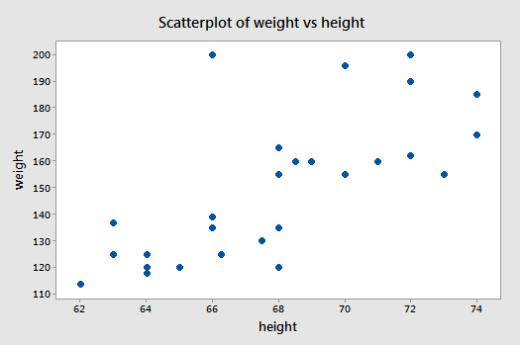
Linear Regression (Machine Learning)
Other questions Linear Regression can guess at.
What will the temperature be in 3 days?
What will my sales be next quarter?
What will the price of a stock be tomorrow

Slide 4
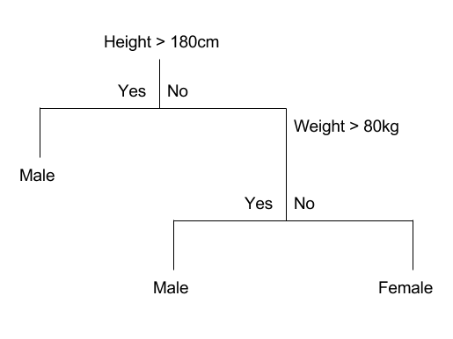
Decision Tree (Machine Learning)

Slide 5
Abnormal events or behavior
Purchases on credit cards that are not consistent with previous purchases.
- outside your usual price range
- outside your usual radius of purchasing area
- outside your usual gap if time between purchases

Slide 6
Which is better (or Which will happen)?
Which is would customers like more? “25% off” or “buy one get one free”
If the stock price of coke goes up? Will the price of Pepsi go up, down, unchanged?

Slide 7
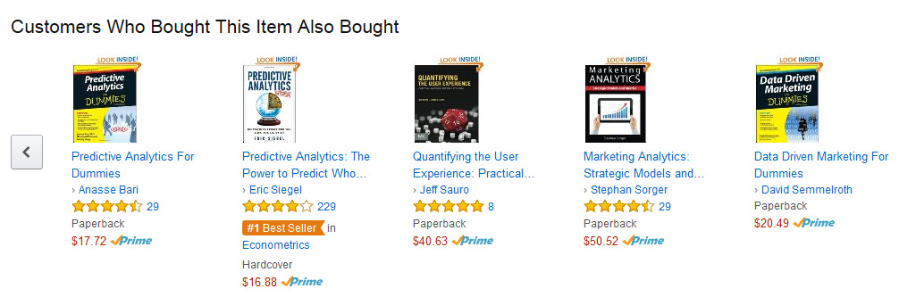
Clustering Algorithms
Which viewers like the same types of Movies?
Walmart – Beer and Diapers on Friday story

Slide 8
Answering a specific question?
What will happen to the stock price next week? May go up, may go down, may stay the same
What will the stock price be next week? (Data must include stock price history to predict)
Which stock is the best to buy for the next week?
What will the effect on derivatives be on changes in stock prices?
What stocks are correlated to each other?
How will changes in correlated stocks effect derivatives?

Slide 9
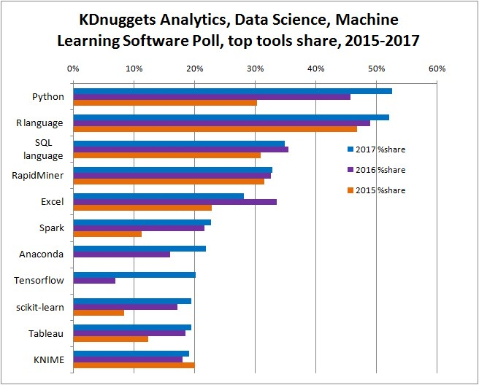
Popular Tools for Data Science

Slide 10
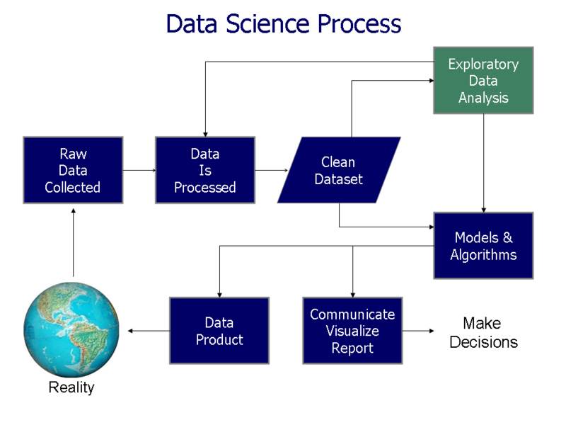
Data Science Process

