Slide 1
Applications Of Ito’s Lemma

Slide 2
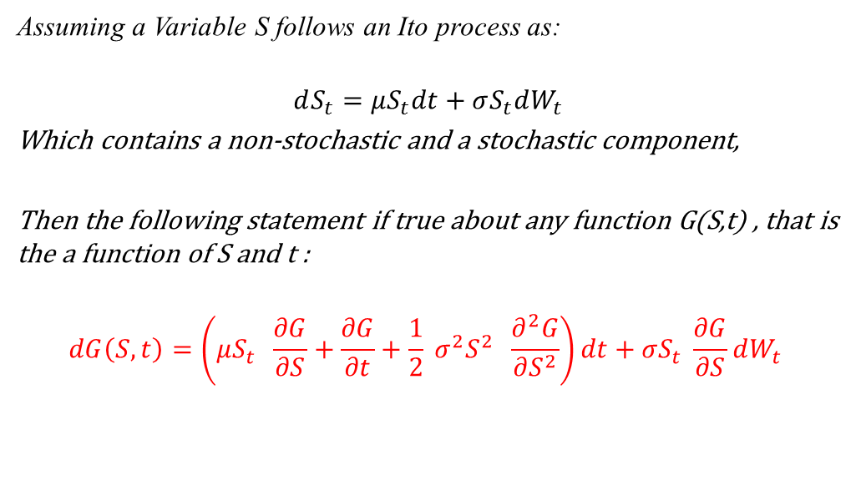
Recall Ito’s lemma
Assuming a Variable S follows an Ito process as:
$$dS_{t}=μS_{t}dt+σS_{t}dW_{t}$$
Which contains a non-stochastic and a stochastic component,
Then the following statement if true about any function G(S,t) , that is the a function of S and t :
$$dG\left(S,t\right)=\left(μS_{t} \frac{∂G}{∂S}+\frac{∂G}{∂t}+\frac{1}{2} σ^{2}S^{2} \frac{∂^{2}G}{∂S^{2}}\right)dt+σS_{t} \frac{∂G}{∂S}dW_{t}$$

Slide 3
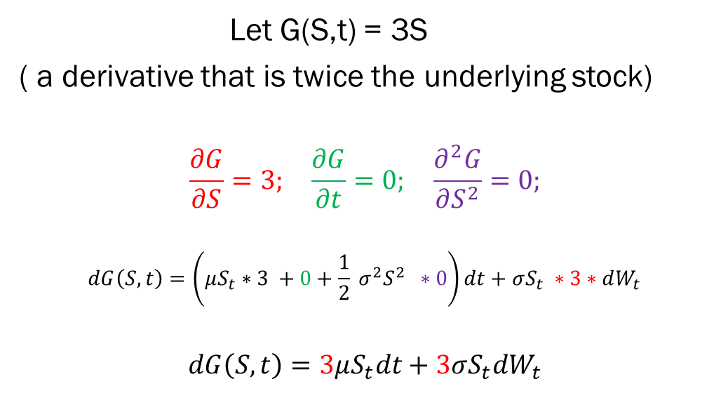
Ex1) Ito’s lemma (Triple stock)
Let G(S,t) = 3S
( a derivative that is twice the underlying stock)
$$\frac{∂G}{∂S}=3; \frac{∂G}{∂t}=0; \frac{∂^{2}G}{∂S^{2}}=0;$$
$$dG\left(S,t\right)=\left(μS_{t}∗3 +0+\frac{1}{2} σ^{2}S^{2} ∗0\right)dt+σS_{t} ∗3∗dW_{t}$$
$$dG\left(S,t\right)=3μS_{t}dt+3σS_{t}dW_{t}$$

Slide 4
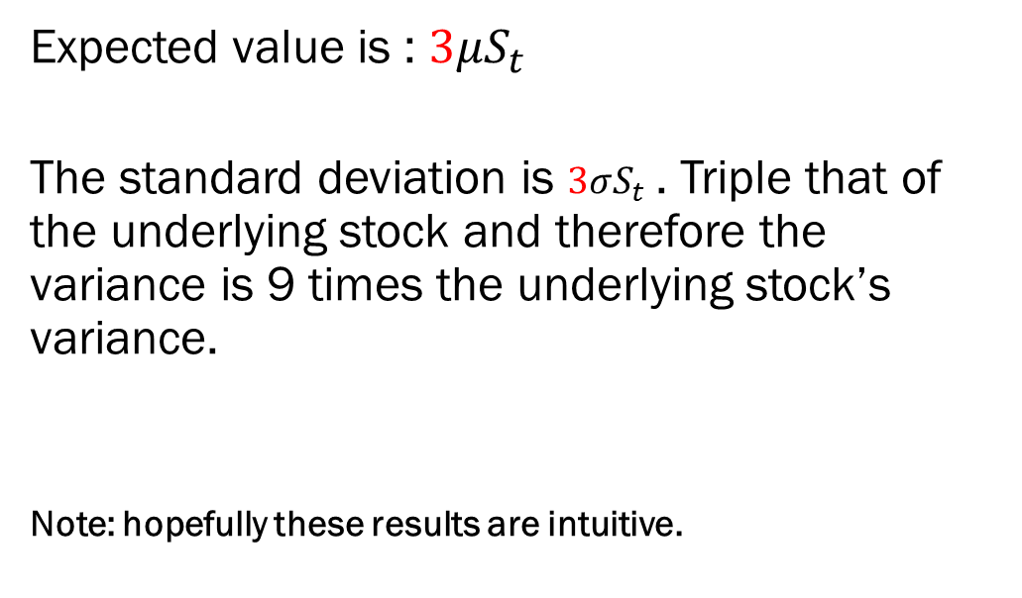
Ex1) Triple stock analysis
Expected value is : $3μS_{t}$
The standard deviation is $3σS_{t}$. Triple that of the underlying stock and therefore the variance is 9 times the underlying stock’s variance.
Note: hopefully these results are intuitive.

Slide 5
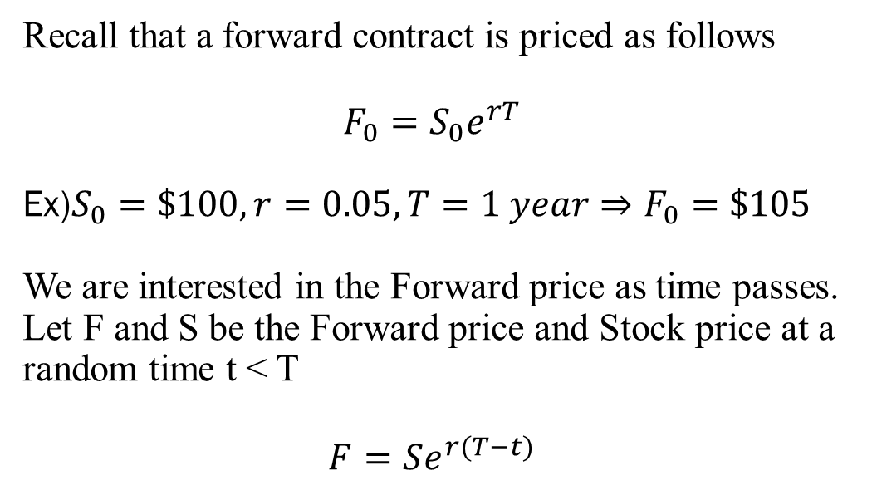
Ex2) Ito’s lemma (Forward)

Slide 6
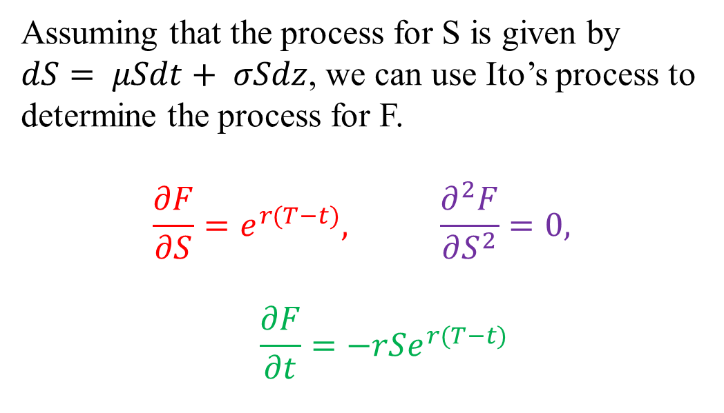
Partial derivatives of Forwards

Slide 7
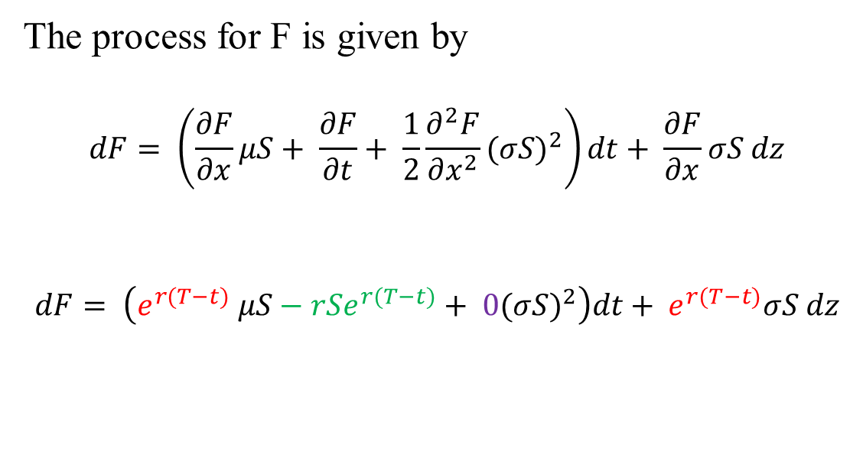
Ito process for Forwards
The process for F is given by
$$dF= \left(\frac{∂F}{∂x}μS+ \frac{∂F}{∂t}+ \frac{1}{2}\frac{∂^{2}F}{∂x^{2}}{(σS)}^{2}\right)dt+ \frac{∂F}{∂x}σS dz$$
$$dF= \left(e^{r(T−t)} μS−rSe^{r(T−t)}+ 0{(σS)}^{2}\right)dt+ e^{r(T−t)}σS dz$$

Slide 8
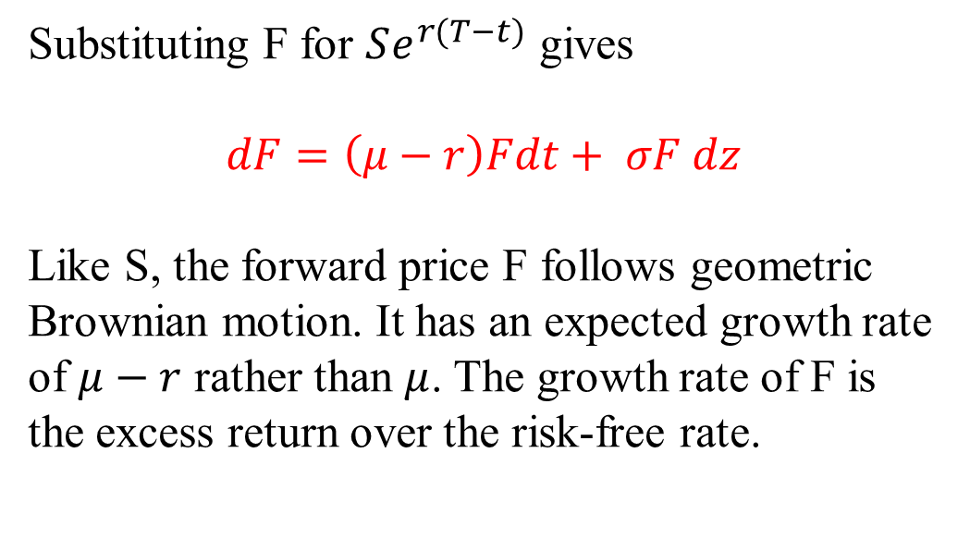
Forward process formula

Slide 9
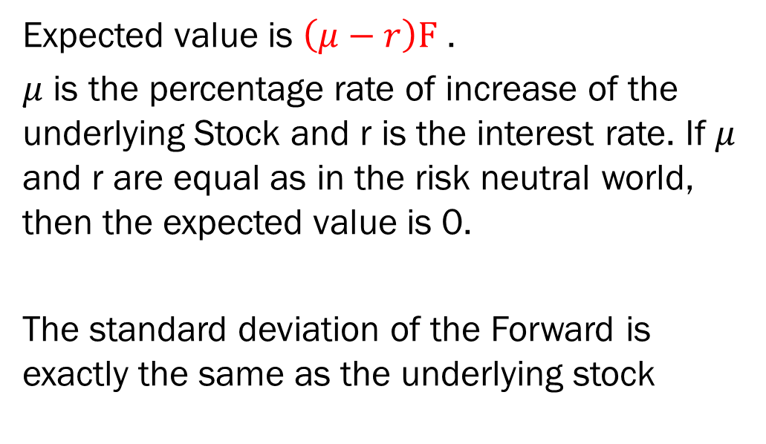
Analysis of Forward Process
Expected value is $\left(μ−r\right)F$ .
$μ$ is the percentage rate of increase of the underlying Stock and r is the interest rate. If $μ$ and r are equal as in the risk neutral world, then the expected value is 0.
The standard deviation of the Forward is exactly the same as the underlying stock

Slide 10
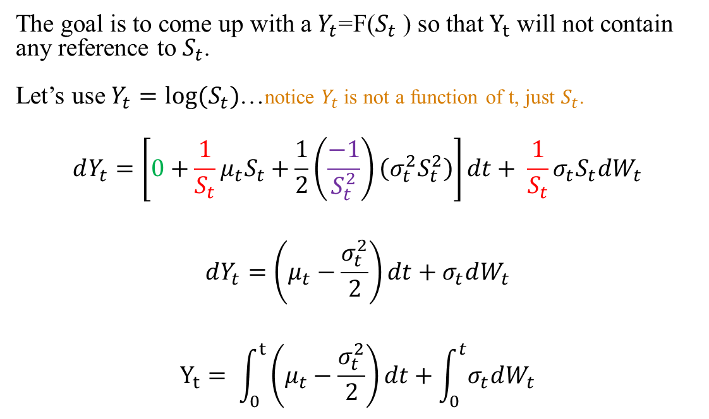
Ex) Lognormal Process
The goal is to come up with a $Y_{t}$=F($S_{t}$ ) so that $Y_{t}$ will not contain any reference to $S_{t}$.
Let’s use $Y_{t}=log⁡(S_{t})$…notice $Y_{t}$ is not a function of t, just $S_{t}$.
$$dY_{t}=\left[0+\frac{1}{S_{t}}μ_{t}S_{t}+\frac{1}{2}\left(\frac{−1}{S_{t}^{2}}\right)\left(σ_{t}^{2}S_{t}^{2}\right)\right]dt+ \frac{1}{S_{t}}σ_{t}S_{t}dW_{t}$$
$$dY_{t}=\left(μ_{t}−\frac{σ_{t}^{2}}{2}\right)dt+σ_{t}dW_{t}$$
$$Y_{t}= \int_{0}^{t}{\left(μ_{t}−\frac{σ_{t}^{2}}{2}\right)dt}+\int_{0}^{t}{σ_{t}dW_{t}}$$

Slide 11
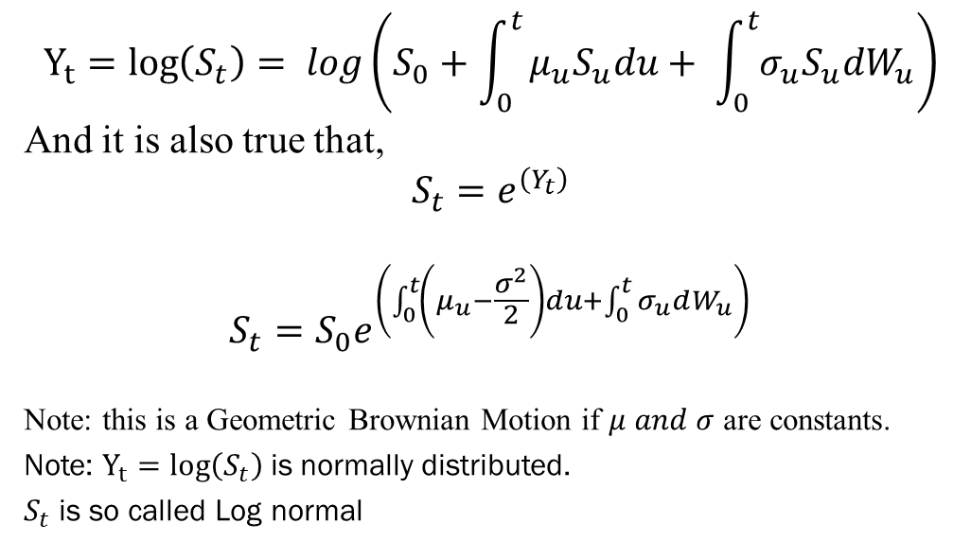
Ex) Lognormal Process
$$Y_{t}=log\left(S_{t}\right)= log\left(S_{0}+\int_{0}^{t}{μ_{u}S_{u}du+ \int_{0}^{t}{σ_{u}S_{u}dW_{u}}}\right)$$
And it is also true that,
$$S_{t}=e^{\left(Y_{t}\right)}$$
$$S_{t}=S_{0}e^{\left(\int_{0}^{t}{\left(μ_{u}−\frac{σ^{2}}{2}\right)}du+\int_{0}^{t}{σ_{u}dW_{u}}\right)}$$
Note: this is a Geometric Brownian Motion if $μ and σ$ are constants.
Note: $Y_{t}=log\left(S_{t}\right)$is normally distributed.
$S_{t}$ is so called Log normal

