Slide 1
Ito’s Lemma
Geometric Brownian Motion
Ito processes
Ito’s lemma

Slide 2
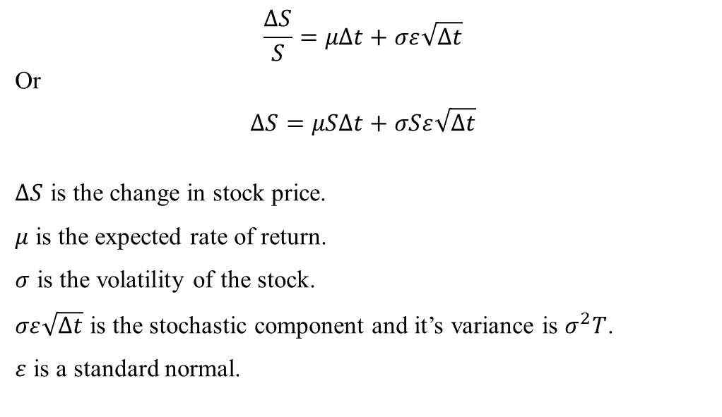
Geometric Brownian Motion

Slide 3
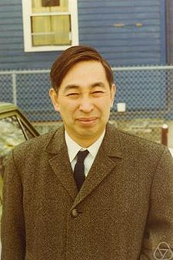
Kiyoshi Ito
Kiyoshi Itō (伊藤 清, Itō Kiyoshi?) (September 7, 1915 – 10 November 2008) was a Japanese mathematician whose work is now called Itō calculus. The basic concept of this calculus is the Itō integral, and among the most important results is Itō's lemma. The Itō calculus facilitates mathematical understanding of random events. His theory is widely applied in various fields, and is perhaps best known for its use in financial mathematics.

Slide 4
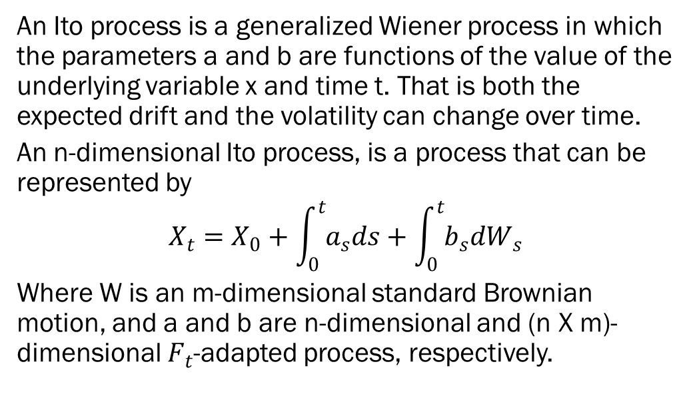
Ito Process

Slide 5
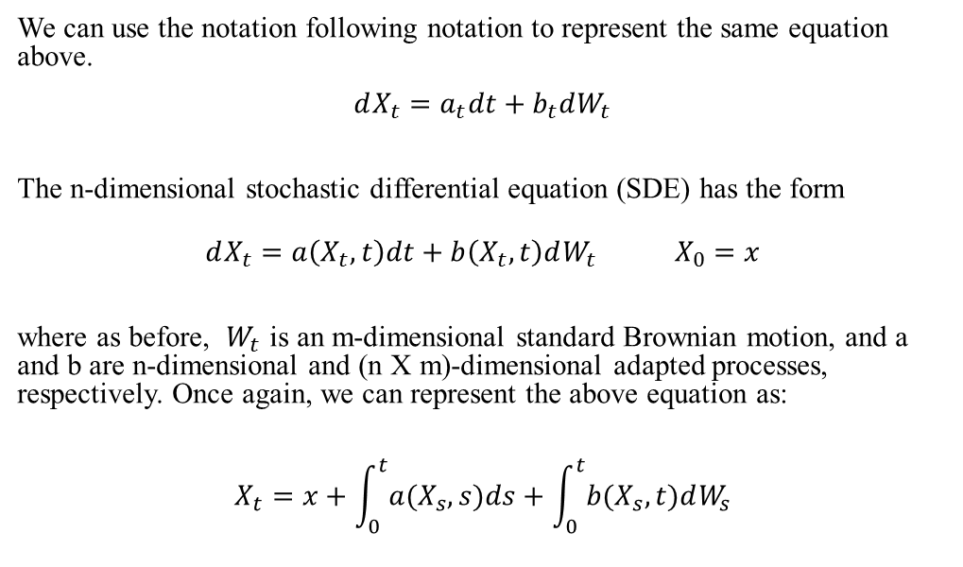
Ito’s Process continued

Slide 6
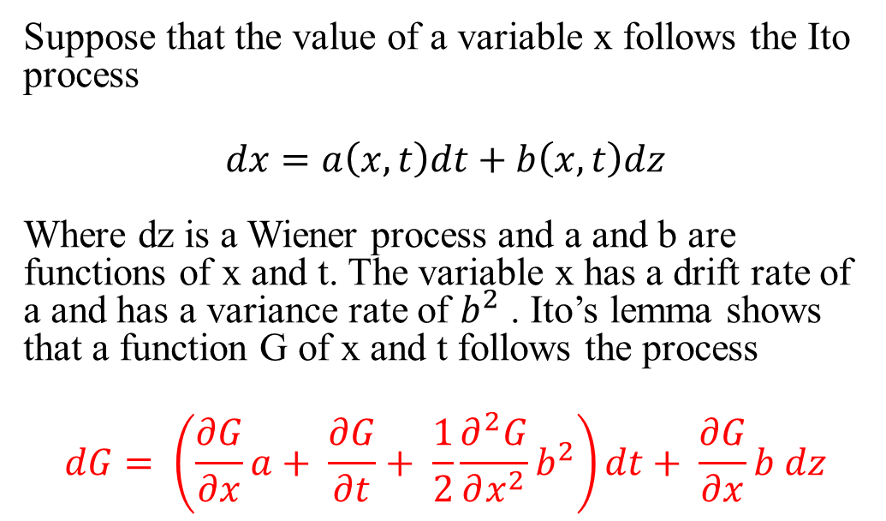
Ito’s Lemma

Slide 7
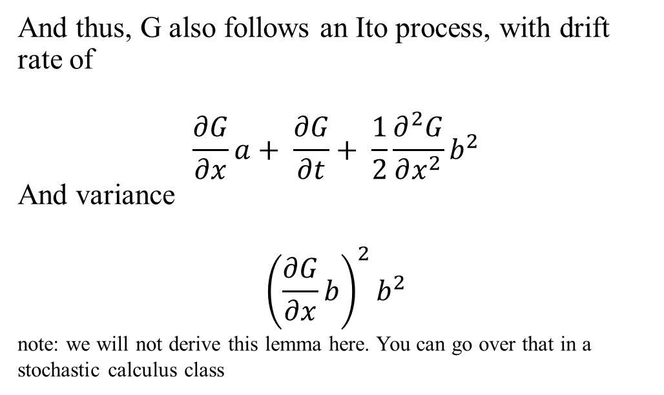
Ito Drift and Variance

Slide 8
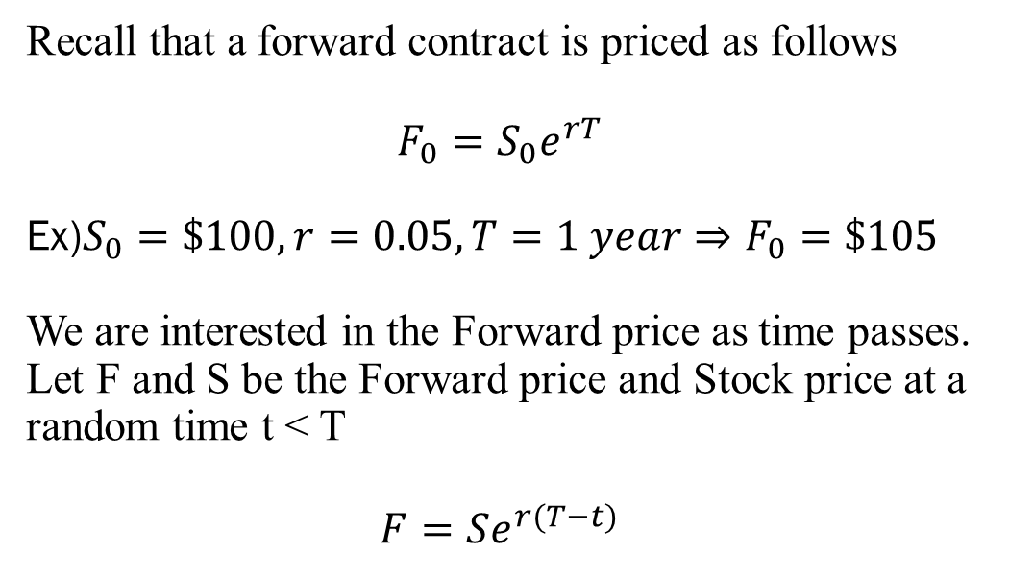
Ito’s lemma on a Forward

Slide 9
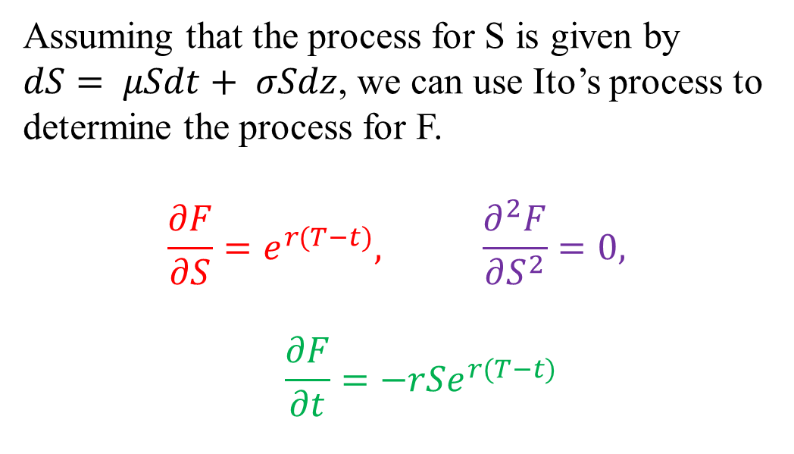
Partial derivatives of F

Slide 10
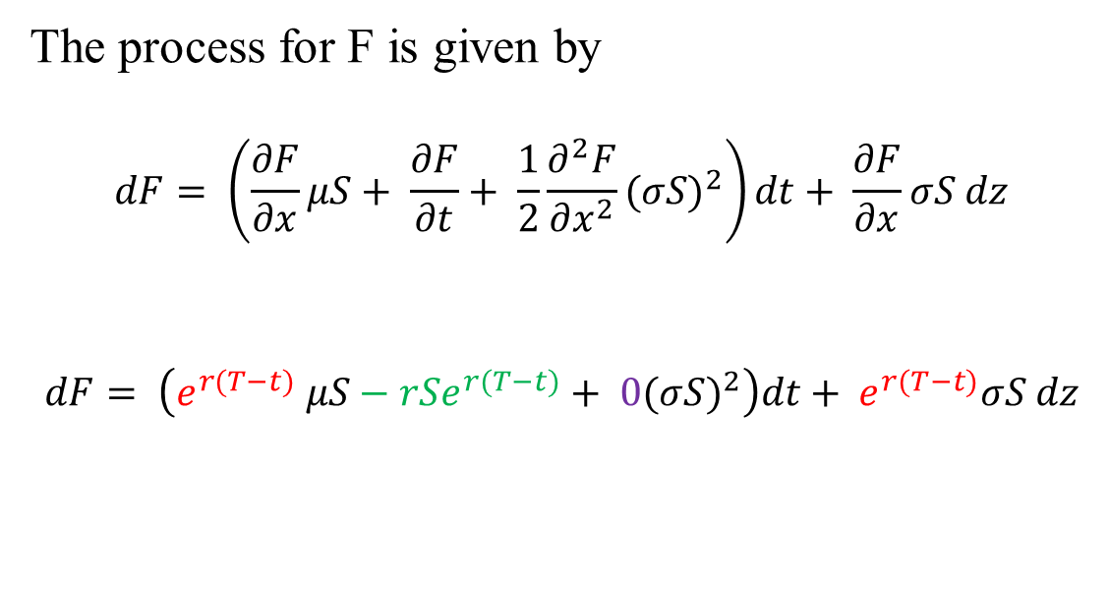
Ito process for F
The process for F is given by
$$dF= \left(\frac{∂F}{∂x}μS+ \frac{∂F}{∂t}+ \frac{1}{2}\frac{∂^{2}F}{∂x^{2}}{(σS)}^{2}\right)dt+ \frac{∂F}{∂x}σS dz$$
$$dF= \left(e^{r(T−t)} μS−rSe^{r(T−t)}+ 0{(σS)}^{2}\right)dt+ e^{r(T−t)}σS dz$$

Slide 11
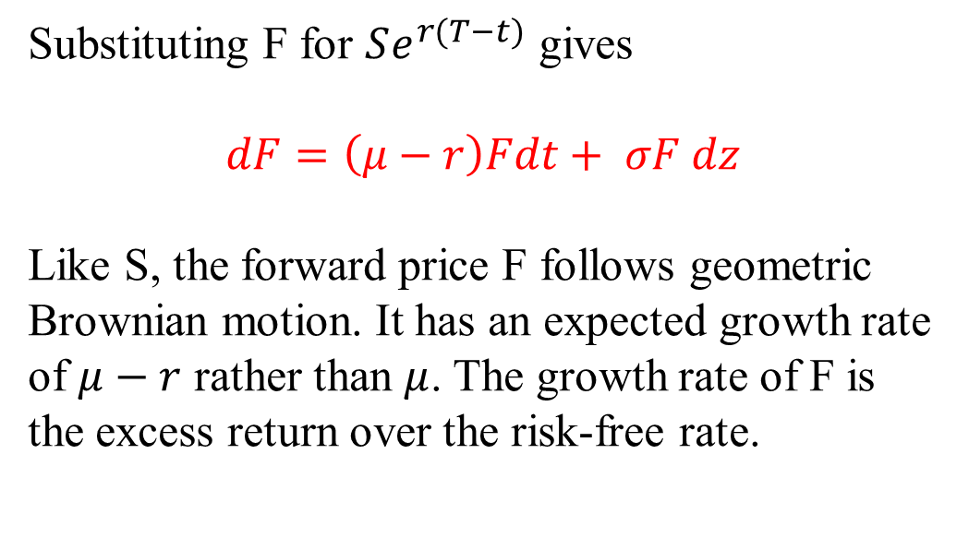
Forward process formula

