Slide 1
Linear Regression
For Big Data sets and Data Science Applications

Slide 2

Average(Mean) and Median
Suppose we have 3 numbers and wanted to know the mean and median?
3, 2, 10
Mean: add them up and divide by n $\frac{\sum{3+2+10}}{3}$ = 5
Median: sort the numbers to get (2,3,10) and pick the middle number to get 3

Slide 3
Finding the mean (sum distances = 0)
Given the numbers (3,2,10) Guess at the mean: 3 (maybe the median is the mean)
Sum the difference from all values to the guessed value:
(3-3) + (2-3) + (10-3) = 0 -1 +7 = +6
- Guess again: 4 and sum (3-4) + (2-4) + (10-4) = -1 -2 +6 = +3
- Guess again: 5 and sum (3-5) + (2-5) + (10-5) = -2 -3 +5 = 0 ← minimal difference = mean
- Guess again: 6 and sum (3-6) + (2-6) + (10-6) = -3 -4 +4 = -3
- Guess again: 7 and sum (3-7) + (2-7) + (10-7) = -4 -5 +3 = -6
We started with a guess of 3, then made progress guessing toward 5, then after 5 our guess regressed away from the minimal value
We are assuming integer values only.

Slide 4
Finding the median (sum |distances|)
Given the numbers (3,2,10) Guess at the mean: 3 (maybe the median is the mean)
Sum the difference from all values to the guessed value:
|(3-3)| + |(2-3)| + |(10-3)| = |0| +|-1| +|+7| = 8
- Guess again: 4 and sum |(3-4)| + |(2-4)| + |(10-4)| = |-1| +|-2| +|+6| = 9
- Guess again: 5 and sum |(3-5)| + |(2-5)| + |(10-5)| = |-2| +|-3| +|+5| = 10
- Guess again: 2 and sum |(3-2)| + |(2-2)| + |(10-2)| = |-1| +|0| +|+9| = 9 ← regressing
We are assuming integer values only.

Slide 5
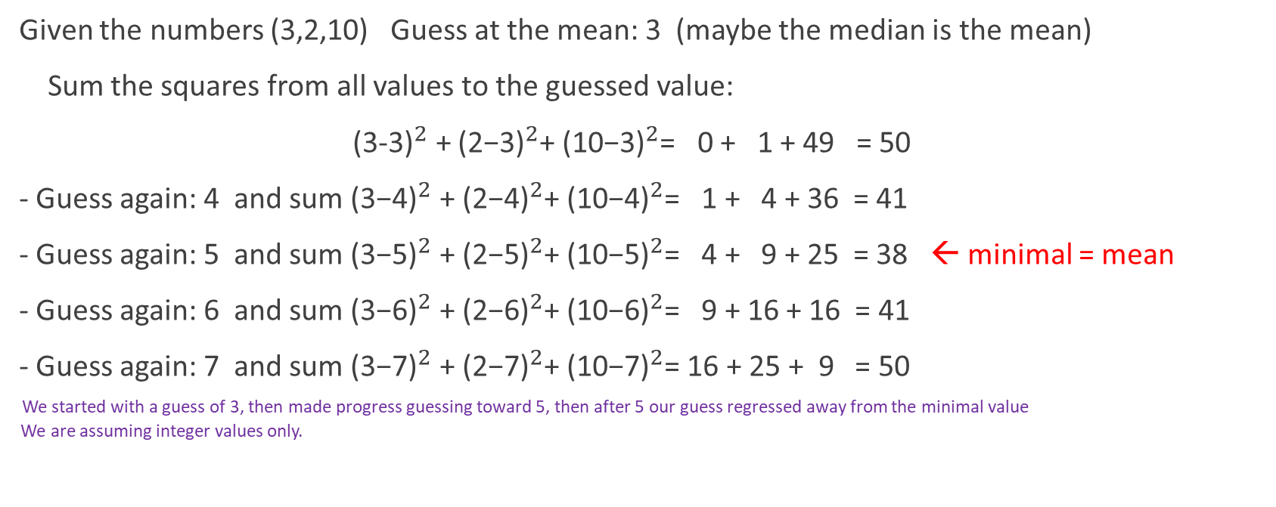
Finding the mean (least sum of squares)
Given the numbers (3,2,10) Guess at the mean: 3 (maybe the median is the mean)
Sum the squares from all values to the guessed value:
${\text{(3-3)}}^{2}$ + ${\text{(}\text{2}\text{−3)}}^{2}$+ ${\text{(}\text{10}\text{−3)}}^{2}$= 0 + 1 + 49 = 50
- Guess again: 4 and sum ${\text{(3−}\text{4}\text{)}}^{2}$ + ${\text{(}\text{2}\text{−}\text{4}\text{)}}^{2}$+ ${\text{(}\text{10}\text{−}\text{4}\text{)}}^{2}$= 1 + 4 + 36 = 41
- Guess again: 5 and sum ${\text{(3−}\text{5}\text{)}}^{2}$ + ${\text{(}\text{2}\text{−}\text{5}\text{)}}^{2}$+ ${\text{(}\text{10}\text{−}\text{5}\text{)}}^{2}$= 4 + 9 + 25 = 38 ← minimal = mean
- Guess again: 6 and sum ${\text{(3−}\text{6}\text{)}}^{2}$ + ${\text{(}\text{2}\text{−}\text{6}\text{)}}^{2}$+ ${\text{(}\text{10}\text{−}\text{6}\text{)}}^{2}$= 9 + 16 + 16 = 41
- Guess again: 7 and sum ${\text{(3−}\text{7}\text{)}}^{2}$ + ${\text{(}\text{2}\text{−}\text{7}\text{)}}^{2}$+ ${\text{(}\text{10}\text{−}\text{7}\text{)}}^{2}$= 16 + 25 + 9 = 50
We started with a guess of 3, then made progress guessing toward 5, then after 5 our guess regressed away from the minimal value
We are assuming integer values only.

Slide 6
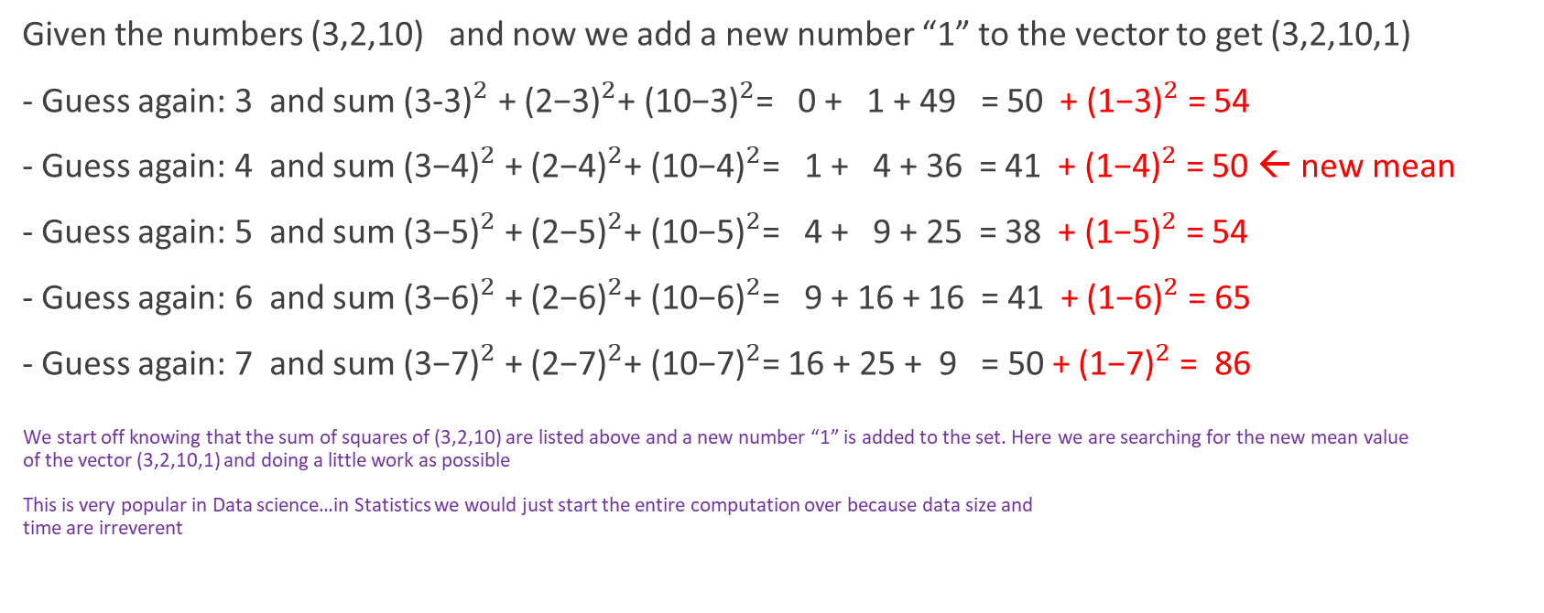
Finding new mean (least sum of squares)
Given the numbers (3,2,10) and now we add a new number “1” to the vector to get (3,2,10,1)
- Guess again: 3 and sum ${\text{(3-3)}}^{2}$ + ${\text{(}\text{2}\text{−3)}}^{2}$+ ${\text{(}\text{10}\text{−3)}}^{2}$= 0 + 1 + 49 = 50 + ${\text{(}\text{1}\text{−3)}}^{2}$ = 54
- Guess again: 4 and sum ${\text{(3−}\text{4}\text{)}}^{2}$ + ${\text{(}\text{2}\text{−}\text{4}\text{)}}^{2}$+ ${\text{(}\text{10}\text{−}\text{4}\text{)}}^{2}$= 1 + 4 + 36 = 41 + ${\text{(}\text{1}\text{−}\text{4}\text{)}}^{2}$ = 50 ← new mean
- Guess again: 5 and sum ${\text{(3−}\text{5}\text{)}}^{2}$ + ${\text{(}\text{2}\text{−}\text{5}\text{)}}^{2}$+ ${\text{(}\text{10}\text{−}\text{5}\text{)}}^{2}$= 4 + 9 + 25 = 38 + ${\text{(}\text{1}\text{−}\text{5}\text{)}}^{2}$ = 54
- Guess again: 6 and sum ${\text{(3−}\text{6}\text{)}}^{2}$ + ${\text{(}\text{2}\text{−}\text{6}\text{)}}^{2}$+ ${\text{(}\text{10}\text{−}\text{6}\text{)}}^{2}$= 9 + 16 + 16 = 41 + ${\text{(}\text{1}\text{−}\text{6}\text{)}}^{2}$ = 65
- Guess again: 7 and sum ${\text{(3−}\text{7}\text{)}}^{2}$ + ${\text{(}\text{2}\text{−}\text{7}\text{)}}^{2}$+ ${\text{(}\text{10}\text{−}\text{7}\text{)}}^{2}$= 16 + 25 + 9 = 50 + ${\text{(}\text{1}\text{−}\text{7}\text{)}}^{2}$ = 86
We start off knowing that the sum of squares of (3,2,10) are listed above and a new number “1” is added to the set. Here we are searching for the new mean value
of the vector (3,2,10,1) and doing a little work as possible
This is very popular in Data science…in Statistics we would just start the entire computation over because data size and
time are irreverent

Slide 7
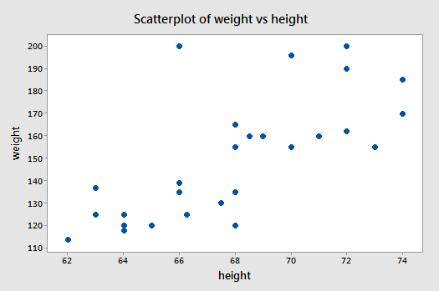
Linear Regression

