Slide 1
Probability Review for Financial Engineers
Part 1

Slide 2
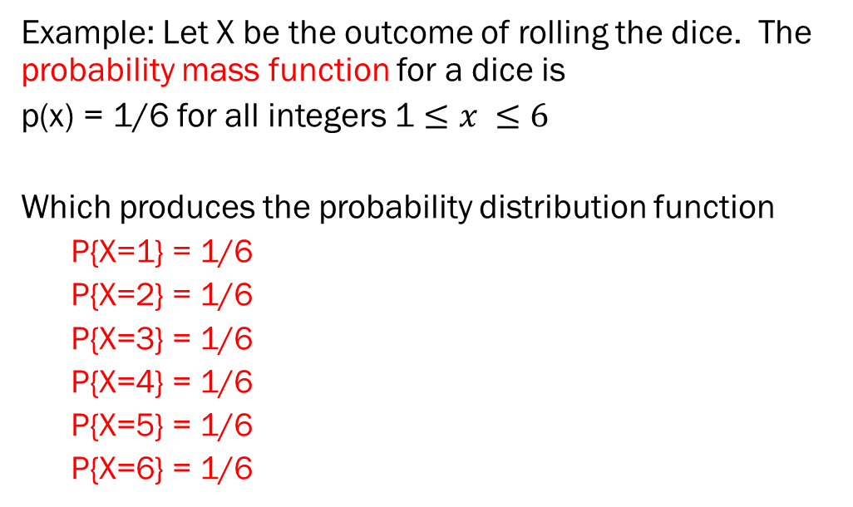
Example) Roll of a dice
Example: Let X be the outcome of rolling the dice. The probability mass function for a dice is
p(x) = 1/6 for all integers 1 $≤x ≤6$
Which produces the probability distribution function
  P{X=1} = 1/6
  P{X=2} = 1/6
  P{X=3} = 1/6
  P{X=4} = 1/6
  P{X=5} = 1/6
  P{X=6} = 1/6

Slide 3
Questions about a Probability distribution
Question: What is the probability that X is 2? Answer: Since this is a discrete case (integer outcomes), we can read this directly from the probability distribution function P{X=2} = 1/6.
Question: What is the probability that X is 2 or less?
Answer: We would sum up all probabilities from -∞ to 2, which would be 1/6 + 1/6 = 2/6

Slide 4
Expected Value
The expected value of a random variable E[X] =
The expected value of the outcome of a dice roll is
1(1/6) + 2(1/6) + 3(1/6) + 4(1/6) + 5(1//6) + 6(1/6) = 3.5

Slide 5
Variance

Slide 6
Standard Deviation
The square root of the variance
Generally symbolized with the Greek letter sigma σ
The expected value of how far a random event is from the expected value of the random event.

Slide 7
Variance Example 1a
A random variable comes out 50 every time
What is the expected value (mean value)? 50
What is the variance? 2500 – 2500 = 0
Note: …it doesn’t vary
What is the standard deviation?
0

Slide 8
Variance Example 1b
A random variable comes out 40 half the time and 60 half the time
What is the expected value?
[(1/2) 40 + (1/2) 60] = 50
What is the variance?
[(1/2)1600 + (1/2)(3600)] – 2500 = 100
What is the standard deviation?
10

Slide 9
Variance Example 1c
A random variable comes out 0 half the time and 100 half the time
What is the expected value?
(1/2) 0 + (1/2) 100 = 50
What is the variance?
[(1/2)0 + (1/2)(10,000)] – 2500 = 2500
What is the standard deviation?
50

Slide 10
Variance of Dice
What is the variance of a dice roll?
[1+4+9+16+25+36]/6 – 〖(3.5)〗^2
= 15.17 – 12.25 = 2.92

Slide 11
Cumulative distribution function (cdf)

Slide 12
Binomial Random Variable

Slide 13
Geometric random variable
The probability the first success will come on the i-th trial

Slide 14
Poisson Random Variable

Slide 15
Continuous Random Variable
The function f is called the probability density function.

Slide 16
Uniform Random Variable

Slide 17
Example) Uniform
A = 1 and b = 3

Slide 18
Exponential Distribution

Slide 19

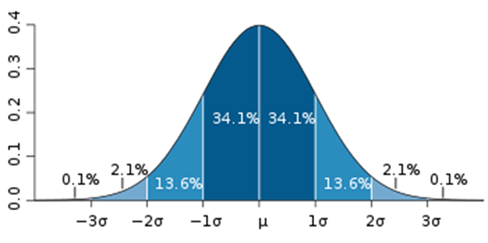
Normal (Gaussian) distribution

