Slide 1
Probability Review for Financial Engineers
Part 2

Slide 2
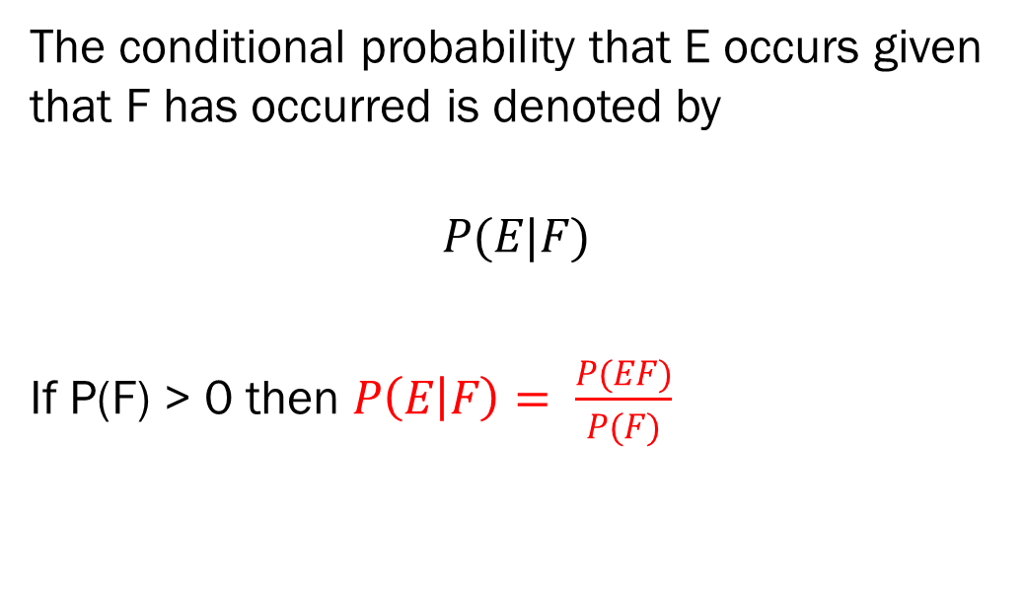
Conditional Probability
The conditional probability that E occurs given that F has occurred is denoted by
$$P(E|F)$$
If P(F) > 0 then $P\left(E | F\right)= \frac{P(EF)}{P(F)}$

Slide 3
Example – 2 dice
2 dice are rolled - a red dice and a green dice,
What is the probability distribution for the total?
2 - 1/36
3 - 2 * (1/36)
…
7 – 6 * (1/36)
…
11 – 2 (1/36)
12 – 1/36

Slide 4
2 Dice example continued
What is the expected value?
7
Ex) What is the probability distribution function for the total given that the Green dice was a 3, that is
P(T|G=3)
4 – 1/6
5 – 1/6
6 – 1/6
7 – 1/6
8 – 1/6
9 – 1/6

Slide 5
Example) Playing Cards
Selecting a card a standard 52 playing card deck
What is the probability of getting an ace?
4/52 = 1/13
What is the probability of getting a ace given that someone already removed a jack from the deck?
4/51 the removal of a jack means that a non-ace has been removed from the deck
What is the probability of getting an ace given that someone already removed a spade from the deck?
1/13 the removed cards suit is independent of the rank question.

Slide 6
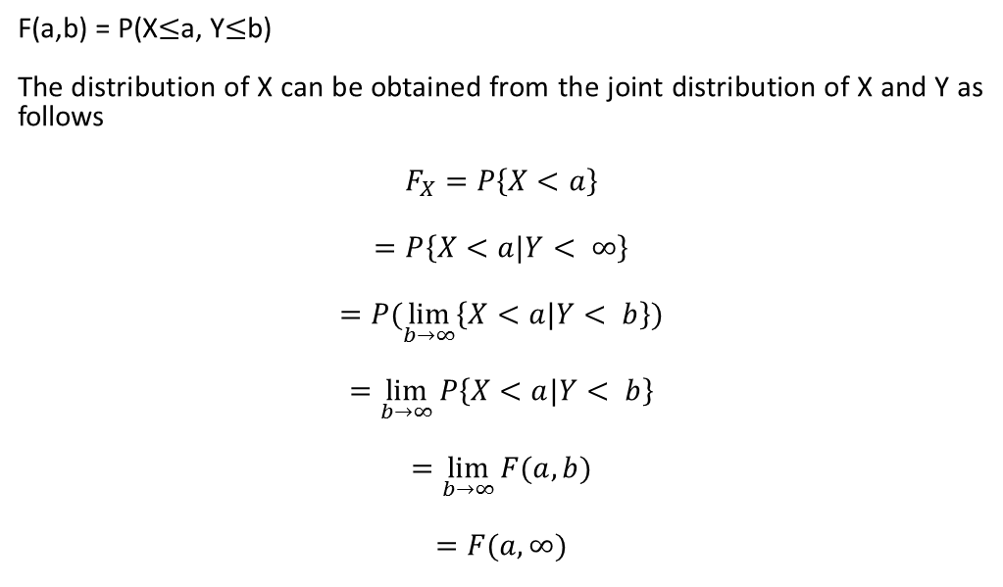
Joint Cumulative Distributions
F(a,b) = P(X$≤$a, Y$≤$b)
The distribution of X can be obtained from the joint distribution of X and Y as follows
$$F_{X}=P\left\{X<a\right\}$$
$$=P\left\{X<a|Y< ∞\right\}$$
$$=P(\lim_{b→∞}\left\{X<a|Y< b\right\})$$
$$=\lim_{b→∞}{P\left\{X<a|Y< b\right\}}$$
$$=\lim_{b→∞}{F(a,b)}$$
$$=F(a,∞)$$

Slide 7
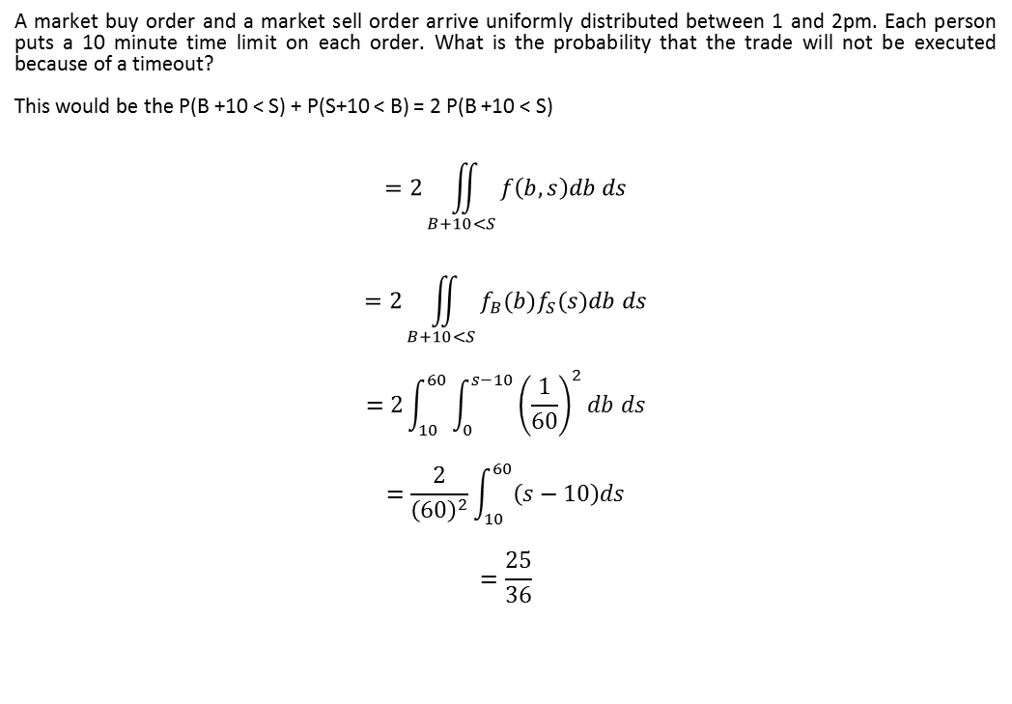
Example – Time between arrivals
A market buy order and a market sell order arrive uniformly distributed between 1 and 2pm. Each person puts a 10 minute time limit on each order. What is the probability that the trade will not be executed because of a timeout?
This would be the P(B +10 < S) + P(S+10 < B) = 2 P(B +10 < S)
$$=2\iint_{B+10<S}{f\left(b,s\right)db ds}$$
$$=2\iint_{B+10<S}{f_{B}(b)f_{S}(s)db ds}$$
$$=2\int_{10}^{60}{\int_{0}^{s−10}{{\left(\frac{1}{60}\right)}^{2}db ds}}$$
$$=\frac{2}{{\left(60\right)}^{2}}\int_{10}^{60}{\left(s−10\right)ds}$$
$$=\frac{25}{36}$$

Slide 8
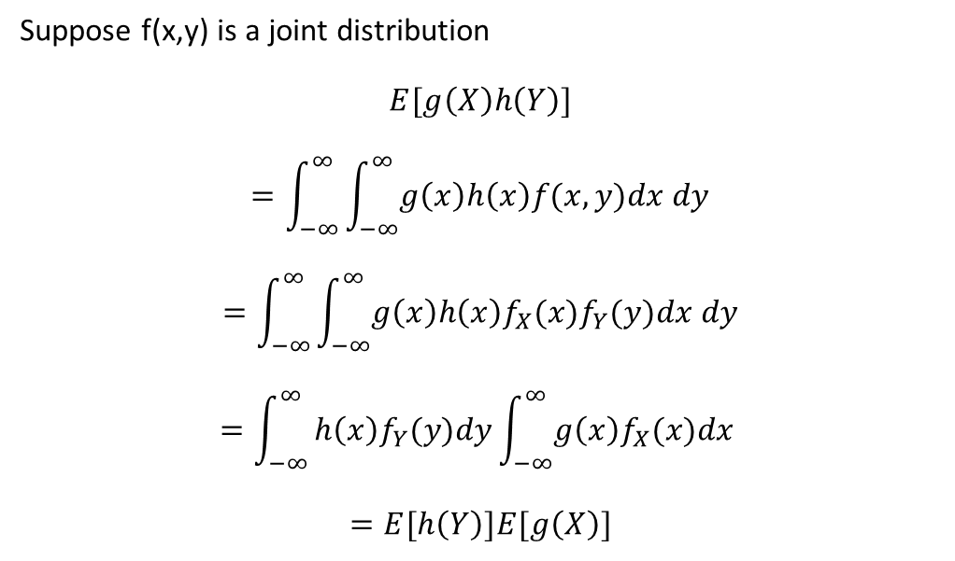
Expected Values of Joint Densities
Suppose f(x,y) is a joint distribution
$$E[g\left(X\right)h\left(Y\right)]$$
$$=\int_{−∞}^{∞}{\int_{−∞}^{∞}{g\left(x\right)h\left(x\right)f(x,y)dx dy}}$$
$$=\int_{−∞}^{∞}{\int_{−∞}^{∞}{g\left(x\right)h\left(x\right)f_{X}(x)f_{Y}(y)dx dy}}$$
$$=\int_{−∞}^{∞}{h\left(x\right)f_{Y}(y)dy\int_{−∞}^{∞}{g\left(x\right)f_{X}(x)dx }}$$
$$=E[h\left(Y\right)]E[g\left(X\right)]$$

Slide 9
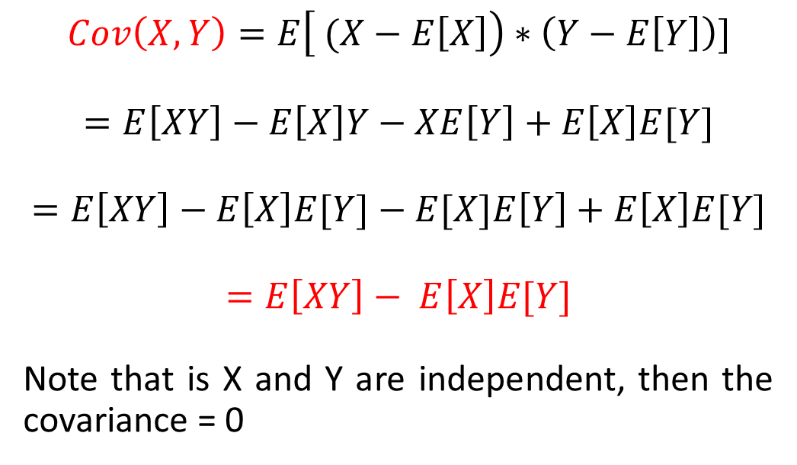
Covariance of 2 Random Variables
$$Cov\left(X,Y\right)=E\left[ (X−E\left[X\right]\right)∗\left(Y−E\left[Y\right]\right)]$$
$$=E\left[XY\right]−E\left[X\right]Y−XE\left[Y\right]+E\left[X\right]E[Y]$$
$$=E\left[XY\right]−E\left[X\right]E[Y]−E[X]E\left[Y\right]+E\left[X\right]E[Y]$$
$$=E\left[XY\right]− E\left[X\right]E[Y]$$
Note that is X and Y are independent, then the covariance = 0

Slide 10
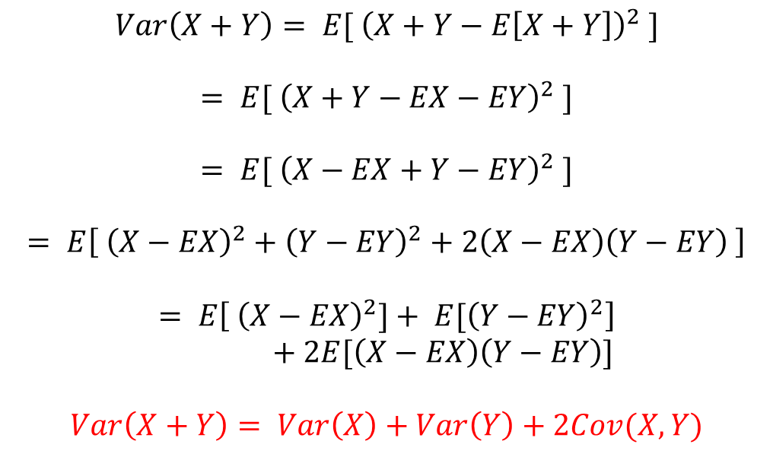
Variance of sum of random variables
$$Var\left(X+Y\right)= E[ {\left(X+Y−E\left[X+Y\right]\right)}^{2} ]$$
$$= E[ {\left(X+Y−EX−EY\right)}^{2} ]$$
$$= E[ {\left(X−EX+Y−EY\right)}^{2} ]$$
$$= E\left[ {\left(X−EX\right)}^{2}+{\left(Y−EY\right)}^{2}+2\left(X−EX\right)\left(Y−EY\right) \right]$$
$$= E\left[ {\left(X−EX\right)}^{2}]+ {E[\left(Y−EY\right)}^{2}\right]+2E[\left(X−EX\right)\left(Y−EY\right)]$$
$$Var\left(X+Y\right)= Var\left(X\right)+Var\left(Y\right)+2Cov(X,Y)$$

Slide 11
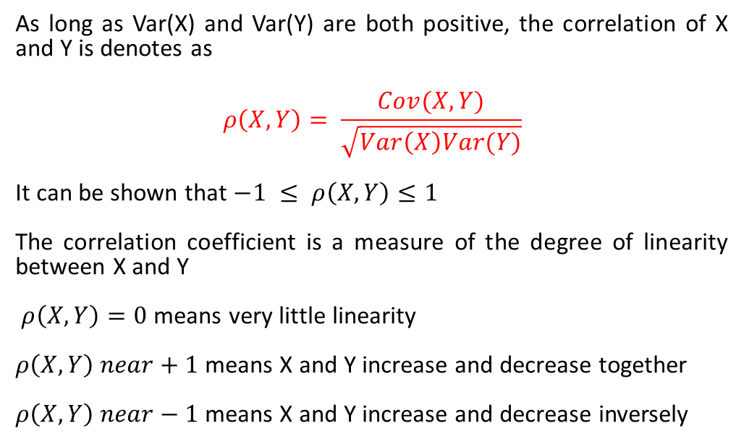
Correlation of 2 random variables
As long as Var(X) and Var(Y) are both positive, the correlation of X and Y is denotes as
$$ρ\left(X,Y\right)= \frac{Cov(X,Y)}{\sqrt{Var\left(X\right)Var(Y)}}$$
It can be shown that $−1 ≤ ρ\left(X,Y\right)≤1$
The correlation coefficient is a measure of the degree of linearity between X and Y
$ρ\left(X,Y\right)=0$ means very little linearity
$ρ\left(X,Y\right) near+1$ means X and Y increase and decrease together
$ρ\left(X,Y\right) near−1$ means X and Y increase and decrease inversely

Slide 12
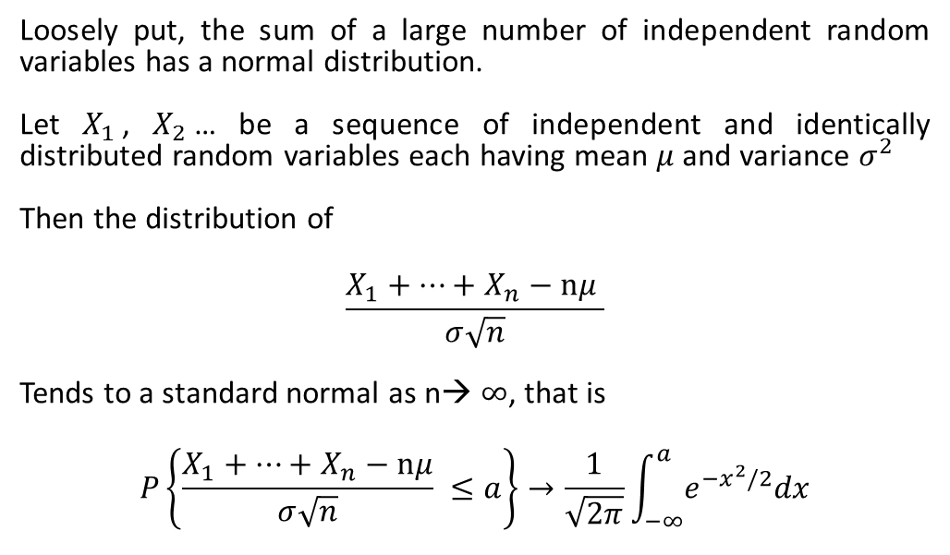
Central Limit Theorem
Loosely put, the sum of a large number of independent random variables has a normal distribution.
Let $X_{1}$, $X_{2}$… be a sequence of independent and identically distributed random variables each having mean $μ$ and variance $σ^{2}$
Then the distribution of
$$\frac{X_{1}+…+X_{n}−nμ }{σ\sqrt{n}}$$
Tends to a standard normal as n→ $∞$, that is
$$P\left\{\frac{X_{1}+…+X_{n}−nμ}{σ\sqrt{n}} ≤a\right\}→\frac{1}{\sqrt{2π}}\int_{−∞}^{a}{e^{−x^{2}/2}dx}$$

