Slide 1
Information Technology Ethics
Notes:
In this Technology in Focus feature, we explore what ethics is, how your personal ethics develop, and how your personal ethics fit into the world around you.

Slide 2
What Is Ethics?
Study of moral choices made by people
Morals: Conforming to accepted ideas of right and wrong
Notes:
Ethics is the study of the general nature of morals and of the specific moral choices made by individuals. Morals involve conforming to established or accepted ideas of right and wrong (as generally dictated by society), and are usually viewed as black and white. Ethical issues often involve subtle distinctions, such as the difference between fairness and equity. Ethical principles are the guidelines you use to make decisions each day.

Slide 3
What is Ethics?
Is topless bathing acceptable?

Slide 4
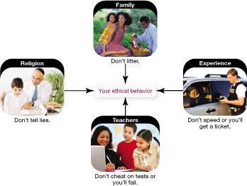
Personal Ethics How do a Person's Ethics Develop?
How do ethics develop?
Family
Cultural bias
Religious affiliation
Life experiences
Notes:
Many elements contribute to your ethical development.
Naturally, your family has a major role in establishing the values you cherish in your own life, and these might include a cultural bias toward certain moral positions.
Your religious affiliation is another major influence in your ethical life, because most religions have established specific codes of ethical conduct. How these sets of ethics interact with the values of the larger culture is often challenging. Issues such as abortion, the death penalty, and war force confrontations between personal ethical systems and the larger society’s established legal-ethical system.
As you mature, your life experiences also affect your personal ethics. Does the behavior you see around you make sense within the ethical principles that your family, your church, or your first-grade teacher taught you? Has your experience led you to abandon some ethical rules and adopt others? Have you modified how and when you apply these laws of conduct, depending on what is at stake?

Slide 5
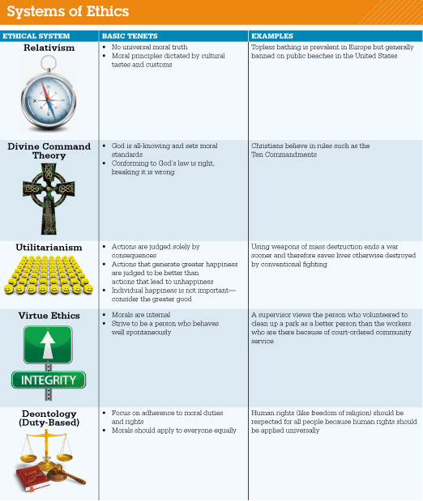
Does Everyone Have the Same Ethical Values? Different Ethic Systems
Notes:
Relativism
Examples
Topless bathing is prevalent in Europe but generally banned on public beaches in the United States
Divine Command Theory
Examples
Christians believe in rules such as the Ten Commandments

Slide 6
Doesn't Everyone Have the Same Ethical Values? Different Ethic Systems
Relativism
No universal moral truth
Dictated by cultural tastes and customs
Divine Command Theory
Conforming to God’s law is good; breaking it is wrong
All-knowing God sets standards. Example?
Notes:
Relativism
Examples
Topless bathing is prevalent in Europe but generally banned on public beaches in the United States
Divine Command Theory
Examples
Christians believe in rules such as the Ten Commandments

Slide 7
The 10 Commandments
You shall have no other gods before Me.
You shall not make idols.
You shall not take the name of the LORD your God in vain.
Remember the Sabbath day, to keep it holy.
Honor your father and your mother.
You shall not murder.
You shall not commit adultery.
You shall not steal.
You shall not bear false witness against your neighbor.
You shall not covet.

Slide 8
Your Choice..
You only have one pill that could save one life….
Do you save one young child or one brilliant scientist?

Slide 9
What is Ethics? Doesn't Everyone Have the Same Ethical Values? (cont.)
Utilitarianism
Greater happiness is better
Individual happiness is not as important
Ex. Using weapons of mass destruction ends a war sooner and therefore saves lives otherwise destroyed by conventional fighting
Virtue Ethics
Morals are internal
Ex. Cleaning a park because you want to and not because it’s court ordered community service
Notes:
Utilitarianism
Examples
Using weapons of mass destruction ends a war sooner and therefore saves lives otherwise destroyed by conventional fighting
The use of torture in interrogation. A utilitarian would consider any action justified if it benefits the greatest number of people. they would hold the view that a criminal or prisoner of war, could be tortured and have his/her rights violated, if doing so would for instance, provide intelligence information that could make the majority of people safer. If that is not a good one, you could go with a hospital that has a limited amount of drugs or resources and had to choose between treating either a child or a brilliant scientist or some other person that could benefit society greatly. a utilitarian would hold the view that the scientist should be saved as he/she provides the greatest benefit to the greatest number of people, and the cost of the child's life would be justified.
Virtue Ethics
Examples
A supervisor views the person who volunteered to clean up a park as a better person than the workers who are there because of court-ordered community service

Slide 10
What is Ethics? Doesn't Everyone have the Same Basic Ethics?
Laws are formal, written standards
Designed to apply to everyone
Enforced by government agencies
Ethics is needed to provide a general set of unwritten guidelines
Notes:
it’s impossible to pass laws
that cover every possible behavior in which humans can engage. Therefore, ethics provide a general set of unwritten guidelines for people to follow.

Slide 11

Ethics Personal Ethics and Your Work Life
Do your ethics change when you go to work?
Employers expect you to follow ethics and rules of conduct
Do not blindly follow unethical practices
Whistle Blowers – reporting your employer
Paid cash and collect unemployment
Control character outside of work
Facebook Comments
Notes:
You may have a set of personal ethics that guide your behavior, but do your ethics change when you go to work?
Of course, your employer expects you to follow the rules of conduct established for the business.
However, this doesn’t mean you need to blindly follow corporate practices that you feel are unethical or detrimental to society.

Slide 12
Technology and Ethics: How One Affects the Other
Technology moves faster than rules can be formulated
Use of technology is often left up to the individual
Ethical considerations are never clear-cut
Notes:
Because technology moves faster than rules can be formulated to govern it, the way technology is used is often left up to the individual and the guidance of one’s personal ethics.
Ethical considerations are complex, and reasonable people can have different, yet equally valid, views. We present alternative viewpoints in each setting for you to consider and discuss.

Slide 13
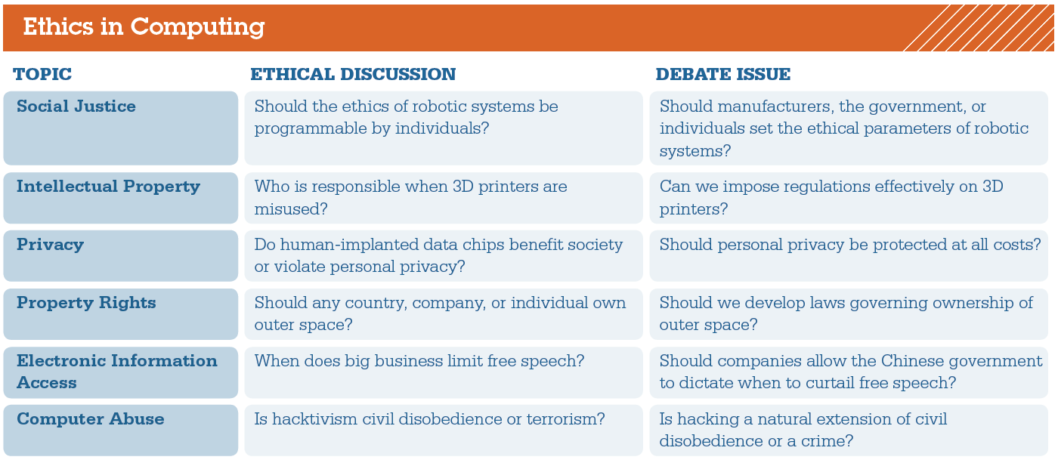
Technology and Ethics: How One Affects the Other
Ethics in computing
Notes:
This figure shows a summary of the ethical issues that will be discussed in this chapter.

Slide 14
Technology and Ethics: How One Affects the Other
Social Justice
Self Driving Cars
Who sets ethical rules for robots? People, Gov’t, company
Driving over a hill, school bus stopped, can’t brake in time
Hit bus to slow down
Left into oncoming traffic
Right over bridge
Intellectual Property
Using 3D printer to make a bike helmet
Privacy
Implanted computer chips
Track People, Medical Records

Slide 15
Technology and Ethics: How One Affects the Other
Property Rights
Mining in outer space
Electronic Information
India – blocked 800 porno sites in 2015
Computer Abuse
Hacktivism
Civil Disobedience or terrorism?

Slide 16
Using Computers to Support Ethical Conduct
Technology can be used to support ethical conduct
Charitable organizations use the Internet for fundraising
The web is a tool for organizing aid to areas in crisis
Websites and Facebook can locate friends and family members after disaster
Notes:
Although there are many opportunities to use computers and the Internet unethically, we can also use technology to support ethical conduct. For example, many charitable organizations use the Internet and other technology tools for fundraising.
Google Person Finder, part of Google Crisis Response, helps individuals and organizations to provide information and updates on persons missing after a disaster.

