Slide 1
Excel (part 1)

Slide 2
Excel Skill Set 1
Normal view, Headers and Footers (Current Date, Filename etc.)
Ranges of Cells (Merging, Aligning, applying Accents etc.)
Column and Row labels (Bold font, increase width etc. )
Functions on Ranges of data (Total, Average, max, min etc.)
Formatting on a range. (Currency, Comma, Total styles)
Using autofill when a clear pattern is set and absolute cell values
Using gridlines for printing.
Using multiple sheets.
Use spelling and grammar checking.

Slide 3
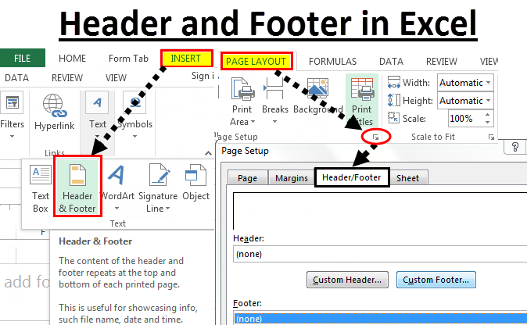
Normal view, Headers and Footers (Current Date, Filename etc.)
Headers and footers (same as Word)
Location: Layout

Slide 4
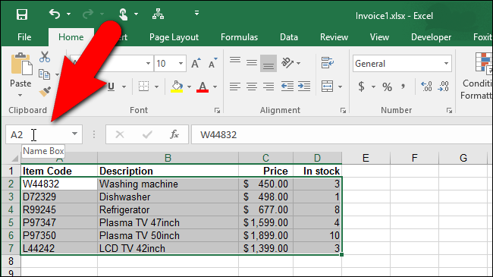
Ranges of Cells
Location: Home → shade range

Slide 5
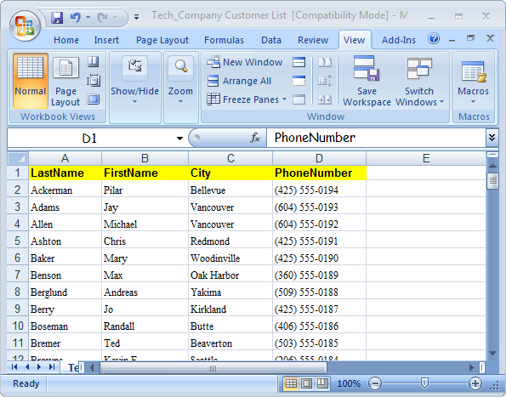
Column and Row labels
Location: shade cells and apply font changes

Slide 6
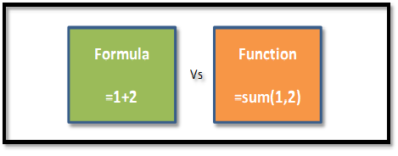
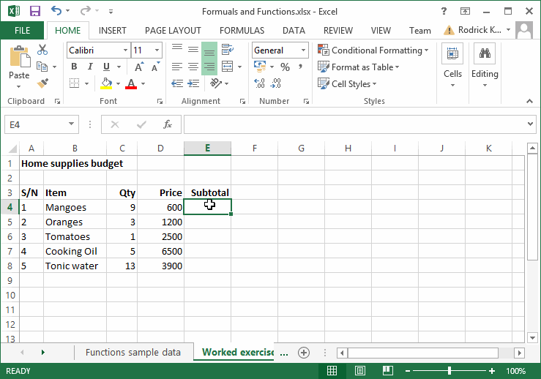
Functions on Ranges of data (sum, average, max, min etc.)
Location: Directly in cell.

Slide 7
AutoFill
Location:
1) surround cells with the pattern.
2) grab the box in the lower right corner of the range
3) drag it to over the range the autofill should be in

Slide 8
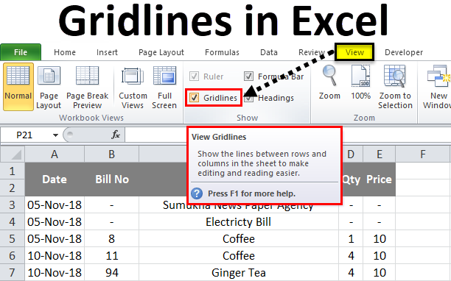
Gridlines for Printing
Location: View → Gridlines

Slide 9
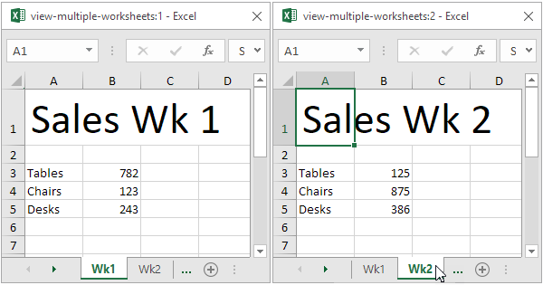
Multiple Sheets
Location: tabs on the bottom of the worksheet
Cells can reference cells on another sheet.

Slide 10
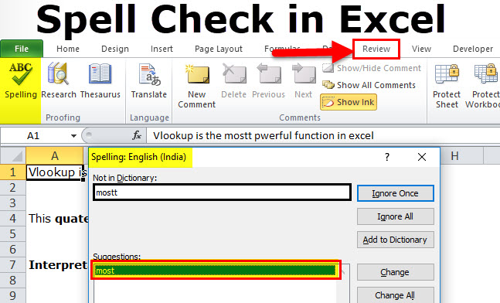
Spelling and Grammar check
Location: Review → Spelling

