Slide 1
Excel (part 2)

Slide 2
Excel Skill Set 2
Align cells and use text wrap and use AutoFit
Column Totals and Total cell style…totaling Rows too
Formula for percent of a Total, percent format and using absolute cell address for AutoFill
Functions on Ranges of data (Total, Average, max, min etc.)
Creating Pie Charts based on Cell Data (layouts, data labels, category names, percentages)
Cluster column charts (resize, layouts styles)
Word Art and Styles
Scale to height of a page
Changing order of sheets

Slide 3
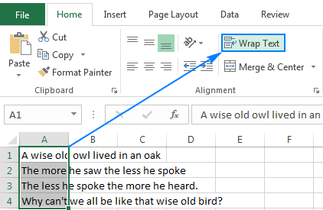
Align cells, text wrap

Slide 4
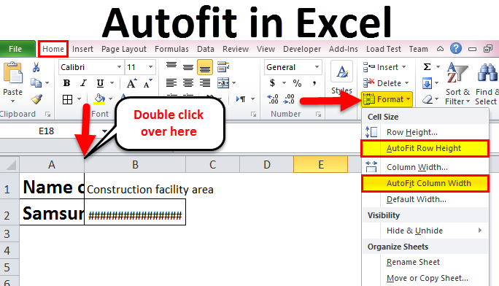
Autofit

Slide 5
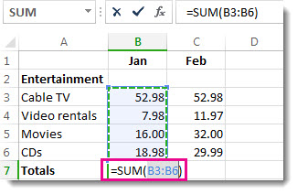
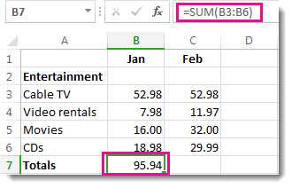
Column totals / Total Style

Slide 6
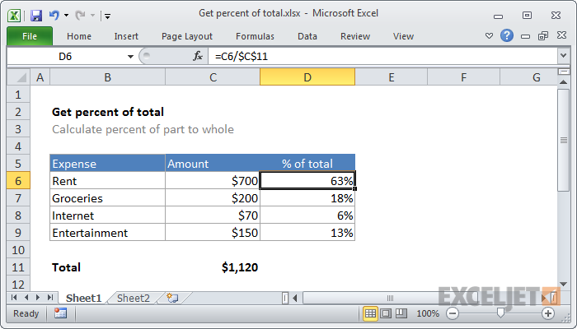
Percent (absolute address)
=C6/C11 relative address
=C6/$C$11 absolute address

Slide 7
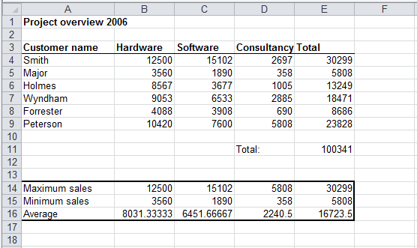
Functions: Min,Max, Average
=max(B4:B9)
=min(B4:B9)
=avg(B4:B9)

Slide 8
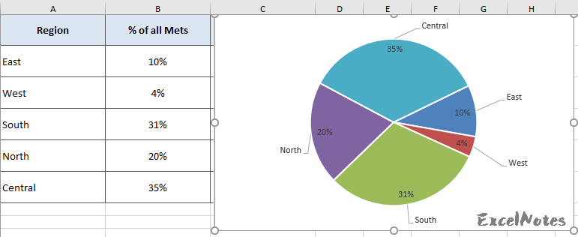
Pie Charts with labels

Slide 9
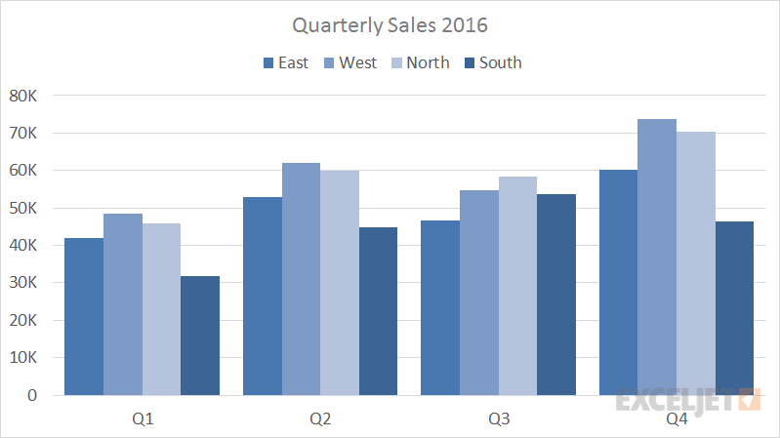
Cluster Charts
More than just a column of number and a column of labels

Slide 10
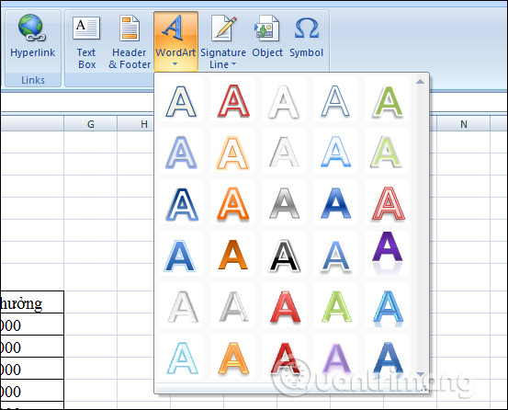
Word Art

Slide 11
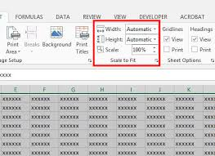
Scale to fit on a page

Slide 12
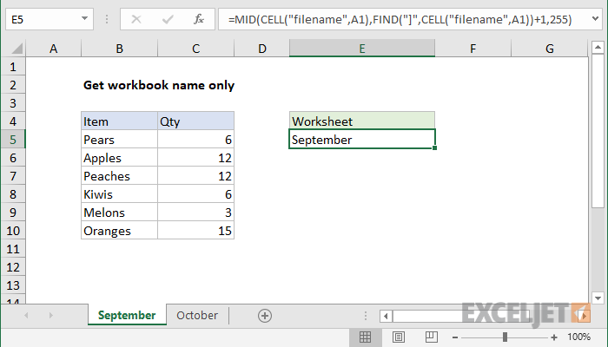
Sheet Names (reordering)

