Slide 1
Excel (part 3)

Slide 2
Excel Skill Set 3
Create formulas using multiple cells: Net Income = Gross Income – ( salaries + rent)
Grouping/ungrouping working (to apply common accents, styles etc.)
Inserting, renaming and moving worksheets.
Coping ranges from one sheet to another.
Pie charts with labels.
Cluster column charts (resize, layouts styles)
Left, center and right footers

Slide 3
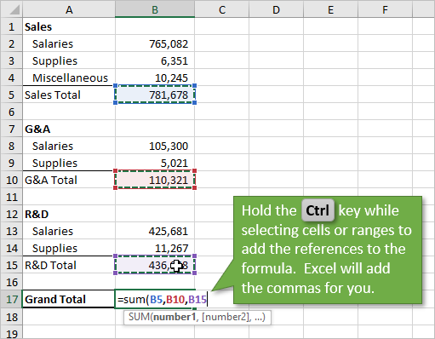
Multi-cell formula
Formulas and functions can operate on any combination of cells. Then do not have to be adjacent

Slide 4
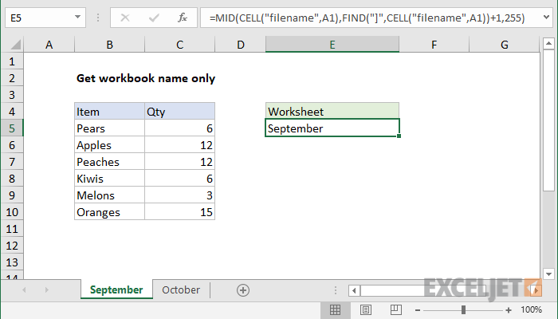
Sheet Names (reordering)

Slide 5
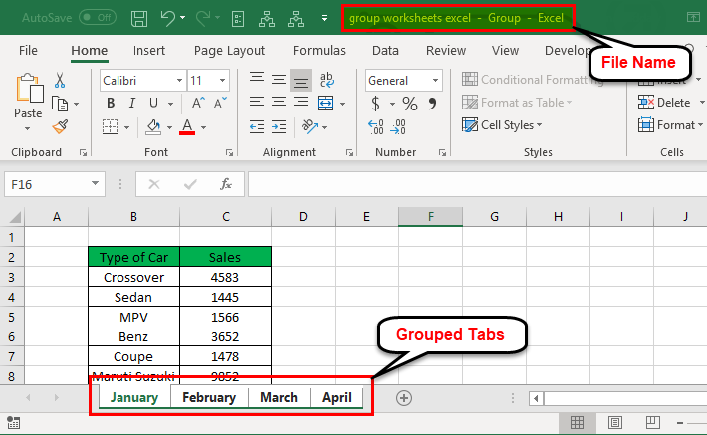
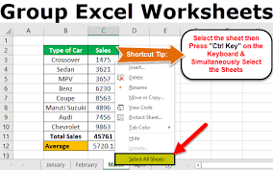
Grouping and Ungrouping Sheets
Grouping sheets is used largely for applying styles, font, accents to all the sheets that are grouped together

Slide 6
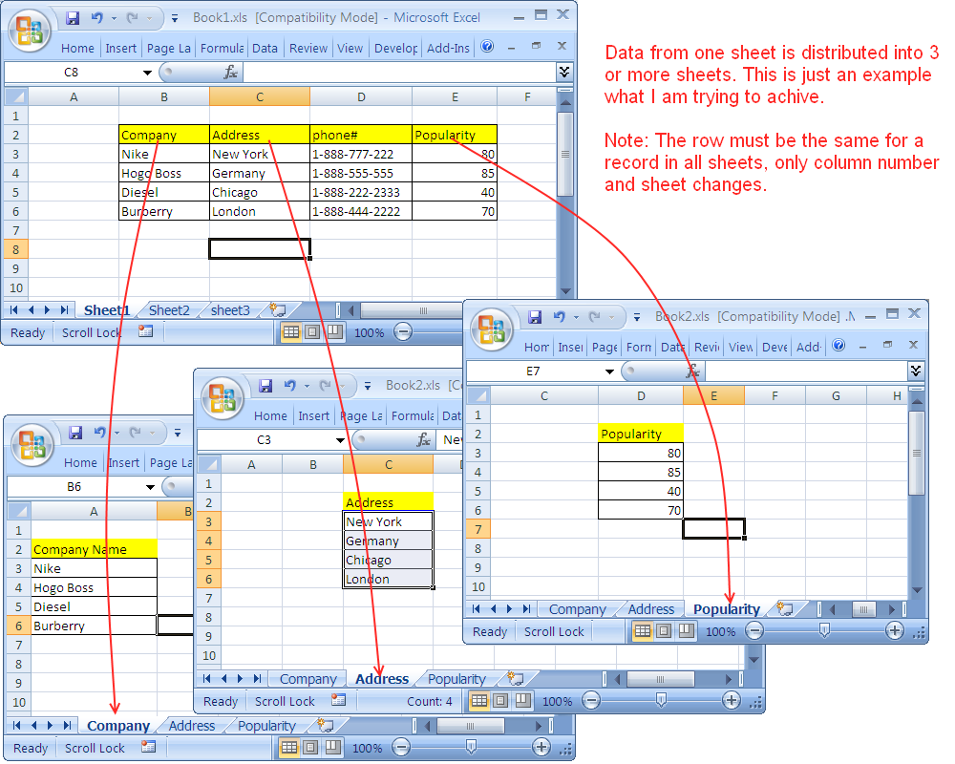
Sheet to sheet
Data from cells in one sheet can be automatically in another sheet.
=SUM(Jan:Dec!A12:C12).

Slide 7
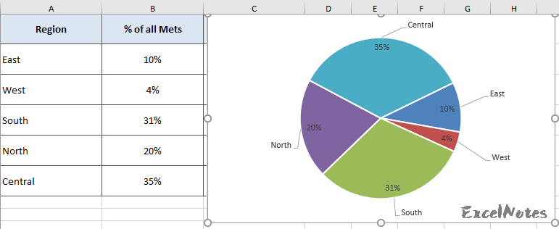
Pie Charts with labels

Slide 8
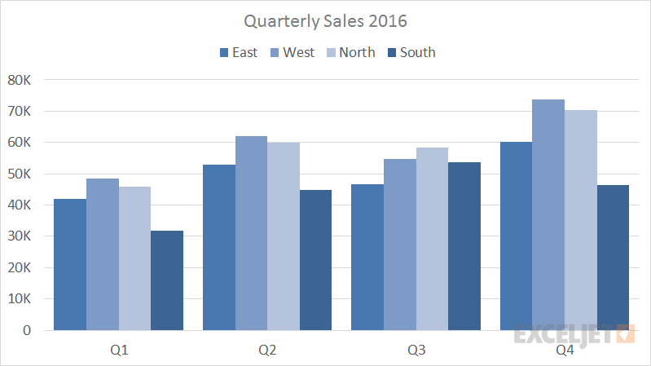
Cluster Charts
More than just a column of number and a column of labels

Slide 9
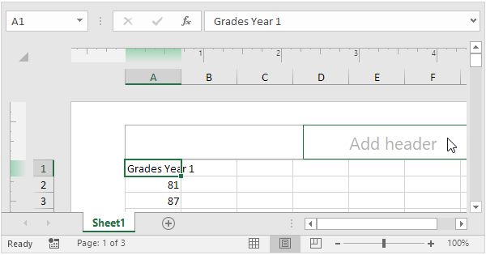
Headers and Footers

Slide 10
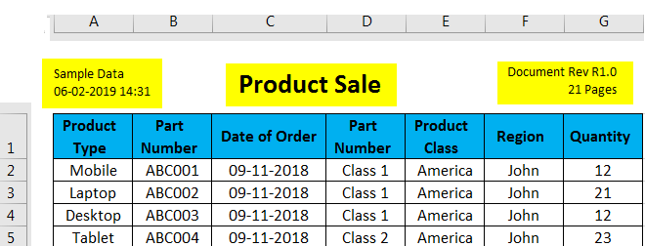
Headers and Footers

