Slide 1
Excel (part 4)

Slide 2
Excel Skill Set 4
NOW function
Applying borders/tables to cell ranges
Sparklines
IF logic in a cell, IF-Else, compound IF-Else (text that contains)
Formatting a range as a table with headers
Hiding and Unhiding rows (and columns)
Left, center and right footers
Naming, grouping, ungrouping and reordering sheets

Slide 3
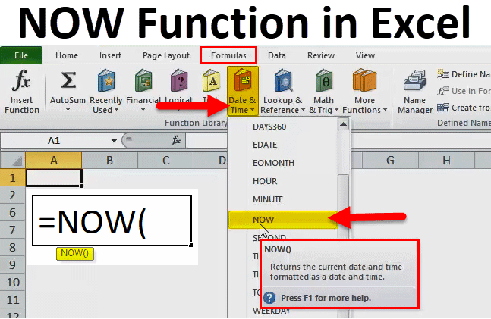
NOW function

Slide 4
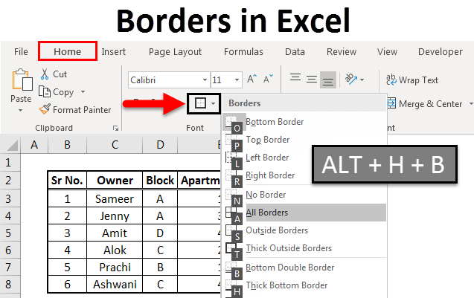
Borders Headings etc.

Slide 5
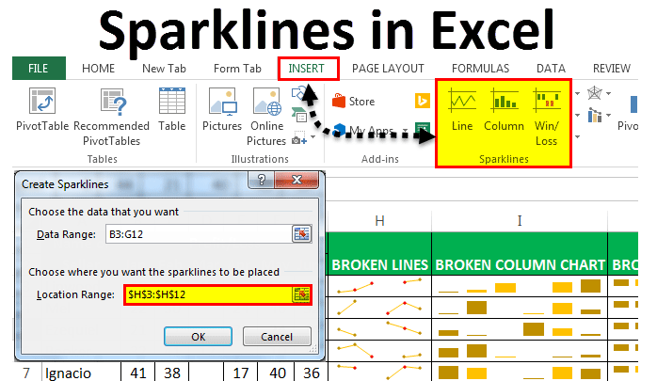
Sparklines

Slide 6
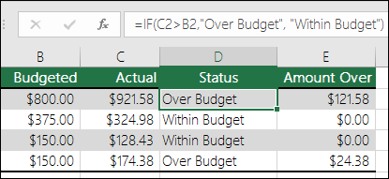
IF statement
IF within budget, say so
Otherwise say over budjet

Slide 7
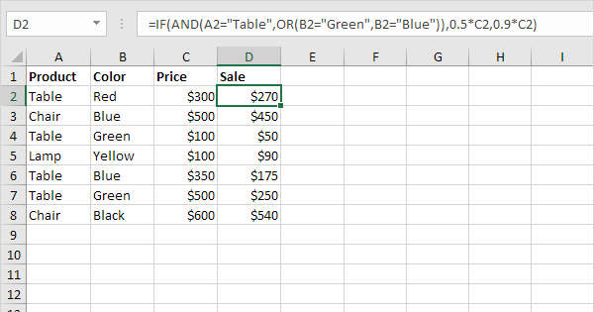
IF logic =IF(Boolean,then,else)
If the item
1) is a Table
2) is Green or Blue
Then the sale price if 50% off
Otherwise, sale price is 10% off

Slide 8
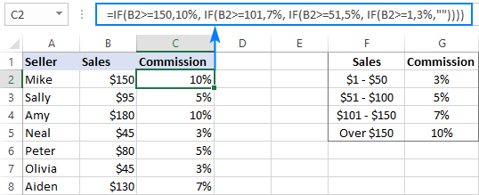
Compound IF (=IF(Boolean),then,IF…)

Slide 9
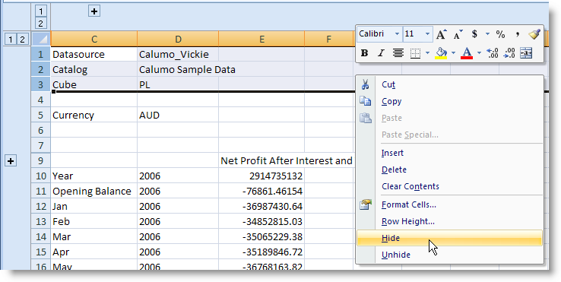
Hiding data

Slide 10
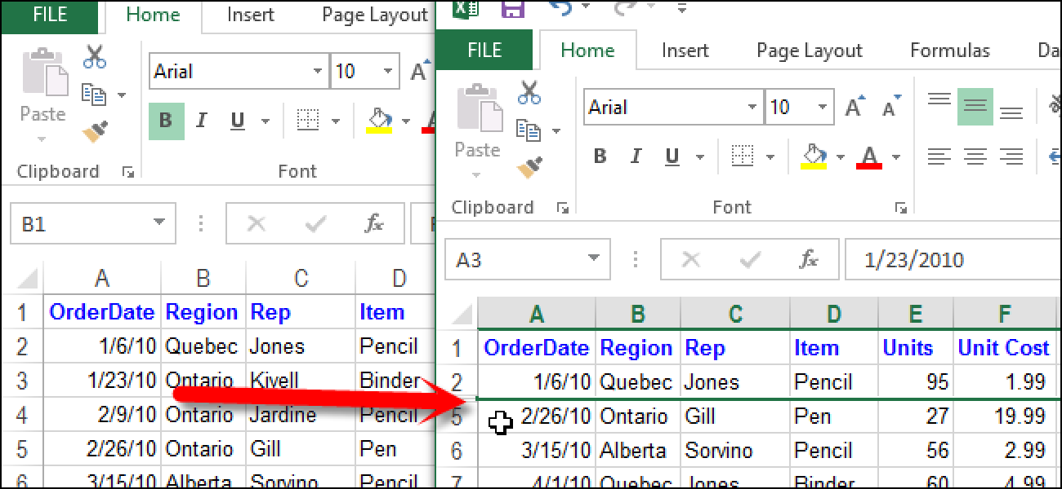
Unhiding Data

Slide 11
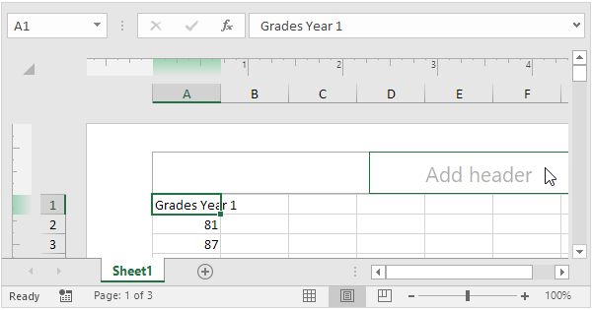
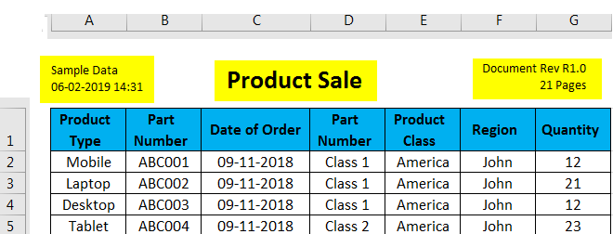
Headers and Footers

Slide 12
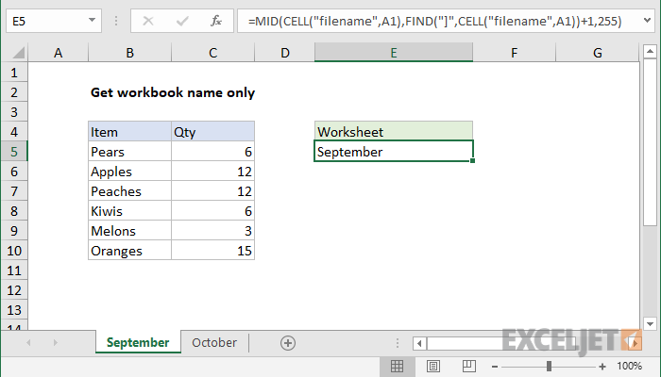
Sheet Names (reordering)

Slide 13
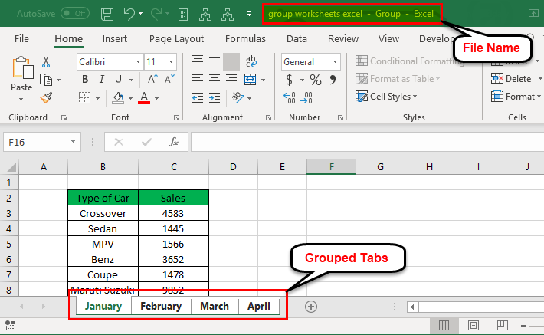
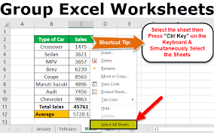
Grouping and Ungrouping Sheets
Grouping sheets is used largely for applying styles, font, accents to all the sheets that are grouped together

Slide 14
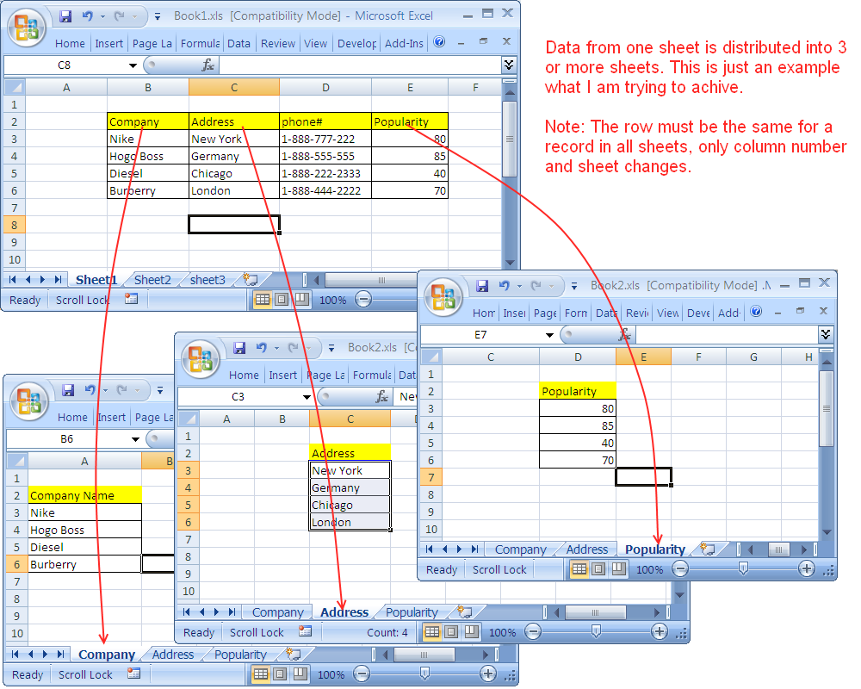
Sheet to sheet
Data from cells in one sheet can be automatically in another sheet.
=SUM(Jan:Dec!A12:C12).

