Slide 1
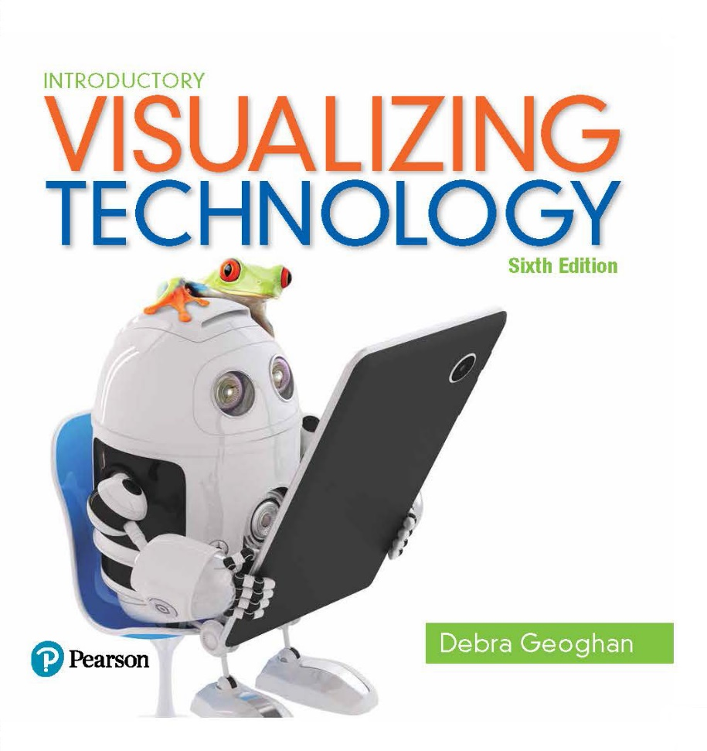
Introductory Visualizing Technology
Sixth Edition
Chapter 3
File Management
Notes:
Welcome to Chapter 3 of Visualizing Technology, the sixth edition, by Debra Geoghan. This chapter describes the importance of file management.

Slide 2
Create Folders to Organize Files
Notes:
Objective 1 explains how to create and use folders to organize your files.

Slide 3
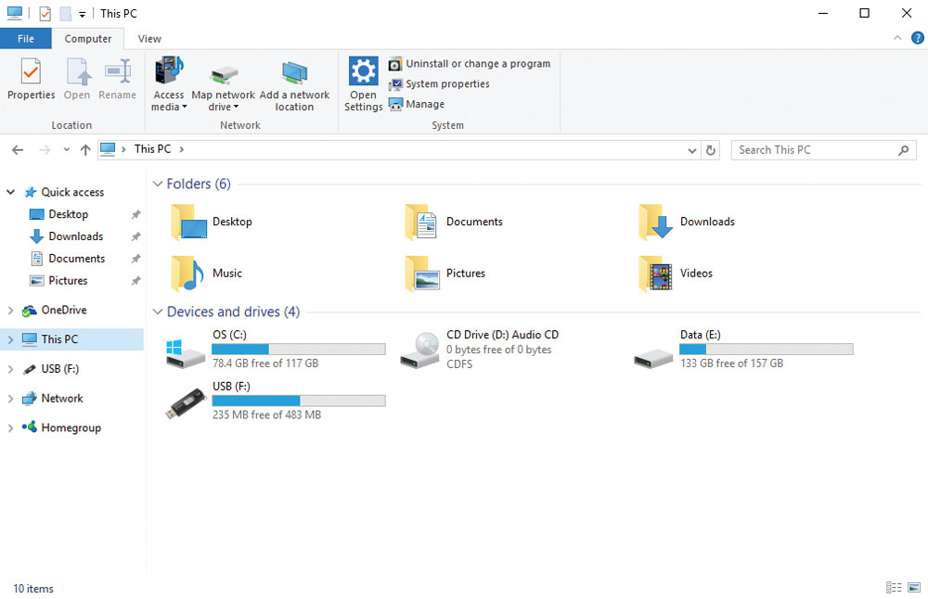
A Place for Everything Navigating Your - Windows Computer
File Explorer—used to navigate your file system in a Windows system
Search box
Ribbon
File list area
Address bar
Navigation pane
Notes:
The Windows File Explorer is used to navigate the Windows folder hierarchy and libraries. To open File Explorer, click the File Explorer icon on the desktop taskbar or go to the Apps menu or click the File Explorer tile on the Windows Start screen.

Slide 4
A Place for Everything Navigating Your - Windows Computer
Hierachy — file structure used by Windows
Ctrl + A – selects all folders
Notes:
The Windows File Explorer is used to navigate the Windows folder hierarchy and libraries. To open File Explorer, click the File Explorer icon on the desktop taskbar or go to the Apps menu or click the File Explorer tile on the Windows Start screen.

Slide 5
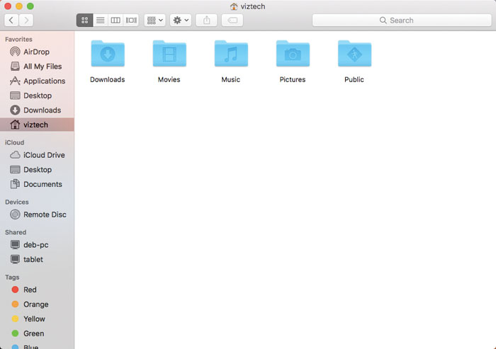
A Place for Everything Navigating Your - Mac Computer
Finder—used to find and organize files, folders, and apps on a Mac
Sidebar
Toolbar
View options
Search field
Contents area
Notes:
For Mac users, the equivalent window is called Finder. It can be opened from the Finder menu bar or by clicking the Finder icon on the dock.

Slide 6
A Place for Everything Navigating Your - Computer
Folder—containers used to organize files on your computer
Library—helps organize content by gathering files from different locations
Documents
Music
Pictures
Videos
Notes:
Folders are containers used to organize files. Additionally, Windows includes libraries to help organize files. There are four libraries—Documents, Music, Pictures, and Videos—and you can create more to suit your needs. Each library includes the corresponding user subfolder. This means that a user logging into a system and accessing a library will only see the content associated with that user login name.
.

Slide 7
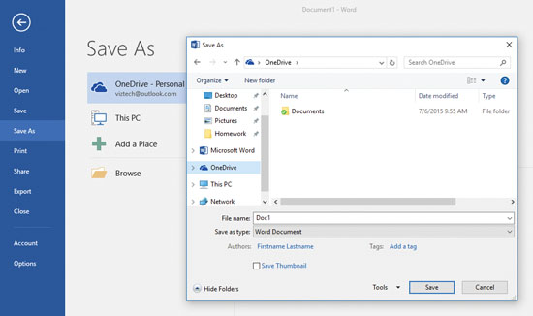
Creating and Using Folders
Folders create a unique organizational scheme
Folders can be created in the Save As dialog box
Folders can be created on flash drives and cloud storage
A good folder scheme enables the quick retrieval of a file
Notes:
You are not limited to using the folder structure created by Windows or OS X. You can create your own organizational scheme; this is especially useful when you use flash drives and cloud storage. It is a good idea to think about how you wish to organize your files and to set up folders that enable you to retrieve them quickly in the future.

Slide 8
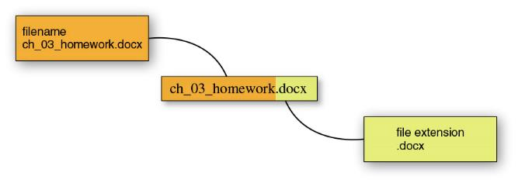
File Names and Extensions
File names contain two parts: name and extension
File names can be up to 260 characters long – this includes the extension and path to the file
Path – Sequence of folders to a file
File names may include spaces and special characters
Characters not usable in a file name are: \ / ? : * ” > <
Notes:
Every Windows file has a file name and an extension. The file name should be meaningful and not exceed 260 characters. There are eight characters that cannot be used; these are the backward slash, forward slash, question mark, colon, asterisk, greater than, and less than. OS X file names can be up to 255 characters and the only illegal character is the colon.

Slide 9
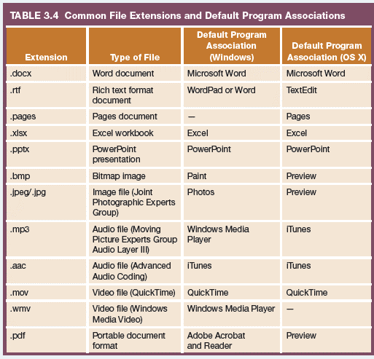
File Extensions and Default Program Association
Notes:
A file extension, assigned by the program used to create the file, helps the operating system determine how to open the file and can therefore display that file’s content accurately. If you change the extension of a file, you may not be able to open it. The table on this slide lists different file extensions, the file type, and the default program that was used to create it.

Slide 10
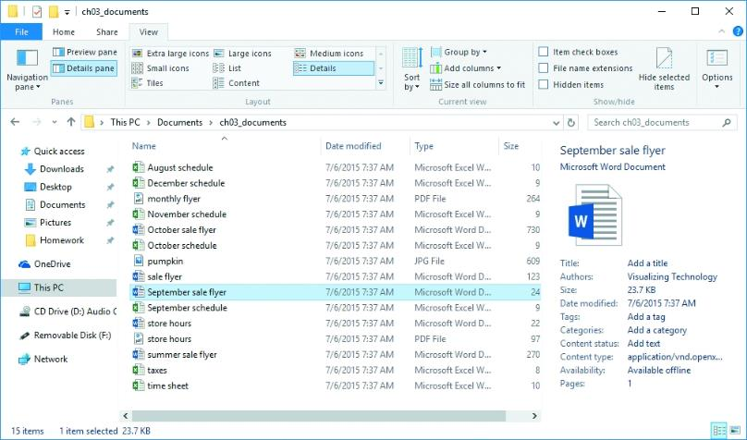
Windows File Properties
Organize, sort, and find files more easily
Automatically created and includes file type, size, and date
Title and author can be added by the user
To view properties:
Right-click on the file and click Properties
Notes:
Every file has associated properties that provide information about the file. You can use these properties to organize, sort, and locate files more easily. The file type, size, and date properties are automatically created while other properties, such as title and author, can be added by the user. A file’s properties are displayed in the Properties dialog box, which is opened by right-clicking on the file in File Explorer and clicking Properties.

Slide 11
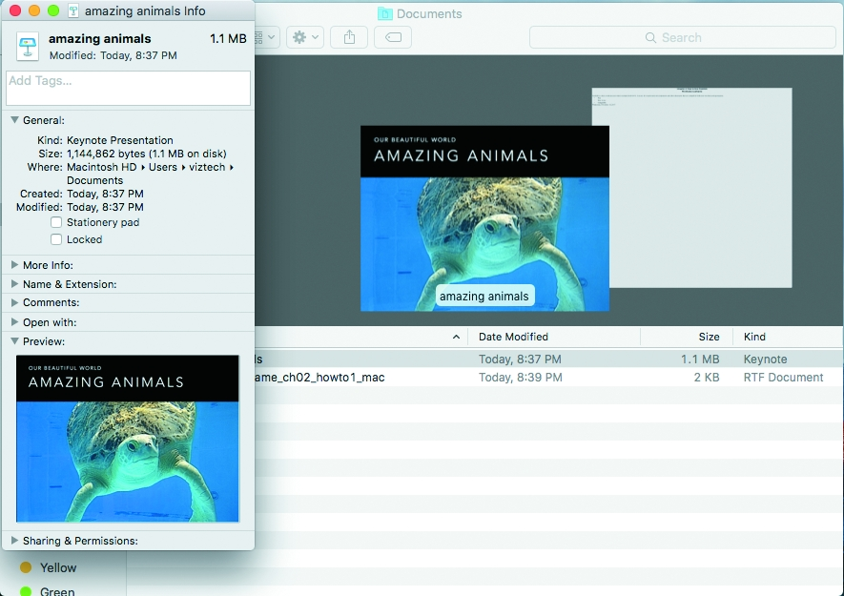
OS X File Properties
To view and modify Properties in OS X:
Open Finder
Select the file
Click Get Info
Notes:
In the Mac OS X, a file’s properties can be displayed by opening Finder, selecting the file, and then choosing Get Info. This will open the Info pane, where you can view the file’s properties and make changes.

Slide 12
Explain the Importance of Backing Up Files
Notes:
Objective 3 explains the importance of backing up files on a regular schedule to another hard drive, a DVD, a flash drive, or the cloud.

Slide 13
Back Up Your Files
Backup—a copy of files stored in another location
Backup storage options:
Internal hard drives
low price, fast speed, secure in system unit
Not recommended for back up
External hard drives
Optical drives
Flash drives
Networks
Use backup utilities to make it easy
Use online backup services for security
Notes:
Backing up is the process of copying your files to another location. There are many backup storage options, including internal hard drives, external hard drives, optical drives, flash drives, and networks. Windows and OS X include a backup utility; however, other options include online backup services that are free or inexpensive.

Slide 14
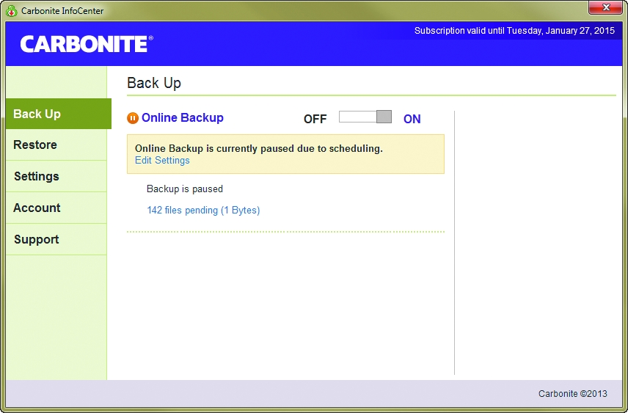
Back Up to the Cloud
Cloud backup—use of Internet backup services
Offer free personal storage of 1 or 2 GB
Unlimited storage for a monthly or annual subscription
Set automatically
Easy set up
Not faster than other backup options
Notes:
Cloud storage is a way to store files in a remote location that is accessible from anywhere. Many sites offer free personal storage of 1 or 2 GB or unlimited storage for a monthly or annual subscription for the storage of working files. Internet or cloud backup services copy your files to cloud storage designed to hold backups. Mozy and Carbonite are two companies that offer cloud backup service.

Slide 15
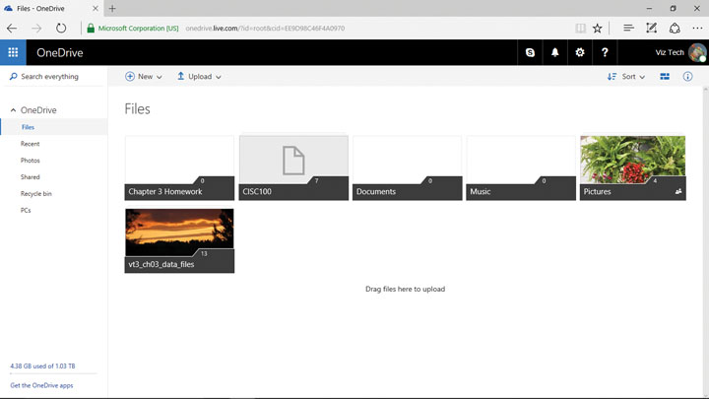
Cloud Storage (1 of 2)
Microsoft OneDrive
Save files directly from Microsoft Office apps
Windows computers connect through OneDrive app
Notes:
Another option for free online storage is OneDrive. You can save directly to your OneDrive from all Microsoft Office applications. Windows computers can connect to OneDrive using the OneDrive app.

Slide 16
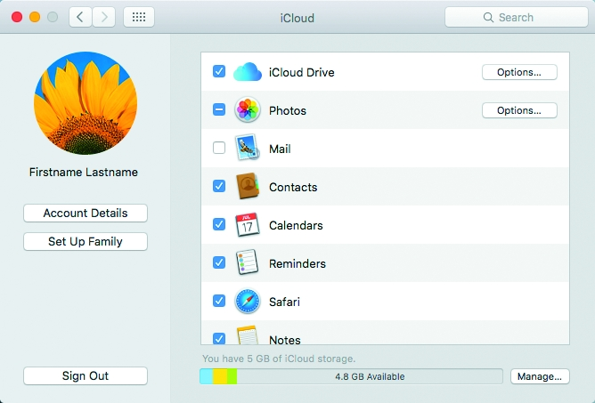
Cloud Storage (2 of 2)
OS X and iOS devices include iCloud
Can be set to automatically sync all of your personal files on all your devices to the cloud
Accesses through the iCloud website
Notes:
For OS X and iOS users, free cloud storage is provided through iCloud.

Slide 17
Demonstrate How to Compress Files
Notes:
Objective 4 demonstrates how to compress files. File compression is the process of making files smaller to conserve disk space and make them easier to transfer.

Slide 18
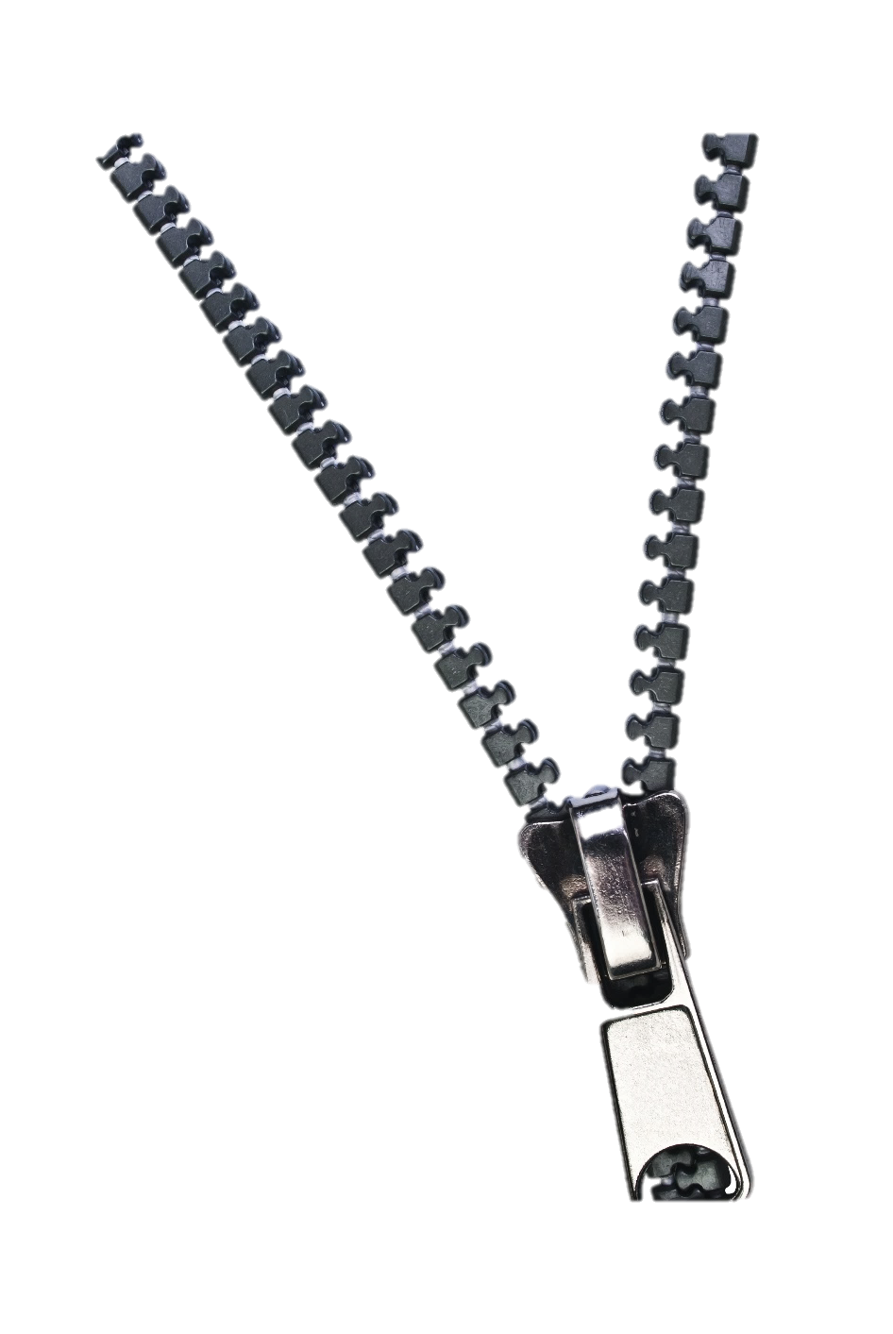
File Compression (1 of 3)
Process of making files smaller:
Conserves disk space
Easier to transfer
Types of file compression algorithms:
Lossy
Lossless
Notes:
File compression reduces the size of a file in order to conserve disk space and make the file easier to attach to an email. There are two types of file compression algorithms: lossy and lossless.

Slide 19
File Compression (2 of 3)
Windows uses ZIP format
Popular file compression programs:
7-ZIP
WinRAR
WinZip
Stuffit
Algorithm – steps to solve problem
Notes:
Windows uses the ZIP format to compress and decompress files.
Popular file compression programs include 7-ZIP, WinRAR, WinZip, and Stuffit.

Slide 20
File Compression (3 of 3)
Lossy
Vs.
Lossless
Contains more info than a human can detect
Substantial amount of data is discarded
Used by ZIP files
For files that contain text and numbers
Takes advantage of redundant information
Can be decompressed with no loss of data
Notes:
Lossy compression is often used on images, audio files, and video files. These files contain more information than humans can detect. The lossy compression algorithm removes that undetectable information from the file. Lossless compression is used on files that contain text and numbers. This algorithm looks for redundancy in the file and creates an encoded file using that information to remove the redundant information; all the information from the original file is restored.

Slide 21
Use Advanced Search Options to Locate Files
Notes:
Objective 5 discusses using advanced search options to search for files.

Slide 22
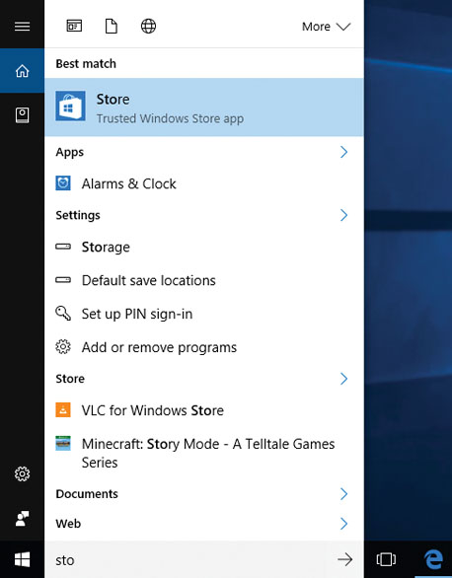
Use Windows to Search for Files
Index – has file info and speeds up search
Control Panel window
File Explorer window
Notes:
In Windows, a search in File Explorer can help you locate files that you’ve misplaced. As soon as you type a letter, number, or character in the Search box in File Explorer, the search begins. The search results include files in the current location and the folders below it in the file hierarchy. With Windows 10, a search locates programs, including apps, settings, and files. You can also ask Cortana—the Windows built-in personal assistant—to help you find what you are looking for.

Slide 23
Use Spotlight in OS X to Search for Files
Search Options in OS X:
Search field in Finder
Help Center built-in search
Spotlight
Accessed by clicking the magnifying glass in the upper right-hand side of the screen
It searches files and folders, contacts, and other objects
Siri—intelligent personal assistant app that enables you to speak using natural language to interact with your Apple device
Notes:
You can access Spotlight, a powerful search tool in OS X, when using Finder by clicking the magnifying glass on the upper right-hand side of the screen. Spotlight searches applications, files and folders, contacts, and other objects on your computer. Spotlight can even provide a definition and do simple math calculations. You can also use Siri, which is an intelligent personal assistant app that enables you to speak using natural language to interact with your Apple device.

Slide 24
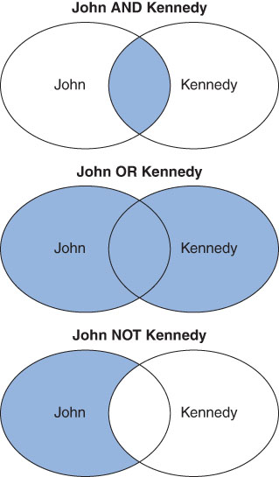
Use Boolean Logic to Refine Searches
Boolean Logic
Created in 19th century
George Boole created the system
Boolean operators:
AND—includes both words
OR—includes either word
NOT—includes the first word and not the second
Used to create search filters in Windows, Spotlight, most databases, and web searches
Notes:
Boolean logic was created by the 19th-century mathematician George Boole. The Boolean operators AND, OR, and NOT are used to create search filters in Windows, most databases, and web searches. In the slide example, search results using AND include both John AND Kennedy; search results using OR include either John OR Kennedy; and search results using NOT include the first term and NOT the second term, John NOT Kennedy.

Slide 25
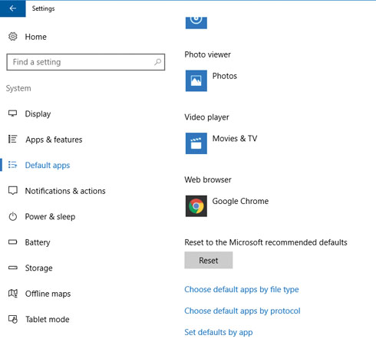
Default Programs
Default program—application associated with a file through the file’s extension/type
Allows you to open, view, and edit the file in the program used to create it
.mov opens QuickTime
Some file types, such as MP3, can be opened by multiple applications
Notes:
A default program is an application that is associated with a file. It allows you to open, view, and edit that file. Windows maintains a list of file extensions and associated default programs, which allows Windows to automatically open the correct program. Keep in mind that some file types, such as MP3, can be opened by more than one application.

Slide 26
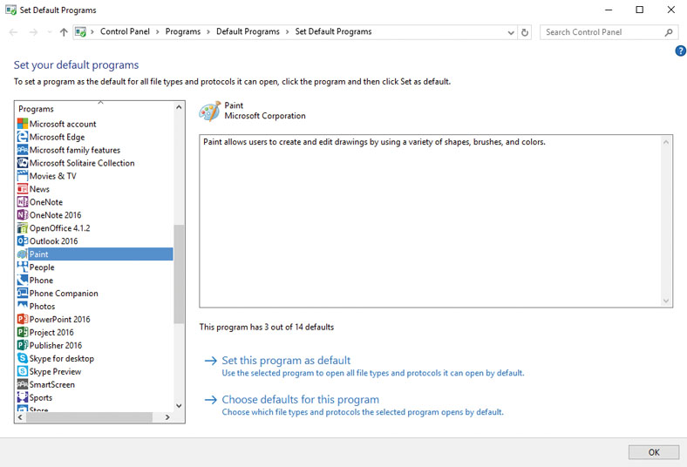
Setting Program Defaults
Notes:
If you want a generic file type, such as MP3, to be opened by a specific application on your computer, you can set that association in the Default Programs control panel. When the panel opens, click Set your default programs. The Set Default Programs control panel window opens. In this panel, you can view and modify the application associated with a file type so it becomes the default.

