Slide 1
Firewalls
Firewalls
Routers, Switches, Hubs
VPNs

Slide 2
Firewalls
Implemented
Hardware
Software
Combination of (Hardware and Software)
Types
Host-based (Personal)
Network

Slide 3
Things we can do with firewalls
All data traffic from outside is separated from inside the firewall
We could allow only traffic coming to port 80 to be allowed.
We could allow all traffic except traffic to port 80 to be allowed.
No ftp traffic allowed (unencrypted passwords)

Slide 4
Network firewall
Use a firewall device (usually a computer running firewall software)
Install 2 interfaces.
1) connected to our internal network interface
2) connected to the external network or internet
All data going to and from the internet travels though the firewall following rules that decide if traffic can or can not go though
Places at the boundary of the trusted network

Slide 5
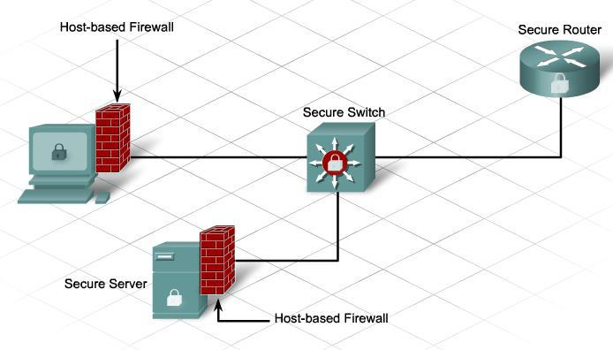
Host based (Personal) Firewall
Software installed on one host (computer) that checks all traffic to-and-from that system.

Slide 6
Layers of firewalls
Several firewalls can be used that prohibit traffic from passing though. This makes it more difficult for hackers to get though.
Most operating systems come with host based firewalls and right there if you have a network based fire wall and use an OS with firewalls, you have 2 layers of firewalls.

Slide 7
Firewalls read IP packets
Network layer data such as IP address and Port Numbers of the source and destination are read and checked against internal tables.
Host based firewalls are usually application firewalls.
Network based firewalls are usually Packet Filters.

Slide 8
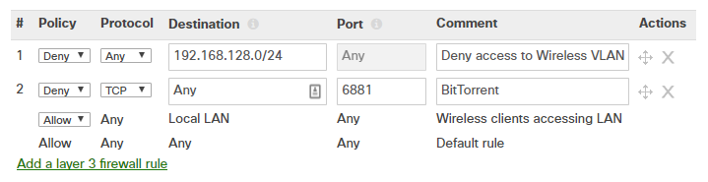
Policies for traffic going through
Allow Policy – all packets that do not meet the “allow criteria” are blocked.
block everything and open holes
Deny Policy - all packets that meet the “deny criteria” are blocked.
block nothing and close holes

Slide 9
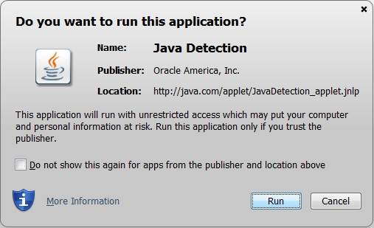
Detections of a possible intrusion

Slide 10
DNS (Domain Name System)
A system that maps IP addresses to URL names
www.facebook.com = 31.13.80.36
www.amazon.com = 13.33.60.247
If you firewall blocks www.facebook.com and you can get to a different ip address to a different facebook server, you can get in directly using the unblocked IP address.

Slide 11
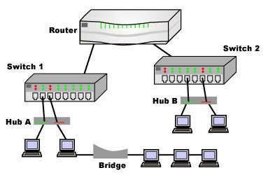
Hubs, Switches, and Routers
Hubs – connect a few computers together. All messages sent out of one computer is broadcasted (spamed) to all computer connected to the hub.
Switch – can be used to join switched LANs
Router – connects at least 2 networks
Bridge – connects two networks
(LANs) to create 1 network.

Slide 12
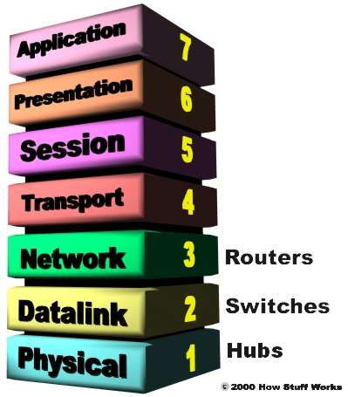
Routers, Switched, Hubs and OSI

Slide 13
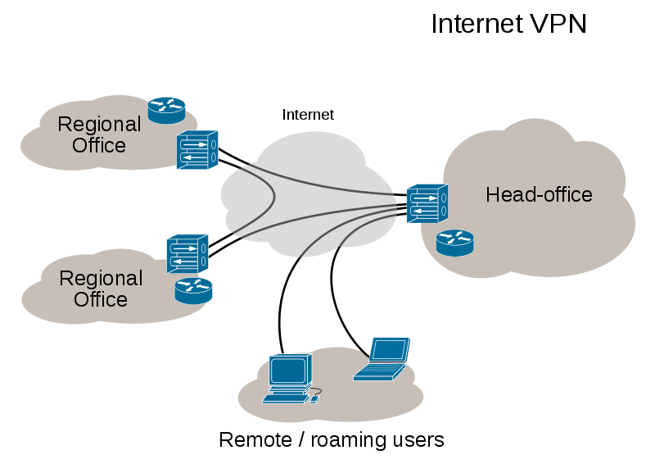
VPN (Virtual Private Network)

Slide 14
VPN (Virtual Private Network)
A virtual private network (VPN) extends a private network across a public network, and enables users to send and receive data across shared or public networks as if their computing devices were directly connected to the private network.
VPNs may allow employees to securely access a corporate intranet while located outside the office
A VPN is created by establishing a virtual point-to-point connection through the use of dedicated connections, virtual tunneling protocols, or traffic encryption

Slide 15
VPN pros and cons
Pros:
VPNs can bypass some firewall content restrictions and censorship.
Cons:
Speed is slowed down:
New link to communication path. You → VPN → Destination
Encryption / decryption algorithms
You compete with other users of the VPN server.
VPN cost about $60/year (Free ones are very slow)

