Slide 1
Arrays
1-2-many dimensional arrays, Set Associative arrays, dynamically size of Arrays

Slide 2
Variables that are common in nature
teamP = “Phillies”
teamM = “Mets”
teamY = “Yankees”
// print the team names
Print(teamP)
Print(teamM)
Print(teamY)

Slide 3
Array – variables with a common name
Teams[3] // create an array of teams that can hold 3 names
Teams[0] = “Phillies”
Teams[1] = “Mets”
Teams[2] = “Yankees”
// print the team names
For (i=0; i<=2; i=i+1)
{
print(Teams[i]);
}

Slide 4
Numbering of elements in array 0 → n-1
If a book has n pages, the pages are numbered from 1 to n.
If an array is n elements in it, shouldn’t the elements be numbered 1 to n like pages in a book?
Answer: No!!!
The way a computer finds the location of an element in an array is to use the array name as the location of where the array starts in memory, then adds the index number (times the size of the elements) to the beginning of the array.
Couldn’t the programming language simply add a 1 to the (array start) + offset + 1 to be likes books which people are used to?
Answer: Yes and some languages do just that.

Slide 5
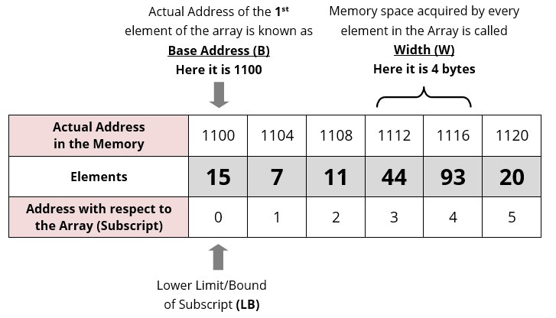
Array Element Address Calculation

Slide 6
Multidimensional Arrays
Cards[13][4] // create a deck of 52 playing cards
Cards[0][0] = “Ace of Spades”
Cards[0][1] = “Ace of Clubs”
Cards[0][2] = “Ace of Hearts”
Cards[0][3] = “Ace of Diamonds”
Cards[1][0] = “Two of Spades”
Cards[1][1] = “Two of Clubs”
Cards[1][2] = “Two of Hearts”
Cards[1][3] = “Two of Diamonds”

Slide 7
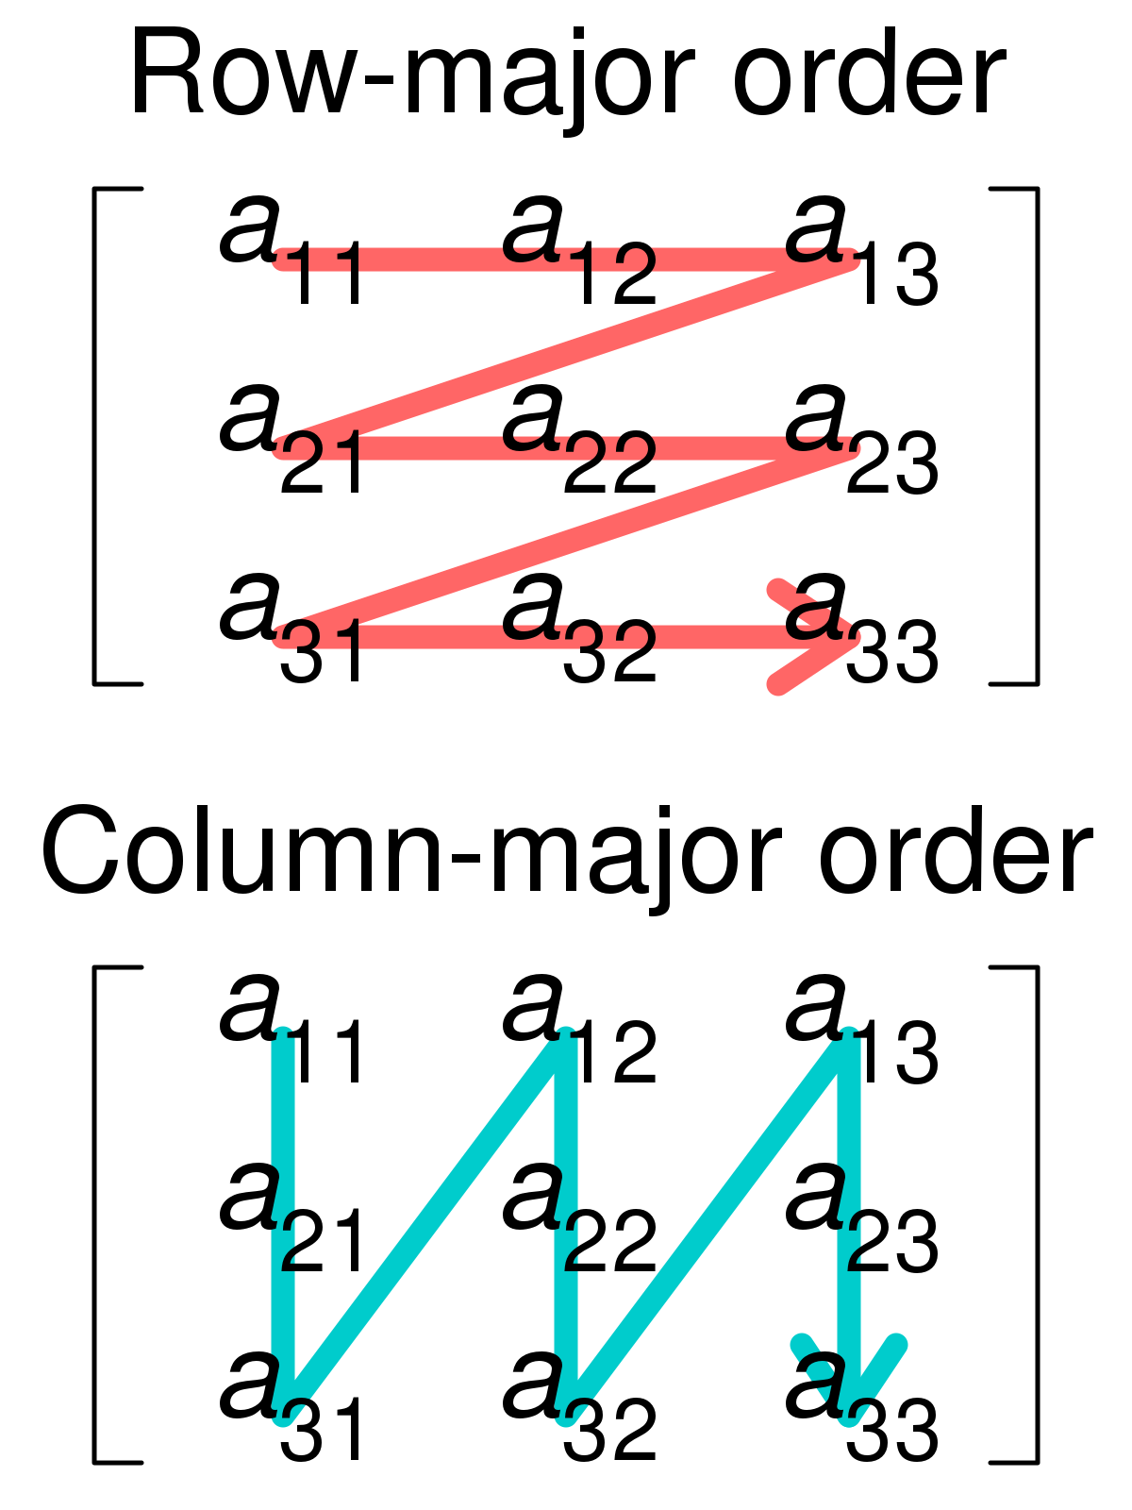
How is a 2 dimensional array stored
Computer memory is linear.
A 2 dimensional array has a row and column value Cards[row][column]
Should the computer store the array as one row after another or one column after another.

Slide 8
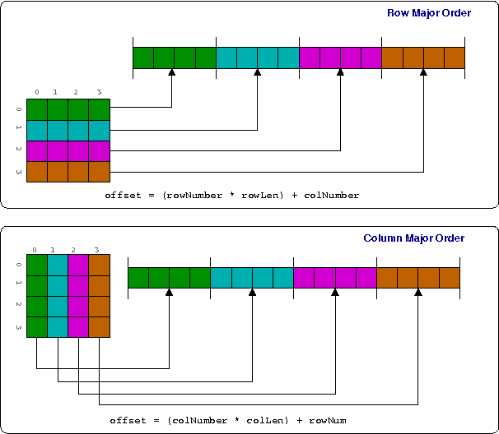
Offset of 2D array in memory
Row major
Offset = (rowNumber +rowlength) + colNumber
Column major
Offset = (colNumber +colLength) + rowNumber

Slide 9
Array of Arrays
Some programming languages allow the user to create an array of arrays.
This allows the rows to be different sizes.

Slide 10
Declaring arrays in various languages
Various programming languages have rules on declaring and using arrays
- Default base index 0 (C, C++, Java, JavaScript, Python) - 1 (Matlab, Fortran, Julia, R)
- Bound check – checking if the element being calculated in actually within the array
- Multidimensional arrays:
  - 1(Basic, RPG),
  multi(C#,MATLAB,php) ,
  AofA (Do, Java, JavaScript, Python)
  - Dynamic Size – yes(Java, JavaScript, Python) no(Go, PL1, RPG)

Slide 11
Access array elements in languages
Access an element | Languages
name[index] name[index1,index2] | ALGOL 58, ALGOL 60, ALGOL 68, AWK, Modula, Pascal, Object Pascal, C#
name[index] | C, C++, Go, Java, JavaScript, Julia, Perl,Python, R , Ruby, Swift
$name[index] | Perl, PHP
name(index) or name(index₁, index₂) | Ada,COBOL, Fortran, RPG, MATLAB, PL/I, Scala, Visual Basic, Visual Basic .NET

Slide 12
Iterating through an array with for
A[10] = {100, 200, 300, 400, 500, 600, 700, 800, 900, 1000]
for (int i=0; i <= (length(A) – 1; i++) // assuming the array is indexed from 0 to n-1
{
print(A[i]);
}

