Slide 1
Java Generics
And collections
Generic Methods and Classes
Java Collections – List, Sets and Maps
Iterators and compareTo()

Slide 2
Generic method
static float add(float f, float g)
{
float answer = f + g;
return answer;
}
static int add(int i, int j)
{
int answer = i + j;
return answer;
}
static long add(long l, long m)
{
long answer = l + m;
return answer;
}
// Generic add method
static <T> add(T a, T b)
{
T answer = a + b;
return answer;
}
float f = 3.14;
float g = 5;
float h = add(f,g);

Slide 3
Generic Class
class Pair<T,S>
{
protected T first;
protected S second;
public Pair( T a, S b )
{
first = a;
second = b;
}
public printPair( system.out.print(“First=” + first .” Second=“ + second”) );
}
Pair<String,Color> colorName = new Pair<String,Color>("Red", Color.RED);
Pair<Double,Double> coordinates = new Pair<Double,Double>(17.3,42.8);

Slide 4
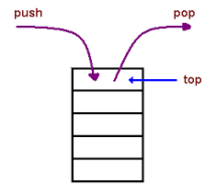
Generics – Stack (of Objects) Class
class Stack<E>
{
private final int size;
private int top;
private E[] elements;
public Stack() { this(10); }
public Stack(int s) {
size = s > 0 ? s : 10;
top = -1;
elements = (E[]) new Object[size]; // create array
}
public void push(E pushValue) {
if (top < size - 1) // if stack is not full
elements[++top] = pushValue; // place pushValue on Stack
}
public E pop() {
if (top > -1) // if stack is not empty
return elements[top--]; // remove and return top element of Stack
}
}

Slide 5
Java Collections
The Java collections framework (JCF) is a set of classes and interfaces that implement commonly reusable collection data structures.
Although it is a framework, it works in a manner of a library. The JCF provides both interfaces that define various collections and classes that implement them.

Slide 6
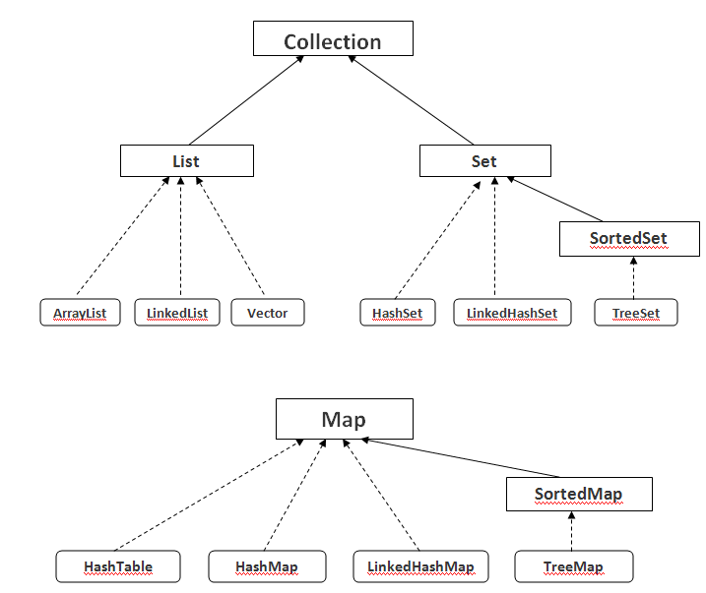
Three main types of Collections
Lists, Sets and Maps

Slide 7
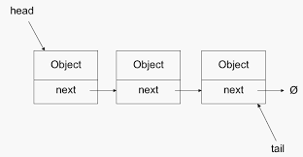
Three main types of collections - Lists
Lists: always ordered, may contain duplicates and can be handled the same way as usual arrays

Slide 8
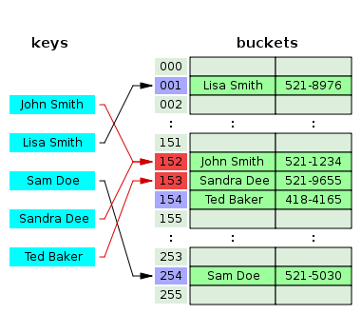
Three main types of collections - Maps
Maps: connect unique keys with values, provide random access to its keys and may host duplicate values

Slide 9
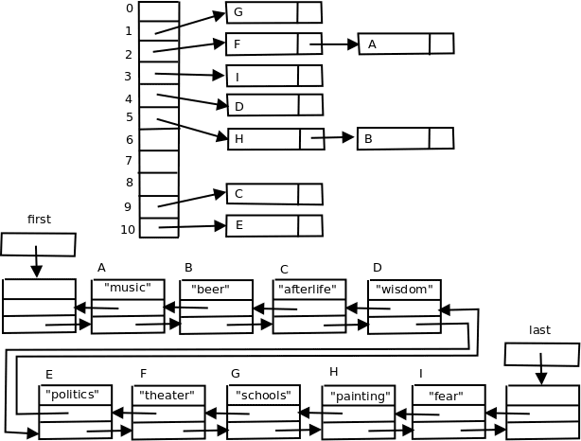
Three main types of collections - Sets
Sets: cannot contain duplicates and provide random access to their elements

Slide 10
Iterators and Iterating
for (int i = 0: i < 10; i++) // i is an iterator of type int
{
// do stuff
}
int i=0; // I is an iterator of type int
while (I < 10)
{
// do stuff
i = i+1;
}
What if you wanted to iterate through a linked list?
What would be the iterator’s type? int? What it the next?

Slide 11
Generic List in Java
String string1 = “first string";
String string2 = “second string";
List<String> list = new ArrayList<String>;
list.add(string1);
list.add(string2);
Iterator<String> iterator = list.iterator();
while(iterator.hasNext())
{
System.out.println(someString);
String someString = iterator.next();
}

Slide 12
Generic Set in Java
Set<String> set = new HashSet<String>;
String string1 = "a string";
set.add(string1);
Iterator<String> iterator = set.iterator();
while(iterator.hasNext())
{
String aString = iterator.next();
}

Slide 13
Generic Map in Java
Map<Integer, String> map = new HashMap<Integer, String>;
Integer key1 = new Integer(123);
String value1 = "value 1";
map.put(key1, value1);
String value1_1 = map.get(key1);
Iterator<Integer> keyIterator = map.keySet().iterator();
while(keyIterator.hasNext()){
Integer aKey = iterator.next();
String aValue = map.get(aKey);
}

Slide 14
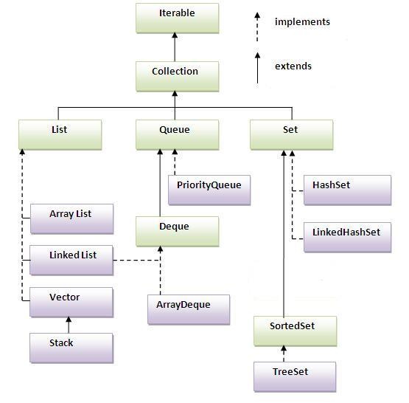
Java Collections Hierarchy

Slide 15
Lists
List listA = new ArrayList();
listA.add("element 0");
listA.add("element 1");
listA.add("element 2");
String element0 = listA.get(0);
String element1 = listA.get(1);
String element3 = listA.get(2);
//access via Iterator
Iterator iterator = listA.iterator();
while(iterator.hasNext()
{
String element = (String) iterator.next();
}
for(Object object : listA)
{
String element = (String) object;
}

Slide 16
Sorting – CompareTo()
List list = new ArrayList();
//add elements to the list
Collections.sort(list);
public int compareTo(Student s)
{
if (gpa > s.gpa) { return 1; }
if (gpa < s.gpa) { return -1; }
if (gpa == s.gpa { return 0; }
}
Note 1:
Since ArrayList implements the Comparable interface. it must supply a compareTo() method.
public interface Comparable<T>
{
int compareTo(T o);
}
Note 2:
You may override compareTo()

