Slide 1
JavaScript - DOM
OnClick
JavaScript functions called from HTML
Slide Show example
Document Object Model

Slide 2
index.html file and how it appears
<html>
<head>
// head related stuff
</head>
<body>
<h1> Welcome to my web page </h1>
<p> Glad you could be here. </p>
</body>
</html>
Welcome to my web page
Glad you could be here.

Slide 3
Click to change a <p> color
<!DOCTYPE html>
<html>
<body>
<p>Some paragraph nobody cares about.</p>
<p id=“jetBlue" onClick=“changeColor()">Click Me Blue.</p>
<script>
function changeColor() {
document.getElementById(“jetBlue").style.color = "blue";
}
</script>
</body>
</html>
Some paragraph nobody cares about
Click Me Blue
Some paragraph nobody cares about
Click Me Blue

Slide 4
Make element a parameter
<p id=“jetGreen" onclick=“changeColor(‘jetGreen’, ‘green')">Click Me Green</p>
<p id=“jetBlue" onClick=“changeColor(‘jetBlue’, ‘blue')">Click Me Blue</p>
<script>
function changeColor(elmntID, clr) {
elmnt = document.getElementById(elmntID);
elmnt.style.color = clr;
}
</script>
Click Me Green
Click Me Blue
Click Me Green
Click Me Blue
Click Me Green
Click Me Blue

Slide 5
Current element is called “this”
<p onClick=“changeColor(this, ‘green')">Click Me Green</p>
<p onClick=“changeColor(this, ‘blue')">Click Me Blue</p>
<script>
function changeColor(elmnt,clr) { elmnt.style.color = clr; }
</script>
Click Me Green
Click Me Blue
Click Me Green
Click Me Blue
Click Me Green
Click Me Blue

Slide 6
Image defined in HTML
<img src=“images/mainSite/companyLogo.jpg" name=“main”
width=“200" height=“400" />
<p> Welcome to the company web page </p>
// image ss1.jpg is the first of 3 images in the slide show
<img src=“images/slideshow/ss1.jpg" name="slide"
width="350" height="250" />
// this html file has 2 images named 1) main and 2) slide

Slide 7
Script defining pictures file paths
<script>
var imageFolder = "images/slideShow/"
var image1=new Image(); image1.src=imageFolder +"ss1.jpg"
var image2=new Image(); image2.src=imageFolder +"ss2.jpg"
var image3=new Image(); image3.src=imageFolder +"ss3.jpg"
</script>
// image1.src will equal the string “images/slideshow/ss1.jpg”
// image2.src will equal the string “images/slideshow/ss2.jpg”
// image3.src will equal the string “images/slideshow/ss3.jpg”

Slide 8
Script to change image every 5 sec
<script>
var step=1
function slideit(){
document.images.slide.src=eval("image"+step+".src")
step++
if (step > 3) { step = 1 }
//call function "slideit()" every 5 seconds aka 5000 milliseconds
setTimeout("slideit()",5000)
}
slideit()
</script>

Slide 9
DOM with JavaScript
With the object model, JavaScript gets all the power it needs to create dynamic HTML:
JavaScript can change all the HTML elements in the page
JavaScript can change all the HTML attributes in the page
JavaScript can change all the CSS styles in the page
JavaScript can remove existing HTML elements and attributes
JavaScript can add new HTML elements and attributes
JavaScript can react to all existing HTML events in the page
JavaScript can create new HTML events in the page

Slide 10
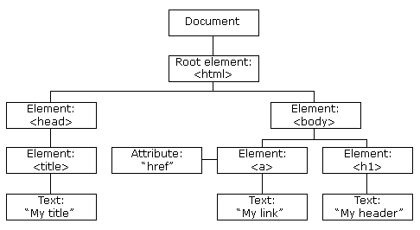
HTML document element tree

