Slide 1
Regular Expressions
In general and In JavaScript

Slide 2
Theory Of Computation/Complexity
The Theory of Computation is a scientific discipline concerned with the study of general properties of computation be it natural, man-made, or imaginary.
Most importantly, it aims to understand the nature of efficient computation.
In theoretical computer science and mathematics, the theory of computation is the branch that deals with how efficiently problems can be solved on a model of computation, using an algorithm

Slide 3
Languages
A language is theoretically a subset of all possible combinations of strings that can be created from a given alphabet.
Example: English is a (natural) language.
The 26 letter alphabet is used to make combinations of strings.
The English language says that some subsets are English words and others are not.
isEnglish(“dog”) → yes // accepts dog
isEnglish(“xyz”) → no // does not accept xyz
isEnglish(“boat”) → yes // accepts boat

Slide 4
Computational Complexity
In computer science, the computational complexity, or simply complexity of an algorithm is the amount of resources(states, time, space etc.) required for running it (a property unrelated to “complexity” in a conventional sense).
The computational complexity of a problem is the minimum of the complexities of all possible algorithms for this problem (including the unknown algorithms).

Slide 5
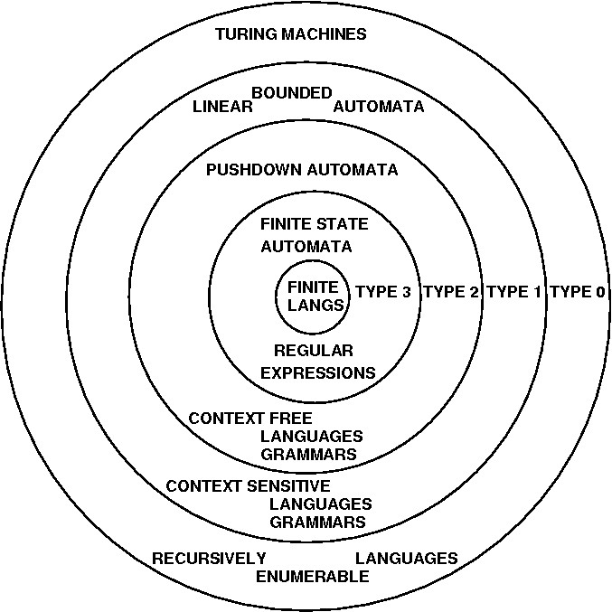
Chomsky’s Hierarchy
A finite-state machine (FSM) or finite-state automaton (FSA, plural: automata), finite automaton, or simply a state machine, is a mathematical model of computation.
It is an abstract machine that can be in exactly one of a finite number of states at any given time.
A FSA accepts Regular Expressions.

Slide 6
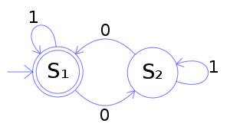
Examples of FSA
A Finite State Automata has a start state and a subset of states that are considered “accepting” states.
The state with the inbound arrow is the start state.
Double circle states are “accepting states”.
Consider the FSA.
What is the alphabet?
What words are accepted?
Besides states, how much memory is needed?

Slide 7
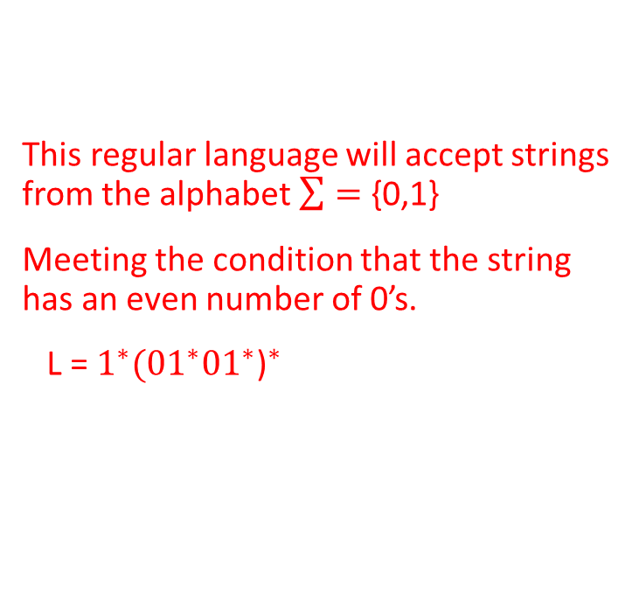
Write a regular expression for this FSA
This regular language will accept strings from the alphabet $\sum{=}$ {0,1}
Meeting the condition that the string has an even number of 0’s.
L = $1^{∗}({01^{∗}01^{∗}\text{)}}^{∗}$

Slide 8
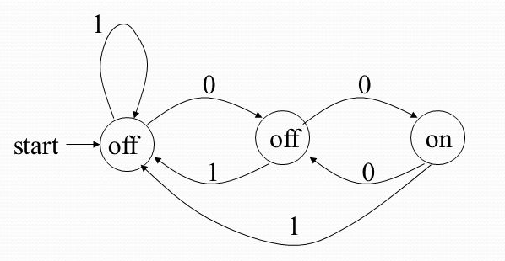
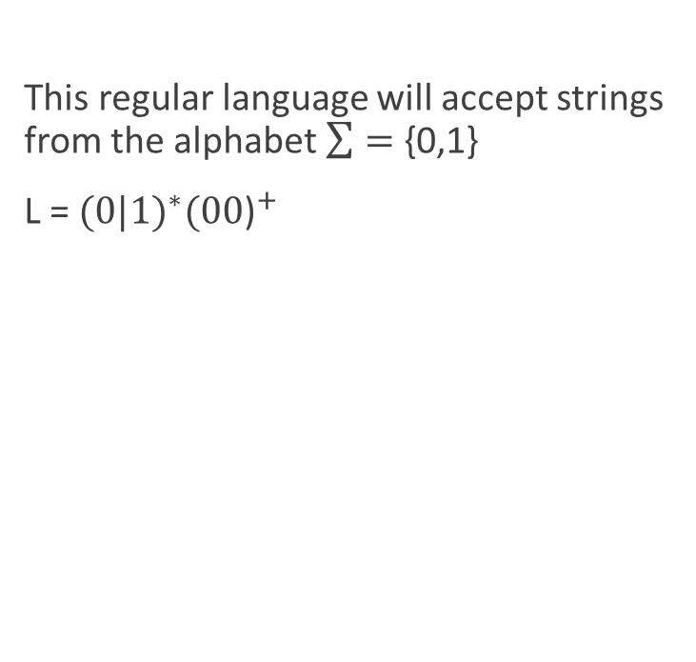
Write a regular expression for this FSA
This regular language will accept strings from the alphabet $\sum{=}$ {0,1}
L = ${(0|1)}^{∗}({00\text{)}}^{+}$

Slide 9
Regex in JavaScript
<script>
function myFunction() {
var str = "Java Script";
var patt = /java/i; // The patt “java” appears in str i=don’t consider case
var result = str.match(patt);
document.getElementById("demo").innerHTML = result;
}
</script

Slide 10
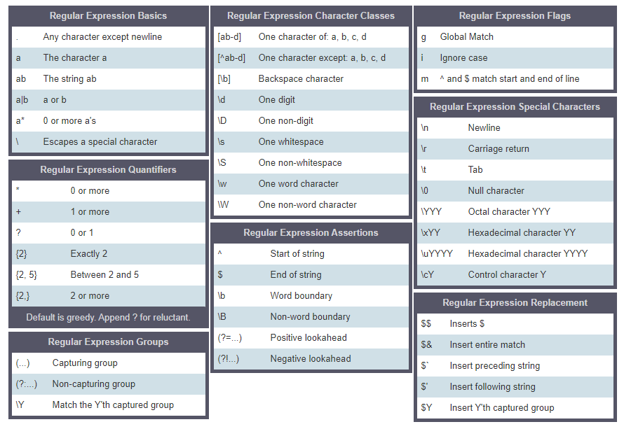
JavaScript Regex Cheat Sheet

Slide 11
Simple validation of an Email Address
function emailIsValid (email)
{
return /\S+@\S+\.\S+/.test(email) // returns true or false
}

Slide 12
Strings have indexes starting at 0
var str = “Hello World!!!";
var n = str.search(“World"); // returns 6 location of start of World

Slide 13
Replace parts of strings
var str = “School is open today!";
var res = str.replace(“open", “closed");
alert(res) // School is closed today!

Slide 14
Modifiers
Modifier | Description
i | Perform case-insensitive matching
g | Perform a global match (find all matches rather than stopping after the first match)
m | Perform multiline matching

Slide 15
Brackets
Expression | Description
[abc] | Find any of the characters between the brackets
[0-9] | Find any of the digits between the brackets
(x|y) | Find any of the alternatives separated with |

Slide 16
Metacharacters
Metacharacter | Description
\d | Find a digit
\s | Find a whitespace character
\b | Find a match at the beginning of a word like this: \bWORD, or at the end of a word like this: WORD\b
\uxxxx | Find the Unicode character specified by the hexadecimal number xxxx

Slide 17
Qualifiers
Quantifier | Description
n+ | Matches any string that contains at least one n
n* | Matches any string that contains zero or more occurrences of n
n? | Matches any string that contains zero or one occurrences of n

Slide 18
Regex exec function
<!DOCTYPE html>
<html>
<body>
<h2>JavaScript Regular Expressions</h2>
<p id="demo"></p>
<script>
var obj = /life/.exec("The best things in life are free!");
document.getElementById("demo").innerHTML =
"Found " + obj[0] + " in position " + obj.index + " in the text: " + obj.input;
</script>
</body>
</html>

Slide 19
True or False (Accept or not?)
<script>
email = “student@college.edu” ;
accept = /\S+(com|edu)/.test(email); // very week
</script>
<script>
email = “student@college.education” ;
accept = /\S+(com|edu)/.test(email); // checks if com or edu is somewhere
</script>

Slide 20
Start with and Ends with Regex
<script>
email = “student@college.education” ;
accept = /^\S+(com|edu)$/.test(email); // a little better
</script>

Slide 21
Validating time in HH:MM format
let goodInput = "12:34";
let badInput = "12:345";
let regexp = /^\d\d:\d\d$/;
alert( regexp.test(goodInput) ); // true
alert( regexp.test(badInput) ); // false
Is the time of day 96:73 valid according to this regex?

Slide 22
Validating time in HH:MM format(better)
let goodInput = "12:34";
let badInput = "12:345";
let regexp = ^[0-2][0-9]:[0-5][0-9]$
alert( regexp.test(goodInput) ); // true
alert( regexp.test(badInput) ); // false
Is the time of day 96:73 valid according to this regex?
Is this time of day 29:59 valid according to this regex?

Slide 23
Let’s make email validation a little better
<script>
email = “student@college.edu” ;
accept = /^(\S)+@(\S)+\.(com|edu)$ /.test(email);
</script>
/ ^(\S)+ @ (\S)+ \. (com|edu) / // spaced out for readability
Starts with 1 or more non-whitespace characters, then exactly 1 @ sign, then 1 or more non-whitespace characters, then exactly 1 period, then end with either com or edu

