Slide 1
Java Script
Cookies, Local Storage, session storage, SSE

Slide 2
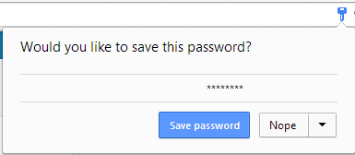
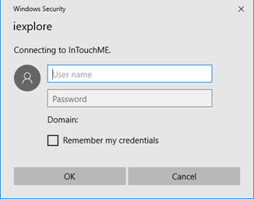
Save password pop ups

Slide 3
JavaScript - Cookies
Cookies are data, stored in small text files, on your computer.
When a web server has sent a web page to a browser, and then the connection is shut down, the server forgets everything about the user (actually that computer/browser).
Cookies were invented to solve the problem "how to remember information about the user":
When a user visits a web page, their name can be stored in a cookie.
Next time the user visits the page, the cookie "remembers" their name.
Cookies are saved in name-value pairs like: email=studentID@college.edu
When a browser requests a web page from a server, cookies belonging to the page are added to the request. This way the server gets the necessary data to "remember" information about users.

Slide 4
Creating a JS cookie
Setting a cookie in a browser
document.cookie = “email=studentID@college.edu";
Setting a cookie that will expire
document.cookie = "email=studentID@college.edu; expires=Thu, 18 Dec 2018 12:00:00 UTC";
Setting the path where the cookie is valid
document.cookie = "username=John Doe; path=/";

Slide 5
Getting the values of the cookies
var cookieTray = document.cookie;
document.cookie will return all cookies in one string much like:
cookie1=value1; cookie2=value2; cookie3=value3;

Slide 6
Cookie String?
The document.cookie property looks like a normal text string. But it is not.
Even if you write a whole cookie string to document.cookie, when you read it out again, you can only see the name-value pair of it.
If you set a new cookie, older cookies are not overwritten. The new cookie is added to document.cookie, so if you read document.cookie again you will get something like:
document.cookie = “email=studentID@college.edu";
document.cookie = “password=HelloKitty";
Cookie is now: email = studentID@college.edu; password = HelloKitty ;
Expired cookies are deleted automatically

Slide 7
Function to set a cookie of a visitor
function setCookie(cname, cvalue, exdays) {
var d = new Date();
d.setTime(d.getTime() + (exdays*24*60*60*1000)); //
var expires = "expires="+ d.toUTCString();
document.cookie = cname + "=" + cvalue + "; expires=" + expires + ";path=/";
}

Slide 8
Function to get a Cookie
function getCookie(cname) {
var name = cname + "=";
var decodedCookie = decodeURIComponent(document.cookie); // Handle special chars
var ct = decodedCookie.split(';'); // parse cookies into tray array
for(var i = 0; i <ct.length; i++) { // search for cookie
var c = ct[i];
while (c.charAt(0) == ' ') {
c = c.substring(1);
}
if (c.indexOf(name) == 0) {
return c.substring(name.length, c.length); // return cookie if found
}
}
return ""; // if not found
}

Slide 9
Function to check if a cookie is set
function checkCookie() {
var email = getCookie(“email");
if (email != "") {
alert(“You have been to this site before " + email);
} else {
email = prompt("Please enter your email address :", "");
if (email != "" && email != null) {
setCookie(“email", email, 365);
}
}
}

Slide 10
Deleting a cookie (expire the cookie)
function deleteCookie( name ) {
document.cookie = name + '=; expires=Thu, 01 Jan 1970 00:00:01 GMT;';
}
Here we are changing the value to “” and expiring the cookie

Slide 11
Where are cookies stored?
A cookie is information stored on your computer by a website you visit.
In some browsers, each cookie is a small file, but in Firefox, all cookies are stored in a single file, located in the Firefox profile folder.
Cookies often store your settings for a website, such as your preferred language or location.

Slide 12
In 2014 – HTML 5 came out
Most interesting new features added
- HTML Geolocation
- HTML Drag and Drop
- HTML Local Storage
- HTML Application Cache
- HTML Web Workers
- HTML SSE (Server Sent Events)

Slide 13
Feature replacements in HTML 5
Removed Element | Use Instead
<acronym> | <abbr>
<applet> | <object>
<basefont> | CSS
<big> | CSS
<center> | CSS
<dir> | <ul>
<font> | CSS
<frame>
<frameset>
<noframes>
<strike> | CSS, <s>, or <del>
<tt> | CSS

Slide 14
HTML 5 - Introduced Web Storage
With web storage, web applications can store data locally within the user's browser.
Before HTML5, application data had to be stored in cookies, included in every server request. Web storage is more secure, and large amounts of data can be stored locally, without affecting website performance.
Unlike cookies, the storage limit is far larger (at least 5MB) and information is never transferred to the server.
Web storage is per origin (per domain and protocol). All pages, from one origin, can store and access the same data.

Slide 15
Storing in localStorage
// Store
localStorage.setItem("lastName", "Smith");
// Retrieve
var lastName = localStorage.getItem(“lastName”);
document.getElementById(“welcomeMSG").innerHTML = “Welcome “ + lastName;

Slide 16
LocalStorage store, expire?, delete
The localStorage properties allow to save key/value pairs in a web browser.
The localStorage object stores data with no expiration date. The data will not be deleted when the browser is closed, and will be available the next day, week, or year.
The localStorage property is read-only.
Delete storage:
localStorage.removeItem(“lastName");

Slide 17
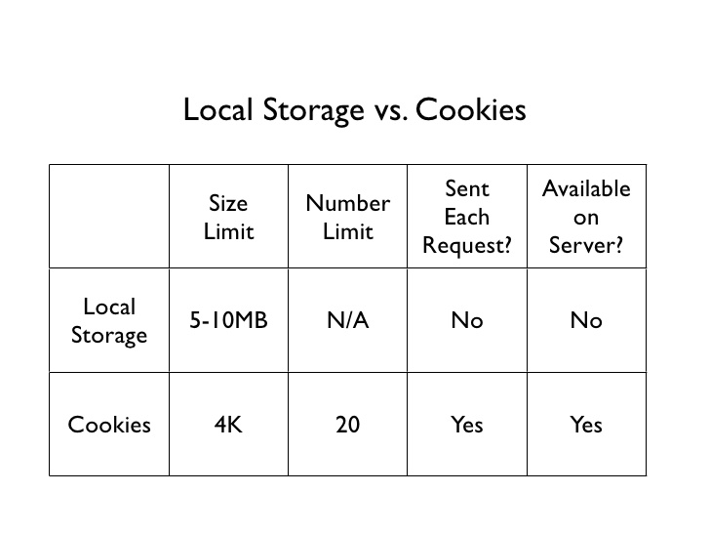
LocalStorage vs. Cookies

Slide 18
SessionStorage
The sessionStorage (like localStorage) properties allow to save key/value pairs in a web browser.
The sessionStorage object stores data for only one session (the data is deleted when the browser tab is closed).

Slide 19
Set, get, remove, clear sessionStorage
window.sessionStorage
Syntax for SAVING data to sessionStorage:
sessionStorage.setItem("key", "value");
Syntax for READING data from sessionStorage:
var lastname = sessionStorage.getItem("key");
Syntax for REMOVING saved data from sessionStorage:
sessionStorage.removeItem("key");
Syntax for REMOVING ALL saved data from sessionStorage:
sessionStorage.clear();

Slide 20
sessionStorage example
if (sessionStorage.clickcount) {
sessionStorage.clickcount = Number(sessionStorage.clickcount) + 1;
} else {
sessionStorage.clickcount = 1;
}
document.getElementById("result").innerHTML = "You have clicked the button " +
sessionStorage.clickcount + " time(s) in this session.";

Slide 21
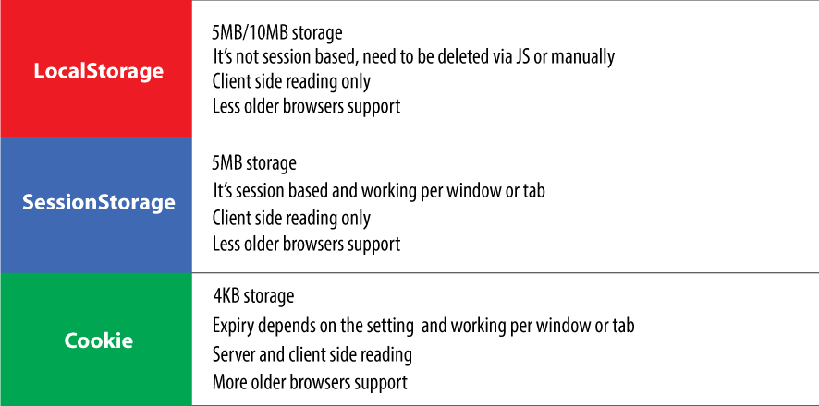
Cookie vs LocalStorage vs SessionStorage

Slide 22
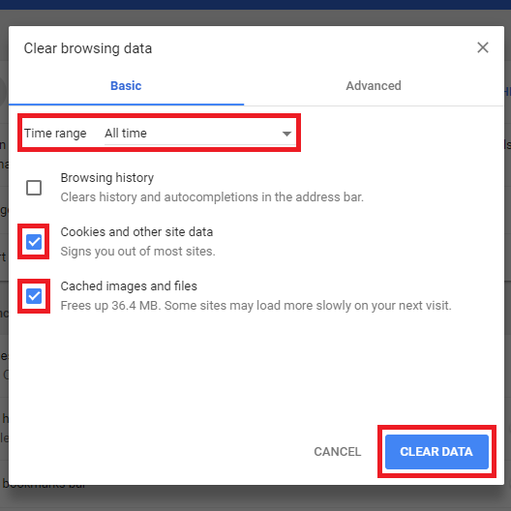
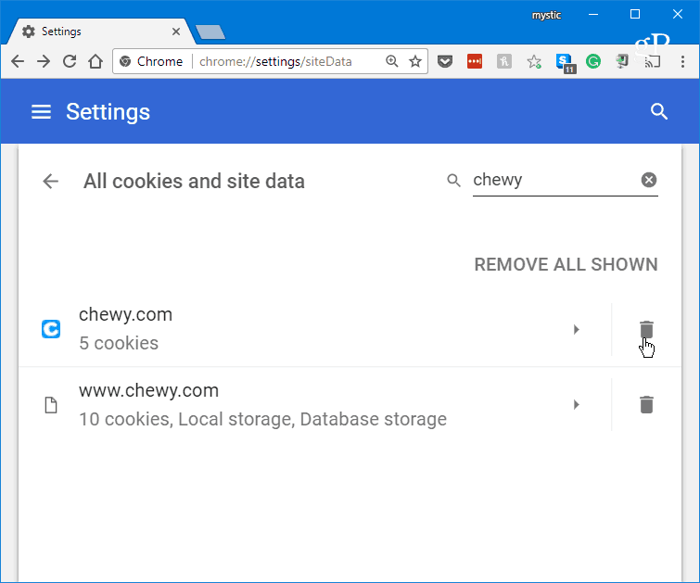
Clearing Cookies (and other data)

Slide 23
SSE (Server Sent Events – New in HTML5)
var source = new EventSource(“./events/latestScore.php");
source.onmessage = function(event) {
document.getElementById("result").innerHTML += event.data + "<br>";
};

Slide 24
Mixing SSE with browser storage
If you do not want server sent events to constantly update your web browser it is recommended
- when updates are sent, update cookie, localStorage, sessionStorage data
- update the server sent data at your pace

