Slide 1
JavaScript with JQuery

Slide 2
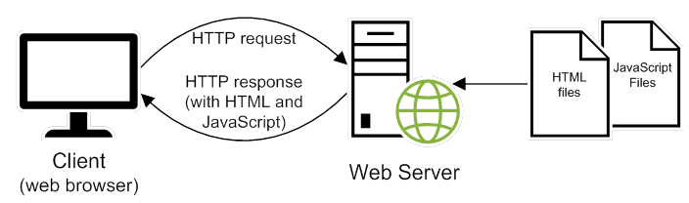
How JavaScript fits into the client/server architecture

Slide 3
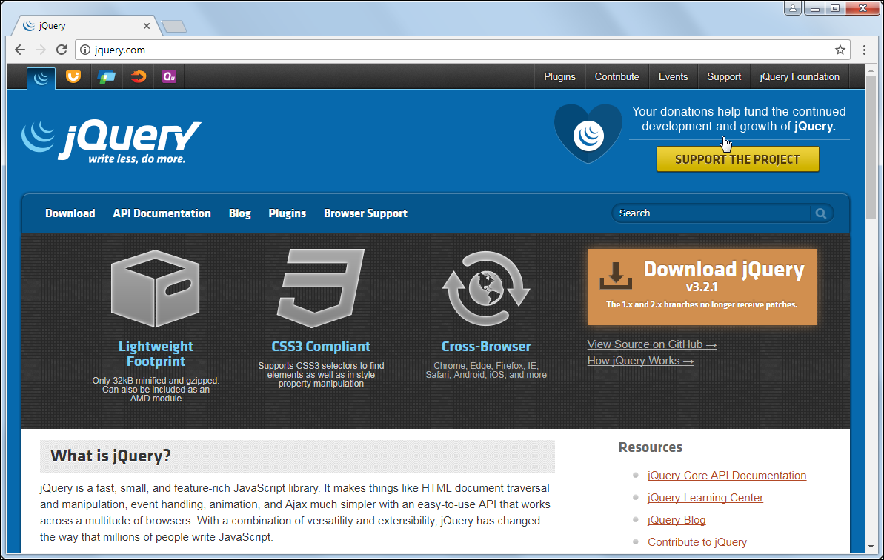
The jQuery website at jQuery.com

Slide 4
What jQuery offers
Dozens of methods that make it easier to add JavaScript features to your web pages
Methods that are tested for cross-browser compatibility

Slide 5
How to include jQuery files in a web page
How to include the jQuery file from your computer
<script src="jquery-3.2.1.js"></script>
How to include jQuery from a CDN
<script src="http://code.jquery.com/jquery-3.2.1.min.js">
</script>

Slide 6
How to code jQuery selectors
By element type
$("h2")
By id
$("#email_address")
By class attribute
$(".warning")

Slide 7
How to call jQuery methods
How to get the value from a text box
var emailAddress = $("#email_address").val();
How to set the text in an element
$("#email_address_error").text(
"Email address is required");
How to set the text for the next sibling
$("#email_address").next().text(
"Email address is required");

Slide 8
How to code jQuery event methods
How to code the ready event method
$(document).ready(function() {
alert("The DOM is ready");
});
How to code the click event method for all h2 elements
$("h2").click(function() {
alert("This heading has been clicked");
});
How to use the click event method within the ready event method
$(document).ready(function() {
$("h2").click(function() {
alert("This heading has been clicked");
}); // end of click event handler
}); // end of ready event handler

Slide 9
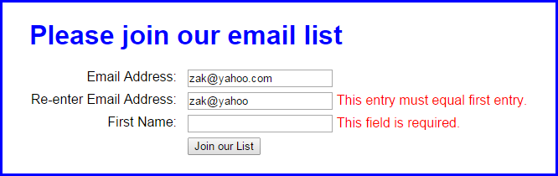
The Email List application using jQuery

Slide 10
The HTML for the Email List with jQuery app
<!DOCTYPE html>
<html>
<head>
<meta charset="UTF-8">
<title>Join Email List</title>
<link rel="stylesheet" href="email_list.css">
<script
src="http://code.jquery.com/jquery-3.2.1.min.js">
</script>
<script src="email_list.js"></script>
</head>
<body>
<main>
<h1>Please join our email list</h1>
<form id="email_form" name="email_form"
action="join.php" method="get">
<label for="email_address1">
Email Address:</label>
<input type="text" id="email_address1"
name="email_address1">
<span>*</span><br>

Slide 11
The HTML for the Email List jQuery app (cont.)
<label for="email_address2">
Re-enter Email Address:</label>
<input type="text" id="email_address2"
name="email_address2">
<span>*</span><br>
<label for="first_name">First Name:</label>
<input type="text" id="first_name"
name="first_name">
<span>*</span><br>
<label>&nbsp;</label>
<input type="button" id="join_list"
value="Join our List">
</form>
</main>
</body>
</html>

Slide 12
The jQuery for the Email List application
$(document).ready(function() {
$("#join_list").click(function() {
var emailAddress1 = $("#email_address1").val();
var emailAddress2 = $("#email_address2").val();
var isValid = true;
// validate the first email address
if (emailAddress1 == "") {
$("#email_address1").next().text(
"This field is required.");
isValid = false;
}
else {
$("#email_address1").next().text("");
}

Slide 13
The jQuery for the Email List app (continued)
// validate the second email address
if (emailAddress2 == "") {
$("#email_address2").next().text(
"This field is required.");
isValid = false;
}
else if (emailAddress1 != emailAddress2) {
$("#email_address2").next().text(
"This entry must equal first entry.");
isValid = false;
}
else {
$("#email_address2").next().text("");
}

Slide 14
The Email List jQuery (continued)
// validate the first name entry
if ($("#first_name").val() == "") {
$("#first_name").next().text(
"This field is required.");
isValid = false;
}
else {
$("#first_name").next().text("");
}
// submit the form if all entries are valid
if (isValid) {
$("#email_form").submit();
}
}); // end click
}); // end ready

Slide 15
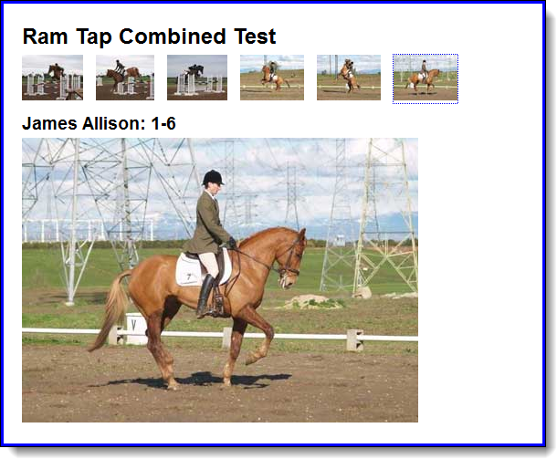
The user interface for the Image Swap application

Slide 16
The script elements for the image swap
<script src="jquery-3.2.1.min.js"></script>
<script src="image_swaps.js"></script>

Slide 17
The HTML for the images
<main>
<h1>Ram Tap Combined Test</h1>
<ul id="image_list">
<li><a href="images/h1.jpg"
title="James Allison: 1-1">
<img src="thumbnails/t1.jpg" alt=""></a></li>
<li><a href="images/h2.jpg"
title="James Allison: 1-2">
<img src="thumbnails/t2.jpg" alt=""></a></li>
...
<li><a href="images/h6.jpg"
title="James Allison: 1-6">
<img src="thumbnails/t6.jpg" alt=""></a></li>
</ul>
<h2 id="caption">James Allison 1-1</h2>
<p><img src="images/h1.jpg" alt="" id="image"></p>
</main>

Slide 18
The CSS for the li elements
li {padding-right: 10px; display: inline; }

Slide 19

A Slide Show application with fading out and in

Slide 20
The script elements for the slide show
<script src="jquery-3.2.1.min.js"></script>
<script src="slide_show.js"></script>

Slide 21
The HTML for the slide show
<section>
<h1>Fishing Slide Show</h1>
<h2 id="caption">Casting on the Upper Kings</h2>
<img id="slide" src="images/casting1.jpg" alt="">
<div id="slides">
<img src="images/casting1.jpg"
alt="Casting on the Upper Kings">
<img src="images/casting2.jpg"
alt="Casting on the Lower Kings">
<img src="images/catchrelease.jpg"
alt="Catch and Release on the Big Horn">
<img src="images/fish.jpg"
alt="Catching on the South Fork">
<img src="images/lures.jpg"
alt="The Lures for Catching">
</div>
</section>

Slide 22
The critical CSS for the slide show
#slides img { display: none; }

Slide 23
Zak’s recommendations for JavaScript websites
Dynamic Drive
The JavaScript Source
Two types of jQuery components that you can add to your website
jQuery plugins
jQuery UI widgets

Slide 24
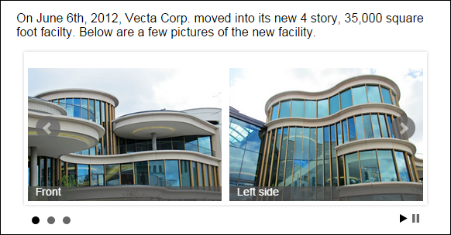
A jQuery plugin for a carousel called bxSlider

Slide 25
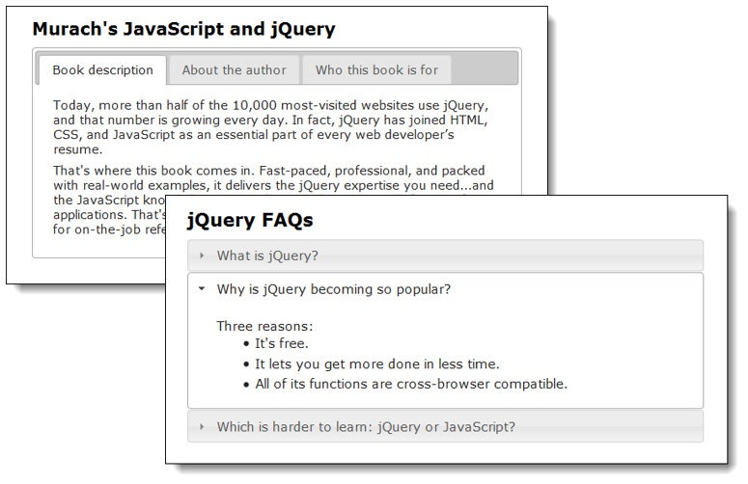
jQuery UI widgets for tabs and accordions

