Slide 1
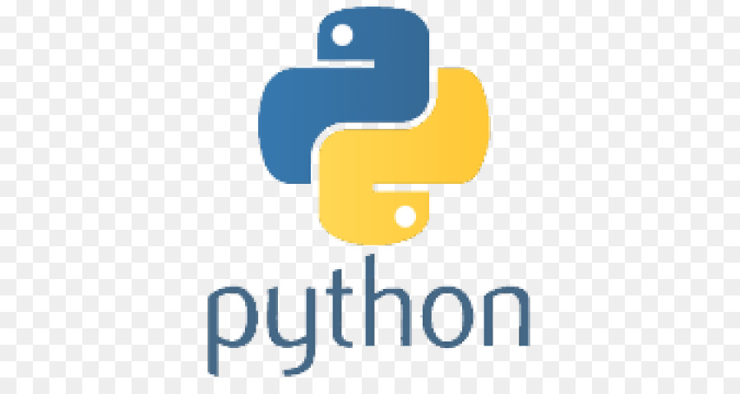
Classes and Objects
Introduction to classes in python
Methods, __init__() inheritance (public, protected, private)

Slide 2
Creating a class
class Person:
first = 'first name'
last = 'last name'
yob = 'NA'

Slide 3
Using the class to create objects
p1 = Person()
p1.first = 'Joe'
p1.last = 'DiMaggio'
p1.yob = '1914'
p2 = Person()
p2.first = 'Micky'
p2.last = 'Mantle'
print(p1.first + " " + p1.last + ‘ was born in ' + p1.yob)
print(p2.first + " " + p2.last + ‘ was born in ' + p2.yob)
OUTPUT:
Joe DiMaggio was born in 1914
Micky Mantle was born in NA

Slide 4
__init__() method
All classes have a function called __init__(), which is always executed when the class is being initiated.
class Person:
first = 'first name'
last = 'last name'
yob = 'NA'
def __init__(self, f, l, y):
first = f
last = l
yob = y
p1 = Person() # would now be an error because parameters to __init__() not supplies
Note:
All class functions (like __init__() automatically have the object itself as the first parameter. It is common to call it ‘self’ but you may call it anything you want.
C++ programmers typically call it ‘this’

Slide 5
Must supply all parameters to __init__()
class Person:
def __init__(self,f,l,y):
first = f
last = l
yob = y
p1 = Person('Joe','DiMaggio','1914')
p2 = Person('Micky','Mantle’) # error did not supply the required YOB
print(p1.first + " " + p1.last + 'was born in ' + p1.yob)
print(p2.first + " " + p2.last + 'was born in ' + p2.yob)

Slide 6
Member methods
class Person:
def __init__(self,f,l,y):
first = f
last = l
yob = y
def getYOB(self)
return self.yob
def setYOB(self,Y)
self.yob = Y

Slide 7
So why did this work without __init__() ?
class Person:
first = 'first name'
last = 'last name'
yob = 'NA’
P1 = Person()
class Person:
first = 'first name'
last = 'last name'
yob = 'NA’
__init__(self);
pass
P1 = Person()
If __init__() is not supplied, python will give you a free one that only takes self as a parameter and does not do anything.
“Pass” means ‘Don’t do anything’ (ie take a pass)
So the class on the left is equal to the class on the right

Slide 8
Inheritance
class Person:
first = 'first name'
last = 'last name'
yob = 'NA'
def __init__(self, f, l, y):
first = f
last = l
yob = y
class BaseBallPlayer(Person):
battingAverage = 0
def __init__(self, f,l,y,t,ba):
Person.__init__(self,f,l,y)
team = t
battingAverage = ba
bbp = BaseBallPlayer(‘Joe’,’DiMaggio’,’1914’,’Yankees’,’325’)

Slide 9
Public attributes
By Default, attributes in python are public (not private) unlike C++/Java
class employee:
def __init__(self, name, sal):
self.name=name
self.salary=sal

Slide 10
Protected attributes
Protected attributes have 1 underscore in front of the variable name
class employee:
def __init__(self, name, sal):
self._name=name
self._salary=sal

Slide 11
Private attributes
Private attributes have 2 underscores in front of the variable name
class employee:
def __init__(self, name, sal):
self.__name=name
self.__salary=sal

Slide 12
Public, Protected, Private
Public – The members of a class which are declared public are easily accessible from any part of the program. All data members and member functions of a class are public by default.
Protected – The members of a class which are declared protected are only accessible to a class derived from it. Data members of a class are declared protected by adding a single underscore ‘_’ symbol before the data member of that class.
Private - The members of a class which are declared private are accessible within the class only, private access modifier is the most secure access modifier. Data members of a class are declared private by adding a double underscore ‘__’ symbol before the data member of that class.

Slide 13
Inheritance (revisited)
class Person:
yob = 'NA'
def __init__(self, f, l, y):
_first = f
_last = l
_yob = y
class BaseBallPlayer(Person):
def __init__(self, f,l,y,t,ba):
Person.__init__(self,f,l,y) # call person constructor
_team = t # set protected attribute team
_battingAverage = ba # set protected attribute
def getBattingAverage(self) # public method that can
return self._battingAverage # access protected data

