Slide 1
IP Addresses
IPv4 (32 bit format)

Slide 2
History of IPv4 (32 bits)
Started in 1970s
RFC 791 which governs IPv4 published in 1981
1985 – 6% of IPv4 addresses were taken
1990 – 13% of IPv4 addresses were taken
1995 – 25% of IPv4 addresses were taken
2000 – 50% of IPv4 addresses were taken
2002 – 67% of IPv4 addresses were taken
2006 – IPv6 (128 bits) introduced

Slide 3
Protocol
The official procedure or system of rules governing affairs of state or diplomatic occasions.
The original draft of a diplomatic document, especially of the terms of a treaty agreed to in conference and signed by the parties.
Sometimes referred to as an access method, a protocol is a standard used to define a method of exchanging data over a computer network such as local area network, Internet, Intranet, etc.

Slide 4
IP (Internet Protocol)
The Internet Protocol is responsible for addressing hosts and for routing datagrams (packets) from a source host to a destination host across one or more IP networks.

Slide 5
IPv4 address
The format of an IPv4 address is a 32-bit numeric address written as four 8-bit numbers in they decimal form separated by periods.
Each of the 4 numbers can be between 0 to 255.
For example, 1.160.10.240 could be an IPv4 address.
In a 32 bit representation, it would be
00000001 10100000 00001010 11110000
Note: there are 4 Gig of IP addresses and they are going to run out soon.

Slide 6
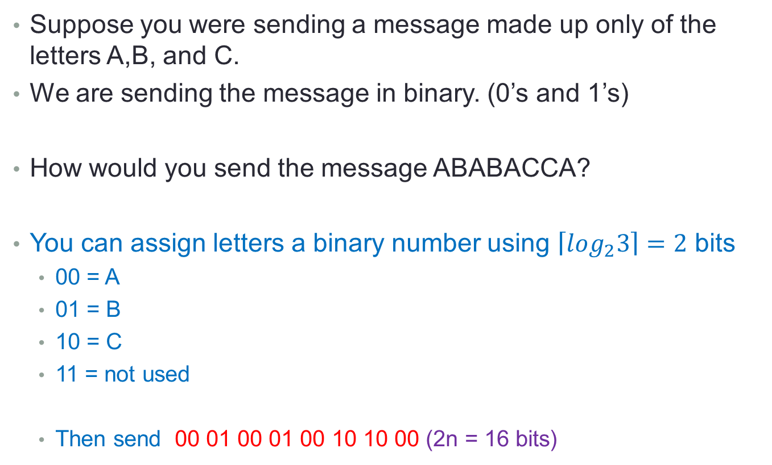
Letter messages send in binary
Suppose you were sending a message made up only of the letters A,B, and C.
We are sending the message in binary. (0’s and 1’s)
How would you send the message ABABACCA?
You can assign letters a binary number using $\left\lceil \log_{2}3\right\rceil =2$ bits
  00 = A
  01 = B
  10 = C
  11 = not used
  Then send 00 01 00 01 00 10 10 00 (2n = 16 bits)

Slide 7
Huffman codes (data compression)
You notice that ABABACCA is 50% A’s , 25% B’s and 25% C’s
Can we use this letter frequency to assign binary values to the letters A,B and C to send the same message but using less bits?
The receiver of the message will know how decode the message.

Slide 8



Huffman codes for A-50% B-25% C-25%
0
1
A
0
1
B
C

Slide 9
Huffman codes (compression)
ABABACCA
Use less bits for the highest frequency letters.
You might assign each letter a binary representation.
  0 = A
  10 = B
  11 = C
  Then send 0 10 0 10 0 11 11 0 (12 bits)

Slide 10
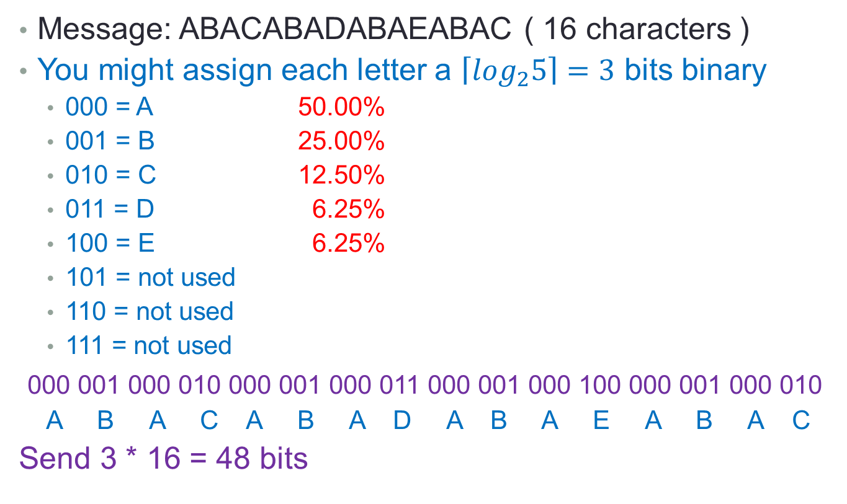
Another Huffman codes example
Message: ABACABADABAEABAC ( 16 characters )
You might assign each letter a $\left\lceil \log_{2}5\right\rceil =3$ bits binary
  000 = A 50.00%
  001 = B 25.00%
  010 = C 12.50%
  011 = D 6.25%
  100 = E 6.25%
  101 = not used
  110 = not used
  111 = not used
000 001 000 010 000 001 000 011 000 001 000 100 000 001 000 010
A B A C A B A D A B A E A B A C
Send 3 * 16 = 48 bits

Slide 11





Huffman codes for IPv4 networks
0
1
A
0
1
B
0
1
C
0
1
D
E

Slide 12
Another Huffman codes example
Message: ABACABADABAEABAC
Notice 50% As, 25% Bs, 12.5% C, 6.25 D’s, and 6.25% Es
We could use the following codes
  A = 0 (if 1st bit=0, character is A, otherwise it’s not A)
  B = 10 (if 1st 2 bits=10, character is B, otherwise it’s not B)
  C = 110 (if 1st 3 bits=110, character is C, otherwise it’s not C)
  D = 1110 (if 1st 4 bits=1110, character is D, otherwise it’s not D)
  E = 1111 (if 1st 4 bits=1111, character is E, otherwise it’s not E)
  0 10 0 110 0 10 0 1110 0 10 0 1111 0 10 0 110
  A B A C A B A D A B A E A B A C
Send 30 bits instead of 48 bits

Slide 13
IPv4 Classes
Class A - ~50% - Network.Host.Host.Host
Class B - ~25% - Network.Network.Host.Host
Class C - ~12% - Network.Network.Network.Host
Class D - ~ 6% - Used for multicasting
Class E - ~ 6% - Used for Research

Slide 14
Subnet (sub networks)
A subnet (short for "subnetwork") is an identifiably separate part of an organization's network.
Typically, a subnet may represent all the machines at one geographic location, in one building, or on the same local area network (LAN).
Having an organization's network divided into subnets allows it to be connected to the Internet with a single shared network address.
Without subnets, an organization could get multiple connections to the Internet, one for each of its physically separate subnetworks, but this would require an unnecessary use of the limited number of network numbers the Internet has to assign.

Slide 15
Highest order octet
Types Range Starting bits Available
Type A 0 to 127 0XXXXXXX 128
Type B 128 to 191 10XXXXXX 64
Type C 192 to 223 110XXXXX 32
Type D 224 to 239 1110XXXX 16
Type E 240 to 255 1111XXXX 16

Slide 16
IPv4 IP address Type A
1st Octal range: 1 – 126
High order bits: 0
Format: Network.Host.Host.Host
Subnet Mask: 255.0.0.0
Number of Networks: 126 (2⁷ – 2)
Hosts per Network: 16,777,214 (2²⁴ – 2)
Note: Class A addresses 127.0.0.0 to 127.255.255.255 cannot be used and are reserved for loopback and diagnostic functions

Slide 17
IPv4 IP address Type B
1st Octal range: 128 – 191
High order bits: 10
Format: Network.Network.Host.Host
Subnet Mask: 255.255.0.0
Number of Networks: 16,382 (2¹⁴ – 2)
Hosts per Network: 65,534 (2¹⁶ – 2)

Slide 18
IPv4 IP address Type C
1st Octal range: 192 – 223
High order bits: 110
Format: Network.Network.Network.Host
Subnet Mask: 255.255.255.0
Number of Networks: 2,097,150 (2²¹ – 2)
Hosts per Network: 254 (2⁸ – 2)

Slide 19
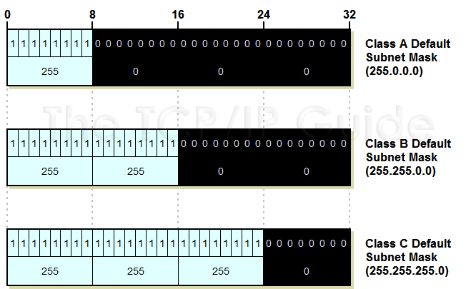
Subnet masks
Or the bits of the IP address to get the Subnet value

Slide 20
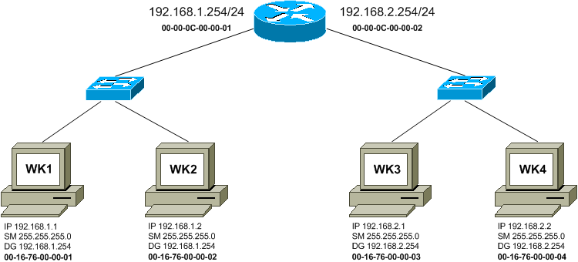
IP routing – Type C address

Slide 21
(RIR) Regional Internet Registry
A regional Internet registry (RIR) is an organization that manages the allocation and registration of Internet number resources within a particular region of the world. Internet number resources include IP addresses and autonomous system (AS) numbers.
African Network Information Center (AFRINIC) for Africa
American Registry for Internet Numbers (ARIN) for the United States, Canada, several parts of the Caribbean region, and Antarctica.
Asia-Pacific Network Information Centre (APNIC) for Asia, Australia, New Zealand, and neighboring countries
Latin America and Caribbean Network Information Centre (LACNIC) for Latin America and parts of the Caribbean region
Réseaux IP Européens Network Coordination Centre (RIPE NCC) for Europe, Russia, the Middle East, and Central Asia

Slide 22
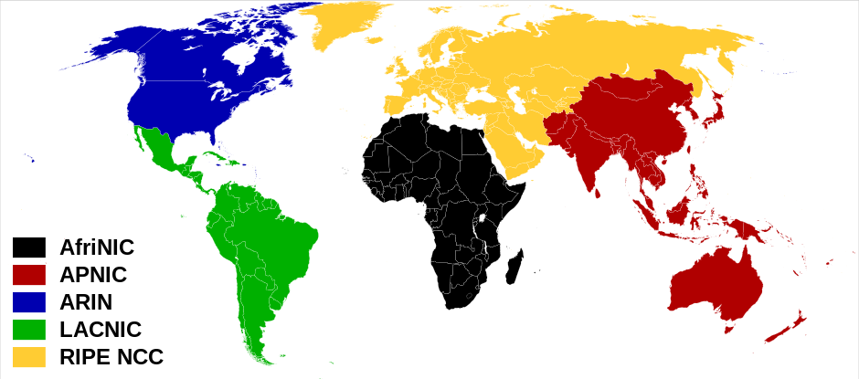
RIR world map

Slide 23
IPv4 address classes recap
The four numbers in an IP address are used in different ways to identify a particular network and a host on that network. Four regional Internet registries -- ARIN, RIPE NCC, LACNIC and APNIC-- assign Internet addresses from the following three classes:
Class A - supports 16 million hosts on each of 126 networks
24 bits on 7 bits = 31 bits
Class B - supports 65,000 hosts on each of 16,000 networks
16 bits on 14 bits = 30 bits
Class C - supports 254 hosts on each of 2 million networks
8 bits on 21 bits = 29 bits

Slide 24
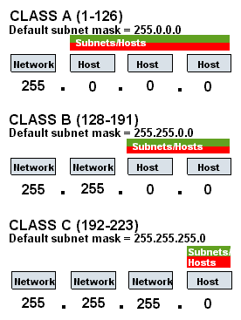
Subnets and Hosts

Slide 25
Dynamic IP addressing
Your company has 1 type C network because that’s all you can afford right now. This allows you 254 IPv4 addresses but you have 1000 computers/fax/IP phones etc. you would like to connect to the internet.
How can you do this?
Answer 1)
  Save up more money and buy 3 more type C network address
  Now you have 4 * 254 = 1016 IPv4 addresses
Answer 2)
  Dynamically assign your 254 IP addresses

Slide 26
Dynamic IP assignment
Your company has 1 type C network because that all you can afford right now. This allows you 254 IPv4 addresses but you have 1000 computers you would like to connect to the internet.
Internally number your 1000 devices (computers, fax, etc.) 1 to 1000
Every time one needs to connect the internet, dynamically assign one of your IPv4 addresses to that device for the duration of that devices connections to the internet.

Slide 27
Dynamic IP example
Internal Device 341 wants to connect to facebook
Internal Device 622 wants to connect to linkedin
You have a type C network 192.181.16.XXX
You control addresses 192.181.16.1 to 192.181.16.254
Internal Device | IP address
341 | 192.181.16.1
622 | 192.181.16.2

Slide 28
Dynamic IP overloading
Internal Device 123 wants to connect to facebook
Internal Device 456 wants to connect to linkedin
You used up all 254 IP addresses
Overload address 192.181.16.254
Internal Device | IP address | Connected IP
123 | 192.181.16.254 | facebook
456 | 192.181.16.254 | linkedin

Slide 29
IPv6 (128 bits – 16 bytes)
New header format designed to keep header overhead to a minimum - achieved by moving both non-essential fields and optional fields to extension headers that are placed after the IPv6 header. The streamlined IPv6 header is more efficiently processed at intermediate routers.
Large address space - IPv6 has 128-bit (16-byte) source and destination IP addresses. The large address space of IPv6 has been designed to allow for multiple levels of subnetting and address allocation from the Internet backbone to the individual subnets within an organization. Obviates the need for address-conservation techniques such as the deployment of NATs.
Efficient and hierarchical addressing and routing infrastructure- based on the common occurrence of multiple levels of Internet service providers.
Stateless and stateful address configuration both in the absence or presence of a DHCP server. Hosts on a link automatically configure themselves with link-local addresses and communicate without manual configuration.
Built-in security: Compliance with IPSec [10] is mandatory in IPv6, and IPSec is actually a part of the IPv6 protocol. IPv6 provides header extensions that ease the implementation of encryption, authentication, and Virtual Private Networks (VPNs). IPSec functionality is basically identical in IPv6 and IPv4, but one benefit of IPv6 is that IPSec can be utilized along the entire route, from source to destination.
Better support for prioritized delivery thanks to the Flow Label field in the IPv6 header
New protocol for neighboring node interaction- The Neighbor Discovery protocol for IPv6 replaces the broadcast-based Address Resolution Protocol (ARP), ICMPv4 Router Discovery, and ICMPv4 Redirect messages with efficient multicast and unicast Neighbor Discovery messages.
Extensibility- IPv6 can easily be extended for new features by adding extension headers after the IPv6 header.

