Slide 1
Deadlocks (part II)
Deadlock avoidance – (not reasonable)
Deadlock detection
Resource Allocation Graphs
Resource Pool and Counting Semaphores

Slide 2
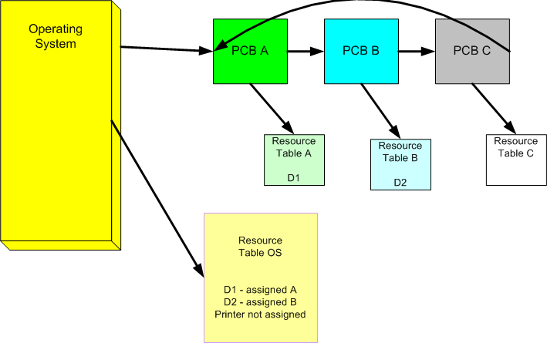
Resource Tables

Slide 3
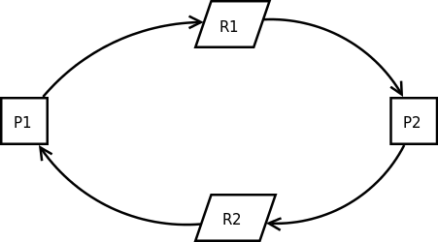
Deadlock Definition
A deadlock is a situation in which two or more competing actions are each waiting for the other to finish, and thus neither ever does.
P1 P2
P(R1) P(R2)
P(R2) P(R1)
CS CS
V(R2) V(R1)
V(R1) V(R2)

Slide 4
Deadlock 4 necessary conditions
Mutual Exclusion – Processes claim exclusive control of the resources they require
Wait For – processes hold resources already allocated to them while waiting for additional resources
No Pre-emption – resources cannot be removed from the process using them until it is used to completion
Circular Wait – A circular chain of processes exist in which each process holds one or more resources that are requested by the next process in the chain.

Slide 5
Deadlock Avoidance (reasonable?)
Designing an Operating System (Linux, Windows, iOS, Android etc.) that avoids deadlocks would require removing at least 1 of the 4 necessary conditions of deadlock.
Many systems programmers would argue that the removal of any one of these 4 would limit the system too much and the gain of having a deadlock-free system would not be worth it.
Just like driving a car, which can on (hopefully rare) occasions get a flat tire, it is popular to design systems that may on rare occasions go into deadlock and the system detects and deals with the problem at that time.

Slide 6
Deadlock Detection
We need a way to detect that 2 or more processes are in a deadlock.
Allow the system to run normally and occasionally have the Operating System check for deadlocks.
If a deadlock is detected, the Operation System should attempt to fix the situation as best as it can which includes asking the users of a deadlocked process to volunteer it killing their process which will return resources to the system, which will then end the deadlock.

Slide 7
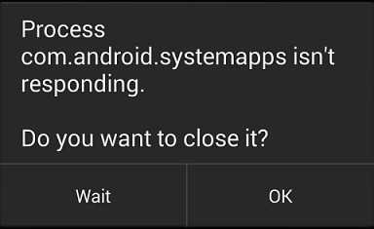
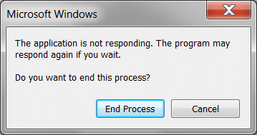
Asking the user to end Deadlock

Slide 8
Review of Data Structures and Algorithms
Graphs can be recorded in memory
Algorithms can be run on graphs that answer questions:
What is the shortest path from point A to point B?
Is a graph fully connected (yes or no)?
Does a graph contain a cycle (yes or no)?
If an existing graph which doesn’t currently have a cycle, was to have an edge added to it, would the graph now have a cycle?

Slide 9
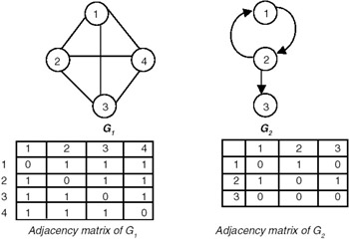
Representing Graphs in Memory
Adjacency matrix

Slide 10
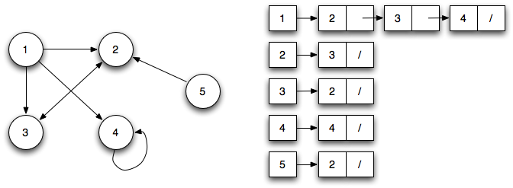
Representing Graphs in Memory
Adjacency lists

Slide 11
Deadlock (DAG with a cycle)
A deadlock is a situation in which two or more competing actions are each waiting for the other to finish, and thus neither ever does.
P1 P2
P(R1) P(R2)
P(R2) P(R1)
CS CS
V(R2) V(R1)
V(R1) V(R2)

Slide 12
Resource Pool
A collection of identical resources
Ex)
A room full of printers
Computer Storage (on the stack or heap)

Slide 13
Counting Semaphores
When a system has multiple identical copies of a resource, a Counting Semaphore can be used to allow mutual access to that pool of identical resources.
S=8
P(S)
{ if (S > 0)
{
S = S - 1;
}
else
{
OS moves the process to the queue waiting for S
}
Update resource tables and the Resource Allocation Graph
}

Slide 14
Counting Semaphores
And the V function for counting semaphores is
V(S)
{
if (a process is waiting for an S)
{
OS moves the process to the ready queue
}
else
{
S = S + 1;
}
Update the resource tables and the RAG
)

Slide 15
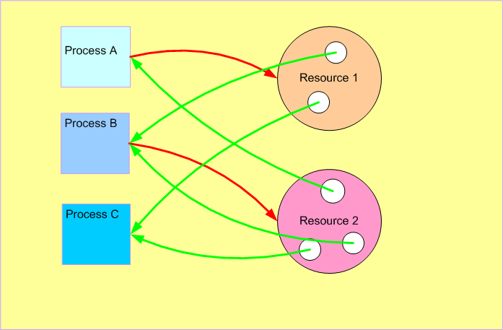
RAG – Resource Allocation Graph (with counting Semaphores)

Slide 16
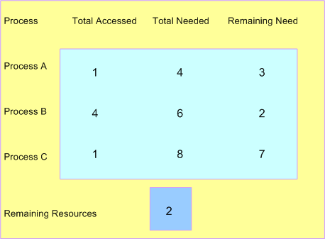
Dijkstra’s Banker’s Algorithm – Safe State
Total common resources is 8

Slide 17
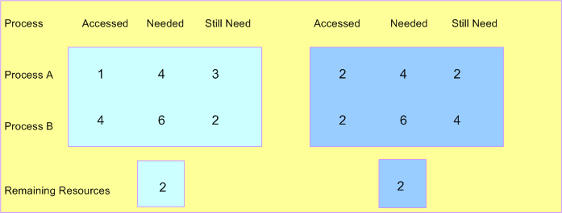
Bankers Algorithm - 2 Resource Pools (not in a Safe State)

Slide 18
P(S) using Banker’s Algorithm
S=8
P(S)
{ if (System would stay in a Safe State)
{
S = S - 1;
}
else
{
OS moves the process to the queue waiting for S
}
Update resource tables and the Resource Allocation Graph
}

