Slide 1

Introductory Visualizing Technology
Sixth Edition
Chapter 10
Security and Privacy
Notes:
Welcome to Chapter 10 of Visualizing Technology, sixth edition, by Debra Geoghan. This chapter discusses security and privacy.

Slide 2
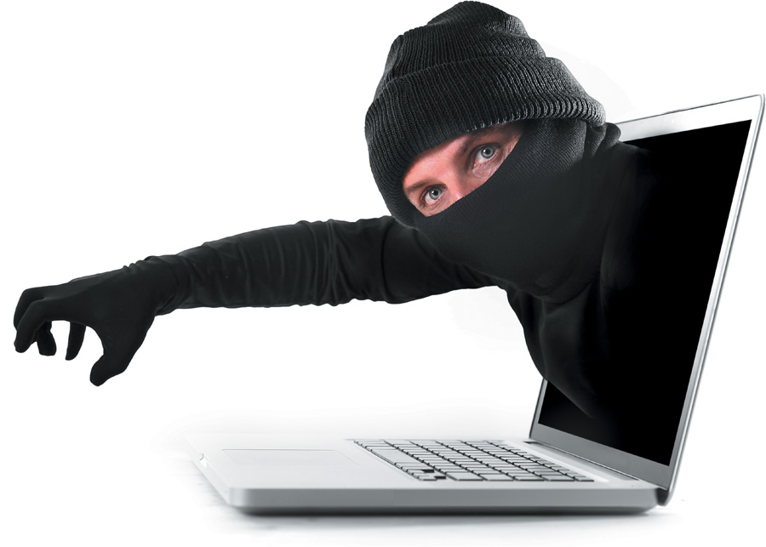
Recognize Different Types of Cybercrime
Notes:
Objective 1 recognizes the different types of cybercrime, including harassment, phishing, pharming, fraud, identity theft, and hacking.

Slide 3
Cybercrime: They Are Out to Get You – Personal Cybercrime (1 of 2)
Harassment
Cyberbullying: between two minors
Cyber-harassment: between adults
Cyber-stalking:
More serious in nature
Stalker demonstrates a pattern of harassment
Poses a credible threat of harm
Notes:
Personal cybercrime is perpetrated against individuals, as opposed to businesses and other organizations. These are crimes that affect you directly and that you need to be aware of. Cyberbullying and cyber-stalking are two categories of harassment. When the exchange involves two minors, it is cyberbullying; when it involves adults, it is cyber-harassment. Cyber-stalking is more serious in nature, with the stalker demonstrating a pattern of harassment and posing a credible threat of harm.

Slide 4
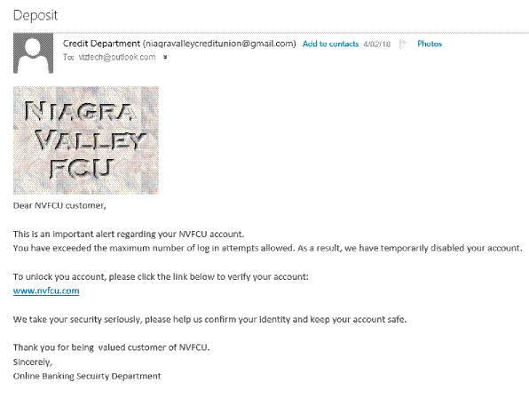
Cybercrime: They Are Out to Get You – Personal Cybercrime (2 of 2)
Phishing
Email messages and IMs
Appear to be from someone with whom you do business
Designed to trick you into providing usernames and passwords
Pharming
Redirects you to a phony website even if you type the URL
Hijacks a company’s domain name
Notes:
Phishing uses email messages and IMs that appear to be from a legitimate business. The intent of such a communication is to trick you into providing personal information.
Pharming redirects you to a phony website even if you type the right address into your browser. They do this by hijacking a company’s domain name that has not been renewed or that has security-compromised web servers. Both phishing and pharming appear to be from legitimate sites.

Slide 5
Cybercrime: They Are Out to Get You – Social Network Attacks (1 of 4)
Adware and other malware
Suspicious emails and notifications
Appear to be from a site administrator
Asking for your password
Threatening to suspend your account
Phishing and "Please send money" scams
Notes:
Social networks provide ways for cybercriminals to contact and scam you. Common threats include:
Adware and other malware
Suspicious emails and notifications
Phishing and other “send money” scams

Slide 6
Cybercrime: They Are Out to Get You – Social Network Attacks (2 of 4)
Clickjacking
Clicking on a link allows this malware to post unwanted links on your page
Malicious script scams
You copy and paste some text into your address bar
It might execute a malicious script
Creates pages and events
Sends spam out to your friends
Notes:
Common threats include clickjacking, in which clicking on a link allows malware to post unwanted links on your page.
In malicious script scams, you copy and paste some text into your address bar, which executes a malicious script that creates pages and events or sends spam to your friends.

Slide 7
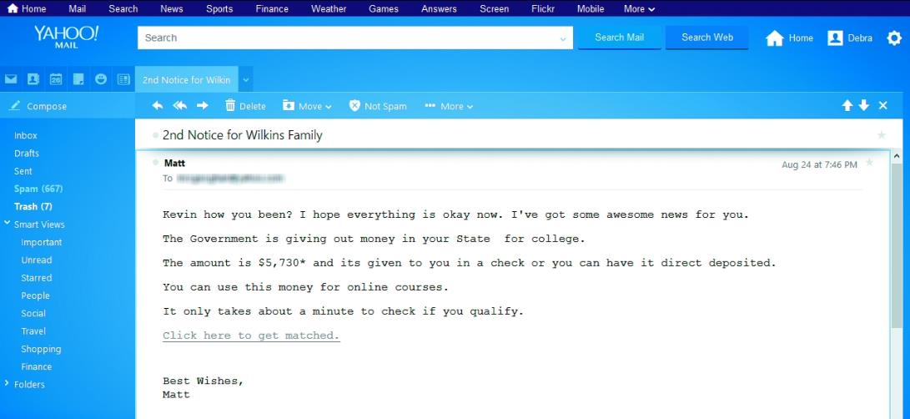
Cybercrime: They Are Out to Get You – Social Network Attacks (3 of 4)
Computer Fraud
Schemes that convince you to give money or property to a person
Shill bidding is fake bidding to drive up the price of an item
Notes:
Computer fraud involves schemes that convince you to voluntarily and knowingly give money or property to a person.

Slide 8

Cybercrime: They Are Out to Get You – Social Network Attacks (4 of 4)
Identity theft
The use of your name, Social Security number, or bank or credit cards for financial gain
Keyloggers
Programs or devices that capture what is typed
Notes:
Identity theft occurs when someone uses your name, Social Security number, or bank or credit cards for financial gain. Keyloggers, programs or devices that capture what is typed on a keyboard, enable criminals to capture enough information to wreak havoc on your finances and life.

Slide 9
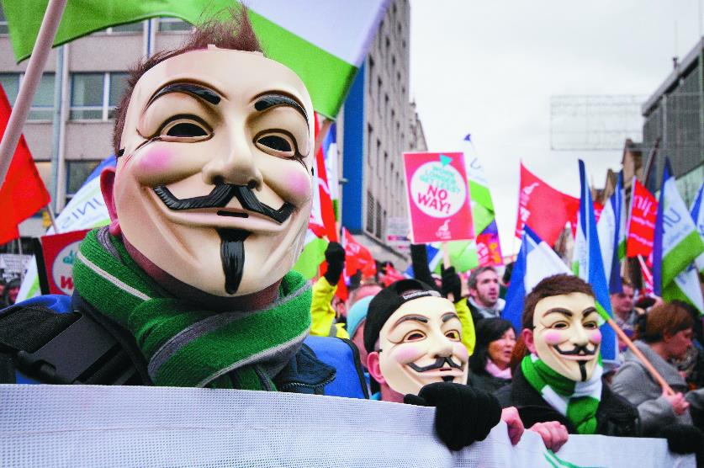
Cybercrime: They Are Out to Get You – Cybercrime Against Organizations (1 of 2)
Hacking
White-hat or “sneakers”
Attempt to find security holes in a system to prevent future hacking
Black-hat or “crackers”
Malicious intent
Gray-hat
Illegal but not malicious intent
Notes:
Hacking is the act of gaining unauthorized access to a computer system or network. Hacking has three categories. White-hat hackers, or “sneakers,” find security holes in a system to prevent future hacking. They are often security experts who are paid to hack systems. Black-hat hackers, sometimes referred to as “crackers,” hack into systems for malicious purposes, such as theft or vandalism. Gray-hat hackers hack into systems illegally but not for malicious intent.

Slide 10
Cybercrime: They Are Out to Get You – Cybercrime Against Organizations (2 of 2)
Hacktivism
Hacking to make a political statement
Data breach
Sensitive data is stolen or viewed by someone not authorized
Cyber-terrorism
unlawful attack on computers to intimidate a government or its people
Notes:
Hacktivism, such as that committed by Anonymous, is hacking to make a political statement.
A data breach occurs when sensitive data is stolen or viewed by someone who is not authorized to do so.
An unlawful attack on computers or networks done to intimidate a government or its people for a political or social agenda is known as cyber-terrorism.

Slide 11

Differentiate between Various Types of Malware
Notes:
Objective 2 differentiates between various types of malware.

Slide 12
Malware: Pick Your Poison – Spam and Cookies (1 of 3)
Includes different types of programs designed to be harmful or malicious
Spam
Adware and spyware
Viruses
Worms
Trojan horses
Rootkits
Notes:
Malware is malicious software that includes spam, adware and spyware, viruses, worms, Trojan horses, and rootkits.

Slide 13
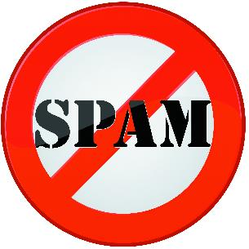
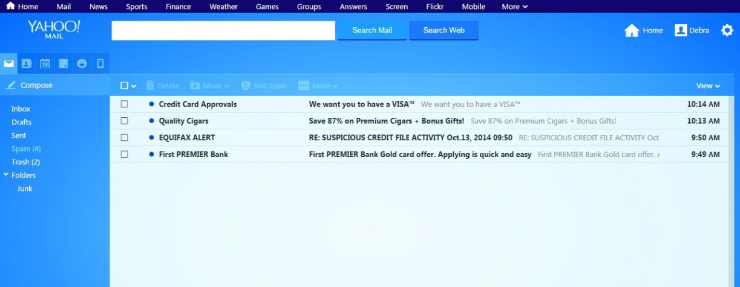
Malware: Pick Your Poison – Spam and Cookies (2 of 3)
Spam
Spamming is sending mass unsolicited emails
Messages are called spam
Other forms:
Fax spam
IM spam
Text spam
Notes:
Spam is a mass, unsolicited email. It is popular because it is easy and inexpensive to implement. Other forms include fax spam, IM spam, and text spam. The act of sending spam is called spamming.

Slide 14
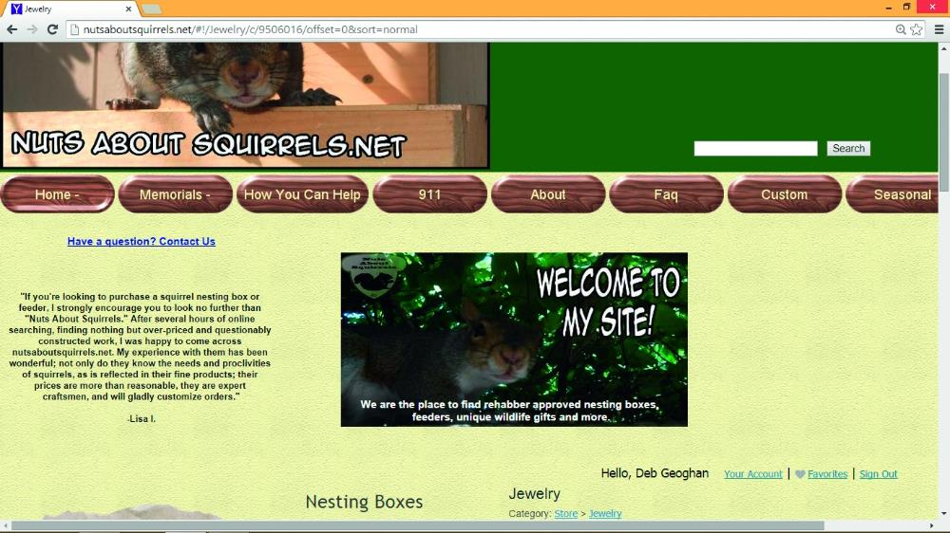
Malware: Pick Your Poison – Spam and Cookies (3 of 3)
Cookies
Installed without your permission
Help websites identify you when you return
Track websites and pages you visit to better target ads
May collect information you don’t want to share
Notes:
A cookie is a small text file that allows the website to recognize the user and personalize the site. Although they are useful, they could be used to collect information that you do not want to share.

Slide 15
Malware: Pick Your Poison – Adware and Spyware (1 of 2)
Adware
Pop-ups or banner ads
Generate income
Use CPU cycles and Internet bandwidth
Reduce PC performance
Notes:
Adware shows you ads, usually in the form of pop-ups or banner ads in websites and in software. Ads generate income for the software developer. When these ads use CPU cycles and Internet bandwidth, it can reduce PC performance.

Slide 16
Malware: Pick Your Poison – Adware and Spyware (2 of 2)
Spyware
Malware
Secretly gathers personal information
Usually installed by accident
Browser hijacker – changes home page and redirects to other websites
Notes:
Spyware is a form of malware that secretly gathers personal information about you. It is usually installed by accident when a user clicks on a pop-up or installs a freeware program that has a tracking feature.

Slide 17
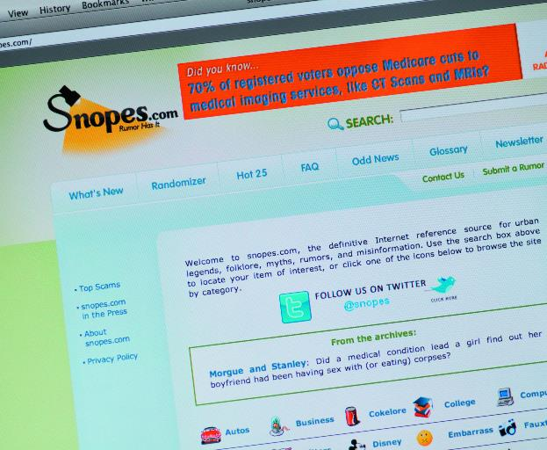
Malware: Pick Your Poison – Viruses, Worms, Trojans, and Rootkits (1 of 5)
Virus - a program that replicates itself and infects computers
Needs a host file
May use an email program to infect other computers
The attack is called the payload
Check to see if message is a hoax
Notes:
A virus is a program that replicates itself and infects computers. A computer virus needs a host file on which to travel, such as a game or email. The attack, also known as the payload, may corrupt or delete files, or it may even erase an entire disk. The virus uses the email program or game on the infected computer to send out copies of itself and infect other machines.

Slide 18
Malware: Pick Your Poison – Viruses, Worms, Trojans, and Rootkits (2 of 5)
Logic Bomb
Behaves like a virus
Performs malicious act
Does not replicate
Attacks when certain conditions are met
Time Bomb
A logic bomb with a trigger that is a specific time or date
April Fool’s Day
Friday the 13th
Notes:
A logic bomb performs a malicious act when certain conditions are met—for example, when an employee name is removed from a database. When the trigger is a specific time or date, such as April Fool’s Day, a logic bomb is called a time bomb.

Slide 19
Malware: Pick Your Poison – Viruses, Worms, Trojans, and Rootkits (3 of 5)
Worms
Self-replicating
Do not need a host to travel
Travel over networks to infect other machines
Conficker worm
First released in 2008
Reemerged in 2010 with new behaviors
Notes:
Like viruses, worms are self-replicating, but they do not need a host. Worms travel over networks, and once a network is infected, it seeks other network machines to infect.

Slide 20
Malware: Pick Your Poison – Viruses, Worms, Trojans, and Rootkits (4 of 5)
Botnet
Network of computer zombies or bots controlled by a master
Fake security notifications
Denial-of-service attacks
Cripple a server or network by sending out excessive traffic
Trojan horse
Appears to be legitimate program
Actually malicious
Might install adware, a toolbar, a keylogger, or open a backdoor
Notes:
A botnet is a network of computer zombies or bots controlled by a master. Fake security notifications are the most common way to spread bots. A botnet could launch a denial-of-service attack, which cripples a server or network by sending out excessive traffic.
A Trojan horse, or Trojan, is a program that appears to be legitimate but is actually malicious. Trojans might install adware, a toolbar, or a keylogger, or open a backdoor.

Slide 21
Malware: Pick Your Poison – Viruses, Worms, Trojans, and Rootkits (5 of 5)
Ransomware
Malware that prevents you from using your computer until you pay a fine or fee
Bitcoin is an anonymous, digital, encrypted currency
Rootkit
Set of programs
Allows someone to gain control over system
Hides the fact that the computer has been compromised
Nearly impossible to detect
Masks behavior of other malware
Notes:
Ransomware is malware that prevents you from using your computer until you pay a fee. Payment is usually requested in bitcoin, an anonymous, digital, encrypted currency.
A rootkit is a set of programs that allows someone to gain control over a computer system while hiding the fact that the computer has been compromised. A rootkit is almost impossible to detect. It allows the machine to become further infected by masking behavior of other malware.

Slide 22
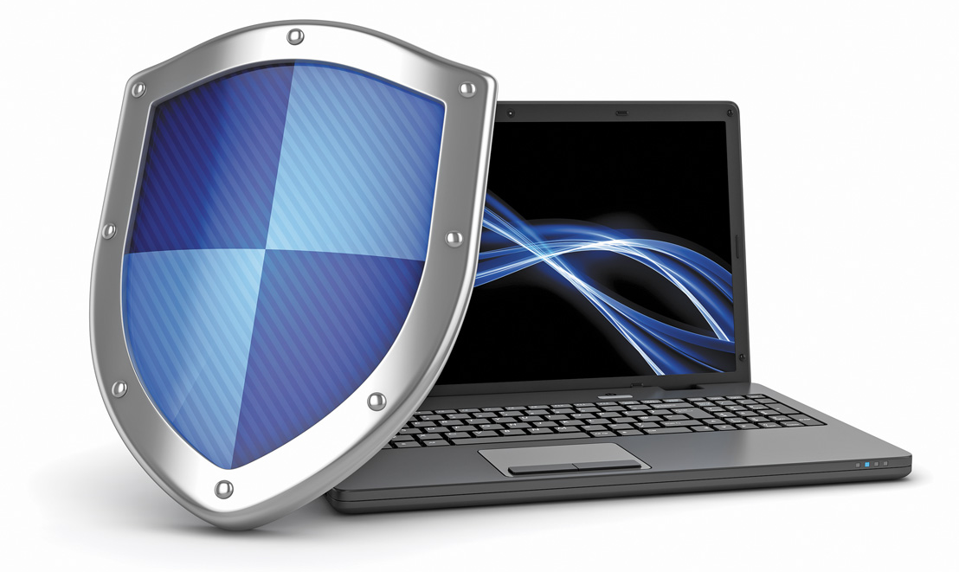
Explain How to Secure a Computer
Notes:
Objective 3 explains how to secure a computer.

Slide 23
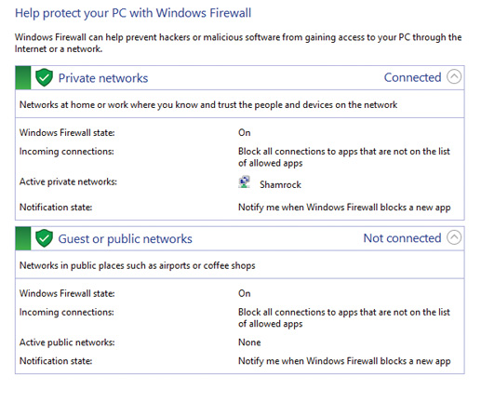
Shield’s Up – Software (1 of 2)
Drive-by download
A visited website installs a program in the background without your knowledge
Firewall
Hardware device that blocks access to your network
Software that blocks access to an individual machine
Notes:
One of the most common ways to get a malware infection on a computer is by downloading it. This could happen in a drive-by download. A drive-by download occurs when you visit a website that installs a program in the background without your knowledge.
A firewall is designed to block unauthorized access to your network, but a software firewall blocks access to an individual machine.

Slide 24
Shield’s Up – Software (2 of 2)
Antivirus program
Protects against viruses, Trojans, worms, spyware
Windows 10 includes Windows Defender
An antispyware program that performs both real-time protection and system scanning
Antispyware software
Prevents adware and spyware from installing
Security suite
Package of security software
Combination of features
Notes:
Antivirus programs protect against viruses, Trojans, worms, and spyware. Antispyware software prevents adware and spyware software from installing itself on your computer. Security suites are packages of security software that include a combination of features.

Slide 25
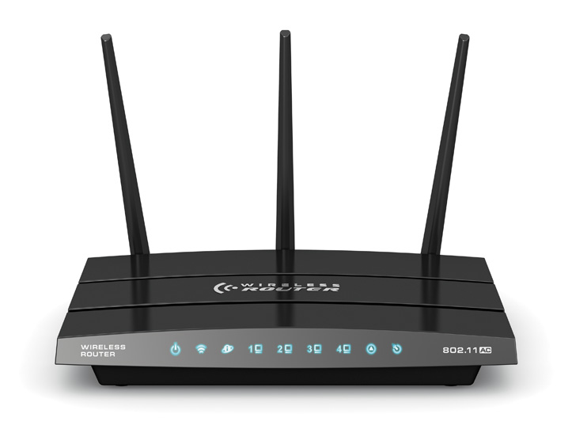
Shield’s Up – Hardware (1 of 2)
Router
Connects two or more networks together
Home router acts like firewall
Network address translation (NAT)
Security feature of a router
Shields devices on private network from the public network
Notes:
A router is a device that connects two or more networks. A home router also acts like a firewall. Network address translation (NAT) is a router security feature that shields devices on a private network (home) from the public network, Internet.

Slide 26
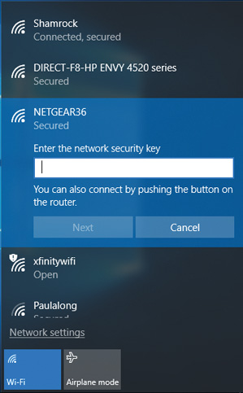
Shield’s Up – Hardware (2 of 2)
SSID (Service Set Identifier)
Wireless network name
Change for security
Wireless encryption
Adds security by encrypting transmitted data
Wi-Fi Protected Setup (WPS) is one option
Notes:
A wireless router provides a wireless access point to your network. Use the router setup utility to change the SSID, service set identifier, or wireless network name, and enable and configure wireless encryption.

Slide 27
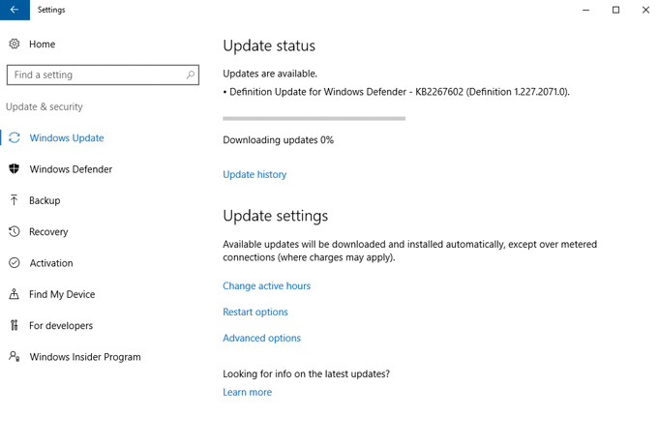
Shield’s Up – Operating System
Most important piece of security software
Keep patched and up-to-date
Notes:
The operating system is the most important piece of security software. It is best to keep it patched and up-to-date. By default, Windows and OS X computers are configured to automatically install updates. The only way to try to be safe is to be proactive and diligent in protecting your computer system.

Slide 28
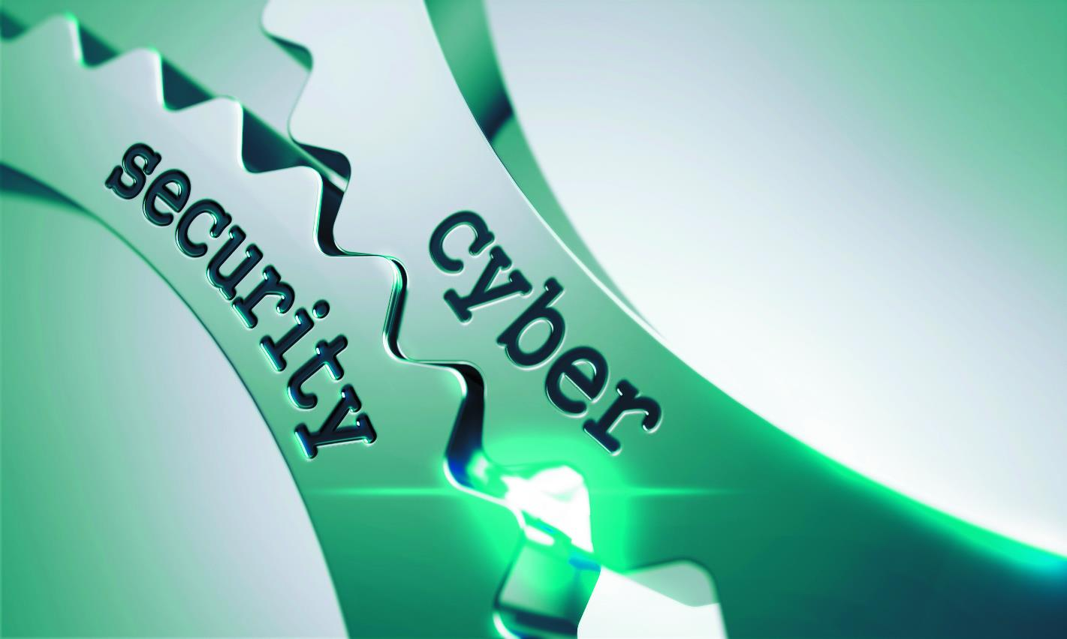
Practice Safe Computing
Notes:
Objective 4 discusses how to practice safe computing.

Slide 29
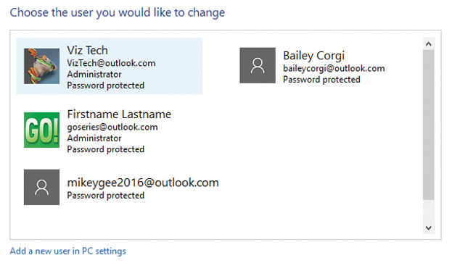
An Ounce of Prevention is Worth a Pound of Cure – User Accounts
Three user account types
Standard – everyday use
Administrator – configure settings
Guest
User Account Control (UAC) notifies you prior to changes made to your computer
Do not turn this feature off
Always read message before clicking Yes
Malware tricks users into clicking fake Windows notifications
Notes:
There are three types of user accounts: Standard, Administrator, and Guest. User Account Control (UAC) will notify you before changes are made to your computer. Do not turn the UAC feature off and remember to always read the message before clicking Yes. Malware can trick users into clicking fake Windows notifications.

Slide 30
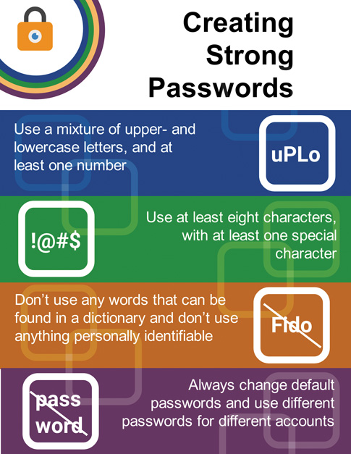
An Ounce of Prevention is Worth a Pound of Cure – Passwords
Notes:
There are many rules to use when creating strong passwords. Some basic guidelines include: using at least eight characters; mixing upper- and lowercase letters; using at least one number and, if allowed, a special character; and eliminating words in the dictionary or ones that are personally identifiable.

Slide 31
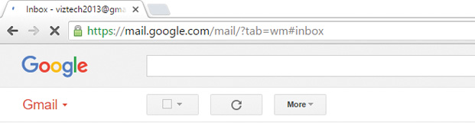
An Ounce of Prevention is Worth a Pound of Cure – Encryption
Converts plain text into ciphertext
Must have a key to decrypt it
Notes:
Encryption converts unencrypted, plain text on a website into code called ciphertext. To read encrypted information, you must have a key to decrypt it. You also need to be sure it is a secure website. You can check for this by confirming the https protocol in the URL and a padlock in the address bar. Windows includes Encrypting File System (EFS), which enables you to encrypt individual files. OS X has a similar feature called FileVault.

Slide 32
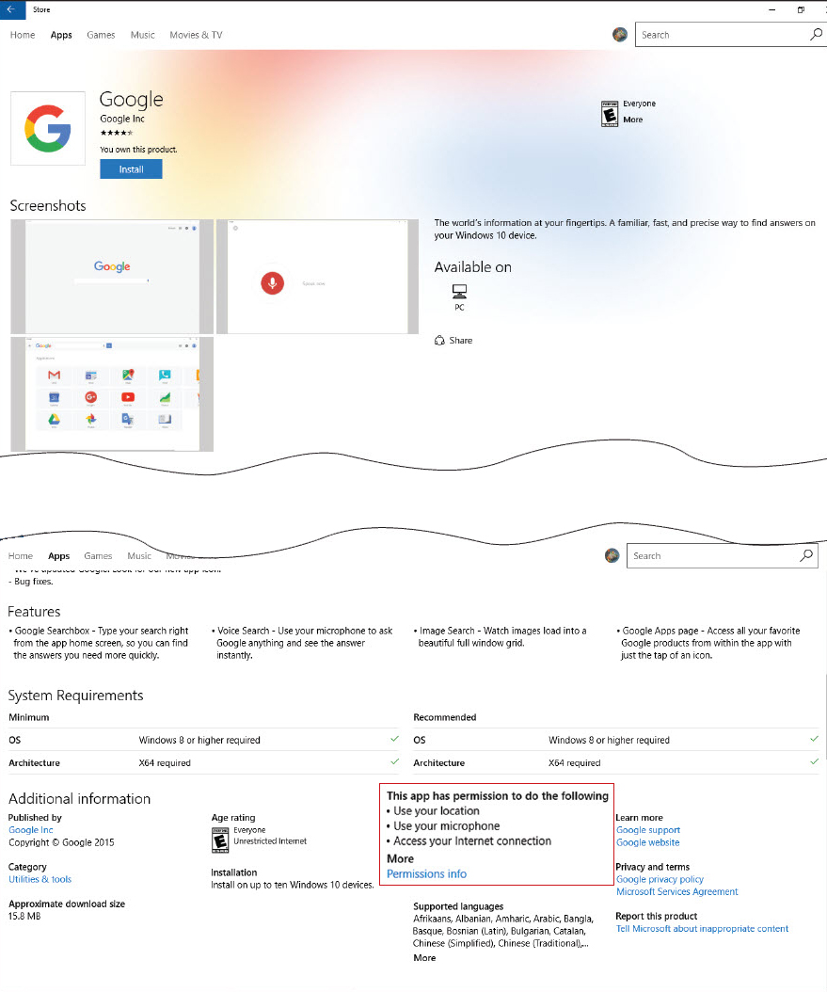
An Ounce of Prevention is Worth a Pound of Cure – Safely Installing Software
Copies files to the computer
Alters settings
Notes:
Installing software copies files to the computer; it may alter system settings.

Slide 33
An Ounce of Prevention is Worth a Pound of Cure – Updating and Installing Software
Protect yourself from downloading problems
Only download from reliable sources
Zero-day exploit
Attack that occurs on the day an exploit is discovered before the publisher can fix it
Bugs
Flaws in the programming of software
Patch or hotfix
Service pack
Notes:
You should only download from reliable sources. An attack that occurs on the day an exploit is discovered, before the publisher can fix it, is called a zero-day exploit.
Software publishers release updates. Updates can address security holes or bugs (flaws in the programming) or add new features. A patch or hotfix addresses individual problems; a service pack is a larger, planned update.

Slide 34
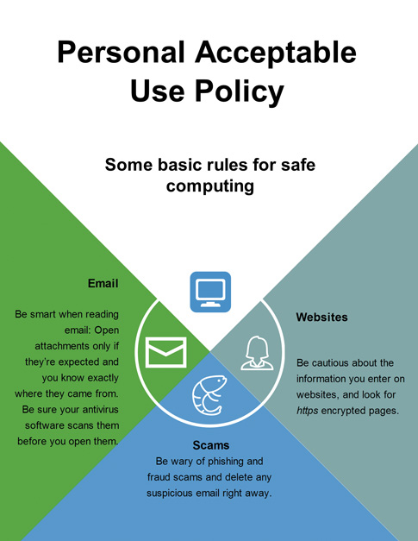
An Ounce of Prevention is Worth a Pound of Cure – Acceptable Use Policies (AUP)
Common in businesses and schools
Rules for computer and network users
Depend on:
Type of business
Type of information
Force users to practice safe computing
Notes:
Many businesses and schools have an acceptable use policy (AUP) by which computer and network users must abide. Restrictions depend on the type of business and type of information to which you need access. Although these policies can be restrictive and annoying, they force users to practice safe computing.

Slide 35
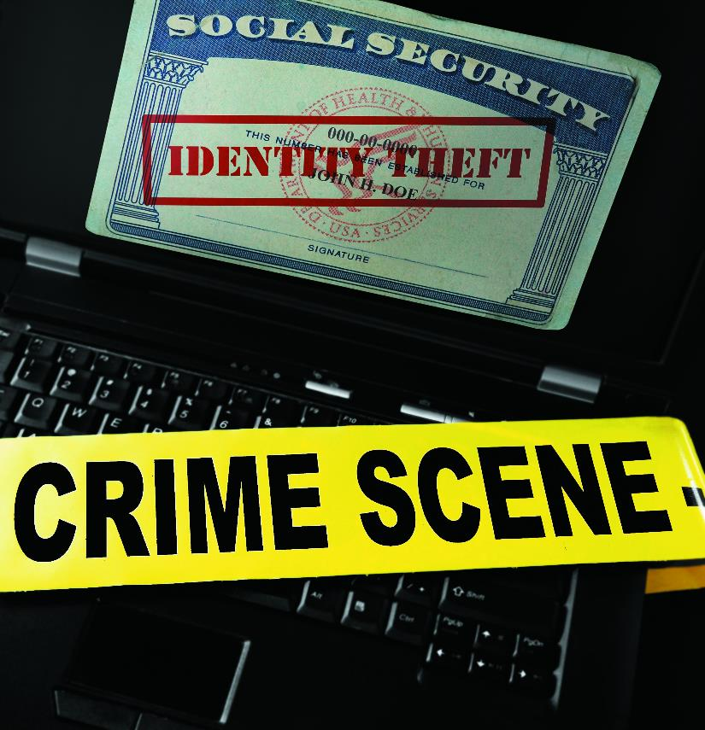
Discuss Laws Related to Computer Security and Privacy
Notes:
Objective 5 discusses the laws related to computer security and privacy.

Slide 36
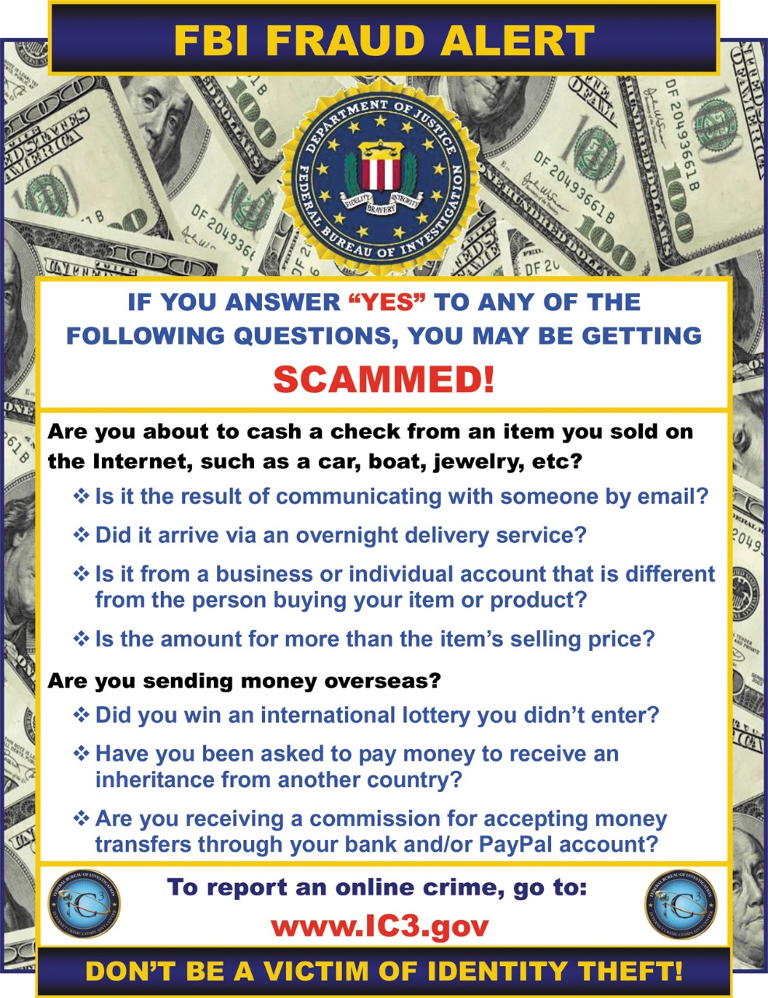
The Law is on Your Side – The Enforcers
No single authority responsible for investigating cybercrime
Internet Crime Complaint Center (IC3)
Place for victims to report cybercrimes
ic3.gov
Reports processed and forwarded to appropriate agency
Notes:
Because crimes are varied, there is no single authority responsible for investigating cybercrime. The Internet Crime Complaint Center (IC3) is a place for victims to report cybercrimes. At its website, ic3.gov, a report is processed and forwarded to the appropriate agency. Agencies include the FBI, U.S. Secret Service, U.S. Immigration and Customs, U.S. Postal Inspection Service, and the Bureau of Alcohol, Tobacco, Firearms, and Explosives (ATF).

Slide 37
The Law is on Your Side – Current Laws (1 of 2)
Computer Fraud and Abuse Act
Makes it a crime to access classified information
Passed in 1986; amendments between 1988 and 2002 added additional cybercrimes
USA PATRIOT Act antiterrorism legislation (2001)
Notes:
In 1986, the Computer Fraud and Abuse Act was passed, making it a crime to access classified information. There were several amendments between 1988 and 2002 that added additional cybercrimes. The USA PATRIOT Act antiterrorism legislation in 2001 included provisions for fighting cybercrime.

