Slide 1
Routing
Shuffle Exchange
Point-to-point, Bus, Ring, Star, Mesh

Slide 2
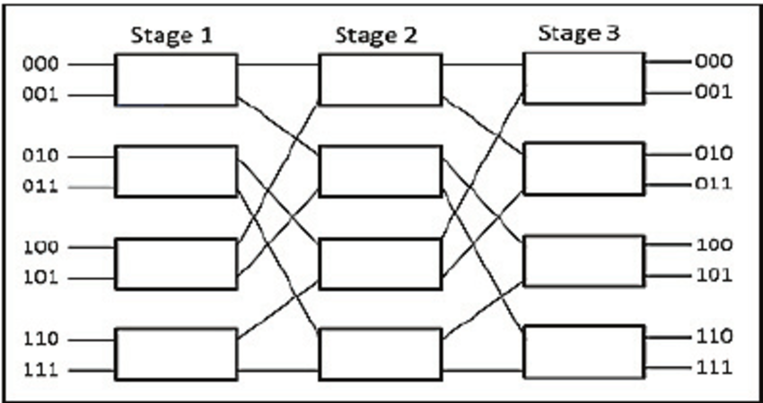
Shuffle exchange

Slide 3
Classifications
Point-to-Point – direction connection between Nodes
Bus – Nodes are connected to a single cable (Bus)
Star – each node is connected to a central node
Ring – a closed bus loop
Mesh – nodes are directly connected to (some/all) nodes

Slide 4
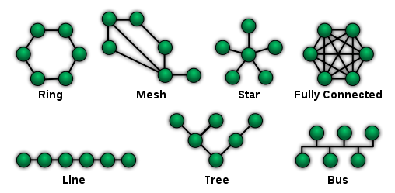
Network Connection Technologies

Slide 5
Communicating on Token Ring
Token ring local area network (LAN) technology is a communications protocol for local area networks.
It uses a special three-byte frame called a "token" that travels around a logical "ring" of workstations or servers.
This token passing is a channel access method providing fair access for all stations, and eliminating the collisions of contention-based access methods.

Slide 6
Communicating on Star
the hub and leaf nodes, and the transmission lines between them, form a graph with the topology of a star.
Data on a star network passes through the hub, switch, or concentrator before continuing to its destination.
The hub, switch, or concentrator manages and controls all functions of the network. It also acts as a repeater for the data flow

Slide 7
Communication on Ethernet
Since all communication happens on the same wire, any information sent by one computer is received by all, even if that information is intended for just one destination.
The network interface card interrupts the CPU only when applicable packets are received: The card ignores information not addressed to it.
Use of a single cable also means that the data bandwidth is shared, such that, for example, available data bandwidth to each device is halved when two stations are simultaneously active.

Slide 8
Connection on Mesh
The message is propagated along a path by hopping from node to node until it reaches its destination. To ensure all its paths' availability, the network must allow for continuous connections and must reconfigure itself around broken paths, using self-healing algorithms such as Shortest Path Bridging.
Self-healing allows a routing-based network to operate when a node breaks down or when a connection becomes unreliable. As a result, the network is typically quite reliable, as there is often more than one path between a source and a destination in the network. Although mostly used in wireless situations, this concept can also apply to wired networks and to software interaction.

Slide 9
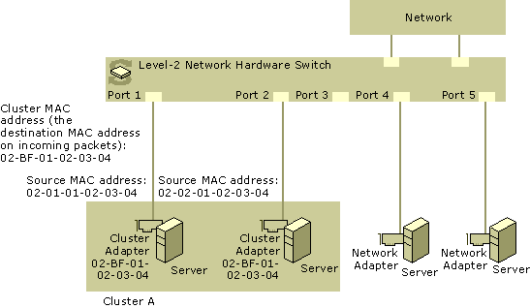
Clusters and load balancing

