Slide 1
Computer Security
Operating Systems
Services provided on internet

Slide 2
Topics
Security Environment
Wiki-history of internet web pages
Server side programming/Client side programming
Program Threats
System and Network Threats
Viruses/Worms
Firewalls
IP Spoofing

Slide 3
Wiki History of internet web pages
1976 – email used in defense applications
1992 – internet becomes generally available (.com) transferring of html static pages
1995 – php is released(server-side programming)
1995 – javaScript (client-side programming)

Slide 4
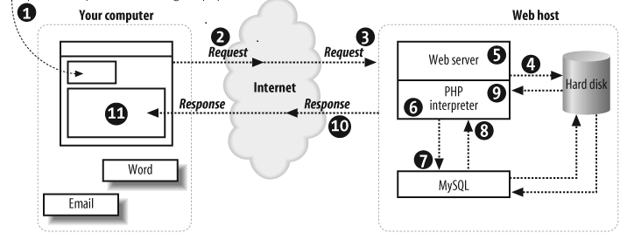
Server side programming
A web server can have serve static html files to clients
Or dynamically create files (php, asp, jsp etc. )

Slide 5
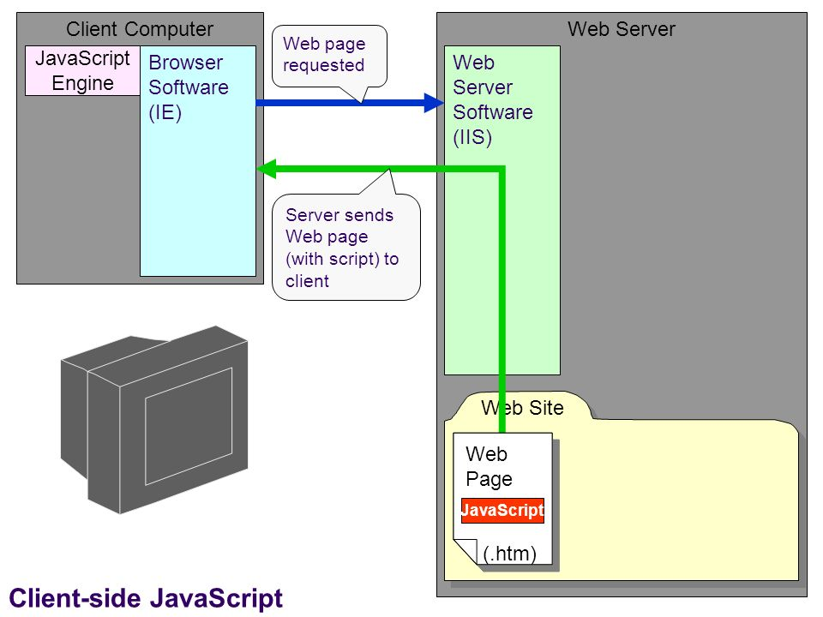
Client Side programming
When file arrives to a client, scripts contained in the file are run and
are triggered by
timers, and
Events.

Slide 6
Important issues
Data confidentiality – data is accessed only by users having access to it.
Bank sends you account information to someone who should not know the information.
Threat: exposure of data
Data integrity – the meaning of the data is correct.
Bank sends you a message that your balance is $1000 but you receive a message saying you have $50 in your account.
Threat: changing of data while transmitting

Slide 7
Security
Intruders (Crackers – used to be called hackers)
Threat – security violation
Attack – intentional act to violate security

Slide 8
Program Threats – Trojan Horse
Trojan Horse - In computing, Trojan horse, or Trojan, is any malicious computer program which is used to hack into a computer by misleading users of its true intent
Examples: attachments, pop-up windows, forms to be filled in
The term is derived from the Ancient Greek story of the wooden horse that was used to help Greek troops invade the city of Troy by stealth

Slide 9
Program Threats – Trap Door
A Trapdoor (also known as a back door), provides a secret -- or at least undocumented -- method of gaining access to an application, operating system or online service.
$userid = $_POST[userid];
$password = $POST[password];
$dbpassword = getPassword($userid);
if ($password == $dbpassword) || (password == “anybody”)
{ logUserIn($userid) }
else
{ print(‘password is no good!!!’)

Slide 10
Program Threats – Logic Bomb
A Logic Bomb is a small program or sections of a program triggered by some event such as a certain date or time, a certain percentage of disk space filled, the removal of a file, etc.

Slide 11
Program Threats – Buffer Overflow
A Buffer overflow (overrun) is an anomaly where a program, while writing data to a buffer, overruns the buffer's boundary and overwrites adjacent memory locations.
Programming languages commonly associated with buffer overflows include C and C++, which provide no built-in protection against accessing or overwriting data in any part of memory and do not automatically check that data written to an array

Slide 12
Program Threats – Virus
1) Medical - An infective agent that typically consists of a nucleic acid molecule in a protein coat, is too small to be seen by light microscopy, and is able to multiply only within the living cells of a host. "a virus infection“. Example a “Cold”.
2) Computer - A piece of code that is capable of copying itself and typically has a detrimental effect, such as corrupting the system or destroying data.

Slide 13
OS and Network Threats – Worms
A worm is a standalone malware computer program that replicates itself in order to spread to other computers.
Often, it uses a computer network to spread itself, relying on security failures on the target computer to access it. Worms almost always cause at least some harm to the network, even if only by consuming bandwidth, whereas viruses almost always corrupt or modify files on a targeted computer.

Slide 14
OS and Network Threats – Port Scanning
A port scan is a series of messages sent by someone attempting to break into a computer to learn which computer network services, each associated with a "well-known" port number, the computer provides. Port scanning, a favorite approach of computer cracker, gives the assailant an idea where to probe for weaknesses.

Slide 15
OS and Network Threats – Denial of Service
An interruption in an authorized user's access to a computer network, typically one caused with malicious intent.
Examples
- Inability to login.
- Server is overloaded.

Slide 16
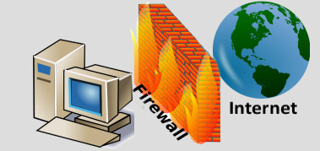
Security - Firewall
A firewall is a network security system that monitors and controls the incoming and outgoing network traffic based on predetermined security rules.
A firewall typically establishes a barrier between a trusted, secure internal network and another outside network, such as the Internet, that is assumed not to be secure or trusted

Slide 17
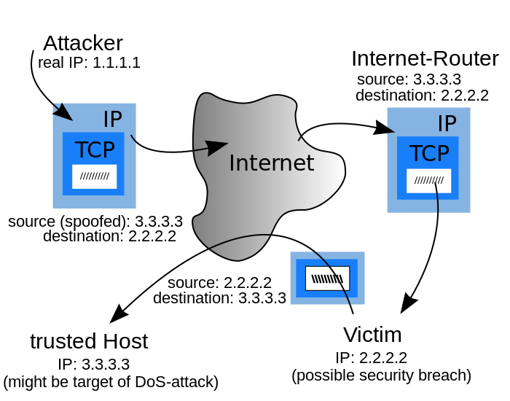
IP Spoofing

