Slide 1
Critical Sections
Dijkstra’s Semaphores

Slide 2
Multiprogramming
Multiple programs sharing a processor
Ex)
Your email is open and receiving email
A web browser is open and pages are being updated
A program of your is running.

Slide 3
Shared Resources
Resources used by multiple programs
Ex)
Printers
Disk drives
Data in a database

Slide 4
Ex) Data in a database
Transfer of money process
Savings = Savings - $100
Checking = Checking + $100
Interest process
Savings = Savings * 1.01
Checking = Checking * 1.01
Possible Schedule
Savings = Savings - $100
Checking = Checking + $100
Savings = Savings * 1.01
Checking = Checking * 1.01
Initial Balances
Savings = $200
Checking = $0
Ending Balances
Savings = $101
Checking = $101

Slide 5
Ex) Data in a database
Transfer of money process
Savings = Savings - $100
Checking = Checking + $100
Interest process
Savings = Savings * 1.01
Checking = Checking * 1.01
Possible Schedule
Savings = Savings * 1.01
Checking = Checking * 1.01
Savings = Savings - $100
Checking = Checking + $100
Initial Balances
Savings = $200
Checking = $0
Ending Balances
Savings = $102
Checking = $100

Slide 6
Ex) Data in a database
Transfer of money process
Savings = Savings - $100
Checking = Checking + $100
Interest process
Savings = Savings * 1.01
Checking = Checking * 1.01
Possible Schedule
Savings = Savings - $100
Savings = Savings * 1.01
Checking = Checking * 1.01
Checking = Checking + $100
Initial Balances
Savings = $200
Checking = $0
Ending Balances
Savings = $101
Checking = $100
Note: customer loses $1

Slide 7
Critical Section
The section of code that requires exclusive access to a shared resource to insure correct processing.
Once the critical section of code has been entered by a process, we need a mechanism to ensure other processes do not enter their critical section until the first process is still processing in it’s critical section.

Slide 8
Atomic Operation
A system operation called by a user process such that once it starts, if the operation system determines the user process’ time quantum has expired, the atomic operation is given enough time to complete before the processor is taken away from that user process.
Consequently, System Atomic operations should be very quick.

Slide 9
Try To Reduce Atomic Operation
void try_to_reduce(S)
{
IF (S == 1)
{
S = 0;
}
ELSE
{
Operating systems moves this process to the queue
of processes waiting for resource S
}
}

Slide 10
Increase Atomic Operation
void increase(S)
{
IF (process(es) are waiting for S)
{
Operating System assign Resource S to the next process
and allows it to return to running again
}
ELSE
{
S = 1;
}
}

Slide 11
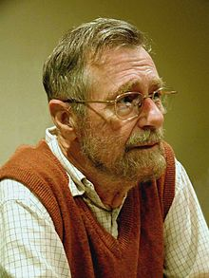
Edsger Dijkstra
In Dutch (Dijkstra’s language)
P stands for probeer te verlagen, literally "try to reduce,“
V stands for verhogen ("increase“)

Slide 12
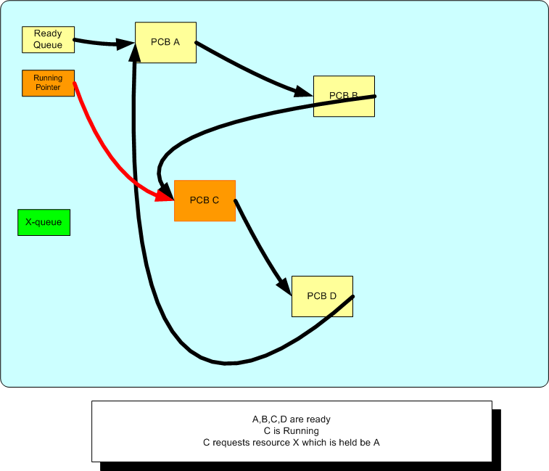
Process C is running & issues P(X)

Slide 13
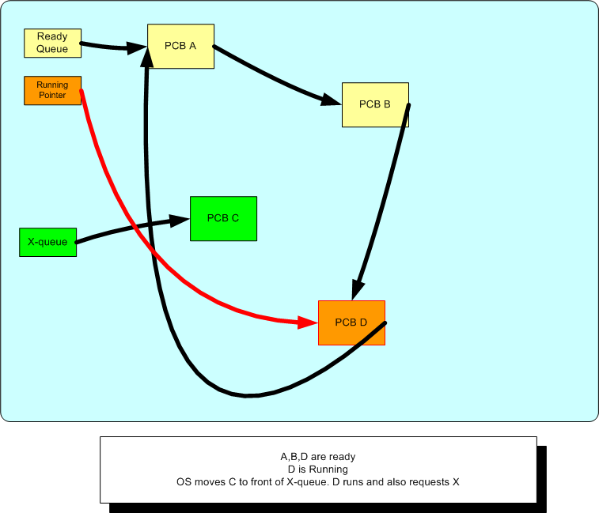
Process C waiting on Resource X

Slide 14
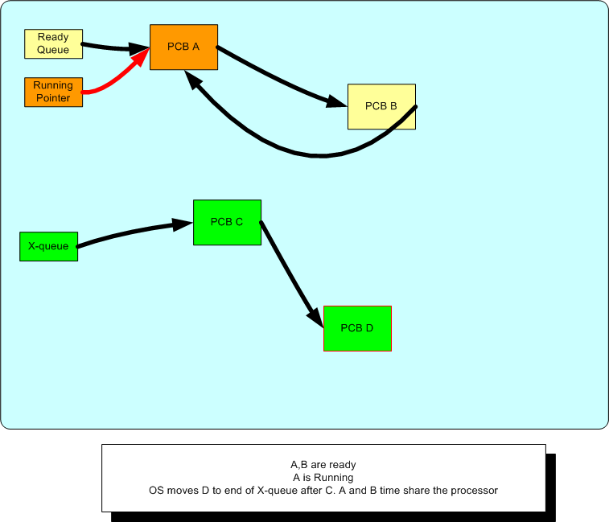
C and D are waiting for resource X

Slide 15
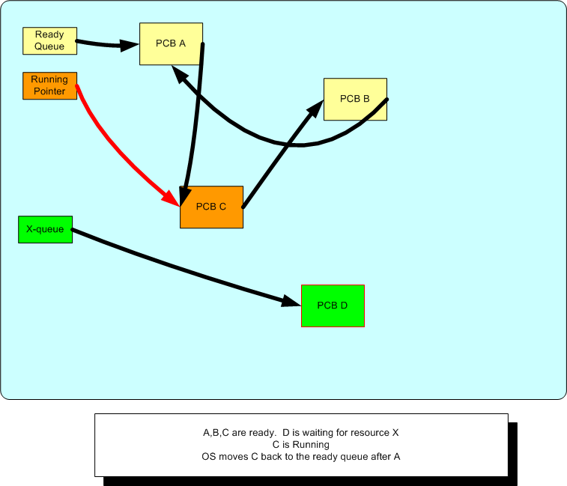
C back to running – D still waiting

Slide 16
Using Dijkstra’s P and V functions
Transfer of money process
P(X)
Savings = Savings - $100
Checking = Checking + $100
V(X)
Interest process
P(X)
Savings = Savings * 1.01
Checking = Checking * 1.01
V(X)
--------------------------------------------------------------------------------------------------
Possible Schedule
P(X) // No waiting
Savings = Savings - $100
P(X) // Wait for V(X)
Checking = Checking + $100
V(X)
Savings = Savings * 1.01
Checking = Checking * 1.01
V(X)
Possible Schedule
P(X) // No waiting
P(X) // Wait for V(X)
Savings = Savings * 1.01
Checking = Checking * 1.01
V(X)
Savings = Savings - $100
Checking = Checking + $100
V(X)

Slide 17
Producer - Consumer problem
2 processes share a resource.
The first process “The Producer” inserts a item it produced in a buffer for “The Consumer” process to consume.
The Producer signals the Consumer to consume the item and also waits for the consumption before proceeding to produce a next item.
The consumer consumes the item, and then signals the producer to produce another item for consumption.
Example) a process sending pages to a printer to print.

Slide 18
Producer – Consumer code
P = 1;
C = 0;
Producer process
while (1)
{
P(P)
Produce
V(C)
}
Consumer process
while (1)
{
P(C)
Consume
V(P)
}

Slide 19
Producer – 2 Consumer code
P = 1;
C = 0;
Producer
while(1)
{
P(P)
Produce
V(C)
}
Consumer1
while(1)
{
P(C)
Consume
V(P)
}
Consumer2
while(1)
{
P(C)
Consume
V(P)
}

Slide 20
Scheduling processes
X = 1;
Y = 0;
Z = 0;
Process1
while(1)
{
P(X)
Do stuff
V(Y)
}
Process2
while(1)
{
P(Y)
Do Stuff
V(Z)
}
Process3
while(1)
{
P(Z)
Do Stuff
V(X)
}

