Slide 1
Socket Programming
Client/Server

Slide 2
Network Socket
A network socket is an endpoint of an inter-process communication across a computer network. Today, most communication between computers is based on the Internet Protocol; therefore most network sockets are Internet sockets.
A socket API is an application programming interface (API), usually provided by the operating system, that allows application programs to control and use network sockets. Internet socket APIs are usually based on the Berkeley sockets standard.
A socket address is the combination of an IP address and a port number, much like one end of a telephone connection is the combination of a phone number and a particular extension. Based on this address, internet sockets deliver incoming data packets to the appropriate application process or thread.

Slide 3
Characterized
An Internet socket is characterized by at least the following :
Local socket address: Local IP address and port number
Protocol: A transport protocol (e.g., TCP, UDP, raw IP, or others).
consequently, TCP port 53 and UDP port 53 are different, distinct sockets.

Slide 4
Socket Types
Datagram sockets, also known as connectionless sockets, which use User Datagram Protocol (UDP).
Stream sockets, also known as connection-oriented sockets, which use Transmission Control Protocol (TCP) or Stream Control Transmission Protocol (SCTP).
Raw sockets (or Raw IP sockets), typically available in routers and other network equipment. Here the transport layer is bypassed, and the packet headers are made accessible to the application.

Slide 5
Some famous port numbers
Port Service Transport Protocol
21 FTP tcp,udp,sctp
22 SSH tcp,udp,sctp
23 Telnet tcp,udp
80 HTTP tcp,udp
443 HTTPS tcp,udp,sctp

Slide 6
Socket pairs
Communicating local and remote sockets are called socket pairs.
Each socket pair is described by a unique 4-tuple consisting of
Source IP address
Source Port number
Destination IP address
Destination port number

Slide 7
Linux system calls for Sockets
socket()
bind()
connect()
listen()
accept()
read()
write()
close()

Slide 8
Server Side
The steps involved in establishing a socket on the server side are as follows:
1.Create a socket with the socket() system call
2.Bind the socket to an address using the bind() system call. For a server socket on the Internet, an address consists of a port number on the server machine.
3.Listen for connections with the listen() system call
4.Accept a connection with the accept() system call. This call typically blocks until a client connects with the server.
5.Send and receive data

Slide 9
Client side
The steps involved in establishing a socket on the client side are as follows:
1. Create a socket with the socket() system call
2. Connect the socket to the address of the server using the connect() system call
3. Send and receive data. There are a number of ways to do this, but the simplest is to use the read() and write() system calls.

Slide 10
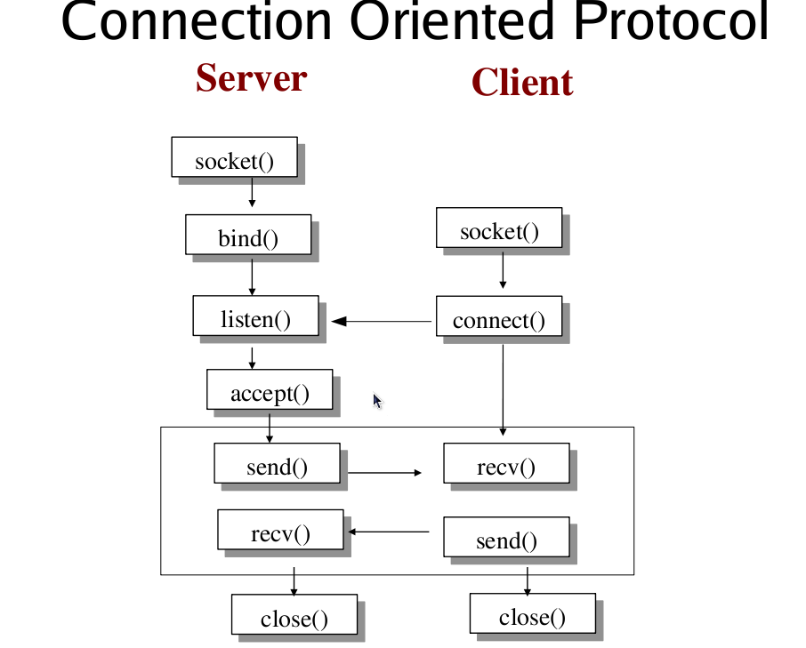
Client-Server

Slide 11
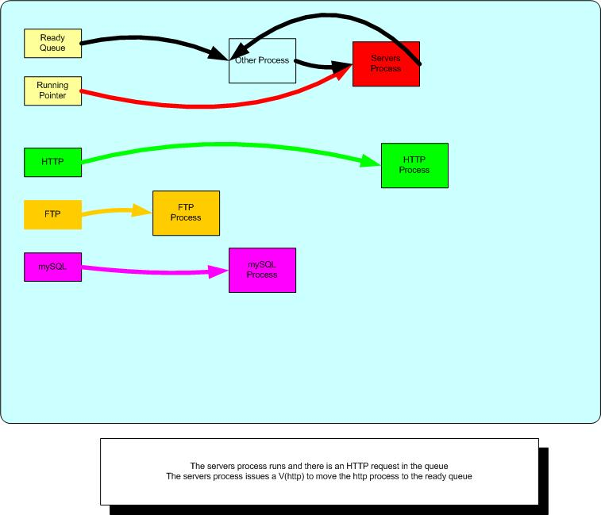
Internal states of proesses

Slide 12
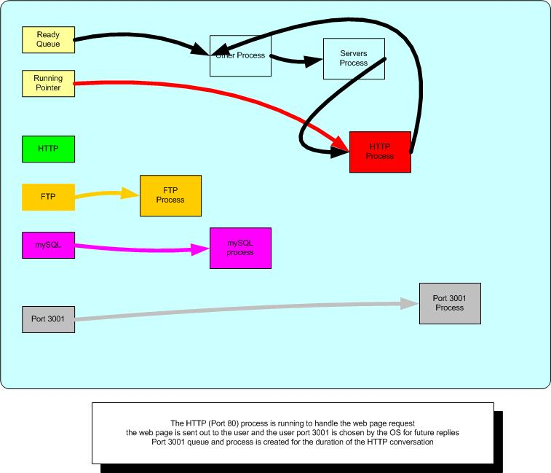
Accept is woken up

Slide 13
socket()
socket() creates an endpoint for communication and returns a file descriptor for the socket.
socket() takes three arguments:
AF_INET for network protocol IPv4 or
AF_INET6 for IPv6.
AF_UNIX for local socket (using a file).

Slide 14
bind()
bind() assigns a socket to an address. When a socket is created using socket(), it is only given a protocol family, but not assigned an address. This association with an address must be performed with the bind() system call before the socket can accept connections to other hosts. bind() takes three arguments:
sockfd, a descriptor representing the socket to perform the bind on.
my_addr, a pointer to a sockaddr structure representing the address to bind to.
addrlen, a socklen_t field specifying the size of the sockaddr structure.

Slide 15
listen()
listen()
After a socket has been associated with an address, listen() prepares it for incoming connections. However, this is only necessary for the stream-oriented (connection-oriented) data modes, i.e., for socket types (SOCK_STREAM, SOCK_SEQPACKET). listen() requires two arguments:
sockfd, a valid socket descriptor.
backlog, an integer representing the number of pending connections that can be queued up at any one time. The operating system usually places a cap on this value.

Slide 16
Accept()
When an application is listening for stream-oriented connections from other hosts, it is notified of such events ( select() function) and must initialize the connection using the accept() function. The accept() function creates a new socket for each connection and removes the connection from the listen queue. It takes the following arguments:
sockfd, the descriptor of the listening socket that has the connection queued.
cliaddr, a pointer to a sockaddr structure to receive the client's address information.
addrlen, a pointer to a socklen_t location that specifies the size of the client address structure passed to accept(). When accept() returns, this location indicates how many bytes of the structure were actually used.

Slide 17
Create a socket
A socket, s, is created with the socket system call:
#include <sys/socket.h>
int s = socket(domain, type, protocol);
listenfd = socket(AF_INET, SOCK_STREAM, 0);

Slide 18
Bind
#include <sys/socket.h>
int bind(int socket, const struct sockaddr *address,
socklen_t address_len);
bind(listenfd, (struct sockaddr*)&serv_addr, sizeof(serv_addr));

Slide 19
Connect to a server from a client
#include <sys/types.h>
#include <sys/socket.h>
int connect(int socket, const struct sockaddr *address,
socklen_t address_len);
int connect(int socket, const struct sockaddr *address,
socklen_t address_len); // example

Slide 20
Allow connections on the server
#include <sys/socket.h>
int listen(int socket, int backlog);
listen(listenfd, 10);

Slide 21
Accept (wake up) input
while(1)
{
connfd = accept(listenfd, (struct sockaddr*)NULL, NULL);
write(connfd, sendBuff, strlen(sendBuff));
close(connfd);
sleep(1);
}

Slide 22
C/C++ socket code
#include <sys/types.h>
#include <sys/socket.h>
char buffer[MAXBUF];
int s = socket(domain, type, protocol)
int bind(int socket, const struct sockaddr *address, socklen_t
address_len);
int connect(int socket, const struct sockaddr *address, socklen_t
address_len);
int listen(int socket, int backlog);
nbytes = write(fd, buffer, 20); /* write 20 bytes in buffer */

Slide 23
Java Client code part 1
public class GreetingClient
{
public static void main(String [] args)
{
String serverName = args[0];
int port = Integer.parseInt(args[1]);
try
{
// try code
}
catch(IOException e)
{
// catch code
}
}
}

Slide 24
Java Client code part 2
try
{
System.out.println("Connecting to " + serverName
+ " on port " + port);
Socket client = new Socket(serverName, port);
System.out.println("Just connected to "
+ client.getRemoteSocketAddress());
OutputStream outToServer = client.getOutputStream();
DataOutputStream out = new DataOutputStream(outToServer);
out.writeUTF("Hello from “ + client.getLocalSocketAddress());
InputStream inFromServer = client.getInputStream();
DataInputStream in = new DataInputStream(inFromServer);
System.out.println("Server says " + in.readUTF());
client.close();
}
catch(IOException e) { e.printStackTrace();}
}

Slide 25
Java Server Code part 1
// File Name GreetingServer.java
import java.net.*;
import java.io.*;
public class GreetingServer extends Thread
{
private ServerSocket serverSocket;
public GreetingServer(int port) throws IOException
{
serverSocket = new ServerSocket(port);
serverSocket.setSoTimeout(10000);
}

Slide 26
Java Server Code part 2 - catch
catch(SocketTimeoutException s)
{
System.out.println("Socket timed out!");
break;
}
catch(IOException e)
{
e.printStackTrace();
break;
}
}
}

Slide 27
Java Server Code part 2 - try
public void run()
{
while(true)
{
try
{
System.out.println("Waiting for client on port " +
serverSocket.getLocalPort() + "...");
Socket server = serverSocket.accept();
System.out.println("Just connected to “ + server.getRemoteSocketAddress());
DataInputStream in = new DataInputStream(server.getInputStream());
System.out.println(in.readUTF());
DataOutputStream out = new DataOutputStream(server.getOutputStream());
out.writeUTF("Thank you for connecting to “ + server.getLocalSocketAddress() +
"\nGoodbye!");
server.close();
}

Slide 28
Java Server Code part 3
public static void main(String [] args)
{
int port = Integer.parseInt(args[0]);
try
{
Thread t = new GreetingServer(port);
t.start();
}catch(IOException e)
{
e.printStackTrace();
}
}
}

