Slide 1
Linux
Operating Systems
Case Study

Slide 2
Objectives
History of Linux
Linux Architecture
Threads and States
Processor scheduling
Virtual Memory – Physical Memory
Free Spaces
Page Replacement
Directories
Files

Slide 3
History of Linux
1960’s MIT, Bell Labs, GE jointly developed Multics
1970’s
  Bell labs people created Unics (Simpler Multics)
  Bell labs changed the name to Unix
1980’s
  Part of the Bell System breakup…Couldn’t license Unix
  Various versions of Unix (Berkeley, HP, etc.)
1990’s
  Linus Torvals begun work on Linux (Clone of Unix)
  Linux is named to mean “Linus’ Unix”

Slide 4
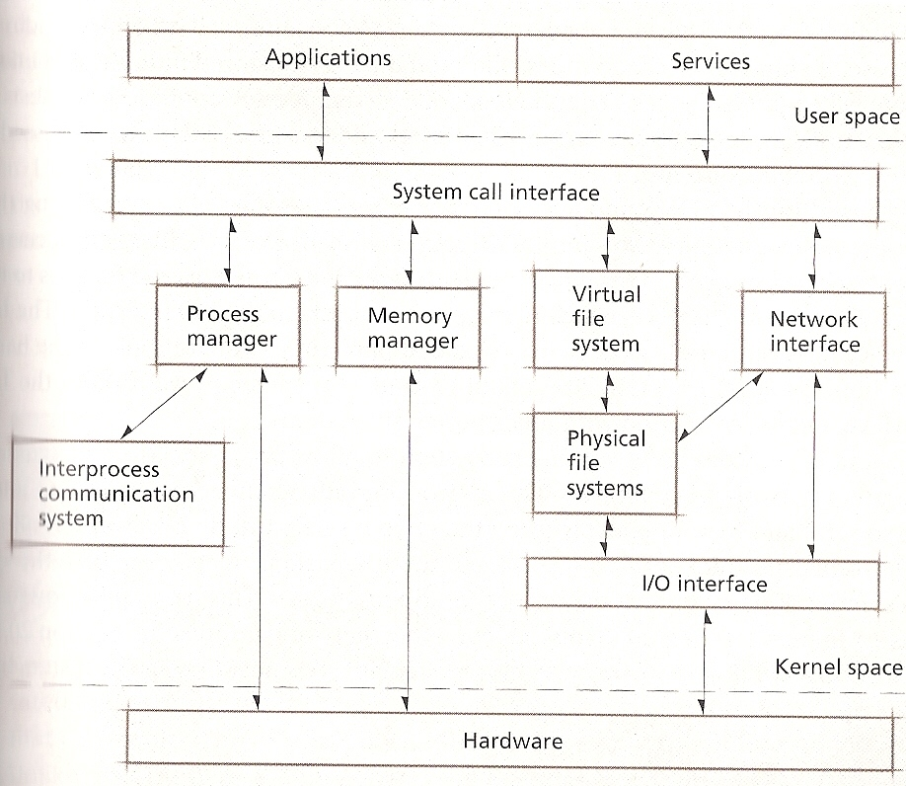
Linux Architecture

Slide 5
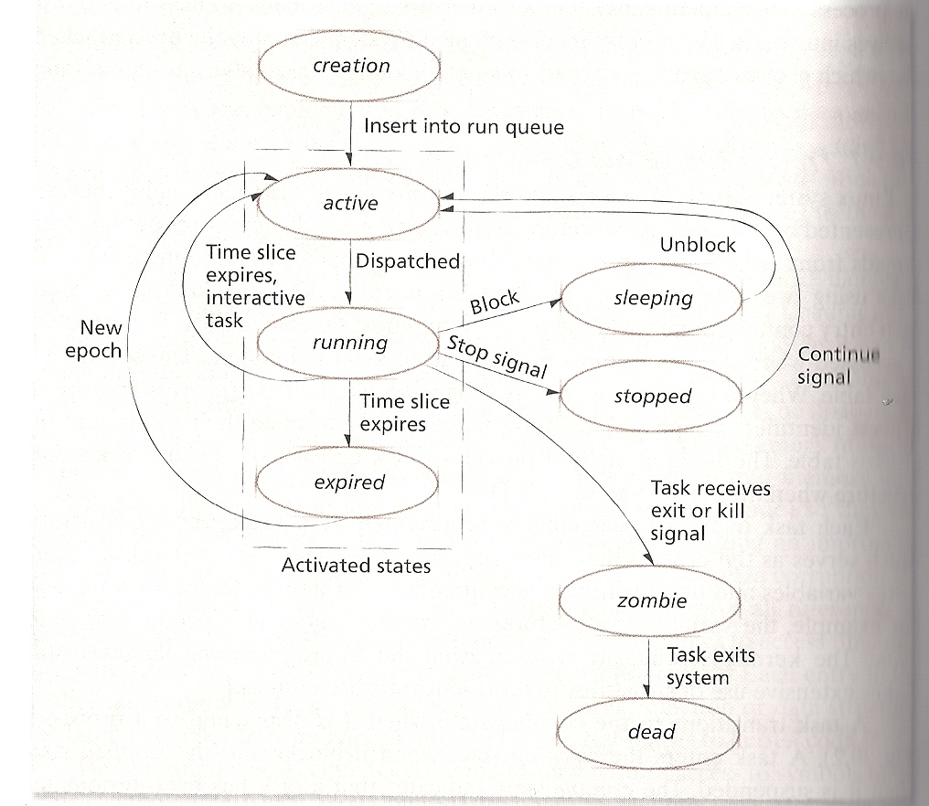
Thread States

Slide 6
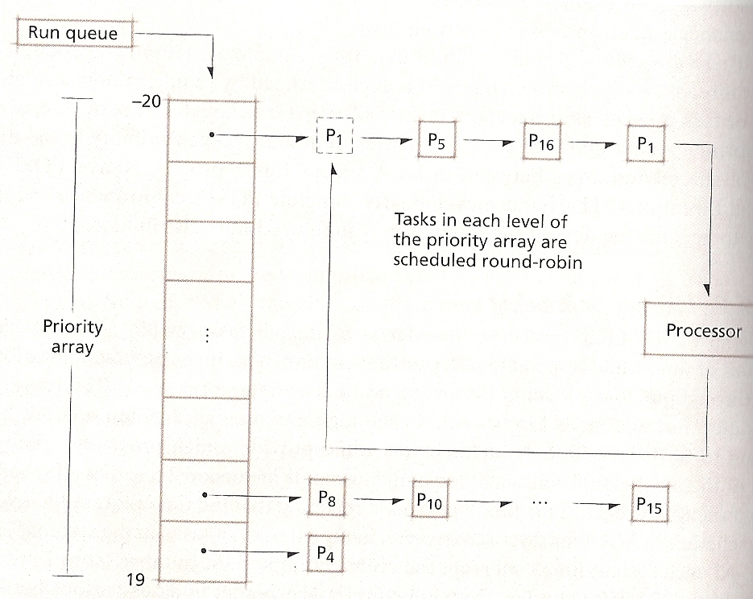
Run Queue and Priorities

Slide 7
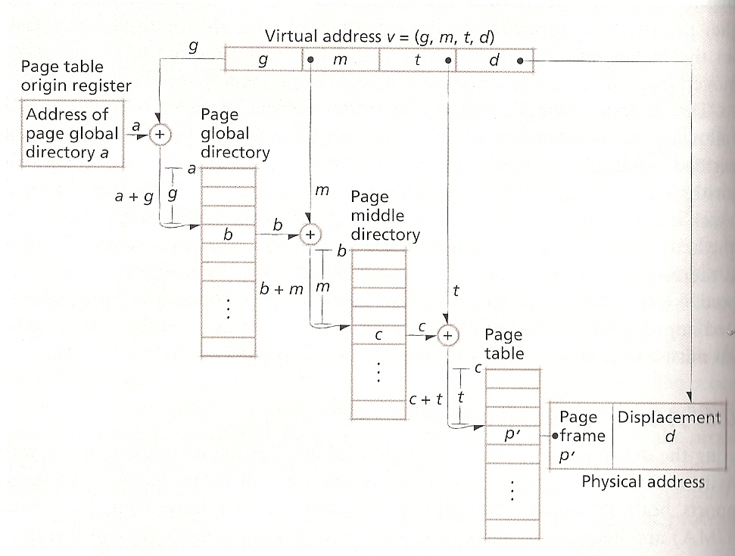
Virtual Address Translation

Slide 8
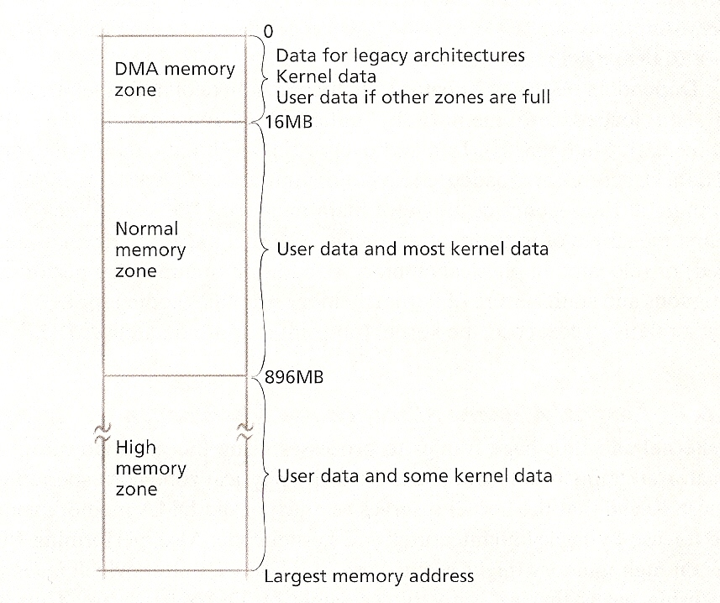
Physical (Real) Memory Zones

Slide 9
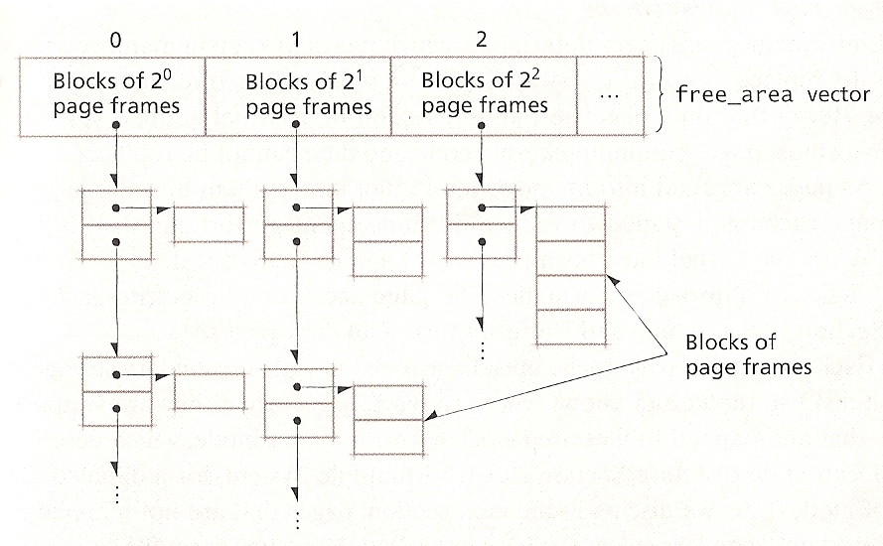
Free area Vectors

Slide 10
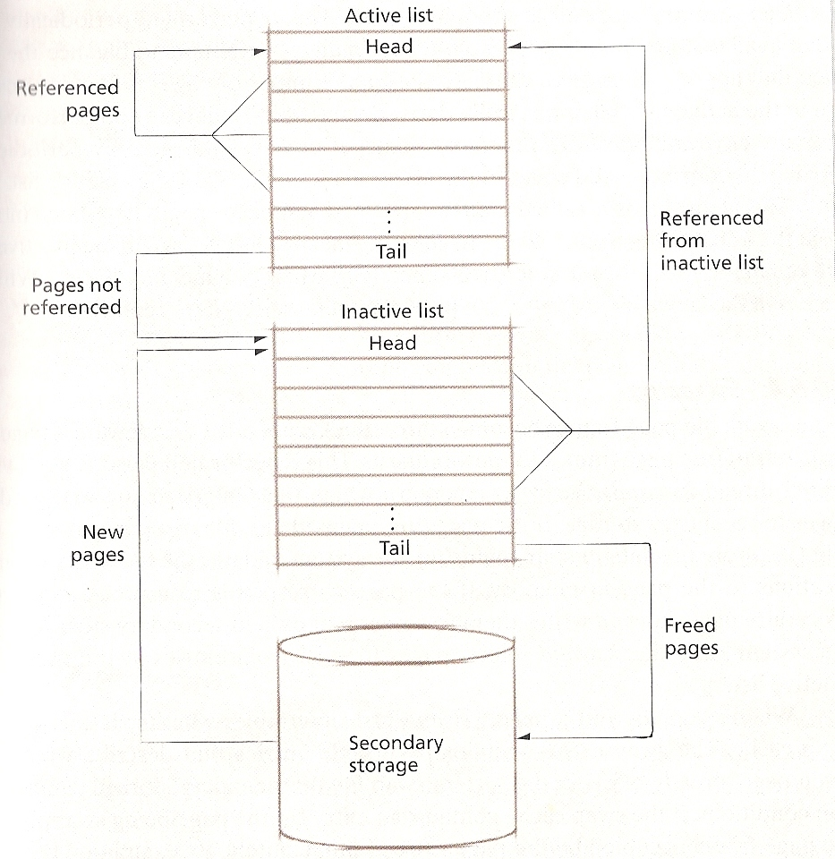
Page Replacement System

Slide 11
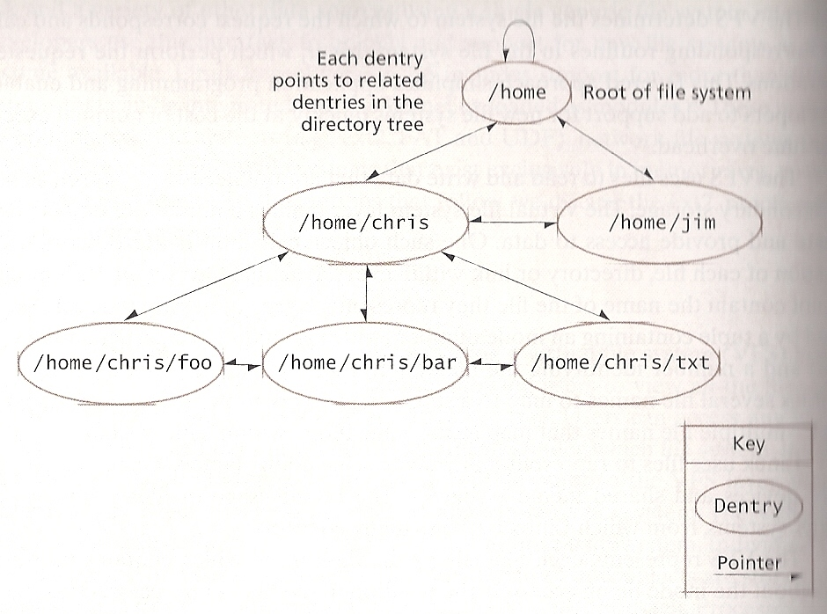
Home Directory (File System)

Slide 12
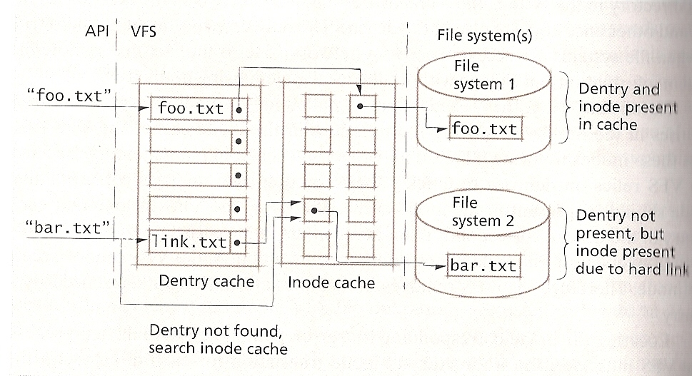
Directory Entry and Inode Cache

Slide 13
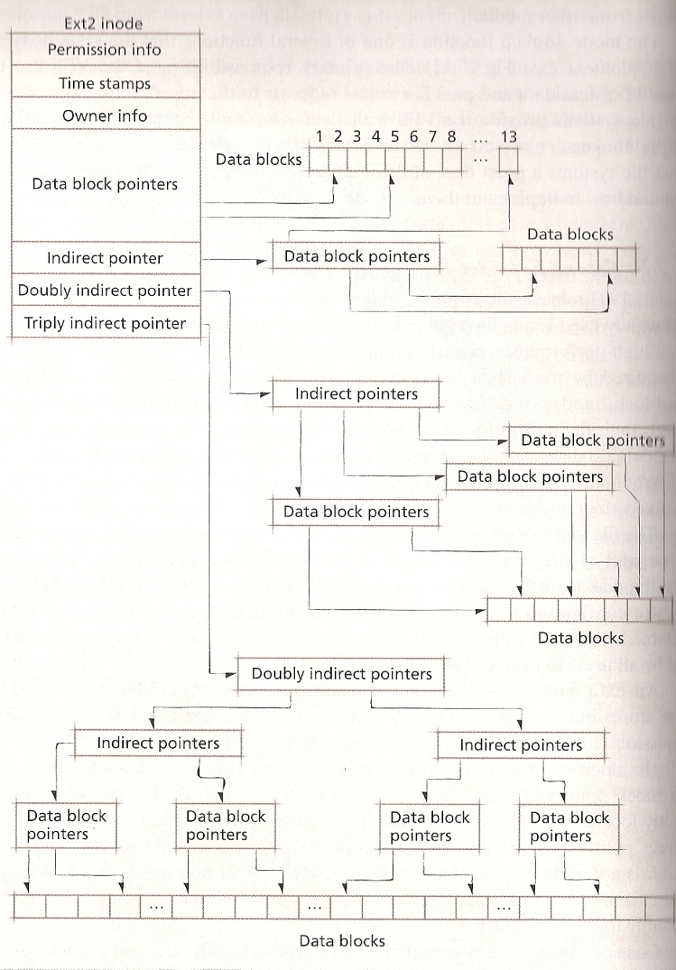
Ext2 inode Contents

