Slide 1
Classes (and Objects)
Classes and objects made from them
Inheritance, interfaces

Slide 2
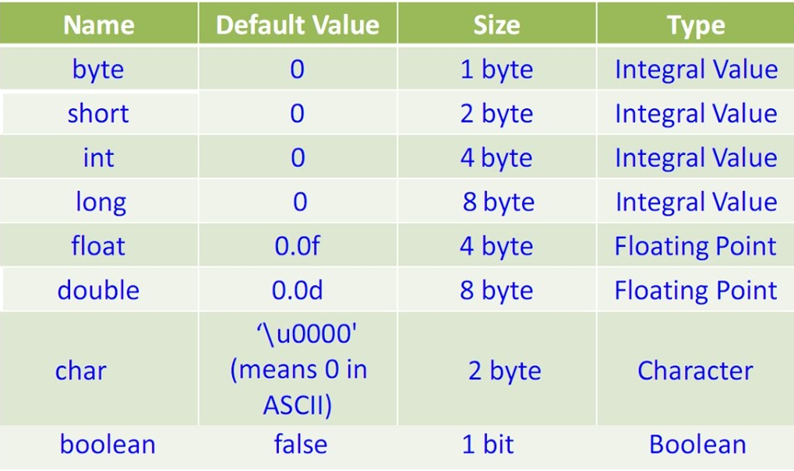
Primitive Types

Slide 3
Non-primitive types
Arrays – a named structure of primitive/non-primitive indexed by an integer value
Strings – a collection of characters
User defined Structure and Classes

Slide 4
User defined structures (C language)
struct person
{
char firstName[20];
char lastName[20];
int dob_year;
}
struct baseballPlayer
{
struct person info;
char team[20];
float battingAverage;
}
Here a person is a classification of how to capture data about a person.
A baseballPlayer is a classification is a special type of person.
Should the programming language define a Baseball Player for all users (application developers) to have to use or should the language allow the user to define a Baseball Player however they want.

Slide 5
Creating and Initializing an instance of a structure (classification), and print
struct person p1 = {
“Joe”,
”Smith”,
1990
};
struct baseballPlayer bbp1 = {
{“Joe”,”Dimaggio”,1914 }
“Yankees”,
0.325
};
printf("Name: %s\n", p1.firstName);
printf("Name: %s\n", bbp1.info.firstName);

Slide 6
Modifying structure data
What if the DOB_year was set to 3030?
What if the baseball player’s team was set to “Rams”?
What if the baseball player’s batting average was set to -0.325? or 11.234 or “Jello”.
What if the person’s last name is “” ( ie Blank)
What if a program over-wrote an array and destroyed data in a structure?
Solution: Object Oriented Programming

Slide 7
Struct with blocked data unblocked access to the data
If you took a struct from the C programming language and made the following changes
- allow storage fields to be blocked from being set/modify/read from outside the struct.
- provide functions/methods that can set/modify/read the storage and are unblocked to users as part of the struct.
struct baseballPlayer
{
blocked struct person info;
blocked char team[20];
blocked float battingAverage;
unblocked void setAvg(float a)
{
if (a =< 1) && (a>=0) { battingAverage = a; }
}
}

Slide 8
Struct with blocked data unblocked access to the data
struct baseballPlayer
{
blocked struct person info;
blocked char team[20];
blocked float battingAverage;
unblocked void setAvg(float a)
{
if (a =< 1) && (a>=0) { battingAverage = a; }
}
}
bbp1.battingAverage = 0.325; // not allowed
bbp1.setAvg(0.325); // allowed
bbp1.setAvg(-0.325); // allowed but does nothing

Slide 9
Pseudo-C(1972) vs. C++(1985)
struct baseballPlayer
{
blocked struct person info;
blocked char team[20];
blocked float battingAverage;
unblocked void setAvg(float a)
{
if (a =< 1) && (a>=0) { battingAverage = a; }
}
}
class baseballPlayer
{
private person info;
private char team[20];
private float battingAverage;
public void setAvg(float a)
{
if (a =< 1) && (a>=0) { battingAverage = a; }
}
}

Slide 10
Classes vs. Objects
A person is a Classification (Class for short)
A baseball player is a Classification
Joe DiMaggio is an instance of a person (and so are you) and an instance of a baseball player.
Baseball player is the class (description (data fields) and functionality (methods))
Joe DiMaggio is an object (i.e. instance of a baseball player). So is Mickey Mantle.

Slide 11
Composition vs. Inheritance
class baseballPlayer
{
private person info;
private char team[20];
private float battingAverage;
public void setAvg(float a)
{
if (a =< 1) && (a>=0) { battingAverage = a; }
}
}
Here the class baseball player is composed of a person, plus additional information related to baseball players.
If you had a baseballPlayer object bbp1, the access the firstName, you use
Print(bbp1.info.firstName).
Why do we need info? Because a baseball player is composed of an person object we called info plus other stuff.
This is called composition.

Slide 12
Composition vs. Inheritance
class baseballPlayer
{
private person info;
private char team[20];
private float battingAverage;
public void setAvg(float a)
{
if (a =< 1) && (a>=0) { battingAverage = a; }
}
}
class baseballPlayer::public person
{
private char team[20];
private float battingAverage;
public void setAvg(float a)
{
if (a =< 1) && (a>=0) { battingAverage = a; }
}
}
bbp1.info.firstName = “Joe”;
bbp1.firstName = “Joe”;

Slide 13
Construction (initialization) of an object
int x; // what value would the primitive variable x be set to? 0? NaN?
String s: // what value should the string be set to?
baseballPlayer bbp1; // what values should the firstName, lastNAme, battingAverage be set to?
The programming language may have default values to set uninitialized data to.
But the programming language doesn’t know have to initialize class (user defined) data.
Solution: a Constructor function which runs when the object first created

Slide 14
Example of a Constructor function
Class fraction {
private int numerator;
private int denominator;
public fraction()
{
numerator = 0; //
denominator = 1; // avoid divide by zero accident
}
}

Slide 15
Class vs object variables
Object variable are variables that each object has. Each baseball player has a firstName, a batting average etc. These are called object variables.
A class may have a variable that is shared by all objects of the class. Like NumOfPlayers.
A static variable (class variable) is shared be all objects of the class.
class baseballPlayer::public person
{
private char team[20];
private float battingAverage;
static private int NumOfPlayers = 0;
public void setAvg(float a)
{
if (a =< 1) && (a>=0) { battingAverage = a; }
}
}

Slide 16
Mathematics vs. Applied Mathematics
1 + 1 = 2 is mathematics
1 banana + 1 banana = 2 bananas is applied mathematics
Is 1 banana + 1 apple = 2 bananas? Answer: no apples are not bananas.
Is 1 fruit + 1 apple = 2 fruits? Answer: yes because apple is fruit
Is 1 fruit + 1 apple = 2 apples? Answer: maybe because the fruit may or may not be an apple
Is an apple composed of a fruit plus additional apple attributes? Answer: no it’s inherently fruit

Slide 17
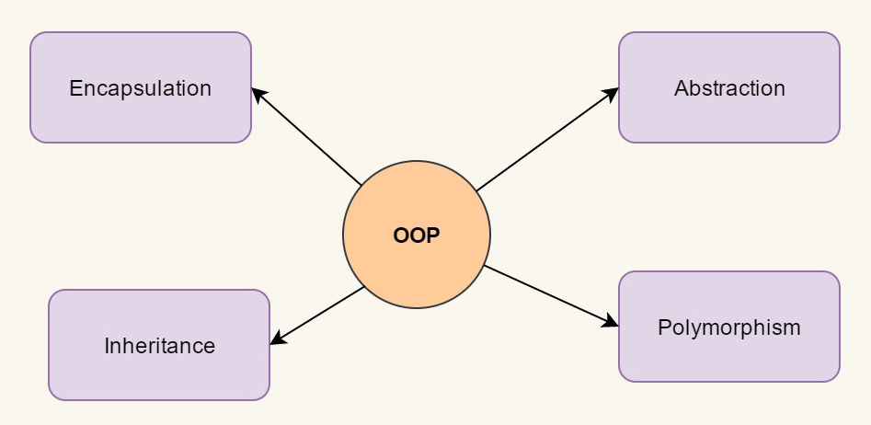
4 Pillars of Object Oriented Programming

