Slide 1
JavaScript – Control Statements
If-then-else
For, While, Do-While loops
Function calls

Slide 2
If Statement
var x = 3;
var y = 4;
var z = 5;
var msg = ‘The range is: ';
if (x < 4) { msg = msg + x + ' '; }
if (y !== 4) { msg = msg + y + ' '; }
if (z == 5) { msg = msg + z + ' '; }
alert(msg);

Slide 3
For loop
var start = 3;
var stop = 20;
var msg = 'The range is: ';
for (i = start; i <= stop; i++) {
msg = msg + i + " ";
}
alert(msg);

Slide 4
While loop
var start = 3;
var stop = 20;
var msg = ‘The range is: ‘;
var i = start;
while ( i <= stop) {
msg = msg + i + ‘ ‘;
i++;
}
alert(msg);

Slide 5
FOR vs. While loops
For loop requires 3 lines of code in the header
Initializer
Boolean statement (if true the loop runs)
1 Statement that runs after the loop completes
While loop has more freedom:
Initialization is done prior to the loop (no limit on lines)
Boolean statement – same as the FOR loop
0 to n statements to the loop to terminate.

Slide 6
If statement in a while loop
var start = 3;
var stop = 20;
var msg = 'The range is: ';
var i = start;
while (i < stop) {
if ((i > 5) && (i < 15))
{ msg = msg + i + ' '; }
i = i+1;
}
alert(msg);

Slide 7
Do - While loop
var start = 3;
var stop = 20;
var msg = 'The range is: ';
var i = start;
do {
if ((i > 5) && (i < 15))
{ msg = msg + i + ' '; }
i = i+1;
}
while (i <= stop);
alert(msg);

Slide 8
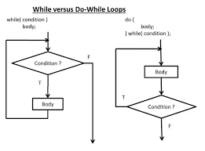
While vs. Do-While
The Do-While loop is exactly like the While loop except that the loop is guaranteed to run at lease once.

Slide 9
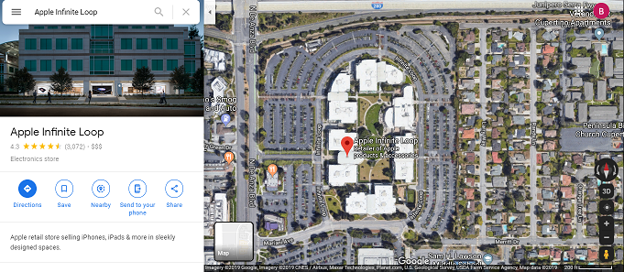
Infinite Loop (Programming or runtime Error)
for (var i=1; i > 0; i = i + 1)
{
// infinite loop
}

Slide 10
If-Then-Else
var dow = 3; // 0=sunday 1 = monday etc
if ((dow >= 1) && (dow <= 5))
{
msg = 'weekday';
}
else
{
msg = 'weekend';
}
alert(msg);

Slide 11
Functions
var dow = 3; // 0=sunday 1 = monday etc
var msg = partOfWeek(dow);
alert(msg);
function partOfWeek(d)
{
if ((d >= 1) && (d <= 5))
{ m = 'weekday'; }
else
{ m = 'weekend'; }
return m;
}

Slide 12
Switch statement (with Default)
var dow = -3; // 0=sunday 1 = monday etc
switch(dow) {
case 0: case 6:
msg = "Weekend";
break;
case 1: case 2: case 3: case 4: case 5:
msg = "Weekday";
break;
default:
msg = "Invalid Day";
}
alert(msg);

Slide 13
Functions in JavaScript
function name(parameter1, parameter2, parameter3) {
// code to be executed
}
When JavaScript reaches a return statement, the function will stop executing. Also if it reaches the end, it will stop.
If the function was invoked from a statement, JavaScript will "return" to execute the code after the invoking statement.
Functions often compute a return value. The return value is "returned" back to the "caller":

Slide 14
FOR vs. While revisited
while (fileNotFull(‘newsfeed.txt’))
{
addMoreStuff();
}
FOR loop
Sets 1 initial control variable
Have a Boolean statement the is initially true and eventually becomes false
A control statement that makes the Boolean become false
In this case, the loop may not run at all. Also, the Boolean is a functions call

