Slide 1

Flowgorithm
Download
Variables
If statements
Loops

Slide 2
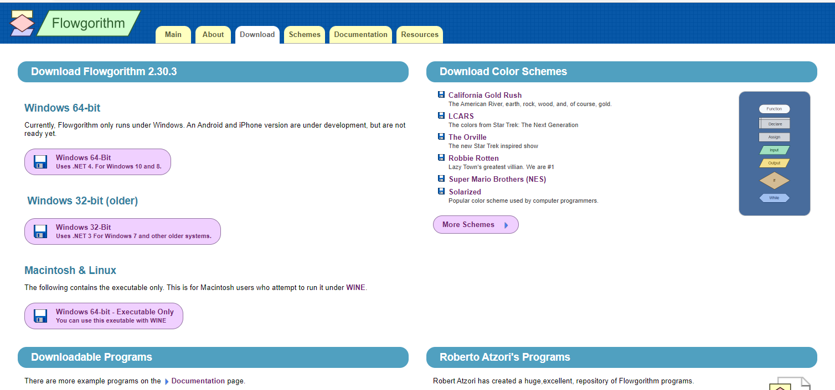
www.flowgorithm.org click download

Slide 3
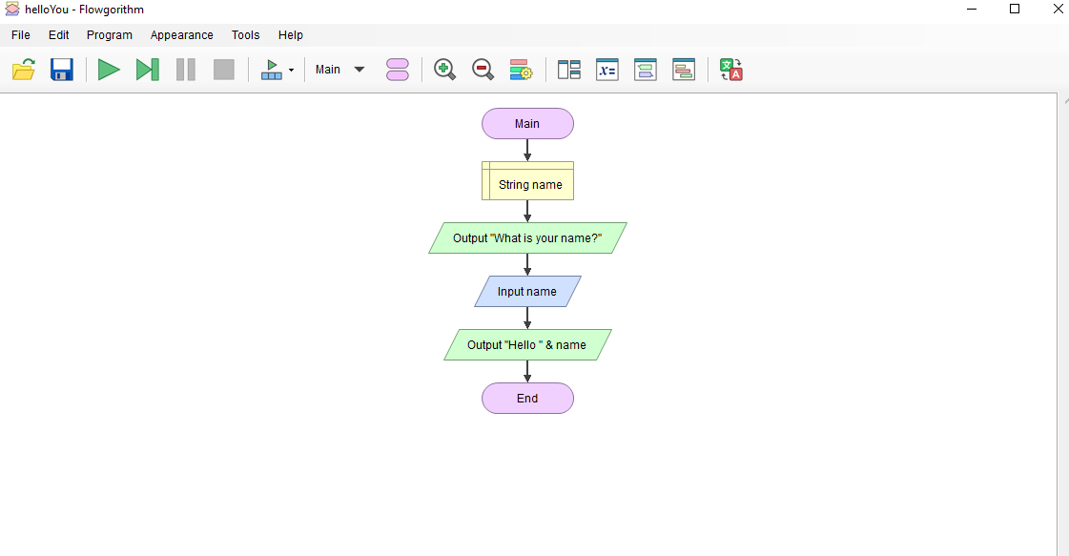
Hello <you>

Slide 4
Code in Python from Flowgorithm
print("What is your name?")
name = input()
print("Hello " + name)

Slide 5
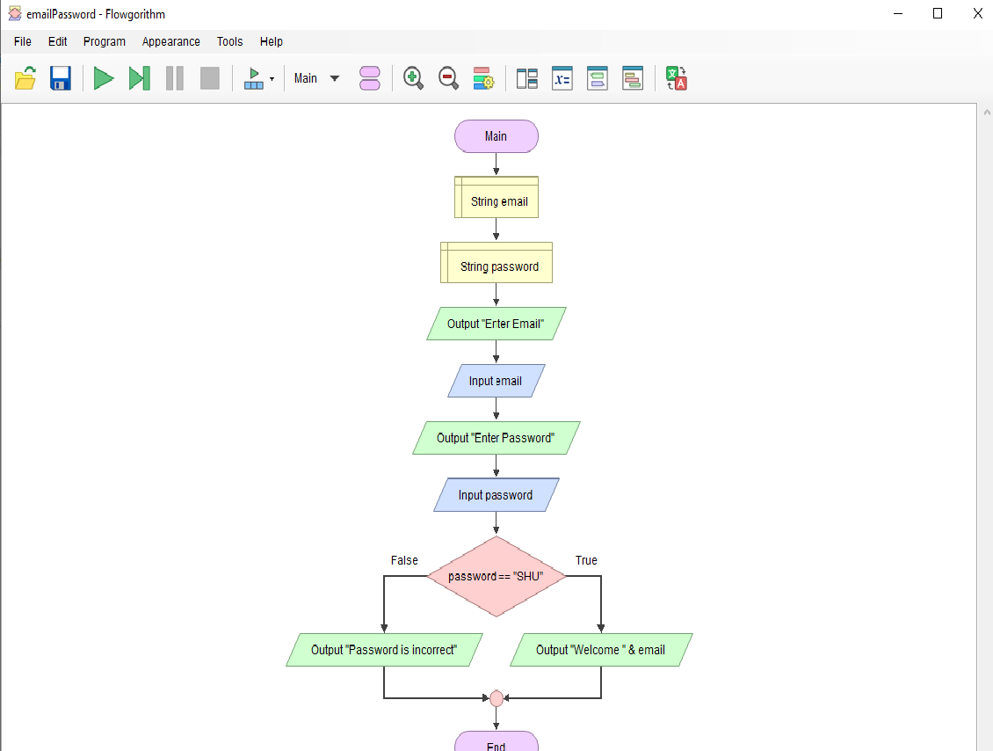
Email password

Slide 6
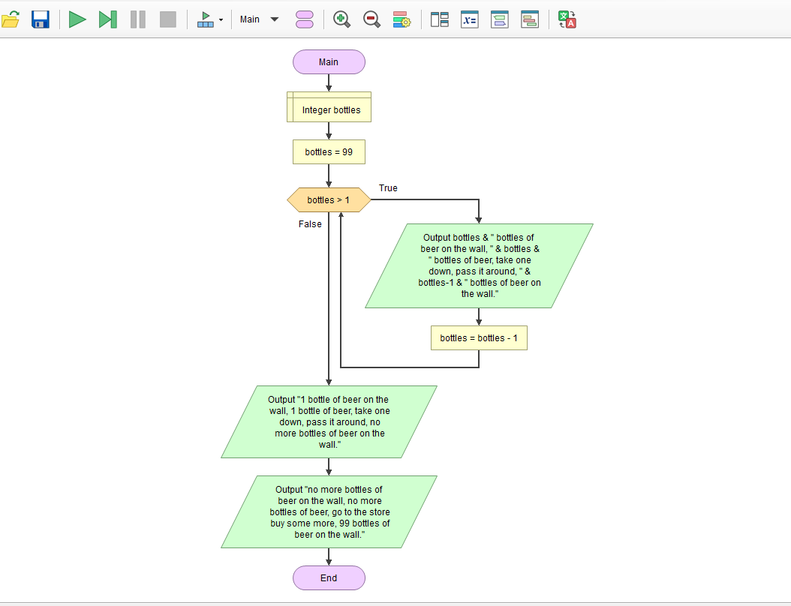
99 bottles of Beer

