Slide 1
Dynamic Pricing
Multi-fare Problem Definition
Marginal Analysis
Littlewood’s Rule
Matlab Code

Slide 2
Problem Definition
Finite capacity c
Finite sales horizon
Zero storage value
Sales often through reservation system
Two market system
Fare class 1, price $P_{1}$ and demand $D_{1}$
Fare class 2, price $P_{2}$ and demand $D_{2}$
where $P_{1}$ $> P_{2}$; $D_{1}$ and $D_{2}$ are independent and $D_{2}$arrived before $D_{1}$

Slide 3
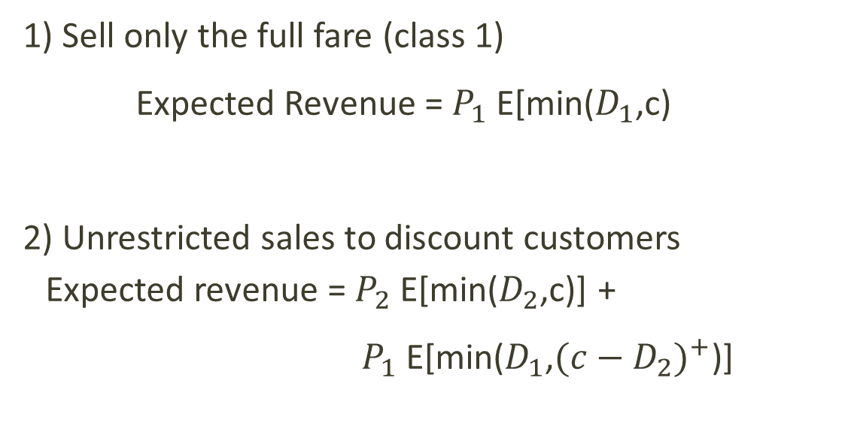
Extreme Strategies
1) Sell only the full fare (class 1)
Expected Revenue = $P_{1}$ E[min($D_{1}$,c)
2) Unrestricted sales to discount customers
Expected revenue = $P_{2}$ E[min($D_{2}$,c)] +
$P_{1}$ E[min($D_{1}$,${(c−D_{2})}^{+}$)]

Slide 4
Hybrid Strategy
Protect y units for sale at fare class 1
- If y = c (strategy 1 above, full fare only sales)
- If y = 0 (strategy 2 above, sell to all customers)
Allow $y ∈\{0,1,…c\}$ to protect level 1 and therefore
c-y seats are available for fare 2.
The expected Revenue (Wealth) received is
W(y,c) = $P_{2}$ E[min($D_{2}$,c-y) + $P_{1}$ E[min($D_{1}$,max$( y,c−D_{2}$))
goal is to maximize W(y,c)

Slide 5
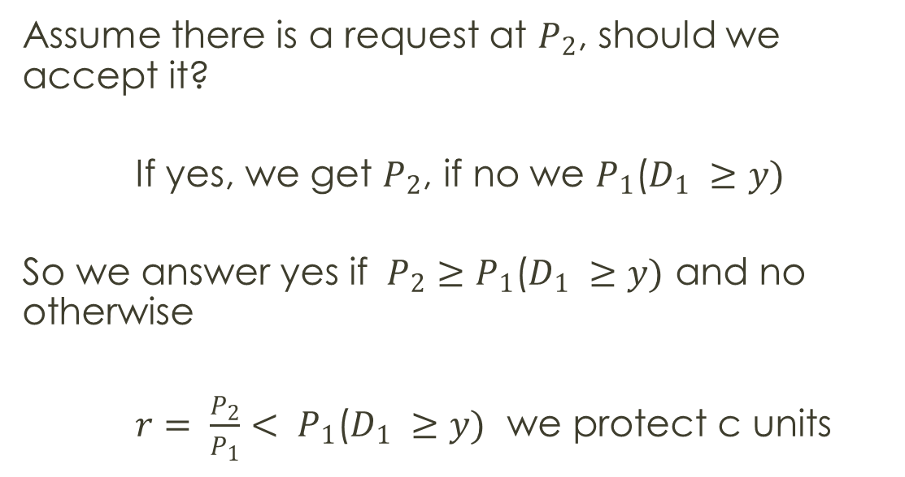
Marginal Analysis
Assume there is a request at $P_{2}$, should we accept it?
If yes, we get $P_{2}$, if no we $P_{1}$($D_{1} ≥y)$
So we answer yes if $P_{2}≥P_{1}$($D_{1} ≥y)$ and no otherwise
$r= \frac{P_{2}}{P_{1}}< P_{1}$($D_{1} ≥y)$ we protect c units

Slide 6
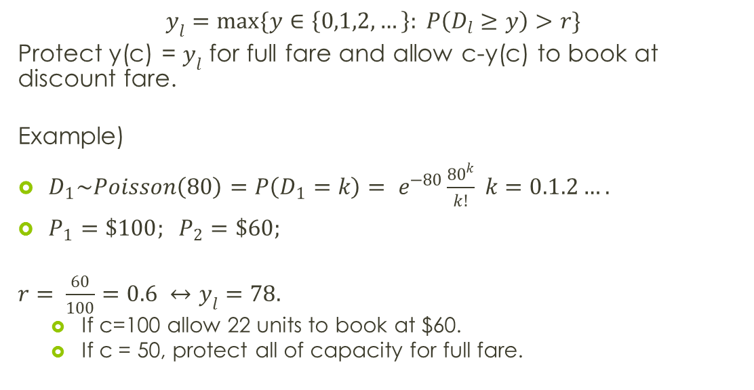
Littlewood’s Rule
$$y_{l}=max\{y∈\left\{0,1,2,…\right\}: P\left(D_{l}≥y\right)>r\}$$
Protect y(c) = $y_{l}$ for full fare and allow c-y(c) to book at discount fare.
Example)
$D_{1}\sim Poisson\left(80\right)=P\left(D_{1}=k\right)= e^{−80}\frac{{80}^{k}}{k!} k=0.1.2….$
$P_{1}=\$100; P_{2}=\$60;$
$r= \frac{60}{100}=0.6 ↔y_{l}=78.$
If c=100 allow 22 units to book at $60.
If c = 50, protect all of capacity for full fare.

Slide 7
Matlab Simulation code
clear all
capacity = 100;
protected = 60;
lambda1 = 40;
price1 = 499;
price2 = 99;
for i = 1:100
Demand2(i) = min(75, capacity-protected);
Demand1(i) = min(poissrnd(lambda1),capacity-Demand2(i));
revenue(i) = (price2*Demand2(i)) + (price1*Demand1(i));
end
mean(revenue)

